Slide 1
Indicator 13: Transition Age IEPs
SY2023-2024 Demonstration of Correction of Noncompliance

Slide 2
Content
Quick review
  Importance of Indicator 13 (I 13)
  What does I 13 measure?
  Where does the data come from?
  How is compliance determined?
  What counts as noncompliance?
  Knowing the required elements of a Transition IEP.
Steps in the demonstration of correction of noncompliance process
How can you ensure accurate data reporting in the future?

Slide 3


Importance of Indicator 13
A critical step in ensuring that we fulfill the purpose and spirit of IDEA.
To ensure that all children with disabilities have available to them a free appropriate public education that emphasizes special education and related services designed to meet their unique needs and . . .
Prepare them for further education, employment, and independent living.
§ 300.1 Purposes
This Photo by Unknown Author is licensed under CC BY-NC-ND
This Photo by Unknown Author is licensed under CC BY

Slide 4
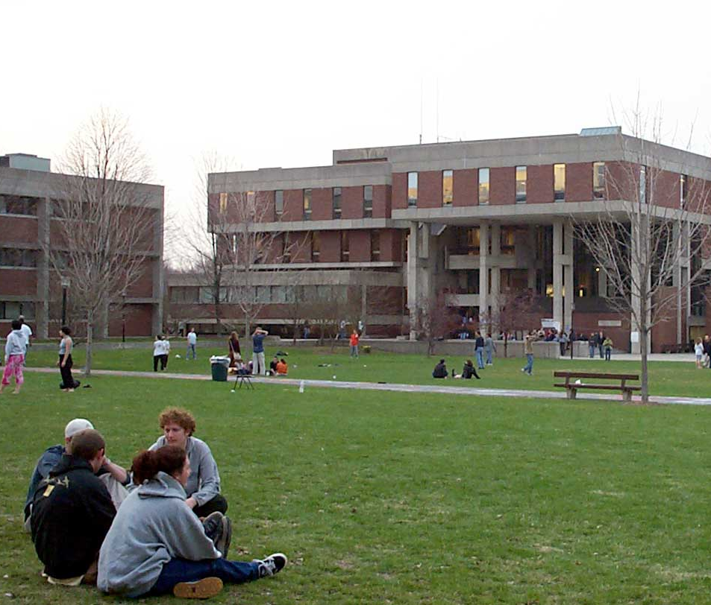


What does Indicator 13 measure?
The percent of children age 16 and above (age 15 in Colorado) with an IEP that includes all eight required elements of the Indicator.
§300.320, §300.321, §300.322, §300.43
ECEA 4.03
Target for this indicator is 100% compliance.
This Photo by Unknown Author is licensed under CC BY-SA
This Photo by Unknown Author is licensed under CC BY-ND
This Photo by Unknown Author is licensed under CC BY-ND

Slide 5
How is compliance determined?
AU Data Submission
Data source – Individual student IEP file reviews
  Student samples pulled from December Count data
  IEP reviews submitted through the protocol in the Data Management System (DMS)
  Student IEP documents uploaded to the DMS
Date range – April 1, 2023 – May 1, 2024
Closing date of AU data submission – May 1, 2024
CDE Data Analysis
CDE verifies that the AU completes the required number of reviews, has uploaded the IEP documents, and that each IEP reviewed includes compliant answers for all 8 required I 13 elements.
CDE will review and verify any noncompliant IEPs through a desk audit of the IEP.

Slide 6
What counts as noncompliance?
  One or more reviewed IEPs were noncompliant for any one of the 8 required transition elements.
Calculation: % Compliant = (Number of youth age 15 and above with IEPs that contain each of the required components for secondary transition/required number of reviews) * 100.
Example:
  Required number of IEP file reviews = 5
  Compliant IEPs = 4
  % Compliant: 4/5 = 0.8 x 100 = 80%
Note: I 13 is an “all or nothing” indicator meaning if one element is missing, the IEP is considered noncompliant.

Slide 7
Reporting Indicator 13 Compliance to OSEP
Office of Special Education Programs (OSEP) clarification to
State Education Agencies (SEAs) 12/16/19
“while the SEA may provide an LEA the opportunity to correct noncompliance prior to the issuance of a written finding, the percentage reported in the APR must reflect the AU’s actual level of compliance prior to the opportunity to correct any noncompliance.”

Slide 8

What does this mean for AUs?
Once CDE reviews a transition IEP (has eyes on it), and
finds noncompliance in one or more elements required for I 13, then
the IEP must be considered noncompliant for I 13 reporting purposes.
  Individual corrections of any noncompliance are still required to be completed

Slide 9

Know the required elements
The required transition IEP elements for Indicator 13
This Photo by Unknown Author is licensed under CC BY-SA

Slide 10
Post Secondary Goals (PSGs)
Appropriate measurable PSGs related to training/education, career/employment, and, where appropriate, independent living skills
  PSGs are required in training/education and career/employment regardless of the severity of the student’s disability
PSGs updated annually
  If this is the first IEP developed after the student turned 15, this element is not applicable. Choose “N/A” as your answer.
This Photo by Unknown Author is licensed under CC BY-SA

Slide 11
Transition Assessments, Transition Services, and Courses of Study
Age-appropriate transition assessments
  Age-appropriate means chronological age
Transition Services
  A coordinated set of activities focused on improving the academic and functional achievement to facilitate the movement from school to post-school activities
Courses of Study that will assist the student in reaching the PSGs
This Photo by Unknown Author is licensed under CC BY-SA

Slide 12
Annual Goals, Student Invitation, Prior Consent to Invite a Representative
Annual goals related to the student’s transition services
Evidence of the student being invited to the IEP meeting where transition services are to be discussed
Prior consent of the parent to invite a representative of any participating agency that is likely to be responsible for providing or paying for transition services.
This Photo by Unknown Author is licensed under CC BY-SA

Slide 13

Consequences of noncompliance
This Photo by Unknown Author is licensed under CC BY

Slide 14

Inaccurate reporting results
Noncompliance results in additional work for you.
Ensuring that the record review data is completed accurately and on time can help to reduce unnecessary work for you in the implementation of the required “demonstration of correction” process.
This Photo by Unknown Author is licensed under CC BY-SA

Slide 15

What is demonstration of correction?
When an AU fails to meet 100% compliance with this indicator, the state must ensure the noncompliance is corrected by:
  1. Ensuring that each child’s IEP is corrected, and identify the root-cause of the noncompliance (“Individual Correction”); and
  2. Review updated data to determine if the AU is correctly implementing the specific regulatory requirements related to Indicator 13 (“Review of Updated Data”).
This Photo by Unknown Author is licensed under CC BY-NC-ND

Slide 16
Demonstration of Correction of Noncompliance Process

Slide 17
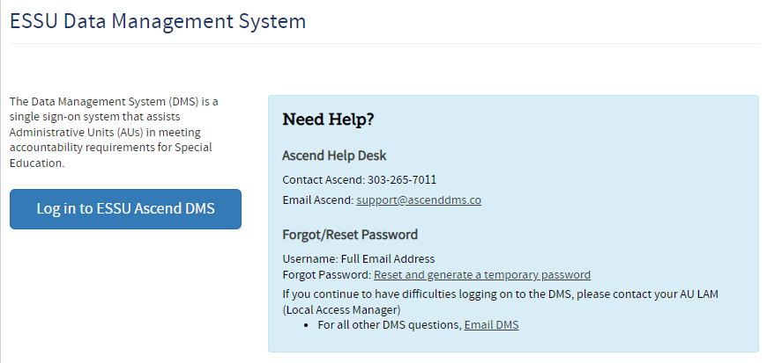
ESSU Data Management System (DMS)
https://www.cde.state.co.us/idm/essu-data

Slide 18
Access to the Ascend DMS
If you do not have access to the new DMS, contact your AU LAM (Local Access Manager).
If you forget your password, there is a “Forgot Password” reset option on the log in page.
The CDE DMS application in Access Management is ASCDMS. Currently, there are 3 roles that grant access to Record Reviews in the DMS:
  MD – For Directors, all access.
  GDnMD – For those who are Gifted and Special Education Directors, all access
  MRR – For Record Review access.
Only one role can be assigned per user. If more than one role is assigned, you will not be able to log in.
If you get a security error message when logging in, have your IT person mark the page as safe, updates to Firewall security may block the page.
Questions about logging in or roles contact Josh Fails at fails_j@cde.state.co.us

Slide 19
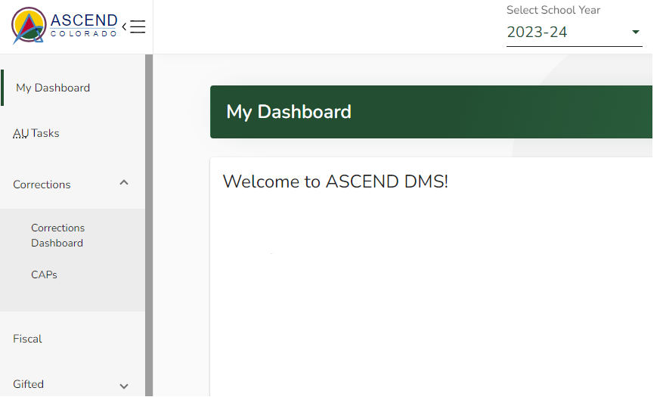
Individual Correction – Prong 1
DMS will open on the My Dashboard page. On the left navigation pane, click the Corrections tab to open the tab for the Corrections Dashboard.

Slide 20
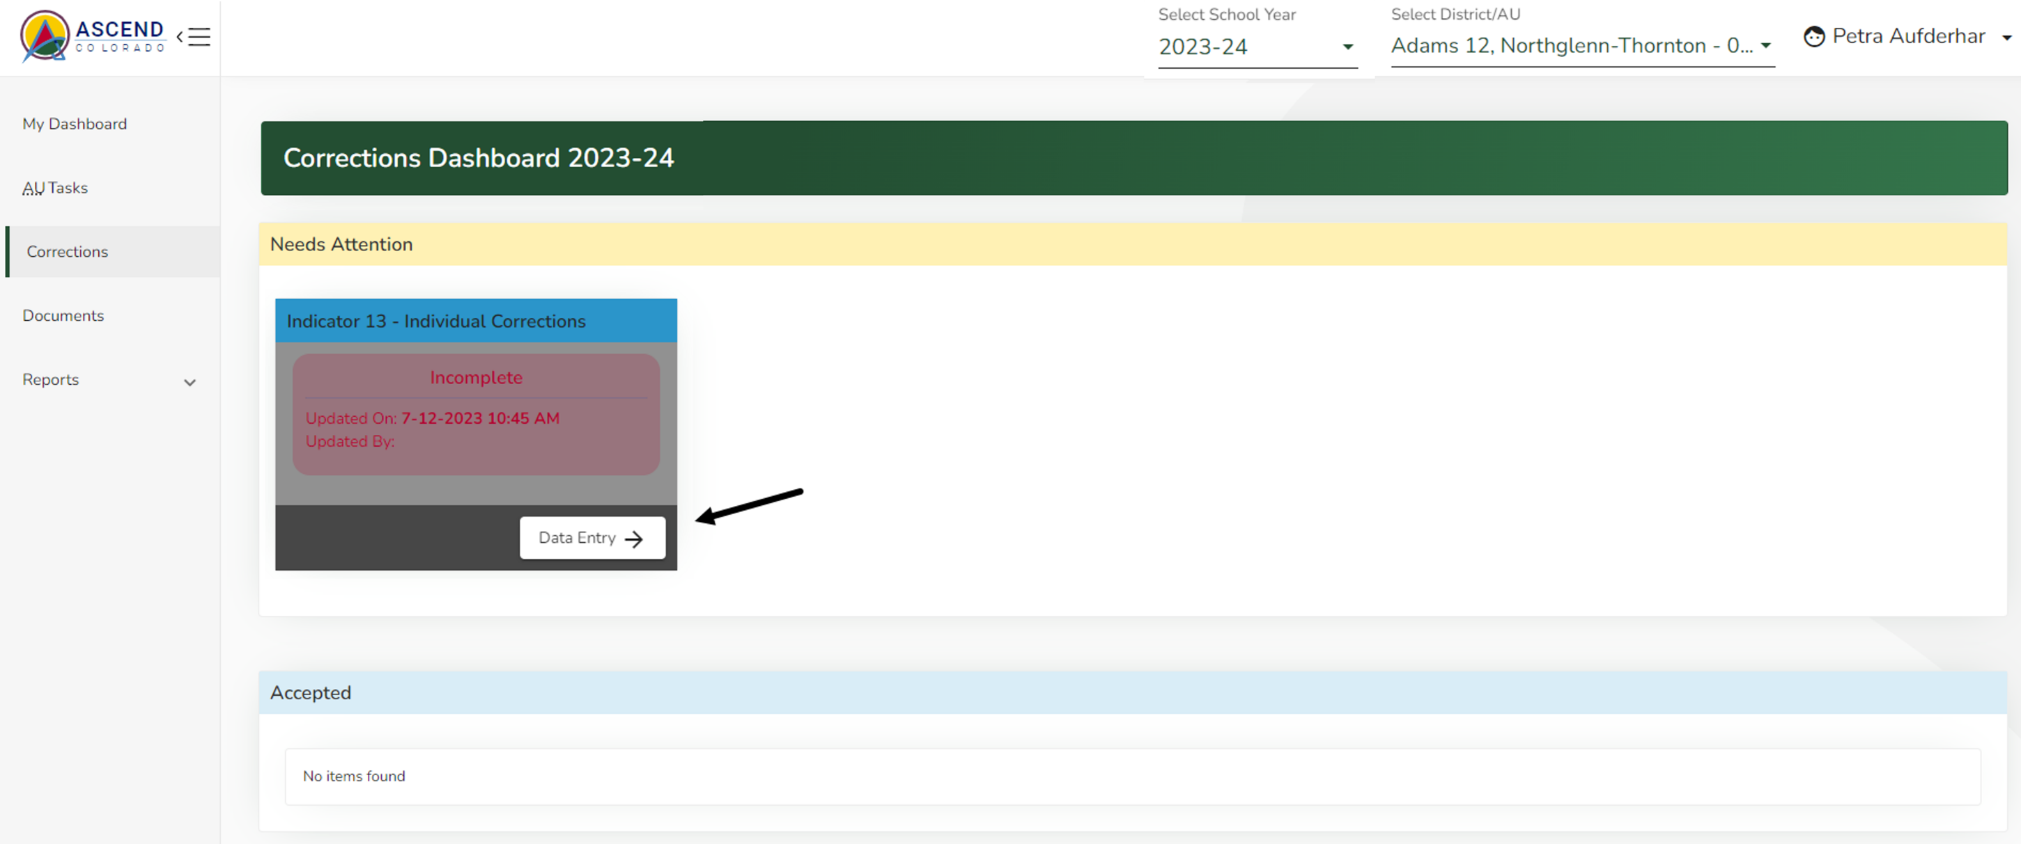
Individual student correction
The Corrections Dashboard page will open. You will be prompted with the red word "Incomplete" below the Indicator 13 - Individual Corrections title when the AU has noncompliant records that need to be addressed. Click Data Entry in the Indicator 13 Individual Corrections tile.

Slide 21
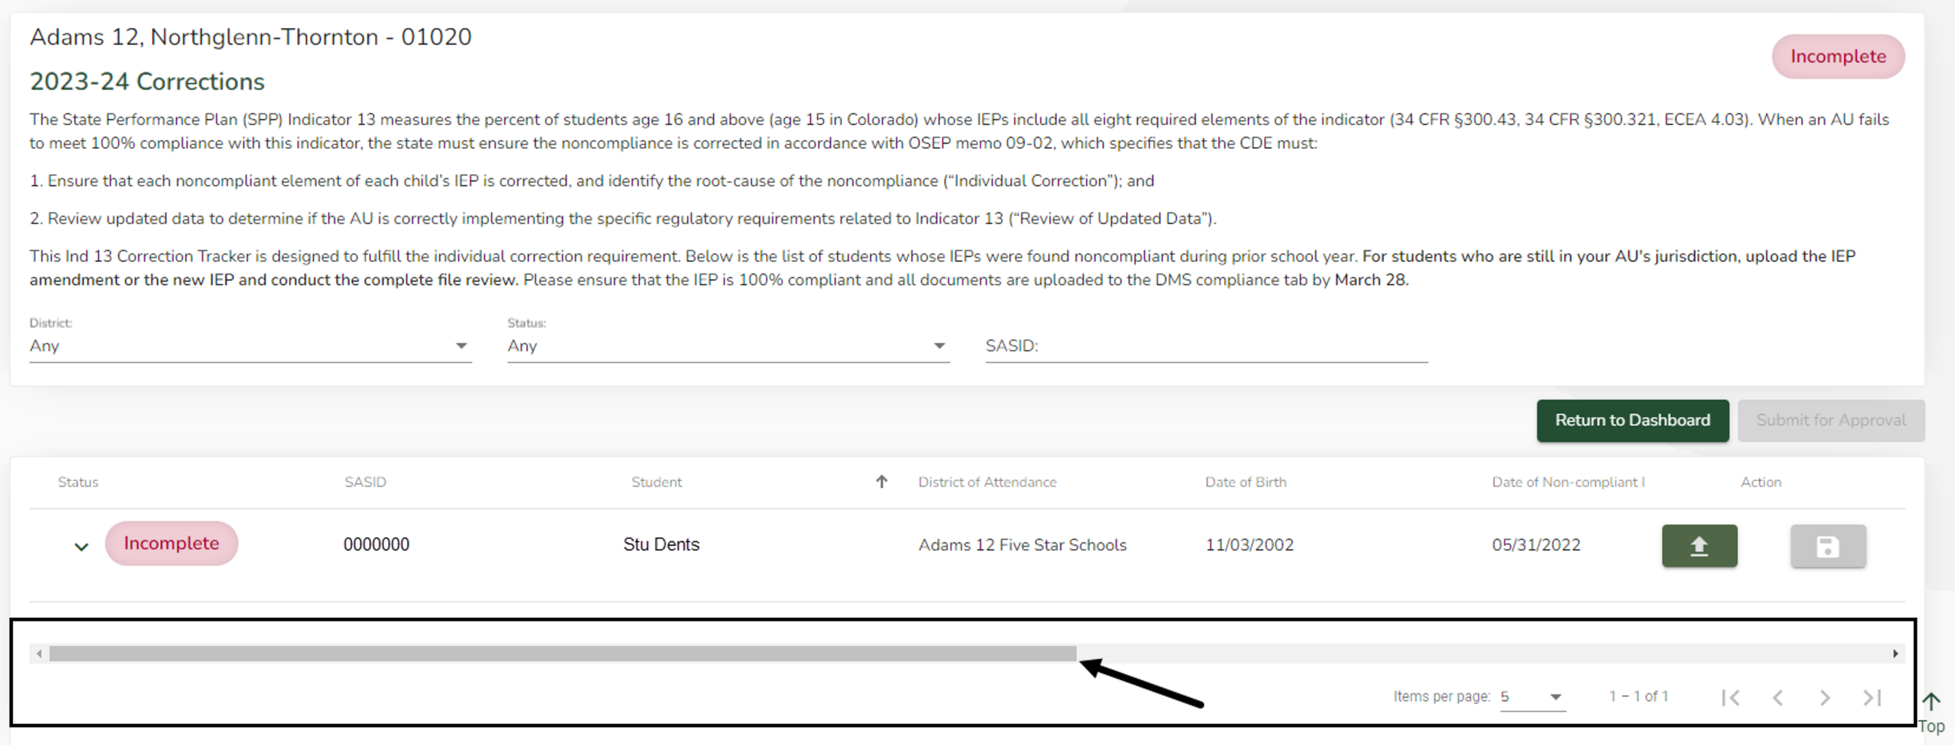
Individual student correction cont.
The records that need to be corrected will be displayed. Using the horizontal scroll bar located at the bottom of the page, scroll to the right to view the noncompliant elements during the Standard Record Review and the questions that require your response.

Slide 22
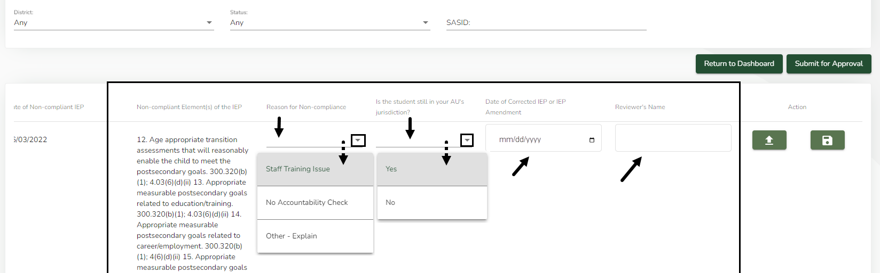
Individual student correction
Required Responses
For each student, provide responses in the columns using drop-down menus, when available.
Reason for Noncompliance
Is the student still in your AU’s jurisdiction?
Date of Corrected IEP or IEP Amendment
Reviewer’s Name
Provide additional explanations in the appropriate column when prompted.

Slide 23
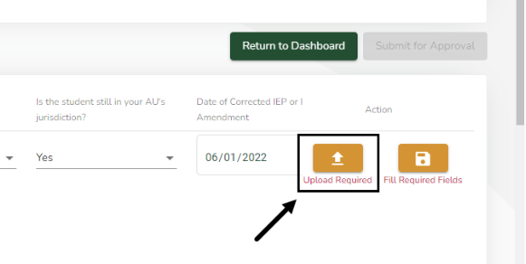
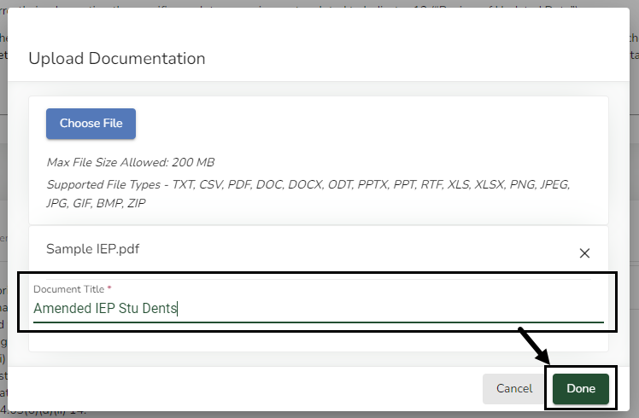
Individual student correction
Uploading Documentation
If the student is still in the AU jurisdiction, you will be required to upload the amended documents to the correction record. In the Actions column, click the Upload (up arrow) icon to upload a document.
An Upload Documentation pop-up box will open. Click the blue Choose File button in the pop-up window and select the file to upload from your computer. Enter a title for the document that includes unique information such as the student’s name and the year of the document. Click the green Done button in the bottom right corner of the box.

Slide 24
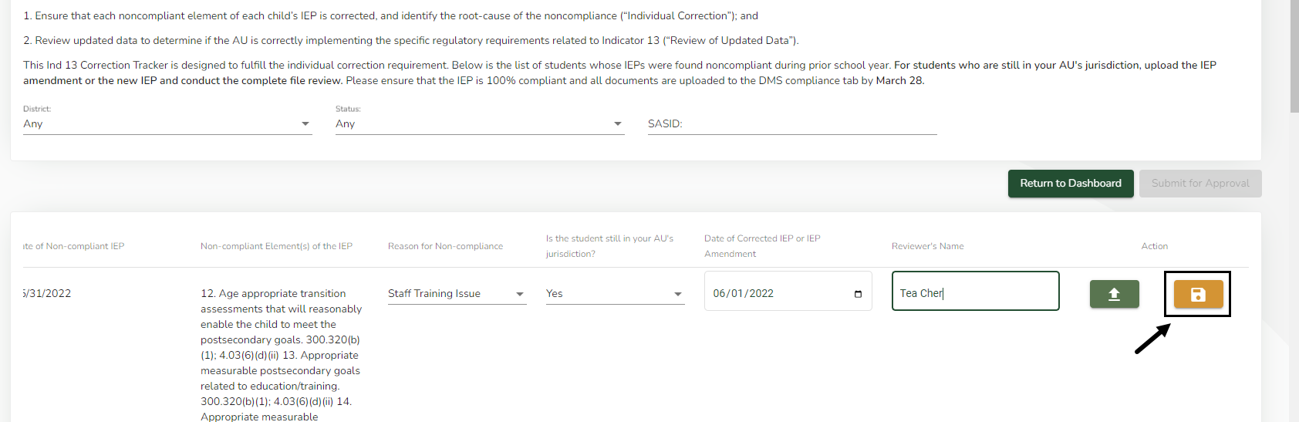
Individual student correction
Save Correction
When all questions have been answered and required documents have been uploaded, in the Action column, click the Save (Disk) icon for the record.

Slide 25
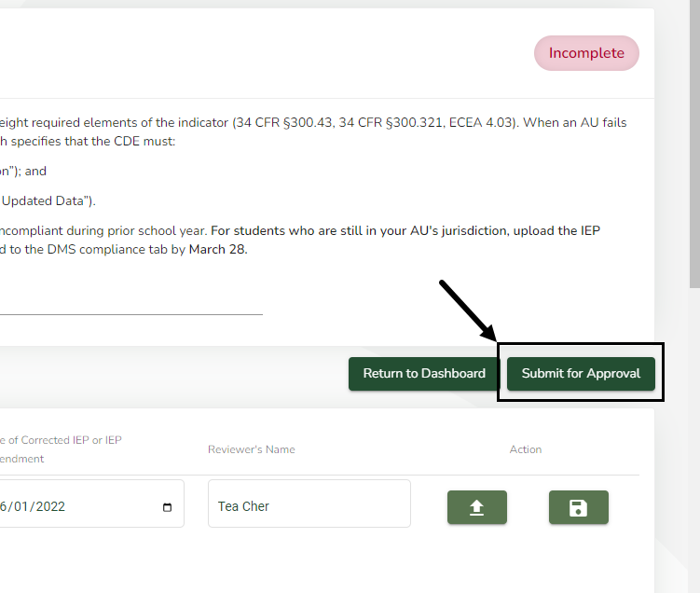
Individual student correction
Submit for Approval
Once all records have been corrected the Submit for Approval button will become available. Click the green Submit for Approval button located in the upper right corner of the list of student correction records to send records to CDE for review.
The DMS will automatically generate an email to CDE that your corrections are ready for their review.

Slide 26

CDE Verification of Corrections
The CDE will verify the “Individual Correction” via a desk audit process and confirm the results to the AU by December 2024.

Slide 27
Individual Correction – Prong 1 Due Date
The Individual Correction process in the DMS is designed to fulfill the “Individual Correction” obligation to ensure that each child’s noncompliant IEP was corrected and identify the root-cause of the noncompliance (“Individual Correction”).
Due Date: November 1, 2024
The CDE conducts a desk audit of the uploaded IEP or IEP Amendment and the information in each student’s correction record.
Results will be reported to the AU.

Slide 28
Review of Updated Data – Prong 2
The CDE must also conduct a “Review of Updated Data” to determine if the AU is correctly implementing the specific regulatory requirements related to Indicator 13.
Method: CDE conducts a collaborative review with the AU to review the required number of Transition IEPs for SY 2024-2025

Slide 29
The Collaborative Review Process – Next Steps
Prepare for the review
Download your AU’s Transition Age student list for SY 2024-2025 from the DMS
Select the required number of students for the review
  IEPs must be active and dated between April 1, 2024 and March 1, 2025
Based on the latest anticipated IEP date of the students selected, select your preferred date for the CDE collaborative review
  Conduct your own review of the IEPs to ensure compliance prior to CDE’s review.
By November 1, 2024, contact Nick Smosna at Smosna_n@cde.state.co.us to schedule your collaborative file review meeting.
Collaborative reviews must be completed by March 1, 2025.
Note: If an AU continues to report noncompliance for Indicator 13, additional monitoring activities may be required.

Slide 30
Review IEPs prior to collaborative visit
Once CDE reviews a transition IEP (has eyes on it), and
finds noncompliance in one or more elements required for I 13, then
the IEP must be considered noncompliant for I 13 reporting purposes.
  Individual corrections of any noncompliance are still required to be completed
  Note: If an AU continues to report noncompliance for Indicator 13, additional monitoring activities may be required.

Slide 31

How can you ensure accurate data reporting in the future?
  Review files prior to a side-by-side collaborative review with CDE
  Review files for compliance on a regular basis: monthly, bi-monthly, quarterly
  Provide training on the DMS record review process to staff conducting file reviews
  If reviews are delegated, require the AU’s designated reviewer to report results to the Director well ahead of the May deadline – no surprises
  Establish a systemic IEP monitoring accountability check procedure
  Use the Secondary Transition IEP File Review Checklist

Slide 32

ESSU Contact Information
Individual Correction Process
Orla Bolger
Supervisor, Data and Monitoring Liaison
Bolger_o@cde.state.co.us
Review of Updated Data: Collaborative IEP Review Process
Nick Smosna
Special Ed. Monitoring and Technical Assistance Consultant
Smosna_n@cde.state.co.us

