Slide 1


Welcome to Ascend
Colorado Department of Education’s Data Management System (DMS)

Slide 2
Topics Covered
System Requirements
System Features
Login
Help Options
Professional Learning System
Dashboard & Left Navigation Pane
Document Upload
Correspondence Search

Slide 3
Ascend DMS System Requirements
How to check browser versions: Chrome:
https://support.google.com/chrome/answer/954 14?hl=en&co=GENIE.Platform%3DDesktop&oc o=0
System Requirements:
Most current versions of Google Chrome, Apple Safari, Firefox, & Microsoft Edge. Check that your browser is updated to the latest version.
Your pop-up blocker must be disabled.
*You may experience better functionality with Google Chrome.
Safari:
https://support.apple.com/en-us/HT204416
Firefox:
https://support.mozilla.org/en-US/kb/update-firef ox-latest-release
Microsoft Edge: https://support.microsoft.com/en-gb/microsoft-e dge/find-out-which-version-of-microsoft-edge-yo u-have-c726bee8-c42e-e472-e954-4cf5123497 eb

Slide 4
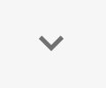


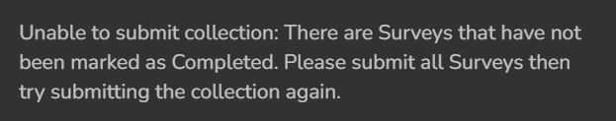
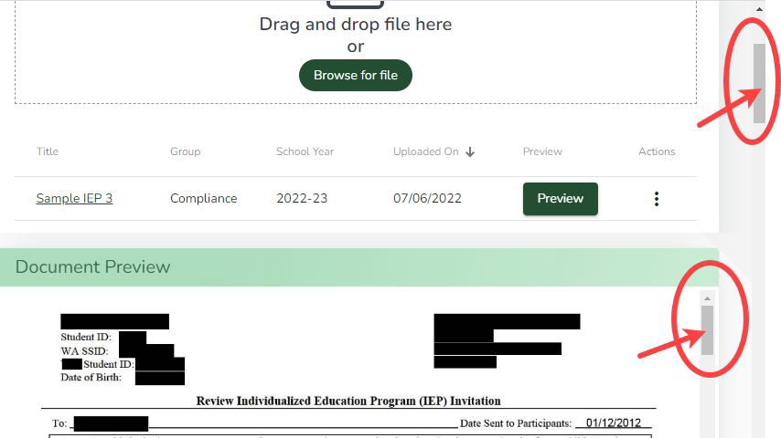
Ascend DMS Tips
System Features:
Caret = an open or filled arrowhead. Clicking on a caret will open hidden information. Re-clicking on a caret will hide the revealed information.
Quick Access Menu (a.k.a. Hamburger Menu) = 3 short stacked horizontal lines. Clicking on a Quick Access icon will reveal hidden information/options.
Modals, pop-ups, and new tabs = may appear as you click on buttons and links. A modal is a text message that will appear on the screen to indicate success or failure on an action.
Vertical and Horizontal Scroll Bars = Be sure to check if the sides and top and bottom of the page, or if any sections or pop-up boxes have these scroll bars used to reveal more information.
# of items per page and page over arrows = may exist at the bottom of the page. You can change the # of items displayed or page over to reveal more information.
Auto-save = Ascend DMS automatically saves when you are working in the system.
4

Slide 5
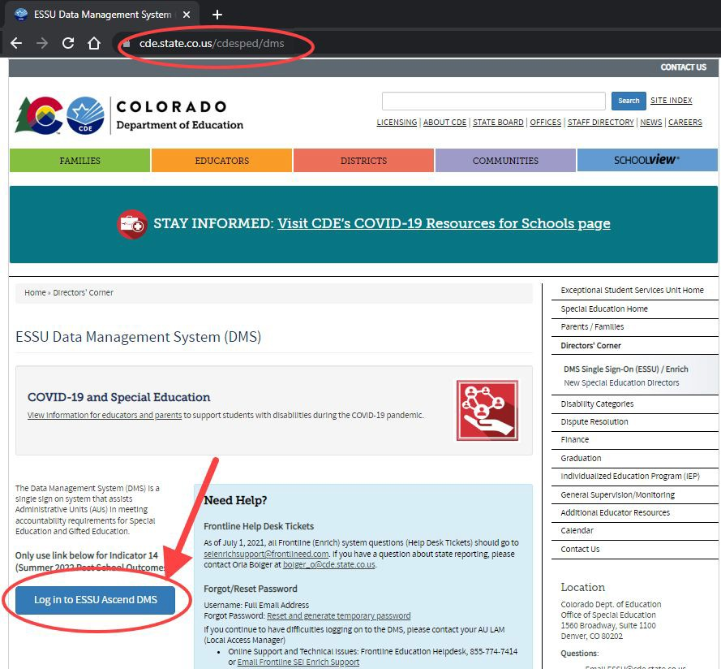
Ascend Login
Go to CDE’s Webpage at: ESSU Data Management System (DMS) | CDE (https://www.cde.state.co.us/cde sped/dms).
Look for the blue button labeled: “Log in to ESSU Ascend DMS” located below the COVID-19 and Special Education section on the left side of the webpage.
Click on the “Log in to ESSU Ascend DMS” blue button.

Slide 6
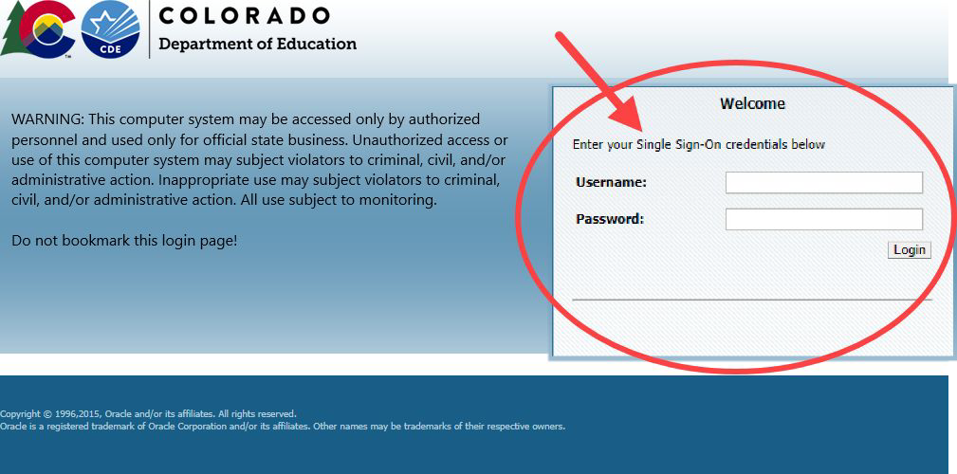
Single-Sign-On
In the gray “Welcome” box on the right side of the webpage, type in your Username (this is your full email address) and Password.
Forgot your Password? Go to: Reset and generate temporary password (https://edx.cde.state.co.us/password management/CDEPasswordApplicati on.html#/ ).
If you continue to have difficulties logging on to the DMS, please contact your AU LAM (Local Access Manager).

Slide 7
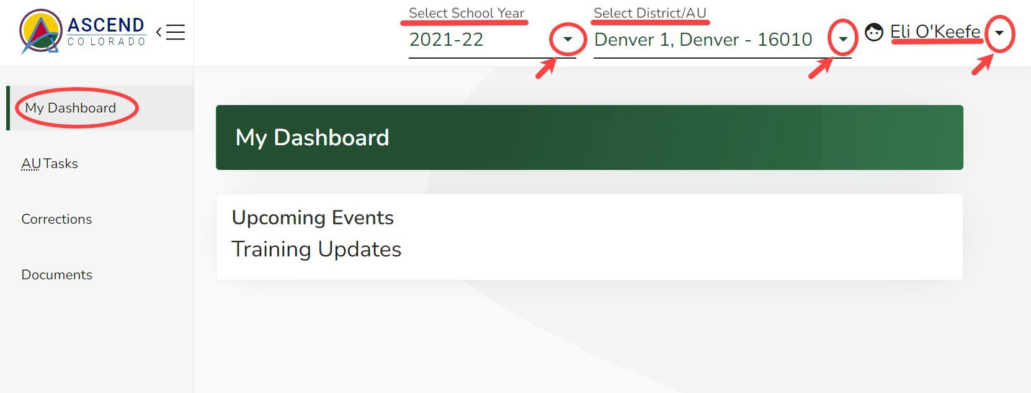
Ascend DMS Dashboard
Upon logging into Ascend DMS, you will land on the “My Dashboard” page. Along the top right side of the screen, you will see 3 drop-down fields:
Select School Year (*default is current school year)
District/AU (*only shows your AU)
Username
Clicking on the shaded caret
(down-pointing arrow) to the right of these fields will reveal options to:
  Select the school year;
  Show your District/AU;
  Adjust your settings or sign out of the system.
System always defaults to current school year
7

Slide 8
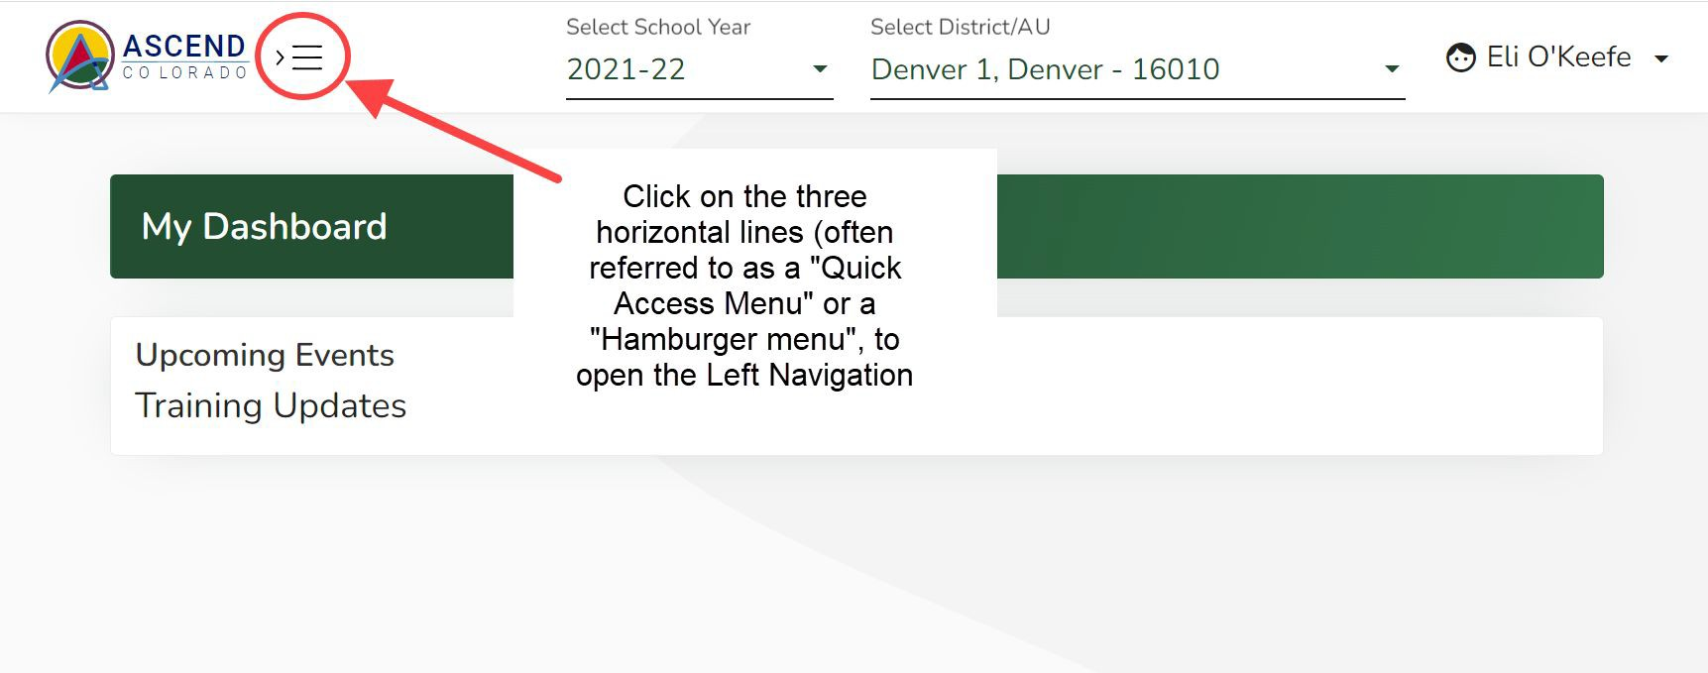
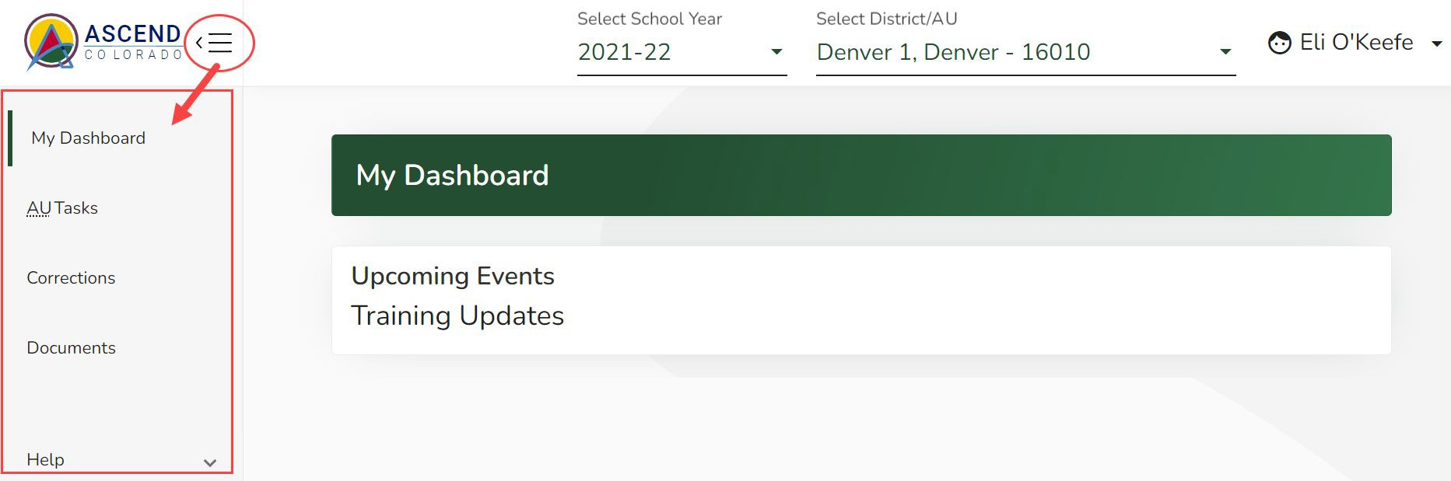
Ascend DMS Left Navigation Pane
Ascend may open with the left navigation pane closed. The left navigation pane contains the links to the various module pages such as AU Tasks, Corrections, Documents, and Help.
To open the left navigation pane:
Click on the Quick Access menu (3 horizontal lines icon) located to the right of the ASCEND logo located in the upper left corner of the screen.

Slide 9
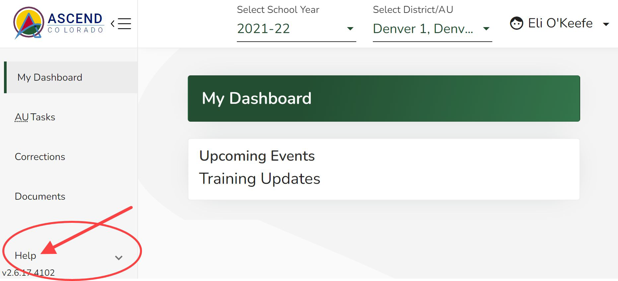
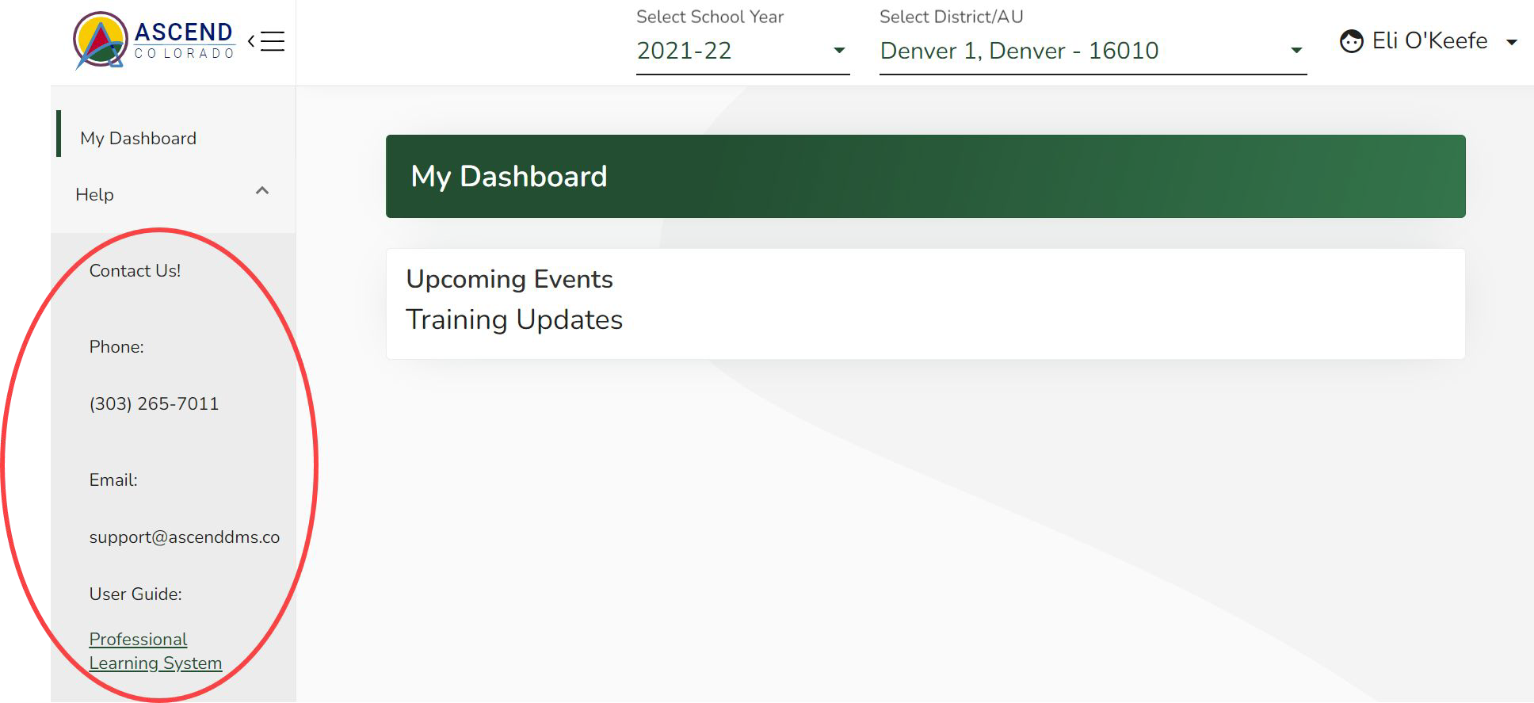
Ascend DMS Help
For Help with Ascend DMS, click on the “Help” label in the left navigation pane.
Help contact information will appear in the left navigation pane below the “Help” label.

Slide 10
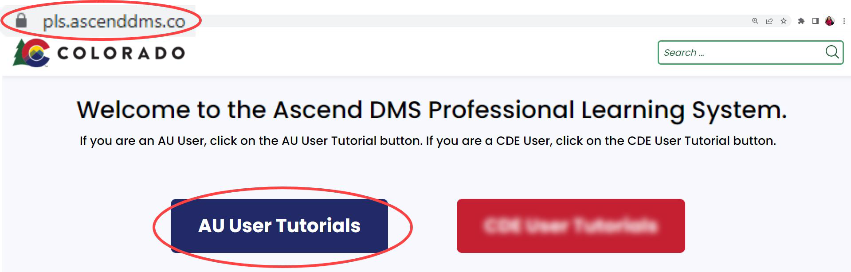
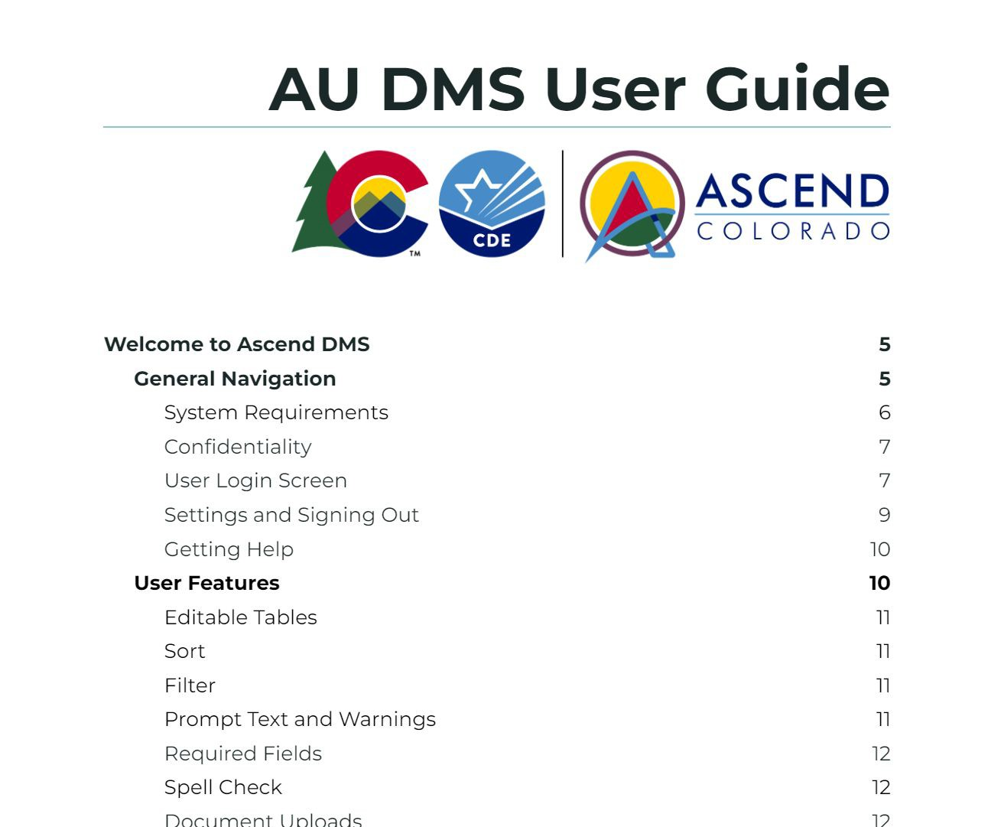
Ascend DMS Help Options
For Help with navigating and using Ascend DMS (including troubleshooting):
● Call: 303-265-7011, or
Email: support@ascenddms.co, or
Go to the Professional Learning System Online self-paced guide (https://pls.ascenddms.co), or
Reference: Ascend AU DMS Colorado System User Guide.
For access, or procedural/compliance questions regarding data management system:
Email: DMS_support@cde.state.co.us
10

Slide 11
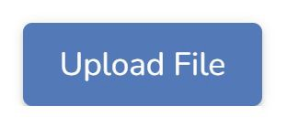
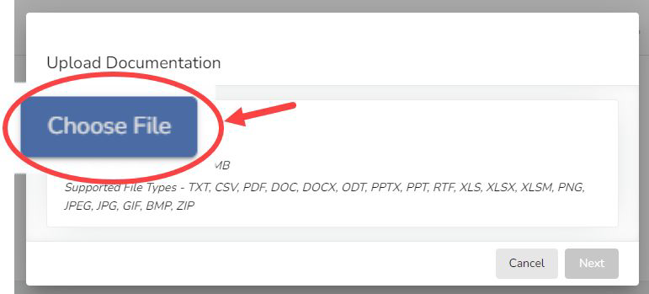
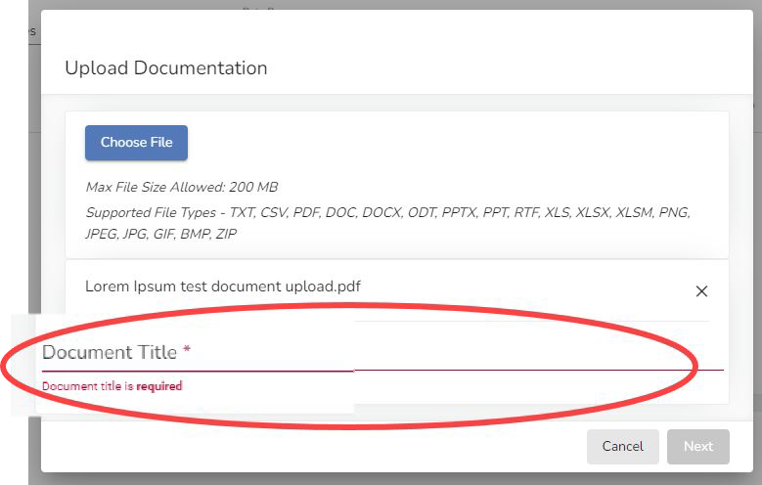
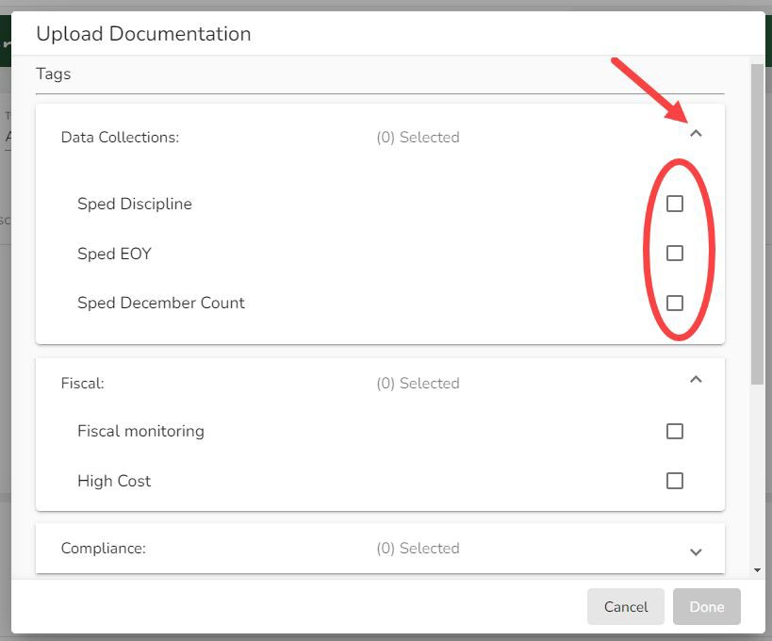
Uploading Documents
Throughout the system you may be required to upload supporting documents. To upload documents:
Click on a blue “Upload File” button
Choose the file(s) from your computer
Provide a Document Title
When required, you must select a “Tag” and “Tag type” that marks what category the document falls under (e.g. Fiscal, Data Collections, Compliance, Dispute Resolution, State Assessment, AU Determination, or SPP). *Assigning the appropriate Tag facilitates searching and filtering for documents
Use the carets on the right side of the Upload Documentation box to open Tag selection fields
Select correct School Year
Click the “Done” button
11

Slide 12
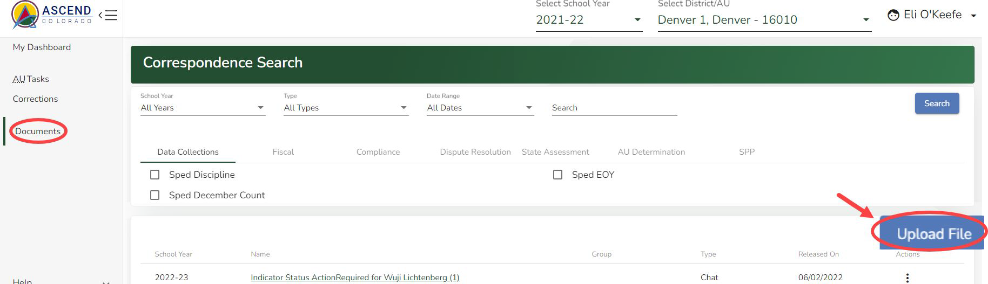
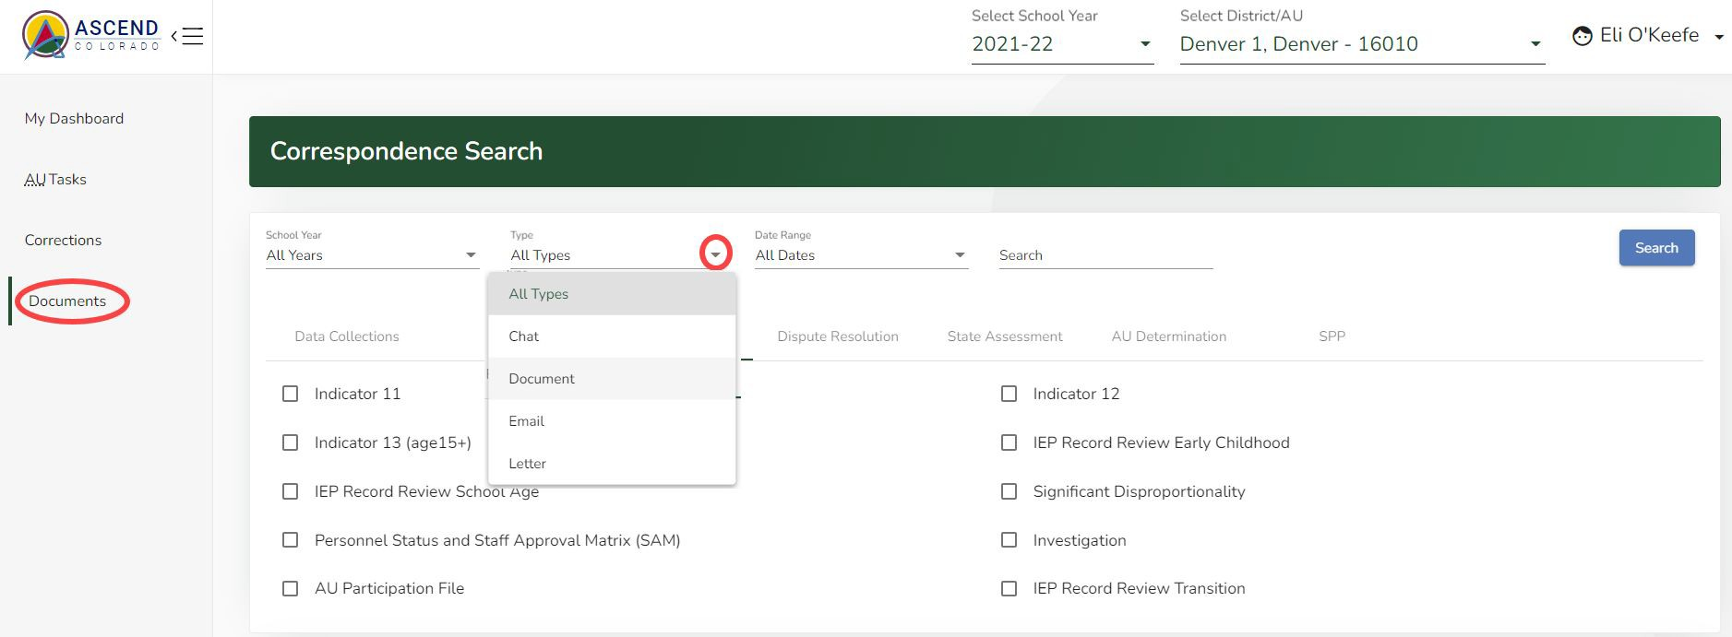
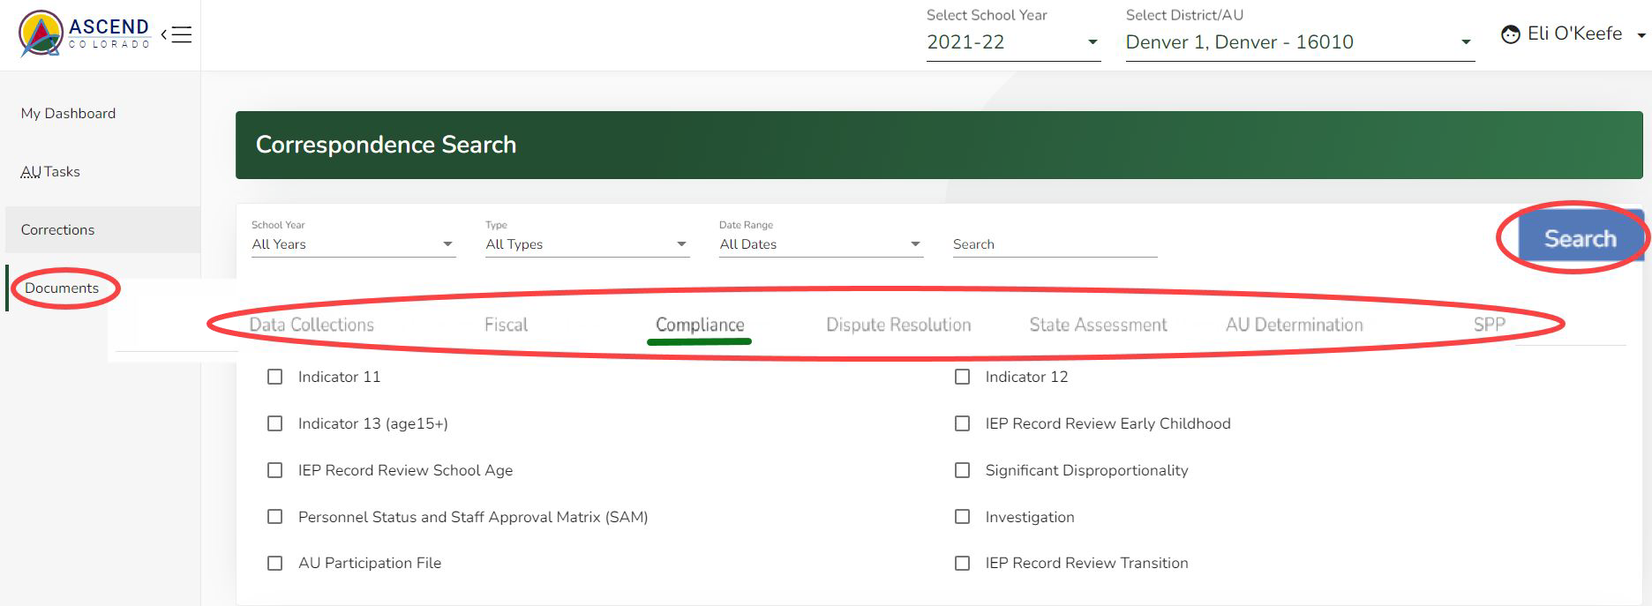
Correspondence Search
Documents can also be uploaded on the “Correspondence Search” page. Click on the “Documents” label in the left navigation pane.
The blue “Upload File” button is located in the top right corner of the list of documents table.
To Search and Filter for uploaded documents:
Use the filter fields (School Year, Type, Date Range) at the top of the page by clicking on the caret to the right of the filter field. Select from the drop-down list that opens.
Click on the filter tag tabs (Data Collections, Fiscal, Compliance, Dispute Resolution, State Assessment, AU Determination, SPP) located below the filter fields to open lists of filter tag checkboxes to select.
Click the blue Search button in the upper right corner of the page.

Slide 13
Questions?

