Slide 1
SY2023-24
Indicator 8: Parent Involvement
Parent Surveys
Colorado Department of Education
Exceptional Student Services Unit
August 2023
Notes:
The CDE office of special education conducts the parent survey every school year. This webinar will summarize how the SY2023-24 survey will take place.

Slide 2
Indicator 8: Parent Involvement
Percent of parents with a child receiving special education services who report that schools facilitated parent involvement as a means of improving services and results for children with disabilities.
This Photo by Unknown Author is licensed under CC BY-SA-NC

Slide 3
What is the State Performance Plan (SPP) Annual Performance Report (APR)?
States submit various data/reports to the U.S. Dept of Education
Office of Special Education Programs (OSEP) at U.S. Dept of Education evaluates States’ special education programs
(SPP/APR) = State’s report to OSEP on how the State’s special education program is doing
Due every February
Data (SPP/APR)
evaluation
Notes:
All states and territories submit various data and reports to the U.S. Department of education.
We, in special education, submit data and reports to the Office of Special Education Programs (OSEP) at the U.S. Department of education.
SPP-APR is one of these reports that all states and territories must submit to OSEP. OSEP uses the SPP-APR submitted by the states to evaluate how special education programs are working in states.
The SPP-APR is due every February. The public input the CDE is collecting for the 2023-24 school year will be submitted to OSEP on Feb 1st, 2025.

Slide 4
Parent Survey and the SPP/APR
Indicator 8: Parent Involvement is a Results Indicator included in the SPP/APR
Colorado uses the Parent Survey to collect the data needed for reporting Indicator 8 results.
Colorado reports:
Percent of parents with a child receiving special education services who report that schools facilitated parent involvement as a means of improving services and results for children with disabilities
Response rate
Representativeness of race/ethnicity in the responses
Representativeness of responses by geographical region

Slide 5
Why survey parents?
Individuals with Disabilities Act (IDEA) regulations
In developing an Individual Education Program (IEP), the team “must consider the concerns of the parents for enhancing the education of their child.” 34 CFR § 300.324(a)(1)(ii)
The IEP team must include the child’s parents. 34 CFR § 300.321(a)(1)
Case law
The IDEA’s procedural requirements for developing a student’s IEP are designed to provide a collaborative process that “places special emphasis on parental involvement.” Sytsema v. Academy School District No. 20, 538 F.3d 1306, 1313 (10th Cir. 2008)
This Photo by Unknown Author is licensed under CC BY-SA

Slide 6
How are the results used?
To use the learning to better serve children, parents, teachers, and the whole IEP process
Report the % of parents who believe schools facilitate parents’ involvement to U.S. Dept of Education (Ind 8)
To learn how parents are involved in children’s special education
Notes:
We conduct parent surveys every school year to learn how parents perceive their involvement in their child’s special education program.
The results can be used by Administrative Units and the Colorado Department of Education to identify areas of strength and areas of opportunities to improve outcomes of students with disabilities.
The aggregated state-wide results are reported publicly and to the U.S. Department of Education as the state performance plan indicator 8.

Slide 7
Size of AU and Student Sample Size
AUs are classified based on the number of students with disabilities in the AU.
4 AUs = Small: 1 – 100 students (survey all students (census))
38 AUs = Medium: 101- 1,000 students (survey 50 students)
22 AUs = Large: 1,001 – 5,000 students (survey 100 students)
4 AUs = Extra large: more than 5,000 students (survey 200 students)
Notes:
Colorado uses a stratified multi-stage sample design where strata are defined by AU size. Colorado uses a combination of census and sampling for Indicator 8 data collection. All AUs are selected annually. CO does not use a separate methodology for preschool children. School age and preschool students are collected in the same way. AUs are classified into four strata: small, medium, large, and extra-large AUs. The sample for each AU is determined by the count of students with disabilities reported by the AU in December Count. The student sample is disaggregated by race/ethnicity for each AU. The sample size is proportionate to those disaggregated numbers.

Slide 8
SY2023-24 Survey will be completed online
Administrative Unit (AU, e.g. district or BOCES)
Parents
Notes:
In SY2023-24, all parent surveys will be completed online. The CDE will provide the list of students whose parents are pre-selected for participation on the ESSU Data Management System family-school tab, as in the last few years.
AUs will send the survey link to the parents so that they can complete it online. AUs have the flexibility in how to distribute the survey link to parents.

Slide 9
Accessing the 2023-24 Parent Survey through the Ascend Data Management System (DMS)
AU - Roles and Permissions with access to the Parent Survey
AU - Monitoring Director (MD)
AU - Monitoring Record Reviewer (MRR)
Link to the Ascend Professional Learning System
Notes:
All aspects of the Indicator 8 survey go through Ascend. You will need to have one of the following roles in the Ascend system to access the Indicator 8 – Parent Survey content.

Slide 10
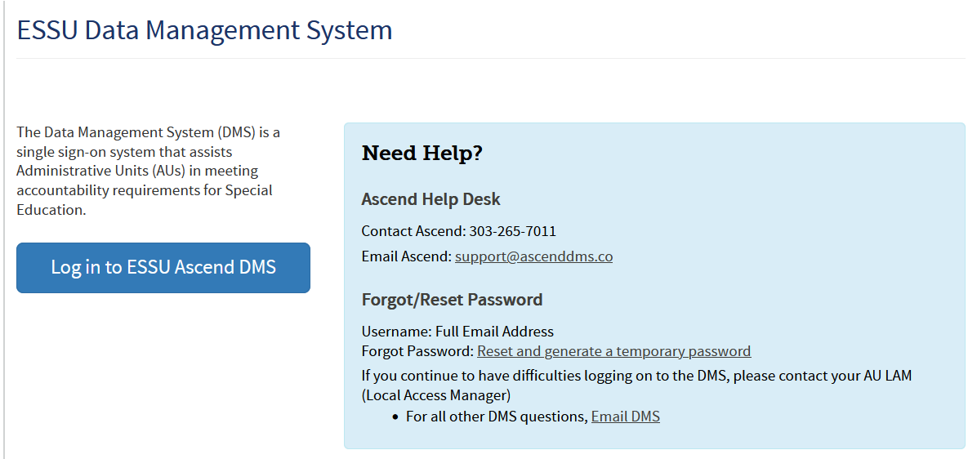
Logging in to the DMS
Sign in to DMS from https://www.cde.state.co.us/idm/essu-data Using your single sign-on.
Notes:
AUs will sign in to the DMS to find the list of students whose parents were randomly selected for participation in the ESSU Data Management System.

Slide 11
Access to the Ascend DMS
If you do not have access to the DMS, contact your AU LAM (Local Access Manager).
If you forget your password, there is a “Forgot Password” reset option on the log in page.
The CDE DMS application in Access Management is ASCDMS. There are 2 roles that grant access to Parent Surveys in the DMS:
MD – For Directors, all access.
MRR – For Record Review access.
Only one role can be assigned per user. If more than one role is assigned, you may not be able to log in.
If you get a security error message when logging in, have your IT person mark the page as safe, updates to Firewall security may block the page.
Questions about logging in or roles contact Josh Fails at fails_j@cde.state.co.us

Slide 12
Where to find your student list
Double your expected Survey count
Notes:
Once you log in, you will see the Ascend DMS Dashboard.
Make sure that the School Year at the top points to the 2023-24 School Year
Select AU Tasks.
You will see the message “Needs Attention” and the “Indicator 8 – Survey Data Collection” tile.
Click on the “Data Entry” button.

Slide 13
Number of students
Reflects double your expected survey count
Notes:
When you first land on the Indicator 8 Collection Dashboard you will see your status showing how many students are in your sample, if they are “in-progress” or “submitted.” This Dashboard also shows you a list of schools with surveys and their progress on their surveys.

Slide 14
Exporting your student lists
Export
Select “All Schools” or a
specific school
Notes:
If you click on “All Schools” or one of the school names you will see a list of students. Click on the Export Student List button to download your list. If you are in a single school, clicking the export button from this screen will give you the file for only that school. Selecting All Schools will give you the entire list of students.
The Export Survey Data button will populate with the survey data as it comes in from parents. The Survey Data will update as surveys are completed.

Slide 15
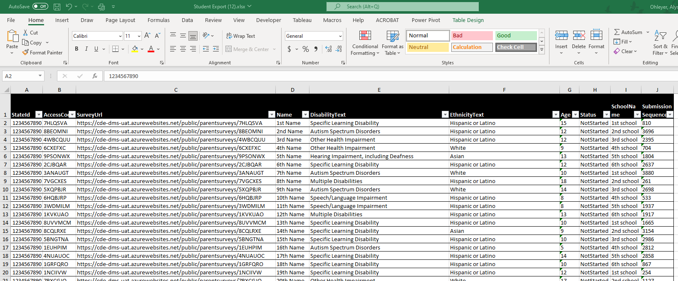
Your Student List
Twice as many students as the AU will survey
 | List includes | Please send surveys to
Small AUs | 100 or less | 50
Mid-sized AUs | 200 | 100
Large AUs | 400 | 200
Each student has a unique access code included in the survey URL.
Parents need this URL code to participate in the online survey.
Notes:
Your student list comes from December Count 2022 data and contains twice the number of required names for parent surveys. We provide double the required number for flexibility to account for students who have left the AU or no longer have IEPs. Please go through the list and select half of the list who are still enrolled within your AU with active IEPs.
In SY2023-24, the CDE asks that small AUs survey 50 parents. That means that they received 100 student names. Mid-sized AUs will survey 100 parents from the list of 200. And large AUs will survey 200 parents from the list of 400.
Each student is assigned a unique access code (see the green highlight). This code is tied directly to the student’s name.

Slide 16
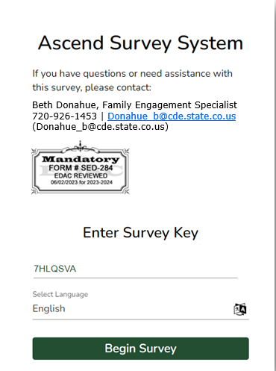
The pre-selected student list unique URL
Individual Survey Links!
Notes:
The individualized survey links should be provided to parents and used in any communication to parents. These URL links will take the parents directly to the login page for the survey and pre-fill the survey key.

Slide 17
Sample communication - English
Dear Parent(s) of 1st Student
The Colorado Department of Education and your local special education administrative unit (e.g., school district, BOCES) conduct a survey every school year to learn how parents are involved in their child’s special education program.
The responses you share will be used to improve the education of children with disabilities in your school district and throughout the State of Colorado. The state-wide results will be reported publicly and to the U.S. Department of Education after the completion of the school year.
Your Personal Survey Link https://ascenddms.co/public/parentsurveys/AccessCode
Due: June 30, 2024
We greatly appreciate your participation!
For information and resources for families of students with disabilities in Colorado, please visit this Colorado Department of Education webpage.
If you have questions or need assistance with this survey, please contact:
Beth Donahue, Family Engagement Specialist
720-926-1453 | Donahue_b@cde.state.co.us
Student Name
Survey Link with unique Access Code
Notes:
Here is a sample for you to use in writing your parent communication. Notice that it has the Student’s name, the unique survey link which includes the Access Code.
AUs are welcome to write their own communication, but please make sure to include the student-specific unique survey link.

Slide 18
Sample communication - Spanish
Student Name
Estimados padres de “1st Name”
El Departamento de Educación de Colorado y la unidad administrativa de educación especial de su localidad (es decir, el distrito escolar, BOCES) realizan una encuesta cada año escolar para conocer la participación de los padres en el programa de educación especial de sus hijos.
Las respuestas que comparta se utilizarán para mejorar la educación de los niños con discapacidad en su distrito escolar y en todo el Estado de Colorado. Los resultados de todo el estado se harán públicos y se informarán al Departamento de Educación de EE. UU.
Su enlace de encuesta personal https://ascenddms.co/public/parentsurveys/AccessCode
fecha de vencimiento: 30 de junio de 2024
¡Agradecemos mucho su participación!
Para obtener información y recursos para las familias de estudiantes con discapacidad de Colorado, visite esta página web del Departamento de Educación de Colorado (Colorado Department of Education, CDE).
Si tiene preguntas o requiere asistencia con la encuesta, comuníquese con:
Beth Donahue, Especialista en Participación Familiar
720-926-1453 | Donahue_b@cde.state.co.us
Survey Link with unique Access Code
Notes:
Here is the Spanish version. The language can be selected at the survey level (which we will see in a bit). Again, please include the student-specific unique access link.

Slide 19
Options on how AUs can distribute the survey to parents
Regardless of the distribution method, give the student-specific URL LINK to the parent!!
Send the link and access code via chat after a virtual IEP meeting
Email
If you are unfamiliar with mail merge, this short mail merge video will be helpful!
On a tablet/laptop after an in-person IEP meeting
Print a paper survey from the Word file found here
1. Add student name and unique link
2. Scan and upload completed paper survey to the DMS, tag “SPP” and “Indicator 8”
Text Message
3. Email Josh Fails that the completed surveys were uploaded
Notes:
AUs can choose any method to distribute the online survey link to the parents.
AUs can email the parents. If you are unfamiliar with mail merge, the short video I linked here might be helpful.
AUs can text message the parents.
If AUs are conducting in-person IEP meetings this school year, you can give the survey on a tablet or laptop afterwards.
Or AUs can send the URL link via chat after a virtual IEP meeting.
If a paper survey is preferred, you can download a PDF version from the link on the slide.
The AU will need to add the student's name and URL link to each printed survey.
When parents return a printed paper survey, please scan and upload the completed survey to the DMS Documents (tag the document SPP>Indicator 8) and email Josh Fails to let him know that the completed surveys were uploaded.
Regardless of the distribution method, please give the student-specific ACCESS LINK to the parent.

Slide 20
When parents use their unique link
20
Notes:
Here is what the parent will see when they use their unique link. Their Survey Key will automatically populate in the Survey Key field.
Parents can select English or Spanish on this page.

Slide 21
Parents are greeted with an overview
21
Notes:
Parents are greeted with an overview and instructions. The language preference can be changed here as well.

Slide 22
Survey questions
22
Notes:
The format in the DMS is easy to navigate and is accessible to screen readers. All questions are accessed by scrolling down the page.

Slide 23
Comments
23
Notes:
There is a field for comments at the end of the survey.

Slide 24
Required Minimum
24
Notes:
Parents must answer at least 12 questions in order to for the survey to be submitted and included in the Indicator 8 calculation. The survey platform will prompt parents to answer at least 12 questions before they can submit the survey. If they don’t answer 12 questions and stop the process, the survey will not be submitted however, their answers will still be saved. The survey will appear as “In Progress” in the Indicator 8 Dashboard until the date that the survey closes.

Slide 25
Summary
The SY2023-24 survey is open August 31, 2023 – June 30, 2024
Student names are randomly selected from December Count 2022 data
AUs receive twice as many students’ names as they will send surveys
Choose the first half from the list who are still enrolled in the AU and have an active IEP.
Include the unique student survey link in your communication
AUs choose how to distribute the survey
Click here for a short video on how to mail merge
Monitor progress as responses come in to the DMS
Notes:
The survey period is from August 31, 2023 through June 30th, 2024.
AUs can send the surveys to the parents anytime during this period.
The students whose parents will participate in the survey have been randomly selected by the CDE.
AUs receive twice as many students’ names as they will send surveys to.
Select half of the list who are still enrolled within your AU with IEPs to send the survey link.
Please send the student-specific access Link.
AUs can distribute the survey using any method they find effective. If you need a refresher on how to mail merge, please see the linked short video.
We recommend that AUs monitor the progress as responses come in on the DMS AU Tasks>Indicator 8 Dashboard.

Slide 26
Generating
Engagement
through
Meaningful
Strategies
Café Discussion with Colorado Special Education Directors and Administrators
Date TBD via Zoom
Topic: Parent Survey Response Rates
AU Directors from across Colorado are invited to attend a Café Style panel discussion to identify strategies for improving parent survey response rates. Directors from high-response districts will serve as panelists to share strategies that have been effective for them. All attendees will have the opportunity to participate in a Q&A session.
Agenda
2:00 – 2:10
Introductions
Opening Remarks from Panelists
2:20 – 2:40
Open Forum Q&A
2:40 – 2:45
Closing
Please watch your email for an invite and additional information.

Slide 27
Thank you for your work in gathering parents’ feedback!
Resources and Contacts
Resources are available on our webpage http://www.cde.state.co.us/cdesped/indicator_08 Indicator 8: Gloria Durosko: Durosko_G@cde.state.co.us DMS and Data Reports: Josh Fails: Fails_J@cde.state.co.us
Family Engagement Specialist: Beth Donahue: Donahue_b@cde.state.co.us
Notes:
Thank you for working with CDE to gather parents’ feedback!
If you have ANY questions or concerns, please reach out to Beth, Gloria, or Josh

