Slide 1
Short Bytes
SEY Data Validation: Dropout Rates

Slide 2
Validation Overview
Error Free
≠
Accurate
Notes:
Review CEDAR reports showing district level and school level dropout rates
Overall
Subgroup data by Race Ethnicity Gender
Subgroup data by Instructional Program Service Type
Use CEDAR reports to review the list of students who are dropouts with exit type 40 or 01

Slide 3
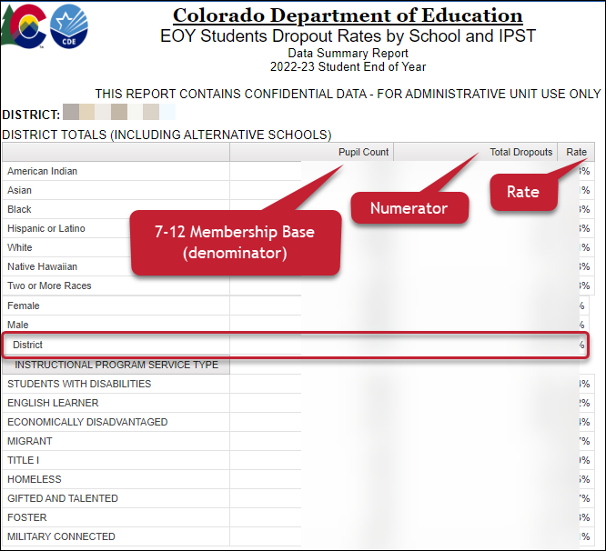
CEDAR Report: EOY Students Dropout Rates by School and IPST
Total number of dropouts
(school exit types 01 & 40)
÷
7th-12th grade Membership Base
(includes students in membership at any point within the school year)
Notes:
This report shows the total dropout at the school and district level along with subgroup rates by gender, race/ethnicity, and IPST category. This report allows districts to preview their dropout rates before they are publicly posted at the conclusion of the Student End of Year data collection cycle.
Includes disaggregated information by gender, race/ethnicity, and IPST category
Available to users with SEY~LEAApprover, SEY~LEAUser, SEY~LEAViewer roles in Identity Management.

Slide 4
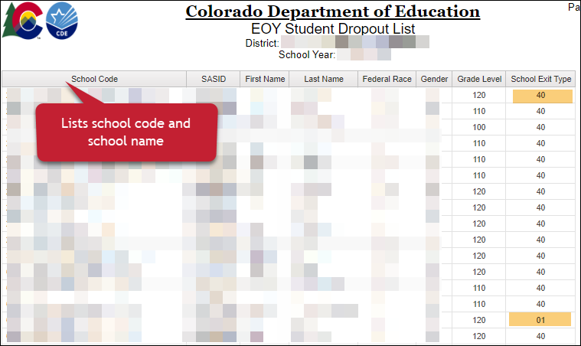
CEDAR Report: EOY Student Dropout List
Notes:
This report reflects the list of students coded as dropouts for a district in the given year.

Slide 5
All Dropout Reports
EOY Students Dropout Rates by School and IPST
EOY Student Dropout Counts by School and Grade
EOY School Membership and Dropout for Grades 7-12
EOY Student Dropout List
EOY End of Year Membership by School, Grade, Race/Ethnicity and Gender

Slide 6
More Information: Student End of Year Website Dropout Statistics Site

