Slide 1


Colorado Department of Public Health and Environment
Child and Adult Care Food Program (CACFP)

Slide 2

CACFP
USDA Program – administered by CDPHE-CACFP
Reimbursement program
Provide nutritious meals & snacks to children & adults in approved programs
Requires all CACFP reimbursement to be used only for food & food service operation
Quality and quantity of food are first!
Must operate a non-profit meal service

Slide 3



CACFP Programs
Child Care Centers
Adult Day Care Programs
Head Start Programs
Homeless/Domestic Violence Shelters
Outside School Hours
At-Risk Meal Program
Family Day Care Homes

Slide 4
Current Library Sites
Carbondale Library
Central Library (Aurora)
Loveland Library
Lucero Library (Pueblo)
Mancos Public Library
MLK Library (Aurora)

Slide 5
CACFP Nutrition-related Goals
Nutrition Education
Nutritional Variety
Exposure to new foods
Following the USDA Dietary Guidelines
Menu Upgrades
Notes:
You may think that because a food meets CACFP guidelines, it is a healthy food. Not true. The CACFP meal pattern allows for a wide variety of foods. Not all choices give the best nutrition for young children. The following are nutrition related goals set forth by the CACFP to improve the nutrition of participants.
Expand as you wish on the above goals

Slide 6
History of At-Risk Afterschool Meals
1994- Healthy Meals for Healthy Americans Act
      Demonstration projects- snacks to children between the ages of 13 and 18, in areas of high rates of violence or drug and alcohol use
2010- The Healthy, Hunger Free Kids Act
      Expanded meal reimbursement for At-Risk Afterschool programs in all States

Slide 7
Program Benefits
Reimbursement for snacks and meals (typically suppers) after school and on weekends and school holidays
Site eligible to claim up to one snack and meal served to each eligible participant per day
All approved at-risk meals and snacks are eligible for reimbursement at the free rate
Eligible for reimbursement during the school year only, unless the qualifying school operates year round

Slide 8
At-Risk Institutions can be…
Independent sites, self sponsor or participate under a sponsor
School Food Authority (SFA)
Child care centers with an at-risk component
Extended day schools
Military programs with an at-risk component

Slide 9
At-Risk Afterschool
Program Requirements
Be organized to primarily provide care for children after school or on weekends, holidays, or school vacations during the regular school year
Site located in a geographical area served by a school in which 50% or more of children enrolled are eligible for free/reduced meals
Operate a program with regular educational or enrichment activities for children during the regular school year

Slide 10
At-Risk Afterschool
Program Requirements
Contact Colorado Department of Human Service to determine licensing status
Colorado requirement: if licensed exempt, programs must meet local health and safety standards in Colorado
        CDPHE CACFP and Environmental Health has established a partnership overcome barriers related to health inspections.

Slide 11
Participant Eligibility
Children who participate in an approved afterschool program and who are age 18 or under at the start of the school year
Federal law has no minimum age for at-risk program participants. For example, Head Starts are an eligible afterschool program are eligible for reimbursement
No requirement that each facility must serve the full age range of eligible children

Slide 12

Meal Pattern Requirements, Components, and Creditable Foods

Slide 13
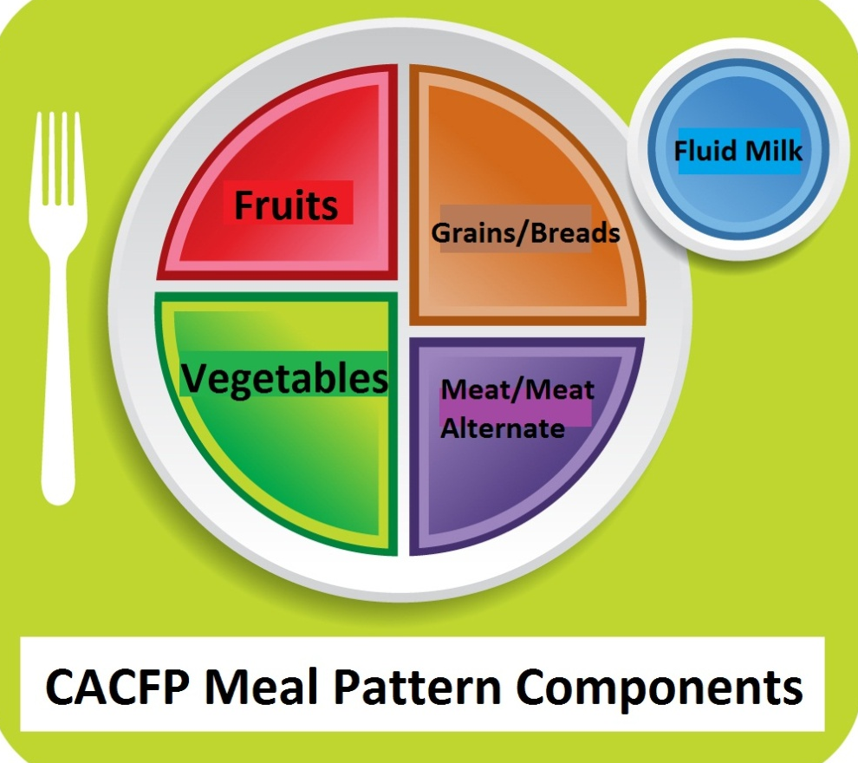
Meal Pattern
Meet USDA guidelines based on age
Include minimum portions & components

Slide 14

Meal Pattern Components
CACFP meal patterns are food based
Components
  Fluid Milk
  Meat/Meat Alternate
  Grain/Bread/Bread Alternate
  Vegetables
  Fruits

Slide 15
Lunch/Supper Meal Pattern
Components | Ages 1-2 | Ages 3-5 | Ages 6-12
Milk | ½ cup | ¾ cup | 1 cup
Fruits | 1/8 cup | ¼ cup | ¼ cup
Vegetable | 1/8 cup | ¼ cup | ½ cup
Grains Bread Cornbread, Biscuit, Roll Pasta, Rice, Grains | ½ slice ½ serving ¼ cup | ½ slice ½ serving ¼ cup | 1 slice 1 serving ½ cup
Meat/Meat Alternate Meat, Poultry, Fish Cheese Eggs Beans Peanut/Nut Butter Yogurt | 1 ounce 1 ounce ½ egg ¼ cup 2 Tbsp** 4 ounces | 1 ½ ounces 1 ½ ounces ¾ egg 3/8 cup 3 Tbsp** 6 ounces | 2 ounces 2 ounces 1 egg ½ cup 4 Tbsp** 8 ounces
Notes:
Talking Points: Walk them through each of the components and serving sizes. Specifically mention the 5 components at lunch and talk about the differences between the age groups. Give sample menu ideas such as Stir fry with chicken, Asian vegetables, rice, mandarin oranges and milk.

Slide 16
Snack Meal Pattern
Components (select 2) | Ages 1-2 | Ages 3-5 | Ages 6-12
Milk | ½ cup | ½ cup | 1 cup
Fruit | ½ cup | ½ cup | ¾ cup
Vegetable | ½ cup | ½ cup | ¾ cup
Grains Bread Cornbread, Biscuit, Roll Cold Cereal Hot Cereal Pasta, Rice, Grains | ½ slice ½ serving ¼ cup ¼ cup ¼ cup | ½ slice ½ serving 1/3 cup ¼ cup ¼ cup | 1 slice 1 serving ¾ cup ½ cup ½ cup
Meat/Meat Alternate Meat/Poultry/Fish/Cheese Egg Beans Peanut/Nut/Seed Butters Yogurt | ½ ounce ½ egg 1/8 cup 1 Tbsp 2 ounces | ½ ounce ½ egg 1/8 cup 1 Tbsp 2 ounces | 1 ounce ½ egg ¼ cup 2 Tbsp 4 ounces
Notes:
Talking point: Mention 2 components at snack and give examples; note the specific serving size requirements especially for fruits and vegetables and meat/meat alternates.

Slide 17

New Age Group 13-18 years old
At-Risk afterschool programs, emergency shelters, participants with disabilities, and children of migrant workers ONLY
No increase in portion size
Better reflect CACFP population
Notes:
The addition of a 4th age group will better reflect the population CACFP serves, particularly in at-risk afterschool programs, emergency shelters, participants with disabilities, and children of migrant workers age 15 and under.
This age group is designed for at-risk afterschool programs, emergency shelters old.
There is not an increase in portion size for the 13-18 year old age group when compared to the 6-12 year old age group.
The minimum portion only needs to be served; however, we recognize larger amounts may need to be served to this age group to meet their nutritional needs.
The meal pattern chart will now include the fourth age group.
Children in child care settings or family day care home settings must not claim meals for children older than 12 years, unless the criteria listed above are met.

Slide 18
At-risk Meal Requirements
At least the minimum portion sizes for 6-12 year old children listed on the meal patterns
        Recommend that seconds are available for older children
Maximum of one snack and one meal per child per day after school
        No requirements for time of meal and snack (ex: supper can be at 3:30)
During the school year on the weekends, holidays, and school vacations

Slide 19
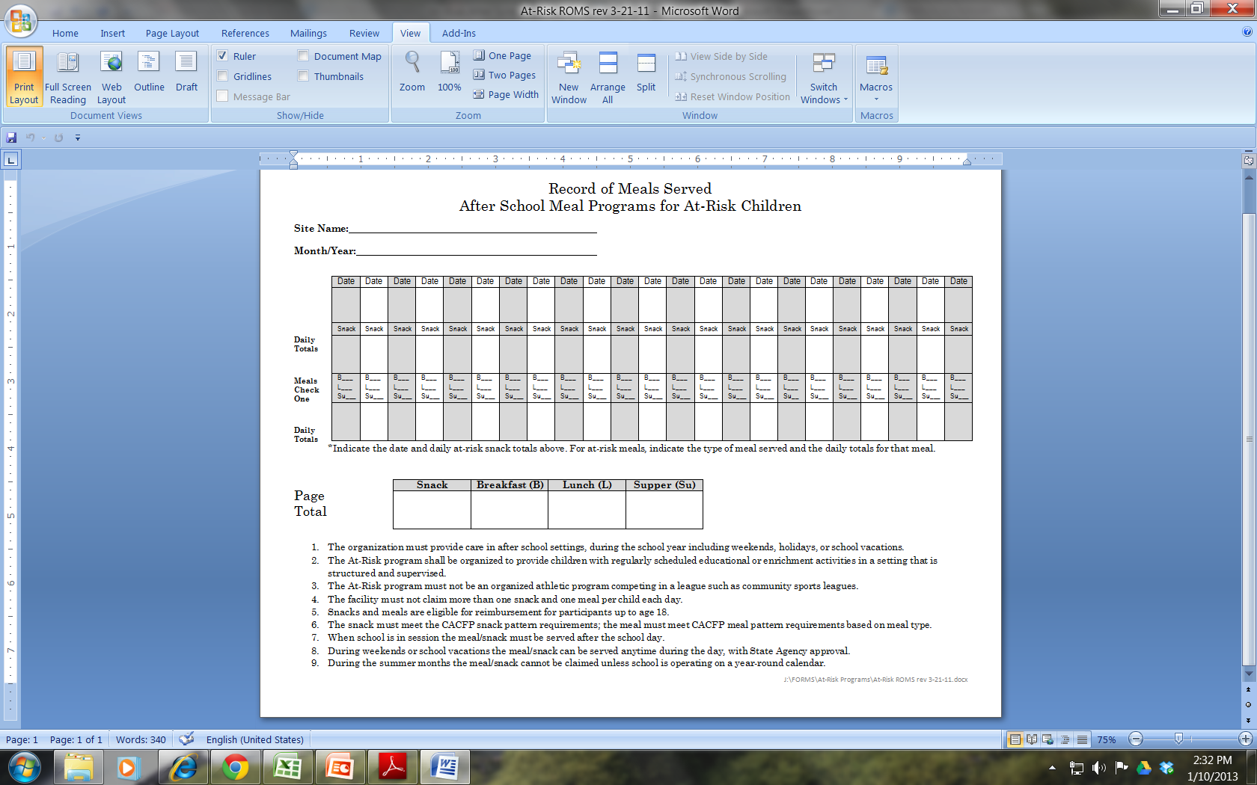
Record of Meals Served (ROMS)

Slide 20
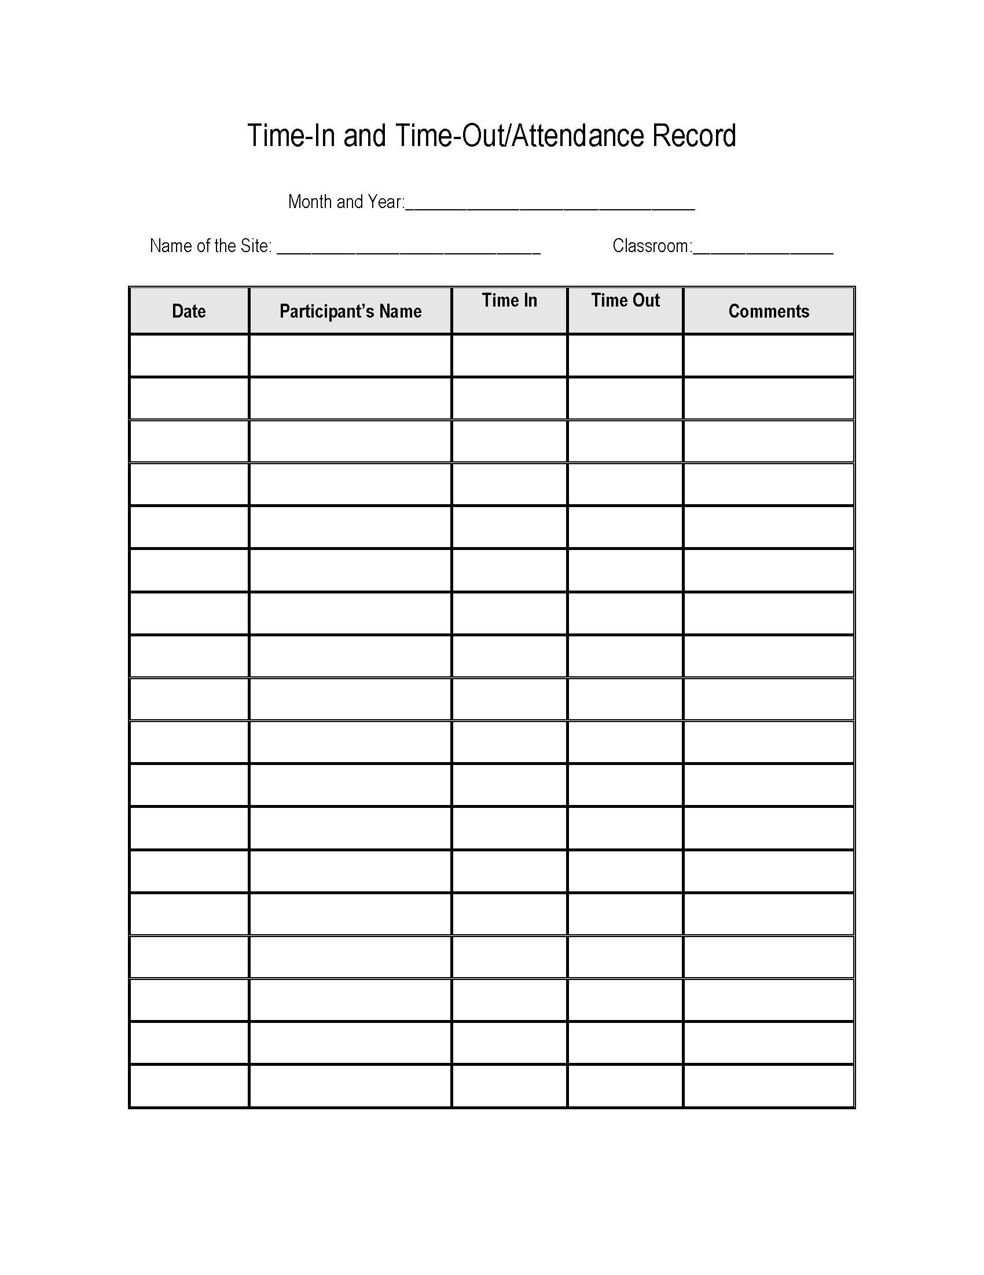
Attendance Requriements
Maintain daily records of each child’s attendance
      Daily attendance roster, or
      Sign in sheet for licensed programs

Slide 21
CACFP Record Keeping
Menus
Production Records
Milk and Food Receipts
Training Records
    Staff training
    Civil Rights
Records of Meals Served (ROMS)
Time-in/Time-Out
Documentation of enrichment activity/calendar of activities

Slide 22
Record Keeping for Claim Reimbursement
Reimbursement can be claimed by programs that meet Federal regulations and:
  Serve creditable meals & snacks
  Record creditable meal & snack content
  Record who eats the meals & snacks
  Keep records of the eligibility status of each participant
  Attendance or Time In/Time Out Records
Records required to make a claim:
  Records of Meals Served (ROMS)
Meals and snacks are reimbursed at the free rate (updated every July)
  Lunch/supper: $3.46
  Snack: $0.88

Slide 23
Contact CACFP
Main line: 303-692-2330
Meghan George-Nichols 303-692-6277
Website: https://www.colorado.gov/pacific/cdphe/cacfp

Slide 24
Questions?

