Slide 1
Data Pipeline Submission
Fiscal Year 2024-25
August 14, 2025
Notes:
Kelly

Slide 2
Data Pipeline Submission Agenda
Agenda
Key Dates
Resources
Reports
Submission Steps
1st Tier and 2nd Tier Errors

Slide 3
Data Pipeline Submission
Dates and Resources
Key Dates
Soft Open available on August 1st
Official Open August 29th
Submissions are Due December 31st
60 Day extensions can be granted by OSA to extend deadline to March 1, 2026
Resources
Business Rules - Helpful Hints
  (in the ‘Lookup Finance December Business Rules’ section of the page)
Quick Reference
Reconciliation Checklist

Slide 4
Data Pipeline Submission
Due Dates and Documentation
Due December 31st, 2025 to CDE and to OSA
FY 2024-25 Financial Audits with Single Audit if required
Due December 31st, 2025 to CDE:
Completion of Finance December data submission
Assurances for Financial Accreditation
Reconciliation Reports
  1st Tier Error Detail Report
  2nd Tier Error Detail Report
  Grant Revenue Reconciliation
Where Do I Send my Audit?
Link takes you to page with details and is found in the Data Pipeline Section of the PSFU website

Slide 5
Data Pipeline Submission
Extension requests
A District may request a 60-day extension from the Office of the State Auditor.
Request must be submitted by December 31, 2025
Request an Extension Form : https://apps.leg.co.gov/osa/lg
CDE honors the extension approved by OSA; send CDE a copy of the approved extension request: schoolfinance@cde.state.co.us

Slide 6
Data Pipeline Submission
Resources
Overview: Focus of today’s session is to highlight:
CDE School Finance Unit Webpage Resources
  Assurances of Financial Accreditation
    Knowing what is required at the end of Fiscal Year will help organize activities during the year to ensure compliance.
  Chart of Accounts
    Understanding is the key to improving district’s financials for both management and compliance
  Financial Policies and Procedures(FPP) Handbook
    Knowing the rules and statute requirements will assist in compliance and understanding
Financial Data Warehouse (FDW) Reports
  All payments sent by CDE for state & federal grants during fiscal year (cash basis)
State Revenue Check figures
  Amounts listed for State Share & ELPA payments, Charter School Allocations & Audit Findings
USDA Foods Report
  Amounts used to record commodities received from CDHS

Slide 7
Assurances for Financial Accreditation
Assurances for Financial Accreditation
Must be submitted with Audit documents (Section 22‑11‑206(4), C.R.S.)
Signed by Superintendent, Business Manager and Board President
District can include Charter School(s) responses in the the district AFA, or the District may require each Charter* to submit its own AFA
*Charter School Form - if submitted independently of District AFA
Signed by the Charter School’s Executive Director, Business Manager, Board President
Assuances Form A must be included for any ‘No’ responses.

Slide 8
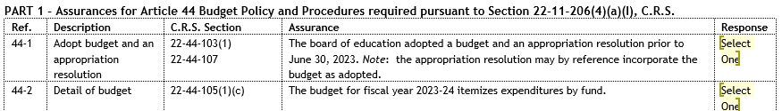
Assurances for Financial Accreditation - continued
Answer all questions - ‘Yes’, ‘No’ or ‘N/A’
‘Yes’ - indicates compliance with statue.
‘No’ - indicates a violation of that specific statute occurred
‘N/A’ - was not applicable
For any ‘No’ response, the Assurances Form A must be submitted with the AFA
Brief explanation for non-compliance (what happened?)
Plan to address the issue so that future violations don’t occur
It’s not scary! CDE does not approach this in a punitive manner. Just be honest in the responses. Oftentimes it is a learning experience for newer business managers.
CDE will ask for Form A to be submitted if not included with other audit documents
All items are governed by statute - with reference to statute(s) on each line

Slide 9
Chart of Accounts
Chart of Accounts
Updated at the start of every fiscal year
Changes are approved by a vote of Financial Policies & Procedures (FPP) committee members
Definitions for each element of the COA - required in data pipeline/financial data
  Required elements: District Code, Admin Unit, School, Fund, Location, SRE, Program, Source/Object/Balance Sheet, Job Class, Grant, Amount*
COA webpage also includes:
List of State & Federal Grant Codes to be used in data pipeline
List of Frequently Requested Codes (ie School Codes, district/BOCES codes, etc)
* Note the amount field must be converted so there are no decimals:
$1000.00 (multiply by 100) is 100000 in the data file (see slide 20)

Slide 10
Chart of Accounts
- Rolling to the Bold
Chart of Accounts - Appendix N: Rolling to the Bold*
The Chart of Accounts is designed to meet legal and regulatory requirements and generally accepted accounting principles while providing as much flexibility as possible for the local school district.
For instance, code structure and definitions allow for varying degrees of detail depending upon local district reporting needs.
CDE will aggregate data upon receipt of electronic data files by “rolling” unbold account codes (submitted in the district’s data) into appropriate BOLDED accounts*.
An example follows on the next slide which demonstrates how “rolling to the bold” works.
Note: the BOLDED codes in the COA are the minimum required reporting level; districts can use more granular account codes if they wish.
*also referred to as ‘rolled-up’ data (Tier 2 = rolled up data in pipeline)

Slide 11
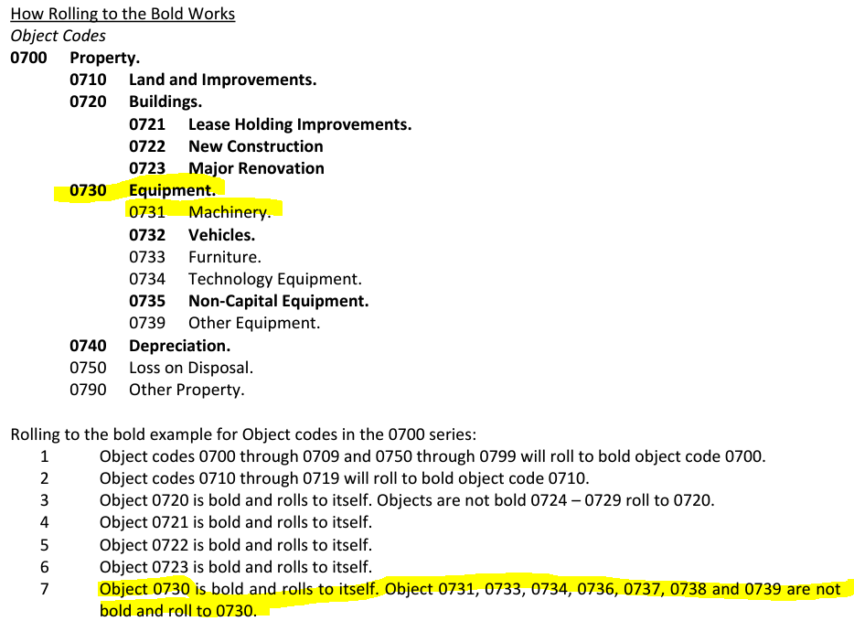
Rolling to the Bold
- Example
From Appendix N:

Slide 12
Financial Policies & Procedures Handbook
Financial Policies and Procedures Handbook
Wide array of important information:
Accounting Principles, GAAP
Budgeting
Fund Uses (General Fund, Food Service, Capital Projects Fund, etc.)
Procedures (ie accounting, payroll, sales tax, etc)
Investments & Cash Management
Tax Levies & Revenue
Certification of Assessed Valuation, Pupil Enrollment, Determination of State Funds, etc.
Sample Auditor RFP (Appendix D)

Slide 13
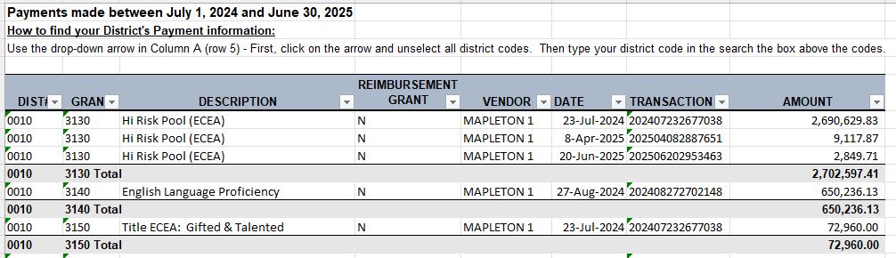
Financial Data Warehouse (FDW) Sub-recipient Reports
Financial Data Warehouse - FDW Reports are prepared by CDE monthly and are accumulative (all payments made during the fiscal year are accumulated each month)
Includes all the State & Federal grant funds distributed by CDE during the fiscal year
Used by district staff to reconcile grant activity & by external auditors to audit/confirm district’s grant activity.
Typically updated by the 1st or 2nd business day of the following month
Cash basis (all grant payments made between July 1st - June 30th)
  In your G/L, there will be reconciling items - (i.e. payments received in July, but A/R is recorded in June - prior fiscal year)

Slide 14
FDW Sub-recipient Reports Continued
Financial Data Warehouse, continued -
Excel version of the FDW report is posted;
  FPP members agreed that the pdf versions are no longer necessary; however, if you need a pdf version reach out to us.
Additional Resources have been added:
Office of Grants Fiscal: Awardee Distribution Lookup Tool
Lookup (CDE payment) information by fiscal year or by grant code
  Includes the current year payment information plus two previous years
State of Colorado: Transparency Online Project (TOPS)
Use filters on the right to select department name and district/BOCES in the ‘Vendor Name’
The website is updated every 5 business day

Slide 15
State Revenue Check Figures
State Revenue Check Figures - used to verify amounts:
State Share Figures Gross figures to pipeline by district
Net figures to pipeline
  Includes SWAP Withholding, Charter Intercept, CSI Administrative Withholding, Audit Repayments & State Share Adjustments
ELPA (English Language Proficiency Act) payments (Grant 3140)
Audit Findings (State Share & Transportation audit repayments/distributions)
  Share Share Adj (Source 3210, Grant 0000)
  Transportation Adj (Source 3200, Grant 3160)
Charter School - minimum allocation amounts**
  Charter School allocations (Source 57xx)
    Appendix K-2: Charter School Allocations
    Appendix K-3: Charter School Intercept Payments
** Do not code charter school allocations as local, state, federal, or ‘other’ revenue! Please use the 5710 and 5711 sources codes.

Slide 16
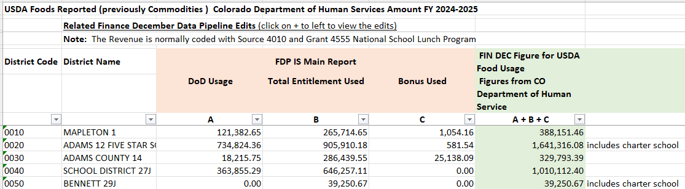
USDA Foods Report
USDA Food Check Figures - used to determine Commodities
The entry is booked to both a commodity expenditure and a revenue account with grant 4555.
Revenue 21-XXX-XX-XXXX-4010-XXX-4555
Expense 21-XXX-XX-3100-0633-000-0000
USDA-related reports:
Agency Entitlement Summary Report from the FDP-IS system (see the 2nd tab in the USDA Foods Report).
Usage report from Ffavors system

Slide 17
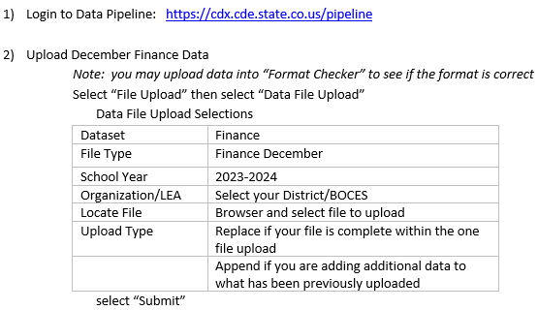
Quick Reference
Access Granted through the District Local Access Manager
LEA Approver
LEA User
Quick Reference

Slide 18
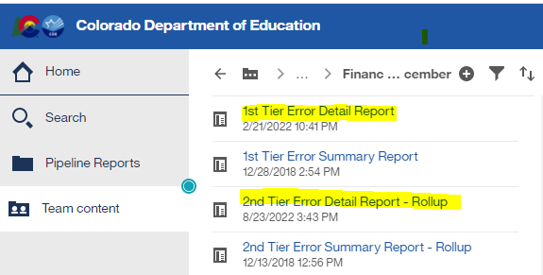
1st and 2nd Tier Error Detail Reports
1st Tier - Business Rules primarily related to account/coding issues
2nd Tier - Business Rules primarily related to dollar amounts
Types of errors
E-type errors: prevent you from moving forward - they are must fix errors
Warnings: indicate something might be incorrect in the data
Must be verified as correct (i.e. reconciliation reports submitted with final audited financial statements)
Can’t move to 2nd Tier until all 1st Tier E-type errors are cleared
Reminder - You can submit data as many times as needed
Run reports in data pipeline:
Note: Can take several days / weeks to clear errors!

Slide 19

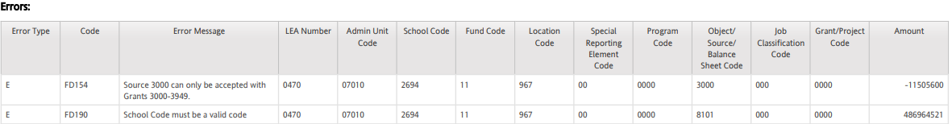

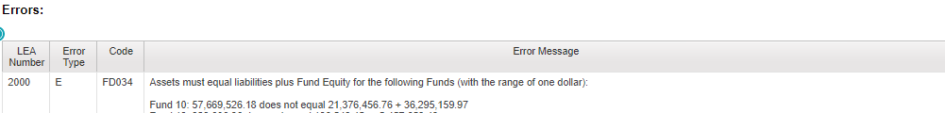
1st Tier & 2nd Tier Reports
Examples

Slide 20
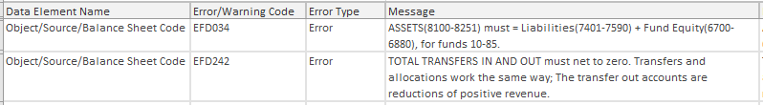
Business Rules - Chart of Accounts Example
Not part of the data file - multiply *100 = $ amount
* Amount field has no decimal (ie 100.00 would be 10000 in data file)
Negative amounts are preceded by a negative sign
Data Pipeline Business Rules (example from 1st Tier):
Data Pipeline Business Rules (example from 2nd Tier):

Slide 21
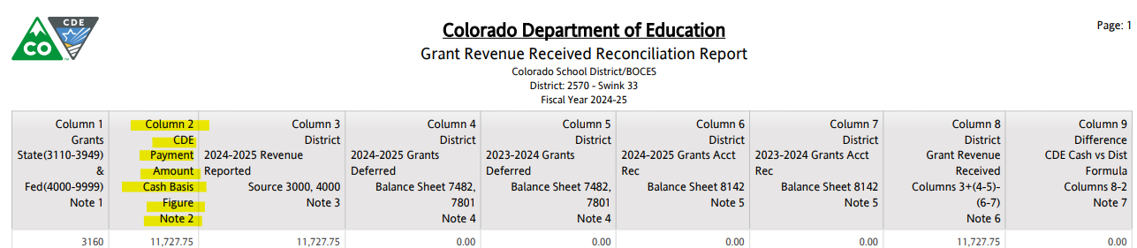
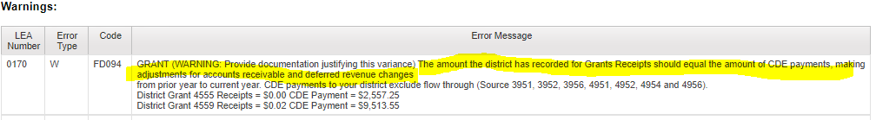
Business Rules - FDW Reports
(Grant payments from CDE) Example
Financial Data Warehouse (FDW) Sub-recipient Reports
Used to populate Column 2 on the Grant Revenue Received Reconciliation Report
From the 2nd Tier Error Detail Report:

Slide 22
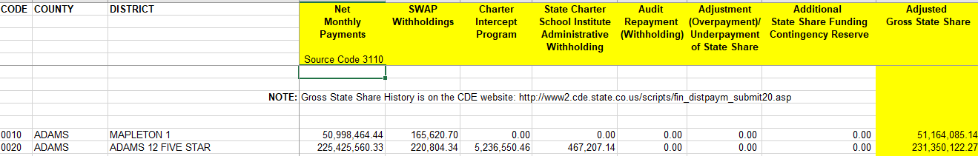
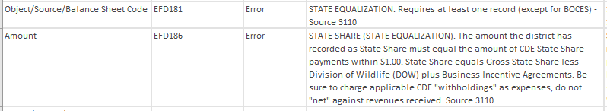
Business Rules - State Revenue Check Figures Example
State Revenue Check Figures Report
Used to populate State Share, SWAP, Audit Adjustments and the minimum Charter & Preschool Allocation Amounts
From the 2nd Tier Error Detail Report:
FY2024-25 School Finance Funding

Slide 23


Business Rules - State Revenue Check Figures Example continued
State Revenue Check Figures Report
From the 2nd Tier Error Detail Report:

Slide 24
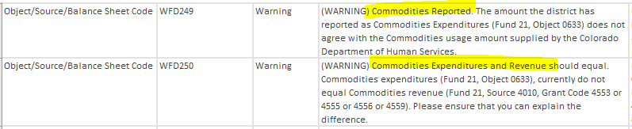
Business Rules - USDA Food Check (Commodities)
Example
USDA Food Check Figures
From the 2nd Tier Error Detail Report:
The entry is booked to both a commodity expenditure and a revenue account with grant 4555.
Revenue 21-XXX-XX-XXXX-4010-XXX-4555
Expense 21-XXX-XX-3100-0633-000-0000
USDA-related reports:
Agency Entitlement Summary Report from the FDP-IS system (see 2nd tab in report).
Usage report from Ffavors system

Slide 25
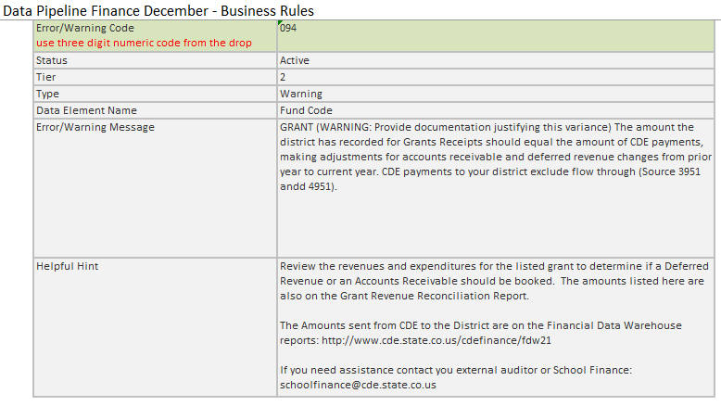
Business Rules Helpful Hints - Example
Data Pipeline: Helpful Hints for Business Rules

Slide 26
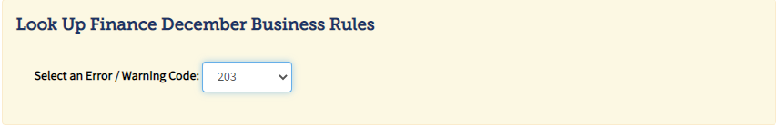
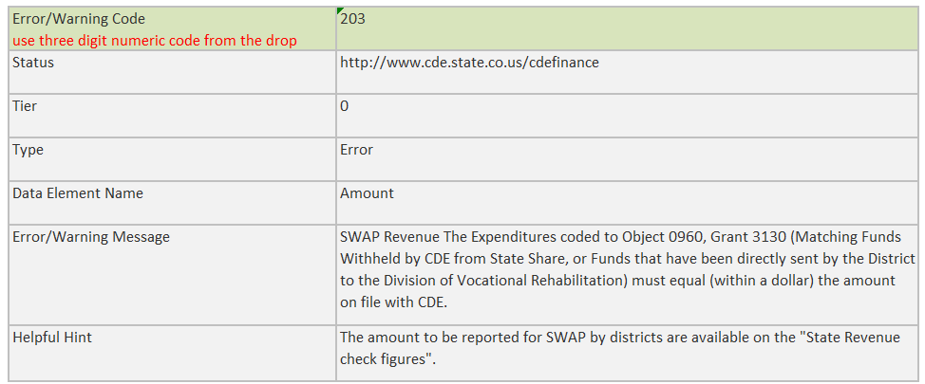
Business Rules Helpful Hints - Example continued
Data Pipeline: Helpful Hints for Business Rules

Slide 27
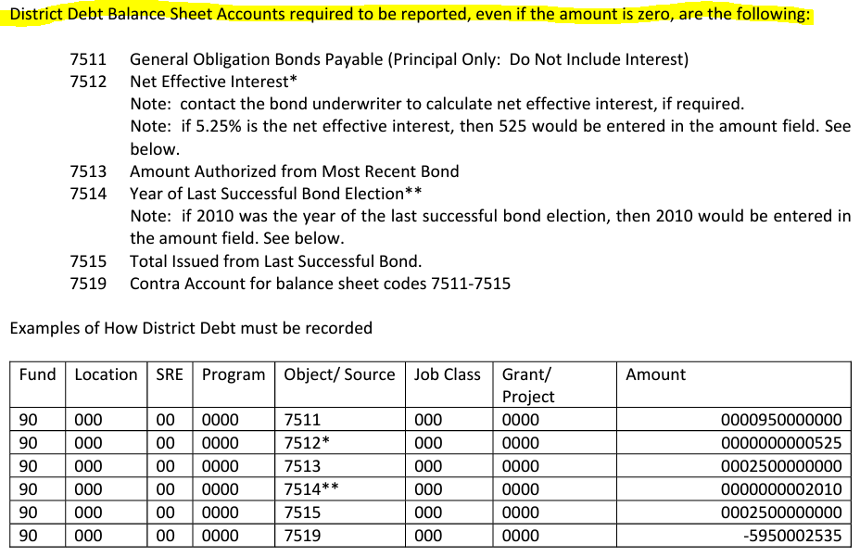
Fund 90 - For Reporting Purposes Only
Fund 90
Not an actual financial fund - used only for reporting purposes
Is required in the Finance December data file even if amounts are zero
District Debt - Appendix R in the Chart of Accounts

Slide 28
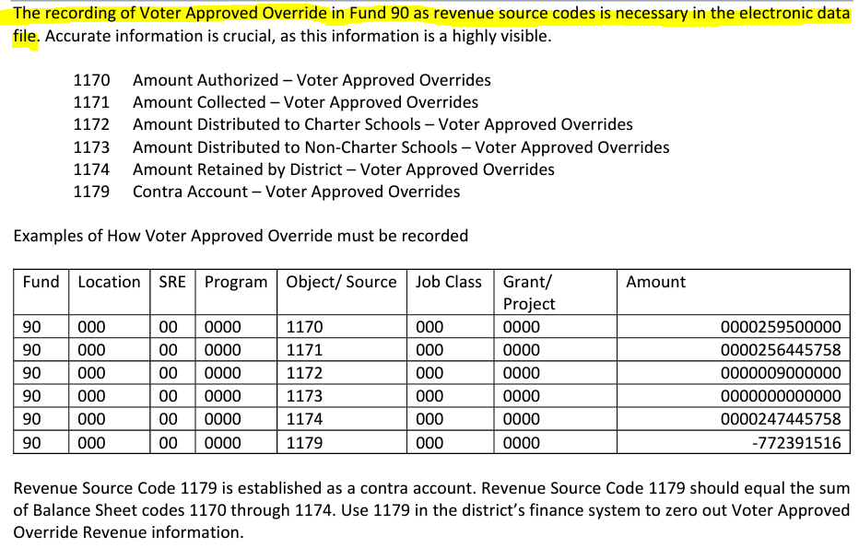
Fund 90 - For Reporting Purposes Only
continued
Voter-Approved Mill Levy Overrides - Appendix R-1 in the Chart of Accounts

Slide 29


Business Rules - Fund 90
Examples
Fund 90 - Errors and Warnings

Slide 30
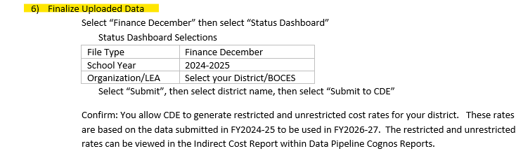
Submitting data to CDE
When all 2nd Tier errors have been resolved, you’re ready to submit your district’s data to CDE. 1st Tier and 2nd Tier errors may take Several days / weeks to clear errors!
Step 6 from the Data Pipeline Quick Reference:
Only the LEA Approver will be able to Finalize Uploaded Data

Slide 31
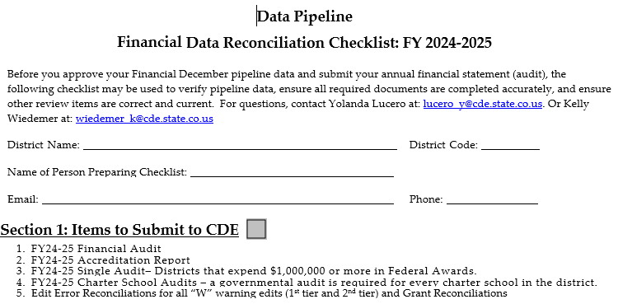
Report Completion &
Reconciliation Checklist
Reconciliation Checklist

Slide 32
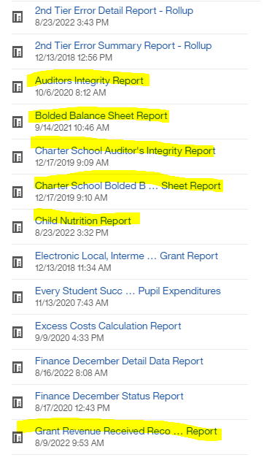
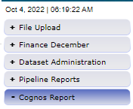

Report Completion & Reconciliation
Run the following reports (in data pipeline-Cognos Reports)
and verify that all information matches the district’s audit:
Auditors Integrity Report
  Including Charter Report if applicable
  The FINAL version must be included in audit
Bolded Balance Sheet
  Including Charter Report if applicable
Reconciliation Reports - Verified & submitted to CDE
Grant Revenue Received Reconciliation Report
Finance December - 1st Tier Error Detail Report
Finance December - 2nd Tier Error Detail Report - Rollup

Slide 33
Report Completion & Reconciliation
Continued
Run the following reports (in data pipeline-Cognos Reports)
and verify Information on the reports is accurate:
Preliminary Maintenance of Effort Report: Provided to Grants Fiscal additional steps may be needed during their review.
Child Nutrition Report: Provided to School Nutrition additional steps may be needed during their review.
Indirect Cost Report: Published on the Indirect cost webpage - once all LEAs are finalized, the FY2024-25 data is used to calculate the rates used in FY2026-27

Slide 34
Data Pipeline
Single Sign-on

Slide 35
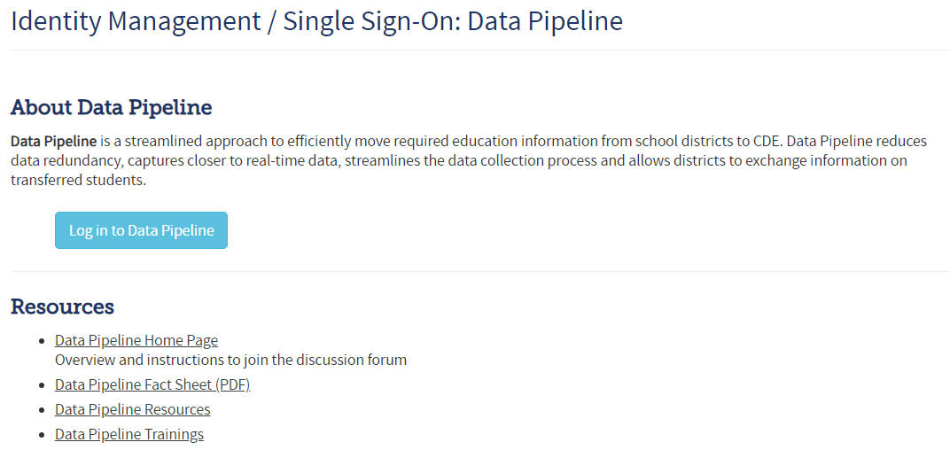
Data Pipeline: Single Sign-on
http://www.cde.state.co.us/idm/datapipeline

Slide 36
Data Pipeline: Single Sign-on
Local Access Manager
CDE does not maintain users/passwords
The Local Access Manager at the district assigns roles for individuals to log-in to the system for the submission.
An individuals can only be assigned to one role
FIN LEA Approver: Has the ability to upload data files, review cognos reports and Finalize the data submission.
FIN LEA User: Has the ability to upload data files and review cognos reports. Is not able to Finalize the data submission.

Slide 37
Data Pipeline: Single Sign-on
Identity Management
CDE does not maintain users/passwords
Webpage with information for the LAM process. https://www.cde.state.co.us/idm
In the Password Assistance section there is a "Request for Assistance" and a "Contact Us" link.
The "Request for Assistance" link will forward the question entered to the LAM assigned at the District/BOCES.
The "Contact Us" link provides a CDE email address to ask the CDE contact a question.

Slide 38
Data Pipeline
Reminders

Slide 39
Data Pipeline Submission
Reminder Due Dates
Due December 31st, 2025 to CDE and OSA
FY 2024-25 Financial Audits with Single Audit if required
Due December 31st, 2025 to CDE
Completion of Finance December submission
Assurances for Financial Accreditation
Reconciliation Reports
  1st Tier Error Detail Report
  2nd Tier Error Detail Report
  Grant Revenue Reconciliation
Where Do I Send My Audit? (for details)

Slide 40
Data Pipeline Submission
Reminder Extension
A District may request a 60-day extension from the Office of the State Auditor.
Note, extension request must be submitted by December 31, 2025
Request an Extension Form: https://apps.leg.co.gov/osa/lg
CDE honors extensions granted by OSA; send CDE a copy of the approved extension request: schoolfinance@cde.state.co.us

Slide 41
Data Pipeline Submission
Reminders
FY 2024-2025 Audit and Financial December Pipeline Deadlines
  December 31st for districts that do not require an extension
  additional 60 Days for districts that have an approved OSA extension
Several districts missed the deadline this year
  We recognize that this has been a challenging year in many aspects
  Now is the time to proactively work to ensure deadlines are met next year
Districts should work with their auditor to ensure statutory submission deadlines are met
  The contract between the district and auditor should articulate statutory deadlines
  Consideration should be given to include interim deadlines, e.g. draft for review by district
  Contract could include expectations for support with Financial December Data Pipeline submissions
  Consideration should be given to include consequences for late submission by the auditor
  Communicate with your Auditor journal entries made to pass 1st Tier and 2nd Tier errors, these may change the trial balance.
    Any changes should be initiated in the general ledger, for the data pipeline file to be recreated.

Slide 42
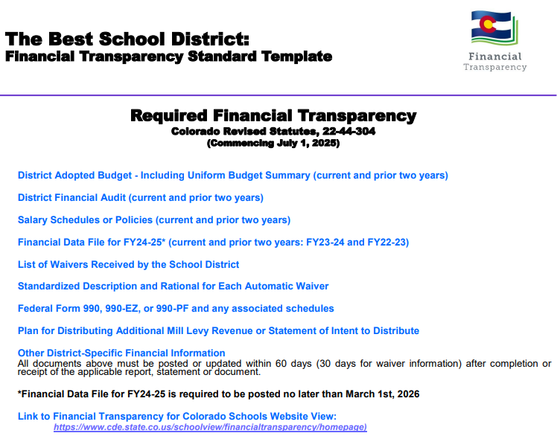
Data Pipeline Submission
Financial Transparency requirements
http://www.cde.state.co.us/cdefinance/sffinancialtransparency

Slide 43
About PSFU
Sheldon Rosenkrance - Chief District Operations Officer
Jennifer Okes - Special Advisor District Operations
Corey Evans - School Finance Executive Director
Tim Kahle - School Finance Program Director
Yolanda Lucero - Fiscal Data Coordinator
Kelly Wiedemer - Fiscal Data Analyst
Kim Reeves - Government Finance Analyst
Tabitha Tyree - School Finance Senior Analyst
Katherine Prter - School Finance Program Manager
Glenn Gustafson, CPA - Part-Time School Finance Program Manager
School Finance Contact Page
Ack! Who do I contact about what?!
Visit the PSFU Contacts page and see “Contact for questions about….”

Slide 44
Any questions?

