Slide 1
Gifted Education Requirements for Charter Schools
Highlights of Rules and Identification Criteria Applicable to Charters
Topic Based Webinar, March 14, 2017
Nikki Myers

Slide 2
Presenters
Nikki Myers
Community Member, Gifted Education State Advisory Committee
Academy Director (founding principal), Academy for Advanced and Creative Learning
Member, League of Charter Schools
Member, & Communications Governor, Colorado Academy of Educators for the Gifted, Talented, and Creative
Mentor, Administrators Mentoring Cohort, Schools of Choice Unit
Notes:
INSERT POLL - Who is in the audience?

Slide 3
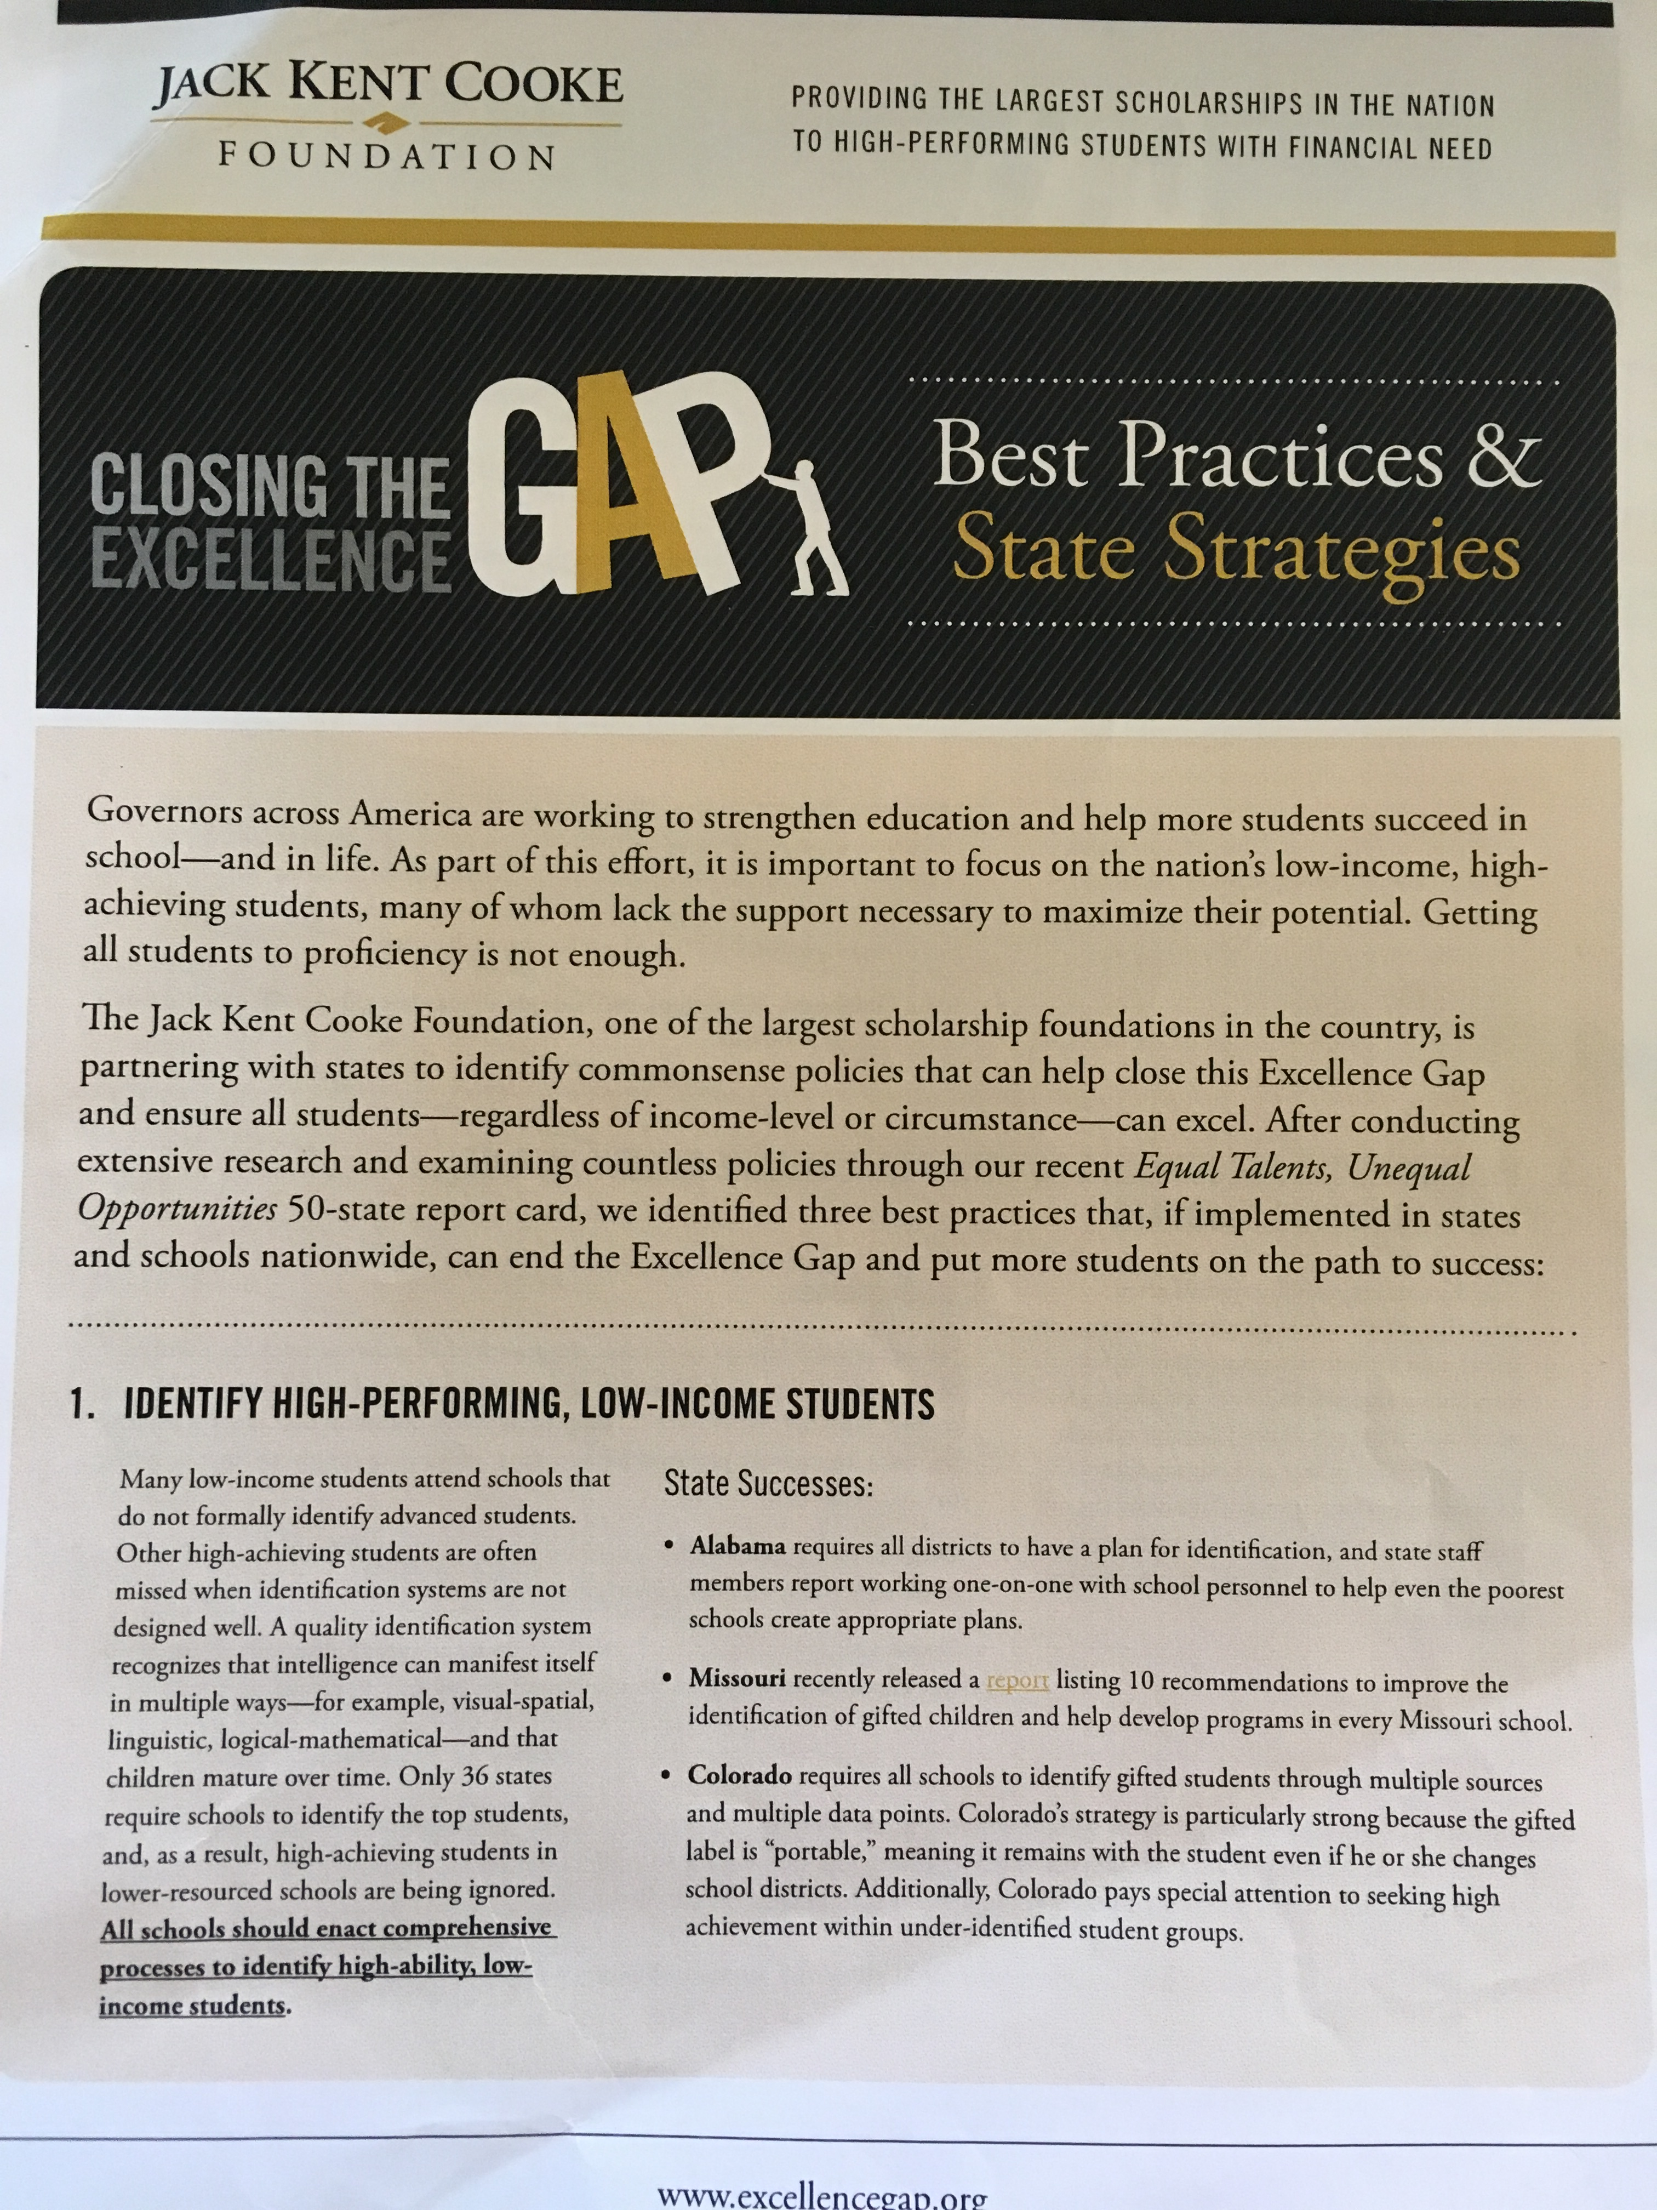
Colorado
Jack Kent Cook Foundation
“Colorado requires all schools to identify gifted students through multiple sources and multiple data points. Colorado’s strategy is particularly strong because the gifted label is “portable,” meaning it stays with the student even if he or she changes school districts. Additionally, Colorado pays special attention to seeking high achievement in under-identified student groups.”
-www.excellencegap.org, recent publication
Identified Nationally with Best Practice

Slide 4
Topics
Legislation
Exceptional Children’s Act (ECEA) and ESSA
HB7-1244 into HB14-1102
Updated Rules, 2015
New in 2015 Rules
Referrals & 30 Day timeline
Assessments & Review Team
Portability
Body of Evidence
Next steps

Slide 5
Why are we doing this?
Does “all kids” mean all?
Notes:
Identification of giftedness ensures that appropriate programming is provided to meet the academic and affective needs and post-secondary outcomes of identified gifted
students. Federal and state statute defines “giftedness” with recognition that this is an area of learning that falls outside typical needs, and into an ‘exception’
category. Therefore, not all students are “gifted”, just as not all students have a learning disability. These students have specific needs that cannot or may not be addressed without adjustments and differentiation provided.

Slide 6
Legislation: Definition
State Definition:
"Gifted and talented children" means those persons between the ages of four and twenty-one whose abilities, talents, and potential for accomplishment are so exceptional or developmentally advanced that they require special provisions to meet their educational programming needs.
Children under five who are gifted may also be provided with early childhood special educational services. Gifted students include gifted students with disabilities (i.e.
twice-exceptional) and students with exceptional abilities or potential from all socio-economic and ethnic, cultural populations.
Gifted students are capable of high performance, exceptional production, or exceptional learning behavior by virtue of any or a combination of these areas
of giftedness: General or specific intellectual ability, Specific academic aptitude, Creative or productive thinking, Leadership abilities, Visual arts, Performing
arts, Musical or Psychomotor abilities. –Colorado
Notes:
Clare:
1- Training should take place prior to school starting
2- Orientation in first two weeks
3- Self-Assessment-in the first month of school
4- Review of Annual Goals & Performance Plan- first month of school : debrief the self-assessment and develop their coaching plan for the year/first semester
5-Mid-Year Review (formative)- Before 2nd semester (Nov/Dec)
6- Evaluator Assessment- Data collected throughout the school year- NOT JUST IN THE SPRING- through coaching and data collection
7-End of Year Review- Late Spring – this can depend, some may bump this up in order to determine positions to fill for next year (you’ll probably already know the answer to that question, but it’s best practice to have a formal evaluation with a teacher before posting their job)
8- Final Effectiveness Rating- Late Spring
9- Goal-Setting & Performance Planning – Before end of school year
Which of these components have you completed this year? INSERT POLL

Slide 7
Legislation
ESSA- Every Student Succeeds Act (federal)
New mentions of gifted students’ needs
National Association for Gifted Children highlights ESSA: http://www.nagc.org/sites/default/files/Advocacy/Q%2BA%20on%20ESSA%20(web).pdf
Colorado’s State Plan
Exceptional Children’s Act (ECEA)
HB7-1244 into HB14-1102
Notes:
Charter schools in Colorado, as providers of free public education, are
created to meet the needs of students in innovative and alternative ways.
While waivers provide opportunties for innovation, a school cannot waive
provisions of the Exceptional Children’s Education Act (ECEA), which
include the education of gifted students. These provisions apply to all
traditional public and charter public schools. Charter schools should be in
collaboration and communication with their Authorizing Unit (AU) and its
gifted programming plan. Former identification practices were outlined by
HB7-1244. Current identification procedures were required by HB14-1102 and
were clarified in 2015 ECEA rules. The criteria and areas of identification
from prior years did not change. Non-compliance can affect charter
agreements, cause Office of Civil Rights complaints, and create compliance
issues for the AU until all of its schools are in compliance.

Slide 8
Gifted Identification Guidebook
https://www.cde.state.co.us/gt/idguidebook

Slide 9
Legislation Updated Rules
Updated Rules, 2015
Referrals and nominations from a variety of sources (teachers, parents, outside community members)
30 Day timeline to respond with next steps
Assessments should support traditionally underrepresented populations
Review Team with a trained person
Determination letter given to parents, placed in cumulative folder
Low score on one assessment cannot limit; full body is required
Portable across all Colorado Districts and schools.
“If the receiving district finds the body of evidence to be incomplete, the receiving district shall consult with, as practical, the former district, parents, and student and re-evaluate the identification determination.”

Slide 10
Coding Gifted Identification
Beginning with the 2016 fall pupil count, gifted student coding will align to the areas of ECEA gifted identification. A district may choose to use the new coding for the 2016-17 school year. All districts must use the new coding for the 2017-18 school year.
p. 20, Gifted Identification Guidebook

Slide 11
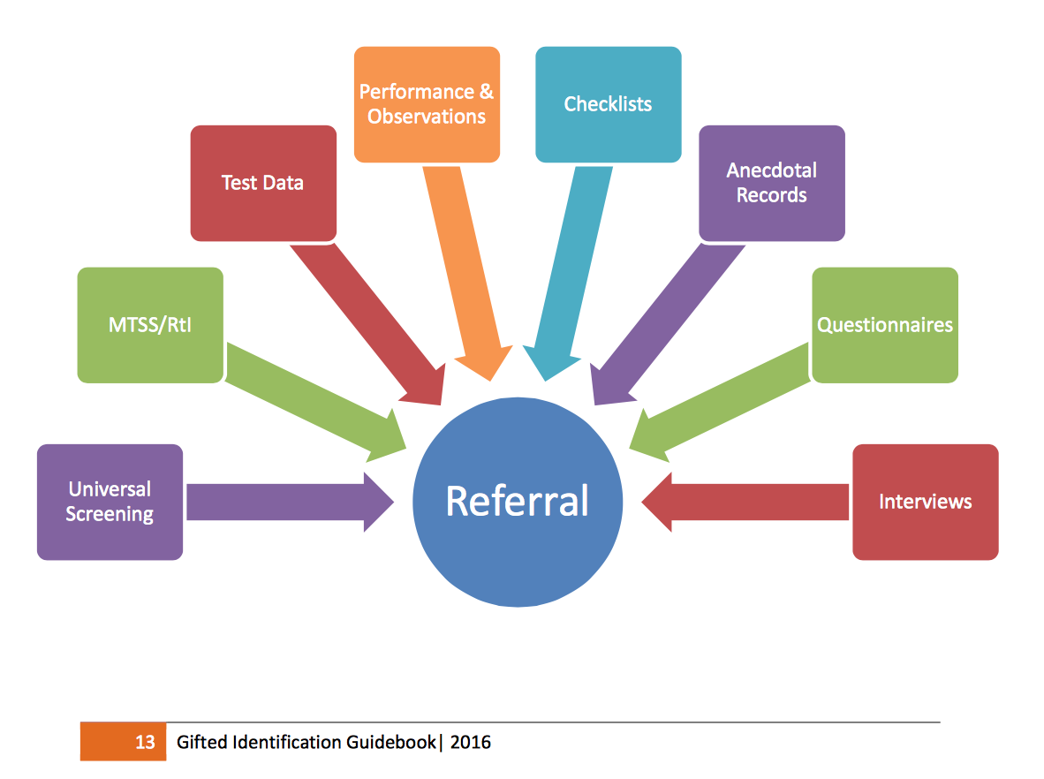
Body of Evidence: Screening Tools

Slide 12
Body of Evidence: Criteria
Criteria
95th percentile and above on norm-referenced standardized test
Distinguished, Advance, Exceeds required for qualitative tools, portfolios, performance assessments, and criterion-referenced tests
Criteria are descriptors for exceptionalities: NOT cut-off scores (no one score limits)
Additional data: anecdotal records, interviews, observations, characteristics, checklists
“Purple Pathway”
State Guidebook

Slide 13
Gifted Identification Assessment

Slide 14
Body of Evidence
BOE
Area of giftedness from the Colorado Definition
“Non-verbal” is not a category
Quantitative + Qualitative required
Quantitative:
Norm-referenced (cognitive and achievement
Criterion-referenced (state tests, curriculum-based measures…)
Qualitative:
Validated-rubrics, performances, interviews
Note about “elite” athletics, with national rankings

Slide 15
Specific Academic Aptitude

Slide 16
Specific Academic Aptitude: Cognitive + Achievement

Slide 17
General Intellectual Ability
Role of Review Team is key.
Underrepresented populations could be missed without this area of recognition.
Notes:
p. 27, Gifted Identification Guidebook: “Students may qualify in the area of general intellectual ability with a score of 95th percentile or above on one or more batteries of a cognitive test. The determination team must collect and review additional data for the body of evidence to develop the student’s learning profile. A gifted determination based solely on a cognitive assessment score, without any other qualifying data, is the exception. A review team should use their professional judgment to determine if identification is appropriate by examining supplemental or non-traditional information collected through interviews, observations or performances beyond the academic content areas. Students from underrepresented populations may not demonstrate gifted abilities through the use of traditional achievement data. When only cognitive ability assessment data meet criteria in a body of evidence (95th percentile or above), the review team may determine that the student is identified with general or specific intellectual ability. This meets portability requirements.”

Slide 18
“Talent Pool”
“A talent pool is defined as a group of students who demonstrate an advanced or even exceptional ability in a particular area, but at this time do not meet the criteria for gifted identification. Often students in a talent pool are provided advanced or gifted programming services. As students are presented with additional levels of challenge and rigor, increased achievement may occur. A student may meet the criteria for gifted identification at a later date.”
– p. 18, Gifted Identification Guidebook
Notes:
p. 18: “AUs may determine if a talent pool is used and the length a time in which a student participates. Selection for a talent pool is not just being included on a list for future identification assessment. Rather, it is inclusion into appropriate differentiated programming options necessary to develop an academic or talent aptitude and promote achievement and growth. Research indicates that some students talented in the arts may not have enough experience and talent development to meet criteria until middle school. This suggests that not all students will stay in the talent pool for the same amount of time.”

Slide 19
Next Steps
Common recognition in the building: all means all
Every teacher is familiar with Colorado’s definition of “gifted”
Review Team is identified.
Someone on the team has training in gifted education. This could include a district/AU representative.
Endorsement requirements have changed.
See your AU for requirements.
“A review team should include at least one person trained or endorsed in gifted identification and programming. Training may include work towards an endorsement or the completion of specific courses in gifted education. The AU determines whether an educator is sufficiently trained in gifted education.” p. 17, Gifted Identification Guidelines

Slide 20
Next Steps (continued)
Parents/Guardians’ Voices are Validated
The AU’s comprehensive program plan describes how parents are informed about access to identification procedures. Parents often provide valuable insight into their child’s strengths, abilities and interests. Primary points for parental involvement are referral and adding important information to the body of evidence. This might include parents completing a questionnaire or checklist or participating in an interview. After thirty years of research at the Gifted Development Center, Dr. Linda Silverman states, “Parents are excellent identifiers of giftedness in their children.” [emphasis added] Additionally, early childhood identification procedures, because of age and lack of contact with the school, have to consider parental feedback more carefully (VanTassel-Baska, 2000). In Early Access, parents will have more involvement in terms of initiating referral and data collection in accordance with the AU’s Early Access procedures [emphasis added].” p. 17, Gifted Identification Guidebook
Contrary to popular belief, not every parent thinks their child is “gifted”. When given appropriate criteria or checklists, parents are often very accurate.

Slide 21
Next Steps (ALP plan)
Writing an Advanced Learning Plan (ALP)
State criteria is used
Review Team makes the determination
The ALP takes the student’s Learning Profile into account.
Strengths-based, not deficit-based. This is not the time to make that kid get better at a weak area with the strength area. This is the time to help that child grow in the strength area.
Student-choice is included. The student should be heavily involved in the selection of goals.
An ALP is done with the student, not to the student.
The ALP takes the school’s programming capacity into account.
The ALP should not be something extra the student has to do: it shouldn’t feel like a penalty to now have more work to do just because the child was identified
The ALP should identify what the teacher/s will do to support the student in his/her identification area. That support will vary depending on the type of identification and the school options available, but at a minimum it should encourage and celebrate the student’s strengths, and clear hurdles/provide flexibility, etc. for that student to grow in that area.
The ALP goals can change over the course of the year, as the student grows, adjusts skills and passion areas, et cetera.

Slide 22
Next Steps (cumulative folder)
The student’s cumulative folder maintains the most recent updates.
Determination letter: identified, identified for Talent Pool, not identified, current ALP included, etc.
The folder clearly identifies information so that any receiving school can maintain portability and see the criteria that was used to identify or not, and can update their own provisions for the student after seeing what was available at the previous school and what is/is not available at the new school and needs to be adjusted.

Slide 23
Note: Early Access
In order to utilize Early Access legislation, an AU must have an approved application on file.
That file determines identification procedures.
4 years old by October 1st for K; 5 years old for 1st grade
97th percentile is part of the application criteria
By September 30th of the enrollment year, the Advanced Learning Plan for the EA student in grades K and 1 must be completed and verified to be counted in October Enrollment.
Early Access Fact Sheet
Early Access is for highly advanced gifted students, not the majority of young/preschool gifted students. This is a small, specific population.

Slide 24
Tips for Teachers
“Gifted” does not equal success in school.
Some of your gifted students are not your students with great grades.
Colorado recognizes that a few students under ECEA law have two areas of exceptionality: they can be twice-exceptional… they can have both giftedness and an area of IEP (special education) or Section 504 (accommodation) for a disability.
This makes the role of the Review Team and a full Body of Evidence critical. One teacher’s view cannot limit an identification.
How “complex” is your instruction?
Check out Dr. Karen Hess’ Cognitive Rigor Matrices for ways to differentiate and provide challenging learning objectives.

Slide 25
Resource: Free eTips for Teachers
The Colorado Academy of Educators for the Gifted, Talented, and Creative has published a series of eTips designed to be bite-sized professional development articles emailed to, or printed for, teachers over the course of a school year.
These are free for districts and schools to use.
These are created by Colorado’s gifted education experts for use in Colorado schools.
Email caegtcinfo@gmail.com to gain access.
Visit caegtc.org

Slide 26
Needed: Gifted Education Representatives
Do you know someone knowledgeable about gifted education in your congressional district?
The Gifted Education State Advisory Committee (GE-SAC) is seeking applications from individuals in Congressional Districts interested in providing input about issues and strengths in gifted education, and exploring timely educational topics impacting gifted students. The Gifted Education State Advisory Committee is a council of citizens appointed by the State Board of Education. The Committee discusses timely topics of importance to gifted student education. GE-SAC provides the State Board of Education recommendations and information about ongoing and emergent needs related to the education of gifted learners.
See a list of current vacancies

Slide 27
Questions

Slide 28
Contact Information
Nikki Myers
Academy for Advanced and Creative Learning
719.434.6566
Colorado Department of Education, Office of Gifted Education
Phone: 303-866-6694
Questions

