Slide 1
Evaluation Practices
A mid-year check in on the evaluation cycle, common challenges, and
next steps
Topic Based Webinar, February 21st, 2017
Jennell Verow & Clare Vickland

Slide 2
Presenters
Jennell Verow
Educational Consultant
Clare Vickland
Director of Student Services, Colorado Charter School Institute
Notes:
INSERT POLL - Who is in the audience?

Slide 3
Topics
Evaluation Cycle Best Practices
Goal Setting
Timelines
Coaching
Observations
Feedback
End of Year Evaluations
Next steps
PD Plan for next year

Slide 4
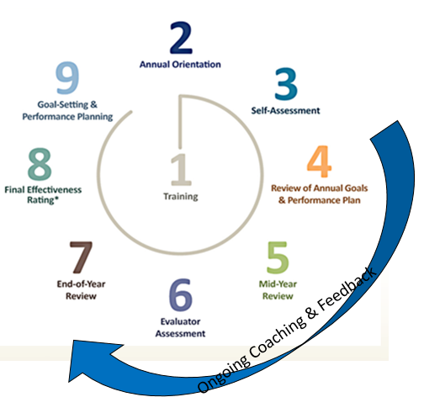
Evaluation Cycle
Notes:
Clare:
1- Training should take place prior to school starting
2- Orientation in first two weeks
3- Self-Assessment-in the first month of school
4- Review of Annual Goals & Performance Plan- first month of school : debrief the self-assessment and develop their coaching plan for the year/first semester
5-Mid-Year Review (formative)- Before 2nd semester (Nov/Dec)
6- Evaluator Assessment- Data collected throughout the school year- NOT JUST IN THE SPRING- through coaching and data collection
7-End of Year Review- Late Spring – this can depend, some may bump this up in order to determine positions to fill for next year (you’ll probably already know the answer to that question, but it’s best practice to have a formal evaluation with a teacher before posting their job)
8- Final Effectiveness Rating- Late Spring
9- Goal-Setting & Performance Planning – Before end of school year
Which of these components have you completed this year? INSERT POLL

Slide 5
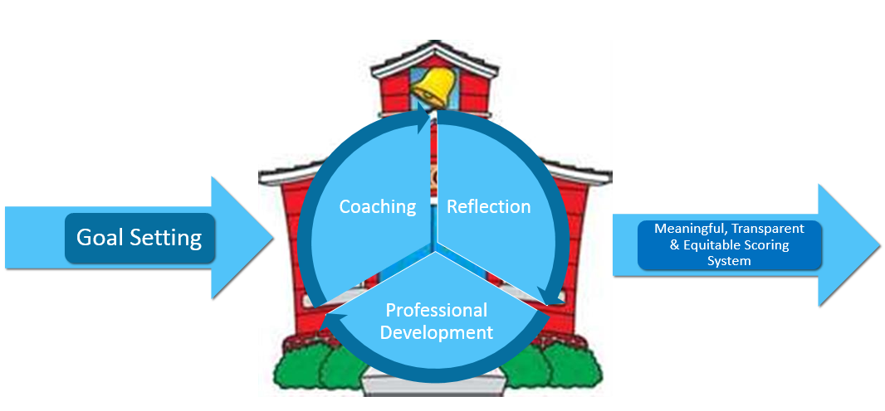
Best Practice
Notes:
Clare:
Utilizing evaluations that prompt continuous goal setting in areas teachers want to work on, paired with professional development supports and coaching in these areas
Using multiple types of data to bring accurate context and meaning to evaluations
Explicitly connecting teacher evaluations to the larger context of school setting
Opportunity for self-evaluation and reflection
Meaningful, transparent & equitable scoring systems

Slide 6
Questions to Consider
Big Picture:
Alignment to mission/vision?
Beliefs about learning and student engagement?
Priorities?
Notes:
Clare:
When designing your evaluation system, consider how it aligns to the unique aspects of your charter school.

Slide 7
Sample Evaluation Protocol/Cycle
Initial PD/Onboarding
Annual Goal Setting (SMART)
BOY Goal Meeting (Aug/Sept)
MOY Goal Meeting (Dec/Jan)
EOY Goal Meeting (before end of evaluation cycle)
Data Collection (throughout school year)
Walkthroughs
Check in meetings
Formal Cycle
Pre Observation Meeting
Formal Observation
Post Observation Feedback Meeting
Formal Evaluation Completion and Check in
Notes:
Jannell- For Admin to use with their staff

Slide 8
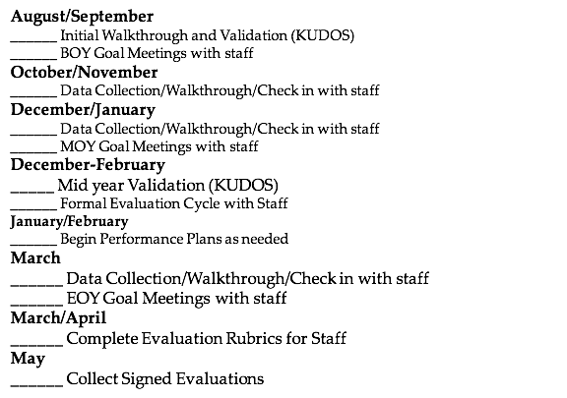
Evaluator Sample Checklist
Notes:
Jannell:

Slide 9
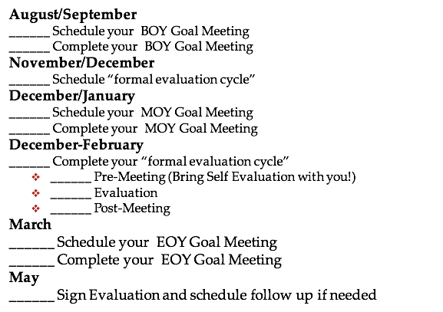
Teacher/Staff Sample Checklist
Notes:
Jannell: Sample to give to their teachers

Slide 10
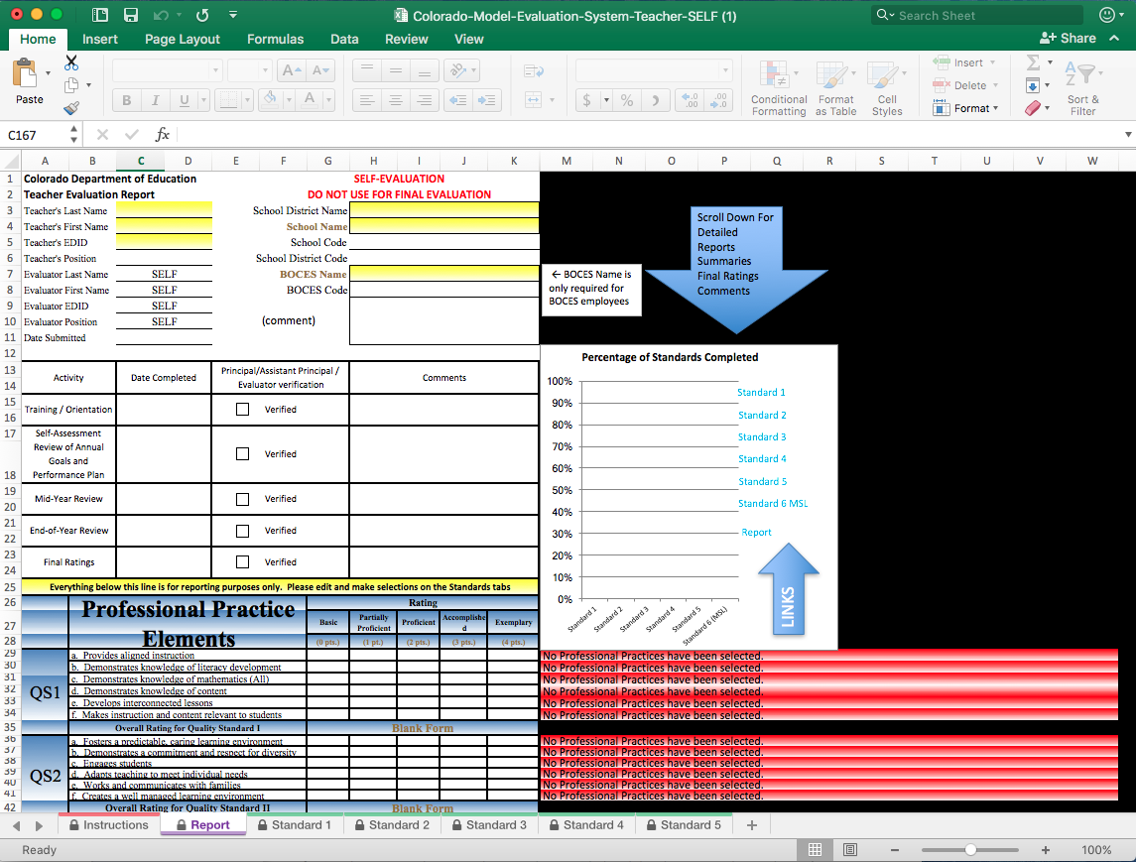
Self-Evaluations
Opportunity to be a self advocate
Opportunity for educators to be thoughtful, reflective and honest about their professional practice.
Opportunity to provide own perception of strengths and growth areas.
“It is considered “best practice” to not only complete a self evaluation but also to engage in a verbal, reflective conversation (with evaluator) about their craft and what they reflected on when doing their self assessment.”
Notes:
Jennell:
“The principles of adult learning show that when people use self-assessment in professional development, they are more likely to sustain their learning, in more disciplined ways, than when evaluators alone enact professional development requirements.
“By engaging in a joint and reflective conversation about a teacher’s craft and practice, goal setting and performance planning are more targeted.
“In this way, teachers and evaluators are working together collaboratively to identify areas of growth and support that are targeted to the real needs and goals of the teacher.”

Slide 11
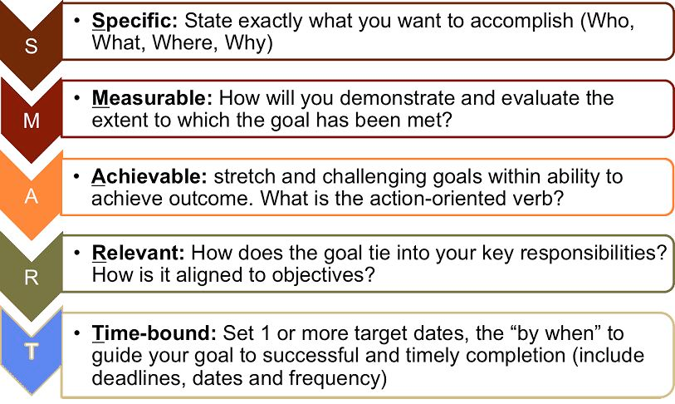
Goal Setting
Keeping Goals SMART!
Notes:
Jannell

Slide 12
Observation Feedback
5 Errors to Avoid:
Error: More is better
Error: Lengthy written evaluations drive change
Error: Just tell them; they’ll get it
Error: State the concrete action step and the teacher will act
Error: Teachers can implement feedback at any time.
Notes:
Jennell:
from leverage leadership pg. 79
Truth: Less is more….chunk your feedback into bite sized, digestible pieces
Truth: Face to face is better! this does work for some… a select few. Think of those students who learn best by long verbal lectures… does it work for all?
Truth: Just like our students: If they dont do the thinking… they wont internalize what they learn. Its all about metacognition
Truth: Teachers need that guided practice… allows teachers to fumble through the process, make mistakes before they are in front of students again. Think of doctors during their residency…
Truth: this serves 2 purposes: transparent expectations and expose natural timelines for implementation. Can this be done in one lesson or over time?

Slide 13
Observation Feedback
6 Steps to Effective Feedback:
Provide precise praise.
Start off session/meeting with one or two pieces for precise praise from your observation.
Probe.
Ask a targeted open-ended question about the core issue.
Identify problem and concrete action step.
Identify the problem and state a clear, measureable, observable action step that will address this issue
Practice.
Role play or simulate how the teacher could have improved the class.
Plan ahead.
Design or revise upcoming lesson plan to implement this action.
Set timeline.
Determine time by which the action will be accomplished.
Notes:
Jennell:
from leverage leadership pg. 78
All about student achievement and reaching goals!
Try to provide praise based on previous goals or action steps… this helps validate the teachers hard work and substantiate the importance of those action steps.
Narrow the focus and prioritize the area in which you will establish an action step.
The goal here is get the teacher to articulate the problem and action step on his/her own. Consider scaffolded levels of support here…
Probe
Ask scaffolded questions
Present data/evidence
When all else fails… tell
“Repetition is the KEY to learning”
Once the action step is identified and practiced- it is locked in place and planned for
Accountability

Slide 14
Observations
Opportunities for Coaching:
Setting Priorities
How long?
How often?
Differentiation?
Resources
Template/Protocols
Who?
Rater Agreement
Notes:
Jannell:
http://files.eric.ed.gov/fulltext/ED532068.pdf

Slide 15
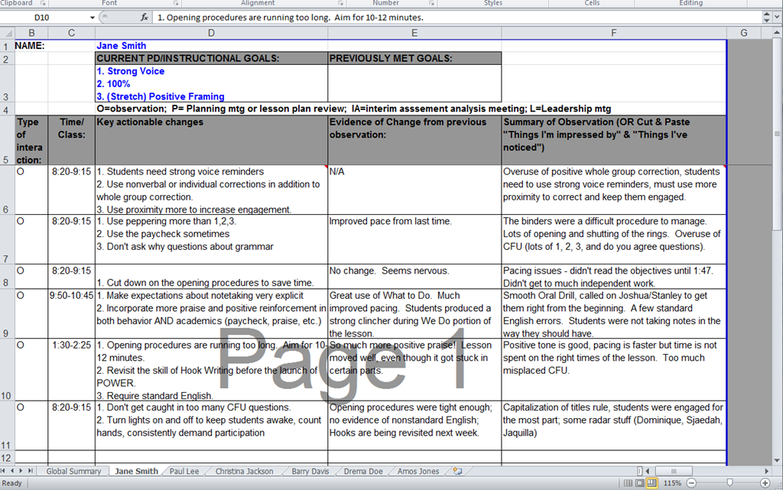
Notes:
Jennell
Sample coaching tracker

Slide 16
Rater Agreement
Absolute Agreement Percentage (consideration)
number of times raters agree on a rating divided by the total number of ratings.
Training Considerations:
Big Picture (purpose/frequency/feedback)
Understanding of Rubric
Identify biases
Common rater errors
Similarity (teacher A is similar to teacher B, so…)
Benefit of the Doubt (Halo ratings)
Confirmations (pre-judgements)
PRACTICE and DISCUSS
BEST PRACTICES!
Notes:
Best Practices:
Avoid subjective terms… use behaviors
Do not rate while observing
record evidence that is relevant
use rubric language… not your “gut”
if no evidence...make no inference
rate performance on each idicator/standard seperately

Slide 17
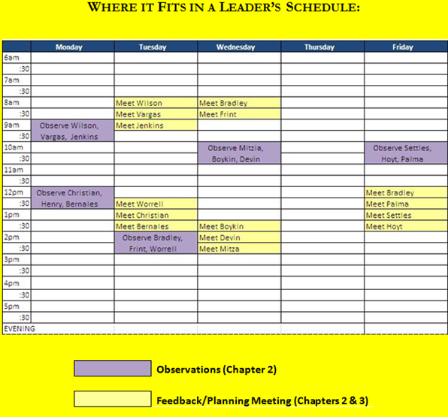
Fitting it all In
Notes:
Jennell
Sample schedule where leader observes 15 teachers, none for a full lesson, each week and has a 30 minute feedback meeting with them afterwards.

Slide 18
Performance Improvement Plans
Step 1: Document Performance Issues
•Employee information, Relevant dates, Description of performance discrepancy or gap, Description of expected performance, Description of actual performance, Description of consequence, Plan of action, Signatures of the manager and the employee, Evaluation of the plan of action and overall performance improvement plan
Step 2: Develop an Action Plan
•Establish a provisional action plan for improvement, which may be adjusted based on employee feedback in the meeting
•SMART goals
•Draw on the job description and HR policies to clearly identify the
performance or behavioral issues and expectations.
Step 3: Review the Performance Plan
Society for Human Resource Management
https://shrm.org/templatestools/howtoguides/pages/performanceimprovementplan.aspx
Notes:
Jennell:
Usually goes hand-in-hand with “red-flag” strategies
PIP timeline (60-90 days)
Some people use PIPs with the intention of firing someone, I’m going to talk about the ones used to help improve performance. Be clear with legal council about what your intention is when drafting PIPs (improve or gather more evidence to let someone go). We are at at-will state so you don’t need a PIP – evaluate if this person can/should be in your building for 60-90 days.
-Need to have the resources to put the coaching in to this person, detail that in the plan. If you don’t follow through with your end you could get yourself in trouble
-CSI Schools: Mountain States HR services
-Other charters, if HUB clients, they provide HR services as well
-If none of these, can ask district or legal council for support

Slide 19
Performance Improvement Plans
Step 4: Meet with Employee
Step 5: Follow Up
Step 6: Conclusion
•If the employee is doing his or her best but just cannot meet one or more objectives, the employer may agree to extend a PIP for a few more weeks or months.
•If the employer determines in retrospect that the objectives were too hard or not completely within the employee’s control, the employer may decide to either extend the PIP or end the PIP due to the progress that was observed.
•If the employer determines the employee is not a good fit or is not really trying to improve even after all this effort, then the employer should consider job reassignment, transfer or demotion or terminate employment based on the specific circumstances.
•
Society for Human Resource Management
https://shrm.org/templatestools/howtoguides/pages/performanceimprovementplan.aspx

Slide 20
Use of Data
Why?
Best Practice
SB191
Objective
Support school goals
Increased buy-in
Notes:
Clare:
Even though many charters waive out of 191, still must meet “spirit of the law” with waiver replacement plan - data must be included
Objective- vs subjectivity of observations/other data sources
Can be used to support the goal of the school - tie data to meeting school-wide goals
Data shows that when teachers are engaged in selecting the measures of student learning they will be held accountable for, they are more likely to use data to inform their instruction than those who do not participate in the selection of data. ENGAGE TEACHERS whenever possible. Also need to engage Board

Slide 21
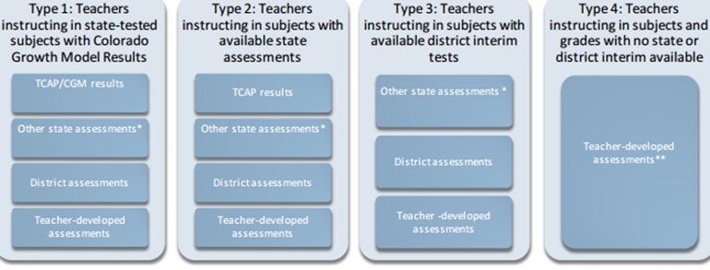
Use of Data
What?
Notes:
Clare:
Lots of options for assessment data that can be used. Here are examples that CDE gives in their guidance document but if you have a waiver you have a LOT more options. What are some other creative data measures that could be included? (share out-POLL)
Parent satisfaction surveys?

Slide 22
Use of Data
How?
Collaborative process with stakeholders
Mission/Vision
School-wide goals
Assessment inventory
Collective vs. individual
Notes:
Clare:
Mission/vision of school - what do you stand for? What makes you unique?
School-wide goals – UIP or strategic plan
Assessment inventory – what types of data are we collecting and what is the value of each?
Collective vs. individual – how much do we want to be collective data (ex: ACT) vs. individual teacher data (class MAP data) ? And what does this say about your culture?

Slide 23
EOY Evaluations

Slide 24
Next Steps
Professional Development Planning for Next Year
Using the data from evaluations
Setting key initiatives & school-wide goals
Setting individual goals
Mentoring/coaching partners & opportunities
Scheduling-daily and monthly
Outside PDs
Budget
Resources

Slide 25
Questions

Slide 26
Contact Information
Jennell Verow
Educational Consultant
jennellverow@gmail.com
Clare Vickland
Director of Student Services
CO Charter School Institute
clarevickland@csi.state.co.us

