Slide 1
Purple Star Schools
GAINS Access

Slide 2
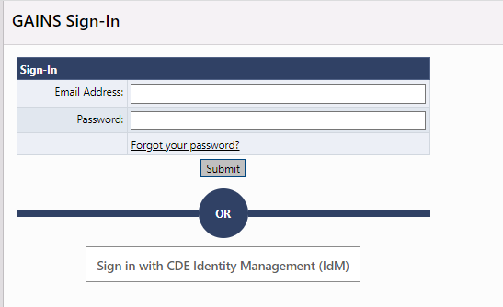
Step 1: GAINS Access
Purple Star Schools
To access GAINS, you will need to complete the Intent to Apply prior to accessing GAINS.
Based on the form, CDE will setup users within GAINS.
Once CDE creates the users, each user will receive an email from GAINS to setup their password.
Once the password is created, users will sign into GAINS through the Native Authentication.

Slide 3
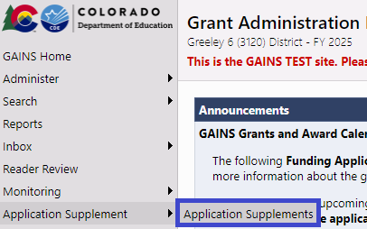
Step 2: Find the Application Supplements
Purple Star Schools
Once logged in, hover over Application Supplement in the left navigation menu and select, Application Supplements.

Slide 4
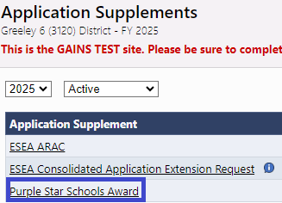
Step 3: Locate the Purple Star Schools Award
Purple Star Schools
Select the Purple Star Schools Award

Slide 5
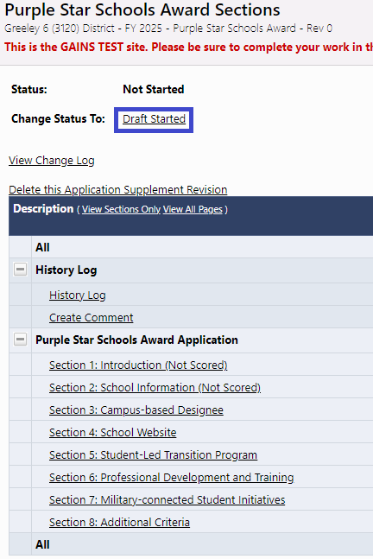
Step 4: Start the Purple Star Schools Award
Purple Star Schools
Be sure to change the status to Draft Started.

Slide 6
Step 5: Complete the Purple Star Schools Award
Purple Star Schools
Go through and complete each page within the GAINS platform.
Every item with an asterisk (*) is required and will prevent submission of the application until the asterisk has been fill out.
Any validation messages found on the sections page will need to be addressed.

Slide 7
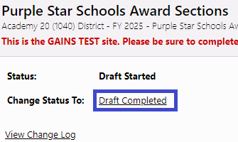
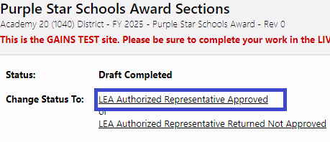
Step 6: Submit the Purple Star Schools Award
Purple Star Schools
Once the validation messages are addressed and you are ready to submit, change the status to Draft Completed.
Once in Draft Completed, the LEA Authorized Representative will be notified that they need to approve the application. The LEA Authorized Representative will then need to login to GAINS and approve the application if there are no changes.
The application is officially submitted to CDE once in, LEA Authorized Representative Approved status.

Slide 8
Contacts
Purple Star Schools
Program Questions:
Christina Monaco, Field Services and Supports Executive Director
303-981-6513 | Monaco_c@cde.state.co.us
GAINS Application System Questions:
Kim Burnham, Competitive Grants and Awards Supervisor
720-607-1495| Burnham_k@cde.state.co.us
Michelle Prael, Senior Consultant
720-545-7368 | Prael_m@cde.state.co.us

