Slide 1
DTC Kick-Off
Meeting One conference number: 1 866 783-5479
Dial *# to mute and unmute your phones.
Please type your Name and District in the Chat box to check in!
October 12th 2017

Slide 2
Introductions
CDE - Collin Bonner- Bonner_C@cde.state.co.us
Technology Specialist Assessment Unit of CDE.
DRC - Andrew Lenn
Project Manager WIDA ACCESS Assessment
Pearson - Jeramy Dichiera
Field Engineer ATE - Infrastructure and Operations

Slide 3
Colorado Assessments Breakdown
Colorado Measures of Academic Success (CMAS)
CO PSAT
& SAT
WIDA: ACCESS 2.0 for ELLs**
National Assessment of Educational Progress (NAEP)****
& International Assessments
ELA (including CSLA***) and CoAlt ELA (DLM)**
SAT
(11th Grade)**
Math and CoAlt Math (DLM)**
PSAT 10
(10th Grade)*
Science and CoAlt Science**
PSAT 8/9
(9th Grade)*
Social Studies and CoAlt Social Studies*
* Required by Colorado law
** Required by Colorado and federal law
*** Allowed by Colorado law
**** Not administered in Colorado in 2018

Slide 4
Online Assessments
ACCESS for ELLs®
Online test option for districts
CMAS
English language arts and math
Including Colorado Spanish Language Arts
Science and social studies
Social studies assessments will be administered on a sampling basis to one‐third of the schools each year.
CoAlt
science and social studies
CoAlt DLM
English language arts and math

Slide 5
2017-18 Assessment Calendar
Assessment | Grade(s) | Tentative Windows
ACCESS for ELLs® | K-12 | January 8 - February 9, 2018
CMAS and CoAlt: Social Studies | 4¹, 7¹ | April 9 - 27, 2018
CMAS and CoAlt: Science | 5, 8, 11²
CMAS: Math and ELA (CSLA³⁾ | 3-8²
CoAlt: DLM ELA and Math | 3-11 | Aligned to CMAS: Math and ELA schedule
CO PSAT | 9, 10 | April 10, 11 or 12, 2018 April 11 - 20, 2018: Make-up window April 10 - 17, 2018: Accommodations window
CO SAT | 11 | April 10, 2018 April 24, 2018: Make-up test date April 10 - 13, 2018: Accommodations window
¹Grades 4 and 7 Social Studies will be administered on a sampling basis
²See next two slides for early window options
³CSLA is for eligible English learners in grades 3 and 4 only

Slide 6
CMAS Assessment Window
Official window: April 9 – 27, 2018
All elementary and middle school science and social studies administrations must be completed within this window
All school-wide paper-based administrations for math and ELA must be completed within this window
Students requiring paper accommodations in schools utilizing the extended online window options may test at the same time as their peers (this includes CSLA)

Slide 7
CMAS Early Window Options
Math and ELA
To compensate for technology capacity, the math and ELA window can open early for online administrations only
Earliest start date for online math and ELA: March 19, 2018
This is an extended window – total of 5 testing weeks
High School Science
To accommodated high school assessment schedules including SAT, AP, and IB exams, the high school science window can open and close early
Early window options high school:
March 26 – April 13, 2018
April 2 – 20, 2018
This is an early window – total of 3 testing weeks
Districts will be asked at fall administration trainings to notify CDE of intent to participate in early windows by December 15

Slide 8
Social Studies
Individual schools will be sampled once in three years
Sampling plan priorities:
Reduce testing burden
Avoid creating cohorts of social studies students
Minimize the number of students who will test as 4th and 7th graders
Provide state level results that can be compared from administration to administration
See notification in Syncplicity (posted August 15, 2017)

Slide 9
Requirements & District Responsibilities §22-7-1013(6), §22-7-1006.3(1)(d-e)
Each LEP must adopt and implement a written policy by which it decides whether to request the paper form of the state assessments for its students.
Decision must be made in consultation with schools and parents.
Copy of policy must be shared with parents and posted on LEP website before the start of the fall semester.
LEP may make the decision by school or class (i.e., by grade level and content area)
LEP will report to CDE the number of students who will take the paper form. (Indicated prior to initial order deadline.)
Considerations
Technology capacity
Logistics
Must have the grade appropriate calculators for math (grades 6-8)
Paper form always available to individual students as an accommodation.
Online form is also available as an accommodation.
Must commit to meeting the security requirements and accounting for all secure materials
Chain-of-custody documentation and reports/documentation for missing materials

Slide 10
Supporting 3 Platforms

Slide 11
Online Assessment Platforms
Assessment | Test Engine | SIS | Notes
ACCESS for ELLs® |  | WIDA Assessment Management System (WIDA AMS) | Caching server Clients for Windows, Linux, Mac OSX, Chromebooks, iPads, and Android
CMAS |  |  | Caching server available Installable apps for desktop, Chromebooks , Androids, and iPads
CoAlt Science and Social Studies | N/A
CoAlt ELA and Math (Dynamic Learning Maps (DLM)) |  | Educator Portal | KITE client install for each device

Slide 12
Dynamic Learning Maps’ KITE System

Slide 13
CoAlt: ELA and Math (DLM)
Computer-based assessment
Individually administered
Test Administrators/DACs use Educator Portal for student management
Students test using KITE Client
Same window as CMAS (PARCC) ELA and Math
If using the 3-week window (paper-based or online), have the same 3 week window for DLM.
If using the 6-week extended window for the general online assessments, have the same 6-week window for DLM.

Slide 14
DLM’s Administration System: KITE Components
Component | Current Software Version | New Software Version | Next Release date | Notes
KITE Client | 3.0 | 5.0 | September2017 | Auto-update will be prompted when the device is powered on, connected to the internet, and KITE Client is launched.
After the update is downloaded, the user will prompted to restart the KITE Client

Slide 15
New Supported Platforms for KITE
Supported Platforms for KITE Client 2016-17
Windows 7. 8.1, 10 (desktop, laptop)
MAC OS X 10.10 – 10.12
macOS 10.13.0 users must complete a manual update for KITE Client 5.0
Chromebook with Chrome OS
iPad, IOS 9 or 10
Educator Portal Supported Browsers
Firefox 38.7.1 or above
Safari 9.0.3 or above
Internet Explorer 11
Chrome 35 or above

Slide 16
KITE Client Whitelist Settings
Whitelist by domain or IP Address
Domain
*.cete.us
*.s3.amazonaws.com
IP Addresses
Files that Need Access Through the Firewall
kiteclientae.exe
kiteclient.exe
tde.exe

Slide 17
KITE Events
DLM Technical Liaison Webinar
Available now!
Recorded Webinar https://kiteassessments.org/sites/default/files/KITE_files/KITE_Client_Bandwidth_DLM.pdf

Slide 18
KITE Questions?

Slide 19
Data Recognition Corporation’s ACCESS for ELLs 2.0

Slide 20
2017-2018 Timeline
Release | Date
Supported System Requirements for ACCESS for ELLs 2.0 Update | 10/2017
Final Site Technology Readiness Checklist | 9/19/2017
Technology User Guide released | 9/19/2017
INSIGHT secure browser 8.0 and Testing Site Manager 9.2 software | 9/6/2017
WIDA AMS Test Setup Available | 11/28/2017
ACCESS for ELLs 2.0 operational testing window | January 8 - February 9, 2018
Notes:
?

Slide 21
ACCESS for ELLs 2.0 Components
Component | Current Software Version | Next Release date | Notes
WIDA Assessment Management System (WIDA AMS) | NA | Available | Device Toolkit is enhanced.
Testing Site Manager (TSM) Caching Software | v9.2 | 9/6/2017 | Auto Update if the option is selected in the web interface.
INSIGHT Test Engine | v8.0 | 9/6/2017 | Auto Update if auto update is selected in the Device Tool Kit

Slide 22
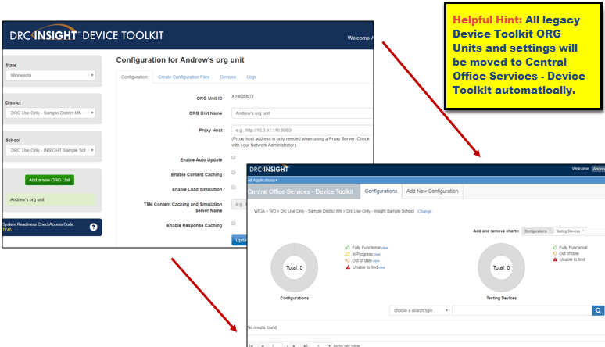
WIDA AMS Updates
Device Toolkit Enhancements

Slide 23
WIDA AMS Updates
Device Toolkit Enhancements
It provides easy monitoring of your TSM devices and testing devices
ORG Units are now called Configurations
Device Toolkit Dashboard allows you to see all Configurations cross your district
All of the TSMs previously defined in your ORG Units are defined in the new configurations
Configuration>Locations> to turn on Content Caching (required) and Response Caching (optional)
Documentation can be found here:
https://www.wida.us/DeviceToolkit.aspx

Slide 24
New Whitelisting Information
Address | Ports
http://wida-insight-client.drcedirect.com/ | 80, 443
https://wida-insight.drcedirect.com/ | 80, 443
https://wbte.drcedirect.com/ | 80, 443
https://www.wida-ams.us/ | 80, 443
https://wida.drcedirect.com/ | 80, 443
https://dtk.drcedirect.com/ | 80, 443
https://api-gateway-cloud.drcedirect.com/ | 80, 443
https://api-gateway.drcedirect.com/ | 80, 443
https://cdn-content-prod.drcedirect.com/ | 80, 443
https://cdn-download-prod.drcedirect.com/ | 80, 443
https://drc-centraloffice.com/ | 80, 443
https://drc-wbte-prod.s3.amazonaws.com | 80, 443
https://www.drcedirect.com | 80, 443

Slide 25
DRC Component Updates
Chrome OS Support and Chrome Devices
As of July 2017, DRC offers the following levels of support for Chrome OS:
Full Support for the current stable channel level
Best Effort Support for stable channel levels between 58 and the current stable channel level
End of Support (no support) for stable channel levels below 58
Automatic Operating System Updates and Other Background Processes
Impacts Google, Microsoft, and Apple
Update processes running in the background on testing devices consume CPU and memory
Can affect the testing experience
Audio playback may be choppy
Speaking test responses may be distorted
Verify devices have the most current version of the operating system before the test session starts to avoid issues.
Notes:
Operating system vendors such as Google, Microsoft, and Apple are moving to a model where operating system updates occur automatically in the background. Update processes running in the background on testing devices consume CPU and memory, and can affect the testing experience—audio playback may be choppy and Speaking test responses may be distorted. To avoid this situation, verify that no background processes are running on testing devices during testing. Also, if a testing device is set to accept operating system updates automatically, verify that it has the most current version of the operating system before the test session starts.

Slide 26
DRC Configuration Updates
Tablet/Netbook/Chromebook Devices
DRC recommends that these devices be streamlined for the DRC INSIGHT App
All applications and features that are unnecessary for testing should be disabled, removed, or turned off to ensure that the maximum amount of device memory is available for testing.
This includes services such as Bluetooth (unless a Bluetooth keyboard or mouse is needed), GPS, and power saving modes that reduce performance to maximize battery life.
DRC recommends rebooting devices before testing.
IPA Software
Intelligent personal assistant (IPA) software, such as Siri for iOS and MacOS, or Cortana for Windows 10, should be disabled during testing for the appropriate devices
If IPA software is not disabled, the testing site is responsible for ensuring the security and integrity of the test by actively monitoring that students are not using these applications
Notes:
These activities help free available memory. Devices that lack sufficient memory during testing may experience issues.

Slide 27
ACCESS for ELLs 2.0 Technology Webinars
Software Updates & Technology Readiness Checklist
Thursday, September 28 from 1:00pm–2:00pm CT
Technology Installations
Thursday, October 5 from 1:00pm- 2:30pm CT
Technology Coordinator Support for Test Administration
Thursday, November 9 from 1:00pm–2:00pm CT
Technology Troubleshooting
Thursday, December 14 from 1:00pm–2:00pm CT
Web Links
View full 2017-18 ACCESS for ELLs 2.0 Webinar Schedule
View Past Webinar Recordings

Slide 28
DRC Questions?

Slide 29
Pearson’s TestNav

Slide 30
2017-2018 Timeline
Task | Description | Date
Update Proctor Cache Device | Software Install | Now
CMAS (ELA, Math, Science, Social Studies) SR/PNP upload | Student Registration Upload | January
Site Readiness Pearson TestNav Technical Training | Webinar | TBD
PAN Training Access | Create practice tests. Tests proctor cache device, TN config, student devices, and capacity. Does not use SRF files in PAN training. | Now
TestNav Configuration in PAN | Points sessions to proctor caching’s IP address | Now
Device Student Preparation | Install Client or Prepare Test Components | Now
Cache Test Content | Decide if Cashing by Test or by Session | March

Slide 31
2017-2018 TestNav Components
Component | Current Software Version | Next Release date | Installation
Proctor Caching | v2017.16 | TBD | Uninstall and reinstall newest version
TestNav Server side software | v8.9 | v8.10 anticipated January | No Install required apps are automatically updated
Desktop App | V1.6.5 | TBD | The new app can be pushed out to Mac OS or Windows OS devices without the need to uninstall the old version.
iPad App | v1.6.1 | TBD | Auto updates are supported
Chromebook App | v1.6.91 | TBD | Auto updates are supported
Notes:
Note: If any district upgraded to Windows 10S Anniversary update - version 1607 or later they can install the app from the Windows app store and this version supports auto updates!!

Slide 32
TestNav Requirements 2017-18
Support ending for:
iOS 9
iPad 2 & 3
Android 5 & 6
Chrome OS 50-56
Increased minimum requirements
1GB - iOS
2GB - Android, MacOS, Windows

Slide 33
Proctor Cache Update
Supports changes made in TestNav 8.9 to better handle republished content.
Removed the Reload button from proctor caching.
Updated the Refresh button to only pull test content that failed to load successfully.
Fixed an issue where the proctor caching password was displayed on the error page when invalid XML was pre-cached.
Updated the code-signing certificate for proctor caching installers.

Slide 34
TestNav Updates
Firefox Extended Support Release (ESR)
Firefox 52 ESR 32-bit browser will be the only browser supported
Students using assistive technologies must test with the Firefox 52 ESR 32-bit browser, which is only available on Windows and Mac
Note: Oracle Corporation has posted notice that Java updates are scheduled on the following dates:
October 17, 2017
January 16, 2018
April 17, 2018

Slide 35
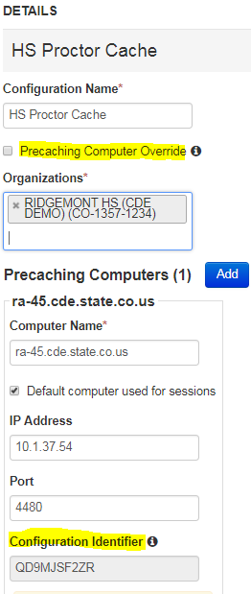
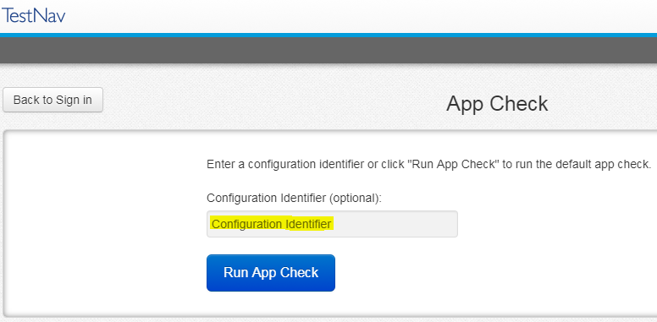
PaNext Updates
TestNav Configurations
Pre-Caching Computer Override selection box
Configuration Identifier

Slide 36
Site Readiness Activities for 2017-18
TestNav 8.10 available in January
CDE recommends:
Preform Assess Testing Capacity in the Setup> Organization in PA Next
Conduct CMAS Infrastructure Trial through the PAnext Training Site
Provides a way to test the local online assessment environment to verify that your network, proctor caching devices, and student testing devices are configured correctly using Colorado-specific item types
Highly recommended for districts and schools using a virtualized device solutions to see how Colorado-specific item types will preform during testing
CMAS: Science and Social Studies Infrastructure Trials

Slide 37
TestNav Questions?

Slide 38
CDE Support
Technical Training Slide Decks – Detailed Training
Follow the structure of documentation
Detailed instructions with links to documentation
Regional DTC Meeting
Deeper dives into real time testing support
Reading log files
Configuring and retrieving SRFs
Case studies involving common testing scenarios.
https://www.surveymonkey.com/r/H59HC9F
Webinars
Trainings - Cover Technical Training Slide Decks
Pearson Field Engineering Services meetings 15, 30, or 60 minutes
Q & A Sessions to answer specific questions
Check http://www.cde.state.co.us/assessment/newassess-dtc for details.

Slide 39
Thanks for Your Time

