Slide 1
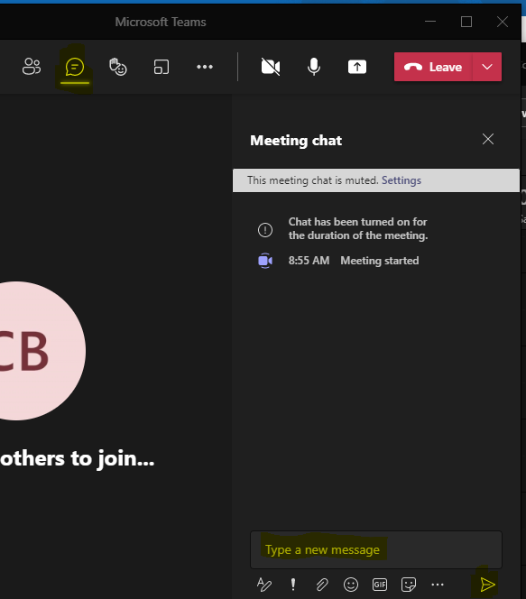
CoAlt Assessments Administration Training for Assessment Coordinators
Welcome!
Introduce Yourself
From the top of the navigation select the Chat icon
In the Type a new message section tell us your district role and how long you have held your position
Select the paper airplane icon in the bottom right corner of the window to send
Note: Select the three dots (…) and click “Turn on live captions” to access closed captioning
Select the Chat icon
Tell us your name, district role, how long you have held your position, and your favorite winter treat.
Send your message

Slide 2
CoAlt Assessments Administration Training for Assessment Coordinators
Spring Administration 2022

Slide 3
Agenda
Lesson 1 – What are the CoAlt Assessments?
Lesson 2 – Security Standards
Lesson 3 – The CoAlt Assessments: ELA and Math
Lesson 4 – DLM: Kite Suite
Lesson 5 – Assessment Coordinators
Lesson 6 – DLM Testlets – ELA and Math
Lesson 7 – CoAlt: Science
Lesson 8 – Planning, Scheduling, and Resources

Slide 4
Lesson 1 What are the CoAlt Assessments?

Slide 5
Lesson 1 of 8
What are the CoAlt Assessments?
Questions

Slide 6
Lesson 2 Security Standards

Slide 7
Lesson 2 of 8
Security Standards
Questions

Slide 8
Lesson 3 The CoAlt Assessments: ELA and Math

Slide 9
Lesson 3 of 8
The CoAlt Assessments: ELA and Math
Questions

Slide 10
Lesson 4 DLM: Kite Suite

Slide 11
Lesson 4 of 8
DLM: Kite Suite
Questions
https://educator.kiteaai.org/AART/logIn.htm

Slide 12
Lesson 5 Assessment Coordinators

Slide 13
Lesson 5 of 8
Assessment Coordinators
Questions

Slide 14
Lesson 6 DLM Testlets: ELA and Math

Slide 15
Lesson 6 of 8
DLM Testlets: ELA and Math
Questions
Administrative training is available through DLM Training Courses site
https://training.dynamiclearningmaps.org/login/index.php

Slide 16
Lesson 7 CoAlt: Science

Slide 17
Lesson 7 of 8
CoAlt Science
Questions
Administrative Training will be available in late-January to mid-February.
Invitations will be sent to official DACs.

Slide 18
Lesson 8 Planning, Scheduling, and Resources

Slide 19
Lesson 8 of 8
Planning, Scheduling, and Resources
Questions
Administrative trainings for CoAlt DLM will be found through the DLM Training Courses.
Administrative Training for CoAlt Science will be available in late-January to mid-February.

Slide 20
Contact Information
CoAlt Assessments and Students with Disabilities | Arti Sachdeva Sachdeva_a@cde.state.co.us
Instructional Accommodations | Gina Herrera Herrera_g@cde.state.co.us
CMAS: Science, Mathematics, and English Language Arts | Sara Loerzel Loerzel_s@cde.state.co.us
Linguistic Accommodations | Heather Villalobos Pavia Villalobos-Pavia_h@cde.state.co.us
Technology Specialist | Collin Bonner Bonner_c@cde.state.co.us
Student Data | Jasmine Carey Carey_J@cde.state.co.us

Slide 21
Thank you

