Slide 1
Colorado Alternate (CoAlt) Assessment
Test Examiner/Administrator Training

Slide 2
What is the CoAlt?
The Colorado Alternate (CoAlt) Assessment is a standards-based assessment designed specifically for students the most with significant cognitive disabilities.
The CoAlt is meant to provide a picture of student performance to schools, districts, educators, parents, and the community.
The CoAlt assesses a student’s performance in English Language Arts, Math, Science, and Social Studies.
Students who take the CoAlt participate in state testing just as their peers without disabilities

Slide 3
Who are the Students?
Students with the most significant cognitive disabilities…
Receive instruction on the Extended Evidence Outcomes (EEOs)
Requires extensive, repeated, and individualized instruction
Uses substantially adapted and/or modified materials
Not IDEA category specific
CANNOT have a Specific Learning Disability (SLD)
Generally – ID, MD, Autism, D/B
Not all students with ID should qualify
CoAlt intended for students 3 SD below mean (~55>)

Slide 4
Who can give the CoAlt?
Certified teacher
Full/part time classroom teacher
Related services provider (SLP, OT, etc.)
Long term certified substitute (see note below)
Participate in training every year
Para-educators cannot administer the CoAlt (ELA/Math/SC/SS)
May be in room as a behavioral/medical/translation support
Must sign security agreement
Test Administrators must not administer the test to relatives nor be in the same testing environment as their relatives during testing
*Districts cannot hire substitutes to give any part of the CoAlt while classroom teachers are with the students.

Slide 5
CoAlt Structure
There are 2 different vendors and 2 different platforms for CoAlt:
ELA and Math
Dynamic Learning Maps (DLM)
Computer based
Registrations are through Educator Portal
Grades 3-8 as alternate to CMAS
Grades 9-11 as alternate to PSAT/SAT
Science and Social Studies
Pearson
Paper based
Registrations are through PA^{next}
SS: 4 & 7 if peers are taking
SC: 5, 8, & 11

Slide 6
Security Standards

Slide 7
CoAlt ELA & Math Security Standards
Testlets must NOT be:
Stored or saved on computers or personal storage devices
Shared via email or other file sharing
Reproduced by any means
Electronic materials used during the assessment administration may not be printed (there are a few exceptions, i.e. TIPS).
Users will not give out, loan, or share their password with anyone. Allowing others access to an Educator Portal account may cause unauthorized access to private information.

Slide 8
Chain of Custody
A documented chain of custody must be kept
Test materials must be secure at all times
With the SAC before and after testing session
With the Test Examiner during testing session
Access before testing may be needed to create accommodations
Notes:
- Secure storage: CoAlt Test Examiners must account for and return test materials and individualized accommodations to the SAC for storage in a secure and locked location immediately after administration, at least on a daily basis. Test materials must not be stored in classrooms.
SAC distributes materials to Test Examiners: The SAC is responsible for the distribution of test materials to CoAlt Test Examiners and for the collection of the test materials during the preparations or accommodations as well as on each day of testing. SACs will have Test Examiners sign the CoAlt materials out and back in once returned. Only materials for the student being assessed at that time should be distributed to the Test Examiner.
-Due to the unique nature of the CoAlt: Science and Social Studies assessments, Test Examiners may need access to a student’s materials prior to the test’s administration in order to prepare any necessary accommodations and organize the provided student materials and manipulatives.

Slide 9
CoAlt ELA & Math (DLM)

Slide 10
PSAT 9/10 & SAT 11
DLM is used as the alternate assessment in lieu of College Board tests
The College Board does not have an alternate to the PSAT 9/10 or SAT 11
CDE contracts with DLM to provide an alternate for students eligible for alternate assessment in 9th-11th grades

Slide 11
Standards: Essential Elements
Essential Elements
The learning targets for the DLM assessments
Provide a bridge from grade-level content standards to academic expectations for students with the most significant cognitive disabilities
Align to CDE’s grade level standards
Notes:
The DLM content standards for all three subject areas are called Essential Elements and are the learning targets for the assessments. The Essential Elements build a bridge from grade-level content standards to academic expectations for students with the most significant cognitive disabilities. Therefore, the Essential Elements are linked to each state’s grade-level standards. With a direct connection to Colorado’s Extended Evidence Outcomes.

Slide 12
Blueprints
Blueprints
List the Essential Elements assessed
For each grade
For each subject
Are organized into groups of related Essential Elements
By claims in ELA and mathematics
In conceptual areas in ELA and mathematics
Notes:
Test blueprints list the Essential Elements assessed for each grade and subject. The blueprints are organized into groups of related Essential Elements by claims and conceptual areas for ELA and mathematics.

Slide 13
Testlets
Testlets are short assessments that comprise the assessment as a whole
The number of testlets varies by grade and subject
Each testlet includes 3-9 conceptually-related items
A student typically takes 5-15 minutes to complete a single testlet
Notes:
The assessment as a whole is comprised of a series of testlets that align to the Essential Elements. The number of testlets varies by grade and subject. Each testlet includes three to nine conceptually-related items. A student typically takes five to fifteen minutes to complete a single testlet. The brevity of each testlet is intended to prevent fatiguing the student, and the set of testlets for each grade and subject are administered across multiple sessions. Note: The assessment is administered one-on-one between the test administrator and student. Even within a class of students in the same grade, students will likely take testlets at varying linkage levels and may need a variety of individualized supports.

Slide 14
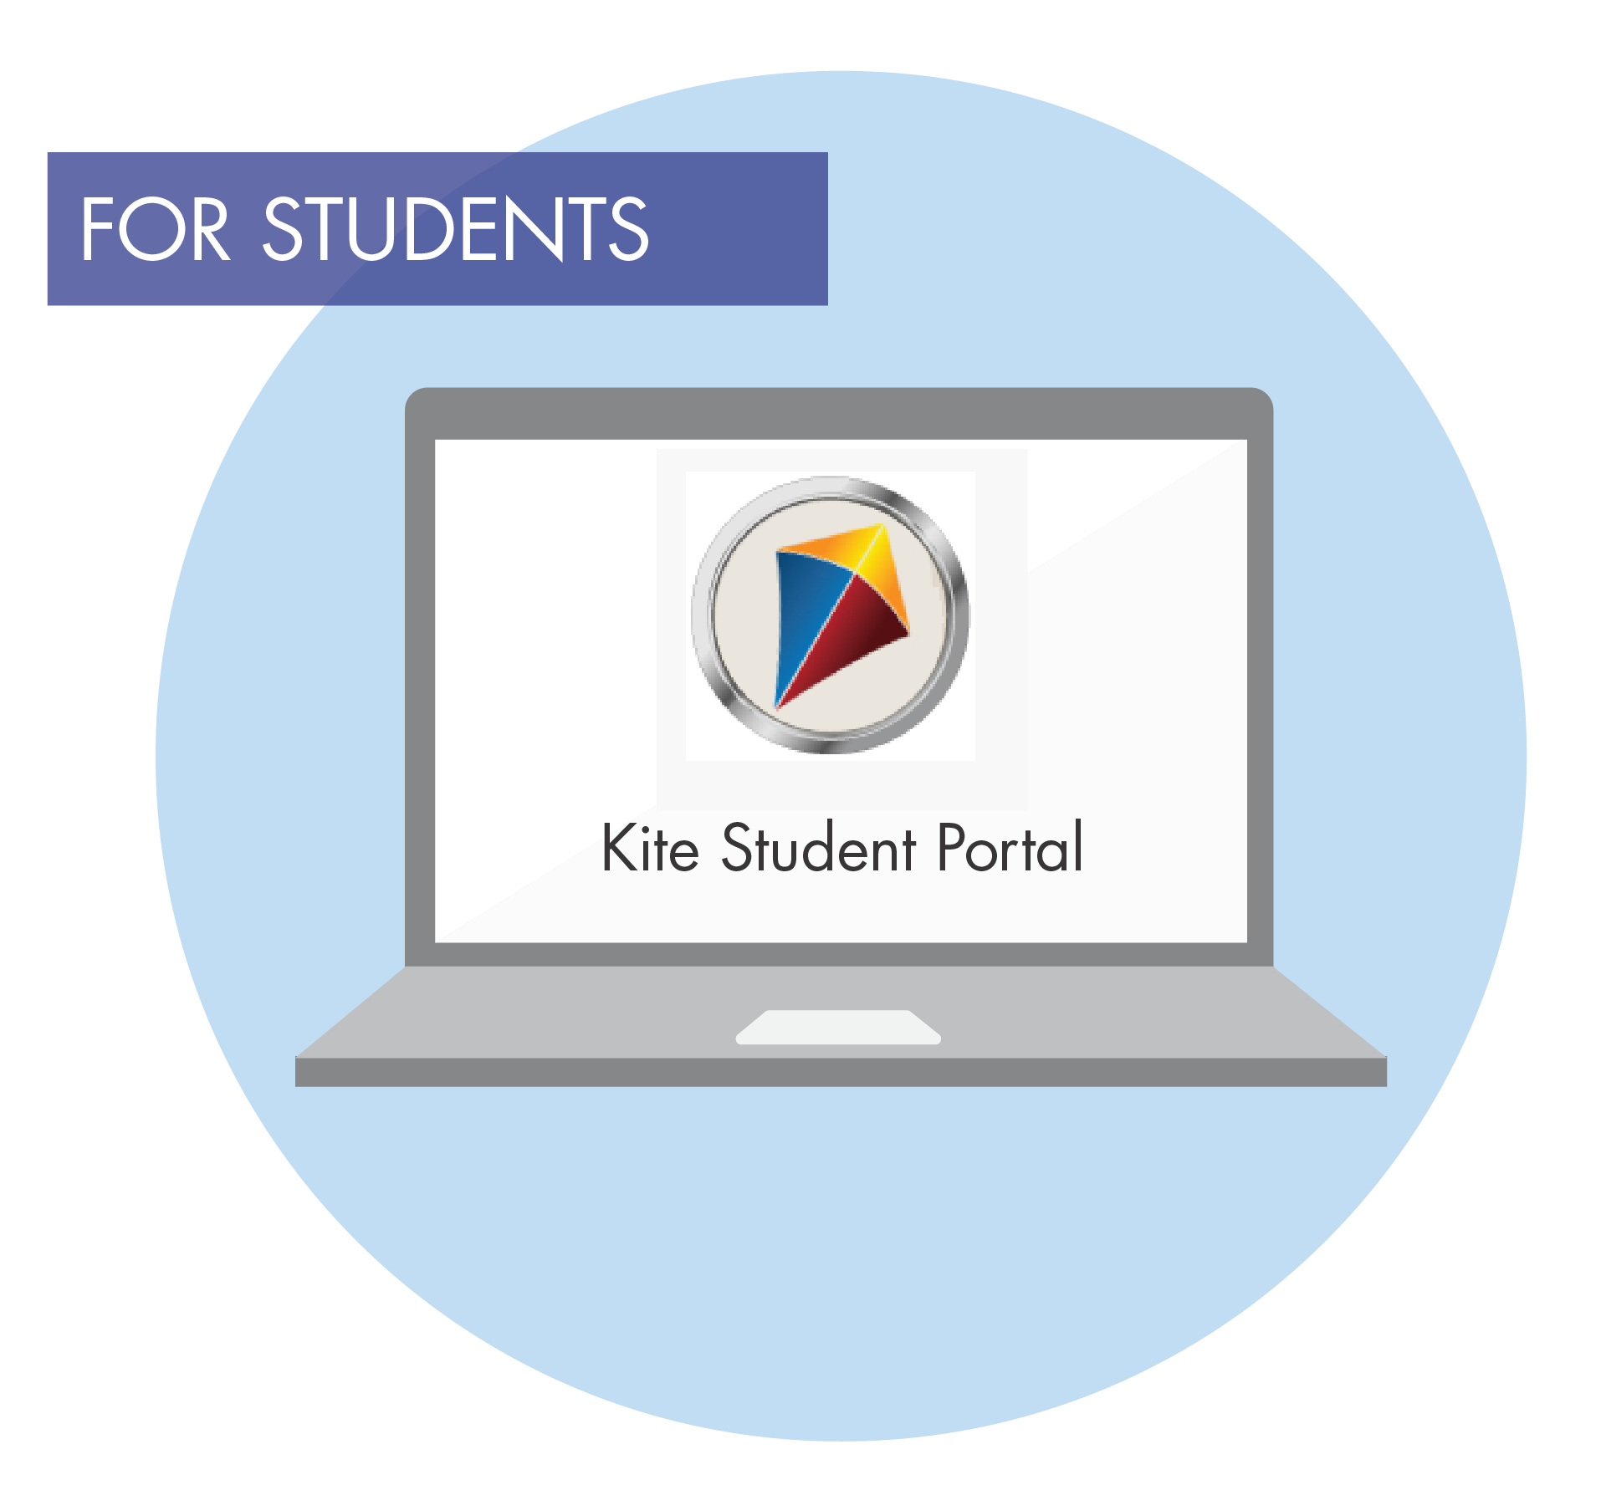
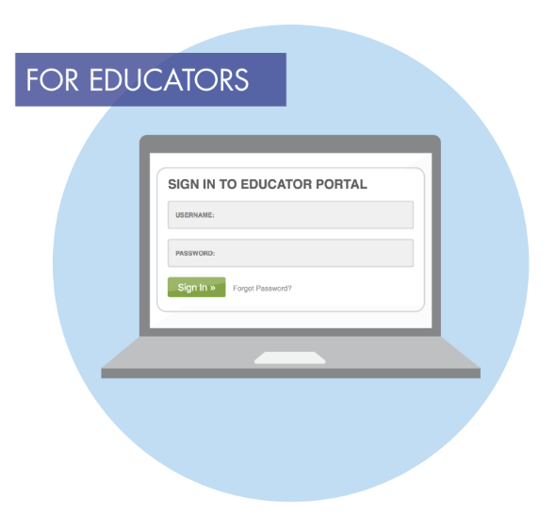
DLM Vocabulary – Kite Suite
Student Portal – used by students to take testlets
Educator Portal – used by test administrators to manage student data and settings
Notes:
Kite Suite is a technology platform. The DLM alternate assessment uses Kite Student Portal and Kite Educator Portal. Students log into Student Portal to take their tests, and test administrators log into Educator Portal to manage student data and settings. More information about both is forthcoming in this training. These icons are reminders that Student Portal is for students, and Educator Portal is for educators.

Slide 15
DLM Vocabulary - Linkage Levels
ELA and Mathematics
Initial Precursor
Distal Precursor
Proximal Precursor
Target
Successor
Notes:
Linkage levels reflect significant milestones en route to the knowledge and skills described by the targeted Essential Element and specify where a student is in relationship to the target Essential Element. The Target level is most closely aligned with the grade‐level Essential Element.
ELA and mathematics each have 5 linkage levels: the least complex linkage level is the Initial Precursor, then the Distal and Proximal Precursors are incrementally more complex, building to the Target level. The Successor level provides students an opportunity to demonstrate a deeper level of understanding of the grade‐level Essential Element and progress beyond the Target level. Some students will reach the Successor level.

Slide 16
Sample Learning Map and Linkage Node for Mathematics
Notes:
The learning maps that DLM creates to guide the development of the assessment, show the relationship between each node or set of nodes and the target. For this example, there is one, two or three nodes identified at each level.

Slide 17
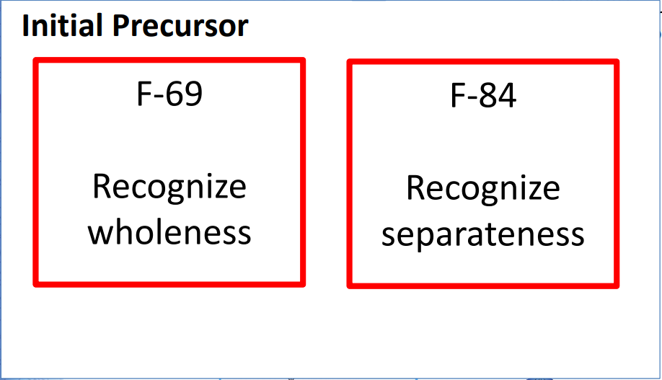
Sample Learning Map and Linkage Node for Mathematics
Notes:
Two nodes have been identified at the initial precursor linkage level. They are, Recognize wholeness and Recognize separateness.

Slide 18
Sample Learning Map and Linkage Node for Mathematics
Notes:
Two nodes have been identified at the initial precursor linkage level. They are, Recognize wholeness and Recognize separateness.

Slide 19
Sample Learning Map and Linkage Node for Mathematics
Notes:
The proximal precursor linkage level is, Add two decimals up to the tenths place.

Slide 20
Sample Learning Map and Linkage Node for Mathematics
Notes:
The target level, which aligns most directly with the Essential Element is, Solve word problems involving addition with rational numbers.

Slide 21
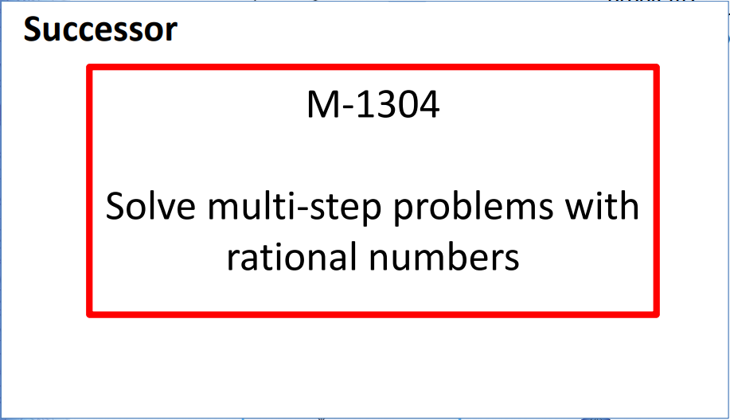
Sample Learning Map and Linkage Node for Mathematics
Notes:
Finally, the successor linkage level, which extends beyond the Essential Element toward the general grade level standard is, Solve multi‐step problems with rational numbers.

Slide 22
Getting Started in Educator Portal

Slide 23
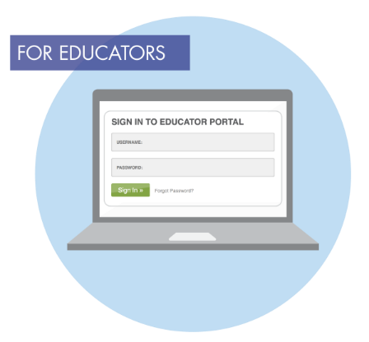
Kite Suite
Educator Portal
Test Security Agreement
Rosters
Personal Needs and Preferences
First Contact survey
Student login credentials
Student Portal
Delivers testlets to students
Allows students to practice taking testlets
Allows teachers to practice test administration
Notes:
Recall that the DLM alternate assessment uses two components of the Kite Suite: Educator Portal for educators and Student Portal for students. The difference between the two can be summarized by pointing out that Educator Portal is about data, and Student Portal is about taking the assessment.
In Educator Portal, the test administrator electronically signs the Test Security Agreement and chooses accessibility supports a student may need by customizing the student’s Personal Needs and Preferences profile, also referred to as the PNP. It is also where the test administrator will provide the Kite system with specific information about the learning characteristics and needs of each of student so that the testlets each student receives in Student Portal are appropriately individualized. Therefore, the choices test administrators and IEP teams make can influence the success a student has when completing the assessment.
Educator Portal is also where test administrators find rosters and each student’s login credentials to use with Student Portal.
Student Portal is the interface students use to take their assessment. Students may also practice taking testlets in Student Portal, and teachers may practice administering testlets in Student Portal. More information on practicing test administration and taking assessments is provided later in the training.

Slide 24
Complete the PNP and First Contact Survey for Each Student
Personal Needs and Preferences (PNP)
The test administrator selects the accessibility supports a student needs.
First Contact survey
The test administrator answers questions about the student.
The system uses the test administrator’s responses to determine the appropriate linkage level for the student’s first testlet.
Notes:
In the Personal Needs and Preferences profile within Educator Portal, the test administrator who is most familiar with the student selects the supports for each student as agreed upon by the IEP team. This is the test administrator’s opportunity to customize the assessment by selecting the accessibility supports each student will need in order to access their testlets.
The assessments are then delivered to the student using Student Portal, which includes the chosen supports. By combining the supports in Student Portal along with allowable assessment practices and flexible test administration procedures, a test administrator can help to eliminate barriers, allowing students to demonstrate what they know and can do with the most appropriate level of independence, thus improving student success.
The test administrator must also complete a First Contact survey for each student in Educator Portal. Remember the First Contact survey is where the test administrator supplies information about each student’s learning characteristics so that the system can determine which linkage level is best for the student’s first testlet. Therefore, an initial testlet will not be available for a student until the test administrator completes the First Contact survey for that student.
Although this training does not show how to fill out the Personal Needs and Preferences profile or the First Contact survey, a Personal Learning Profile training is available on the state pages of the DLM webpage. Several states require completion of the Personal Learning Profile training as a part of this required Test Administrator Training. If required, the training will appear in Moodle after the completion of the Module 4 post-test.

Slide 25
First Contact Survey
Must be submitted every year for each student
Includes questions about
Sensory and motor characteristics
Computer access
Attention
Communication
Academic skills
Determines linkage level for first testlet
Students move up, down, or stay at the same level based on their answers on the testlet
May only move one level at a time
Notes:
Again, a First Contact survey must be completed for each student before the first testlet is administered each year. The survey has questions regarding the student’s sensory and motor characteristics, computer access, attention, receptive and expressive communication modes, and academic content skills. The system will save a student’s First Contact survey from one year to the next, but the teacher must update and resubmit it each year.
The test administrator must answer all required questions in order for the system to acknowledge the First Contact survey as complete. The primary reason the First Contact survey is so important is because it provides the system with information to deliver a testlet at the linkage level most appropriate for each student in a subject area. After the student completes a testlet in a subject area, the system analyzes the student’s performance on the testlet to determine if the next testlet will be at the same linkage level, one level lower, or one level higher.

Slide 26
Test Tickets/Testlet Information Page (TIP)
Download/print the Test Ticket and TIP ahead of testing
Spring assessment window
Accessed from the Test Management section of Educator Portal
Securely destroy each Test Ticket and TIP after use.
Notes:
Each time a testlet is assigned to a student, a unique Testlet Information Page, commonly referred to as a TIP, becomes available in Educator Portal under the Test Management section during the spring assessment window. The TIP provides information the test administrator will need in order to administer the testlet to the student. Test administrators may download or print the TIP if desired; however, after the testlet is administered, the downloaded or printed TIP must be destroyed because TIPs are considered secure testing materials.
The Test Tickets contain the student login and password information necessary to log into testing via the Kite Student Portal.

Slide 27
Testlet Information Page (TIP)
Testlet type
Number of items
Materials needed
Materials use
Suggested substitutions
Notes:
The sample TIP shown here is for a mathematics testlet. Like all TIPs, it provides specific information about the testlet, including the type of testlet (computer-delivered or teacher-administered) the number of items, any materials that may be needed, and suggested substitutions for materials. When applicable, the TIP also includes alternate text for students with visual impairments and accessibility supports not allowed.
A test administrator should never attempt to administer a testlet without first reading the TIP for that testlet.

Slide 28
DLM Testlets
Notes:
The following series of slides show an example of a testlet.

Slide 29
Testlets
Testlet Items | Assessment Scheduling | Number of Testlets Per Subject
3-9 conceptually-related items | 5–15 minutes to complete a testlet | 7-9 for ELA and for mathematics, depending on the grade
all items within a testlet are the same linkage level | each testlet administered one-on-one (test admin to student)
Notes:
The entire assessment for a content area is comprised of a series of mini‐assessments. These mini‐assessments are called testlets. Each testlet is limited to 3‐to‐9 conceptually‐related items, and all items within a single testlet align to only one linkage level. Each testlet must be administered one‐on‐one between the test administrator and the student. A student typically takes between 5‐to‐15 minutes to complete a testlet. The system determines the linkage level of each testlet for each student.
Once the student completes a testlet, the system scores the student’s responses in order to generate the next testlet. There is a delay between the time the student submits the testlet and the time the next testlet arrives. Typically, a new testlet is delivered in 15 minutes.

Slide 30
Computer-Delivered Testlets
Maximize student interaction
Each testlet begins with an engagement activity
Each testlet consists of 3-9 related items
Maximize student independence
Student selects response choices independently
Supports allowed for
Entering the student’s responses
Navigating screen to screen
Notes:
There are two types of testlets: computer-delivered and teacher-administered. A computer-delivered testlet is completed by the student on a computer or tablet in Student Portal. A teacher-administered testlet is delivered in Student Portal; however, scripted directions are provided to the test administrator, and the test administrator interacts directly with the student in administering the testlet. Then the test administrator records the student’s responses in Student Portal. Testlets include two primary parts: the engagement activity and the actual testlet items or questions.
Most testlets are computer-delivered.
Before looking at the different item types, it is important to understand that computer-delivered testlets should do two things: maximize student interaction and student independence. If able, the student enters their responses independently. If the student needs assistance, the test administrator may enter the student’s responses. The student may also receive support in navigating from one screen to the next, but prompting is not allowed. Other allowable and unallowable test administration practices will be covered later in the training.

Slide 31
Engagement Activities
Mathematics | ELA
• Short setup/scenario for the items | • Text presented twice • 1st reading is for engagement • 2nd reading has items interspersed
Purpose is to:
Motivate students
Provide a context for the items
Activate prior knowledge
Notes:
Engagement activities vary by content and testlet, but regardless of the type of engagement activity, the purpose is the same--to motivate students, provide a context for the items, and activate prior knowledge. The engagement activities themselves do not require students to respond to questions.
Mathematics engagement activities are typically very short, like the engagement activity for the sample testlet that states, “Deb is learning about shapes.” ELA testlets include two readings of a text. The first reading serves as the engagement activity, and then the second reading has either the items placed throughout or at the conclusion of the second reading.

Slide 32
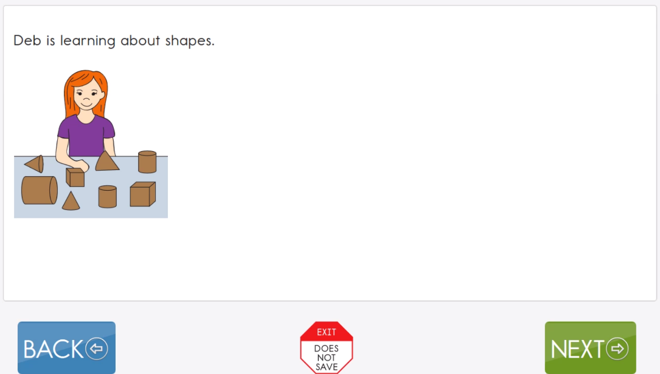
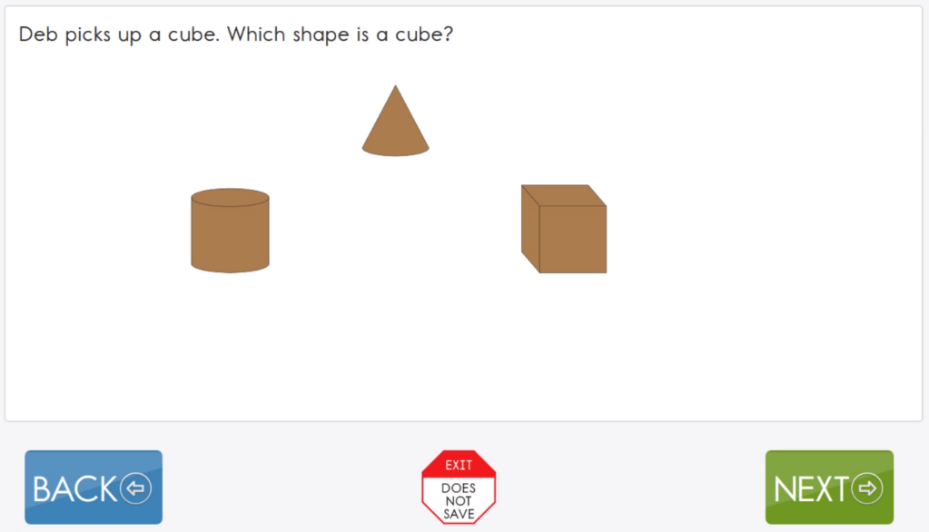
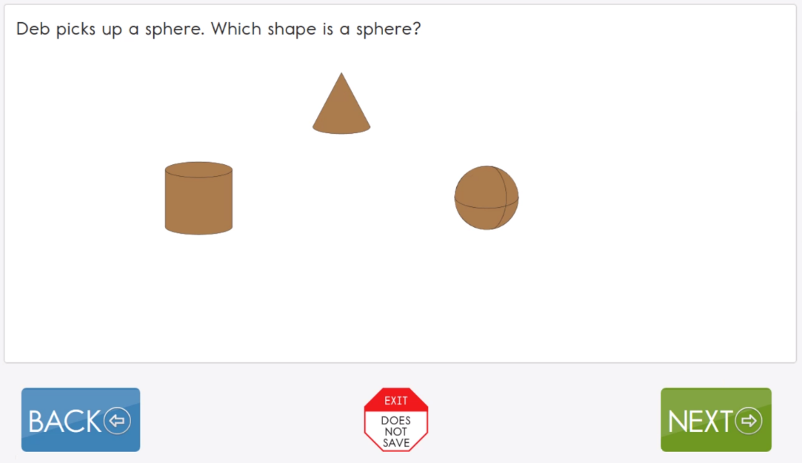
Notes:
After the engagement activity, the first item refers back to Deb and includes the question, “Which shape is a cube?” The following items are related both to the engagement activity and the first item.

Slide 33
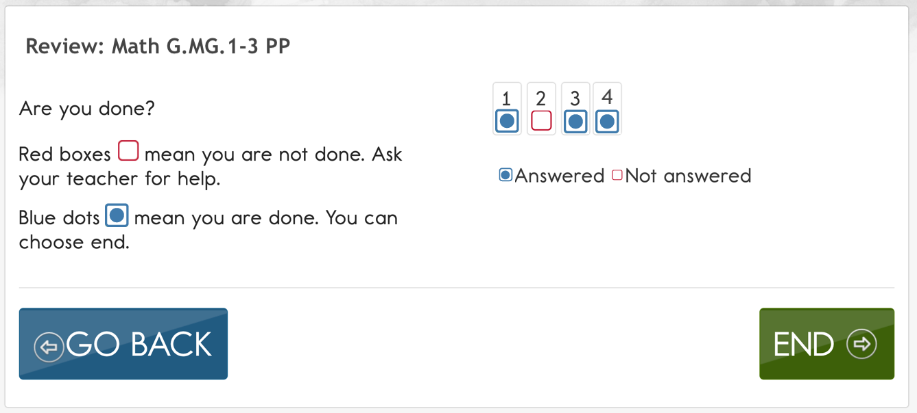
Review Screen
Notes:
Testlets end with a screen that indicates which items have been answered and which have not. Students have the opportunity to respond to any items they may have skipped before ending the testlet.
Module 2 addresses the different kinds of items students may encounter, how they will indicate their responses, and other test administration procedures.

Slide 34
Teacher-Administered Testlets
Directions to the test administrator in Student Portal
Scripted statements/interactions
Items are for the test administrator to complete based on observation of behavior
Used for:
Some testlets at the Initial and Distal Precursor linkage levels
All writing testlets
Notes:
Like computer-delivered testlets, teacher-administered testlets are accessed in Student Portal. The test administrator is given a script to follow, step by step. The script tells the test administrator what to say and do throughout the testlet, and the test administrator observes what the student does in response to the script, and then enters the student’s responses based on those observations.
Teacher-administered testlets are predominantly at the lower linkage levels because students with the most complex needs may still be developing symbolic understandings. Teacher-administered testlets are also used when the content cannot be assessed with information presented on the computer screen.
Also, no matter what grade or linkage level, one of the student’s ELA testlets will be a writing testlet. All writing testlets are teacher-administered.

Slide 35
Teacher-Administered Item
Educator Directions:
In this testlet you will present the student with objects that are the same and objects that are different. It is important that objects that are the same are identical.
Gather two identical bowls and two identical crayons. You may substitute other objects if required.
For the first two items, you will use two bowls and one crayon. For the second two items you will use two crayons and one bowl.
Notes:
In the teacher-administered testlets, response options appear on an educator direction screen. These directions provide instructions on how to interact with the student. The text presented in bold after SAY is spoken directly to the student. The actions described after SHOW are performed by the test administrator for the student. However, due to hearing or vision limitations, some students will not be able to see what is shown, and others will not be able to hear what is said. SHOW should be interpreted to mean that a test administrator should present the materials to the student, using sensory modalities appropriate for that student. SAY may require non-verbal communication appropriate for the student’s sensory modalities, such as signing.
As the steps are completed, the test administrator observes how the student responds to the item and records that response by selecting the best match from the list of statements on the page. Once selected, the test administrator then uses the navigation buttons at the bottom of the screen to move to the next screen. For the testlets at the Initial Precursor linkage level and some at the Distal Precursor linkage level, “No response” is a response option. If a student does not respond to an item, and “No response” is not an option, the test administrator should leave the item unanswered. Both the “No response” option and an unanswered item will be counted as incorrect.

Slide 36
Combination Mathematics Testlets
Some mathematics testlets are a combination of teacher-administered and computer-delivered
Teacher-administered items come first
Transition directions are provided to the test administrator
Computer-delivered items come second
Notes:
Most testlets are either teacher-administered or computer-delivered. However, a few mathematics testlets combine the two types. These are delivered to students who are able to complete computer-delivered items, but the testlet includes items that have test content presented by the test administrator following the onscreen directions. In these combination testlets, Student Portal presents the teacher-administered items first. Then the test administrator is directed to have the student complete the remaining items independently on the computer.

Slide 37
Teacher-Administered Writing Testlets
Engagement activity requires the student to select a topic
Test administrator
Follows Educator Directions
Interacts with student
Observes and records observations of student writing
Writing product is not submitted
Notes:
All writing testlets are teacher-administered. The test administrator delivers a structured writing activity to the student. The testlet begins with an engagement activity that requires the student to select a writing topic. Then step-by-step scripted directions are provided which ask the student to engage in writing tasks. After each step, the test administrator records the student’s response in Student Portal. Some writing testlets also require the test administrator to evaluate the written product. In all cases, selections are made from the onscreen options that best reflect the test administrator’s observations. The student’s writing product is not submitted.
There is a separate video that provides more information about the writing testlets. Access the video on the Educator Resource Page found on the state pages of the DLM website.

Slide 38
Familiar Texts
Familiar Texts
Provide opportunity for students to interact with ELA materials prior to testing
Intended for use because students in this population need multiple exposures to materials in order to acquire information
Located on the DLM webpage
Are not required for the test
Each testlet provides the text as part of the testing session

Slide 39
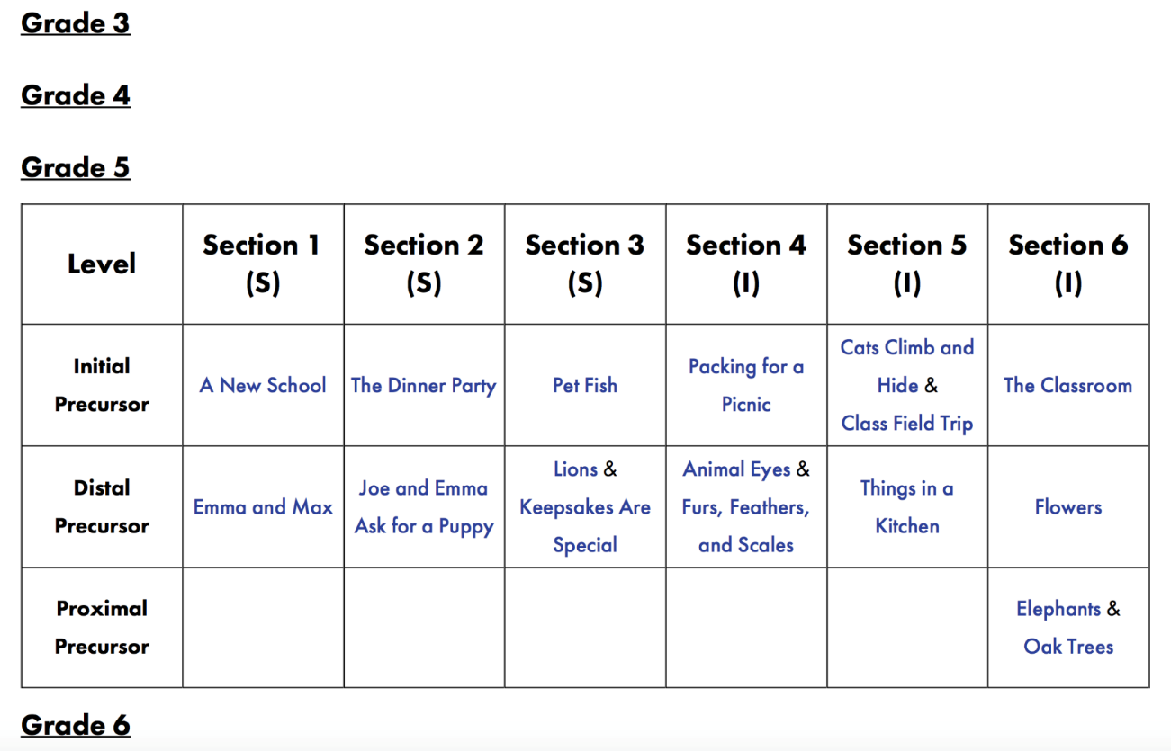
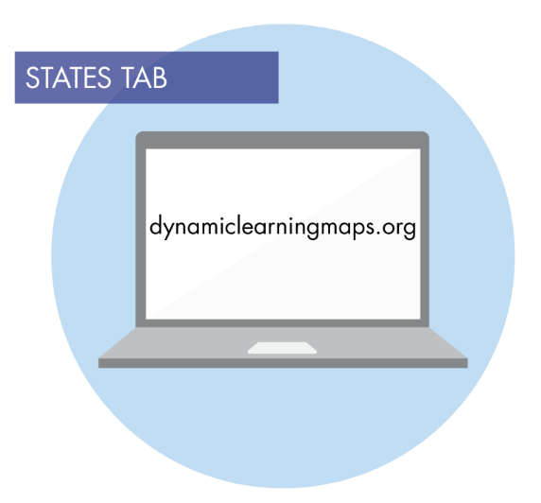
Familiar Texts
Notes:
For ELA, some students will receive a TIP that indicates the teacher should use the familiar text. The teacher accesses the DLM website and locates the familiar text. The teacher then uses the text

Slide 40
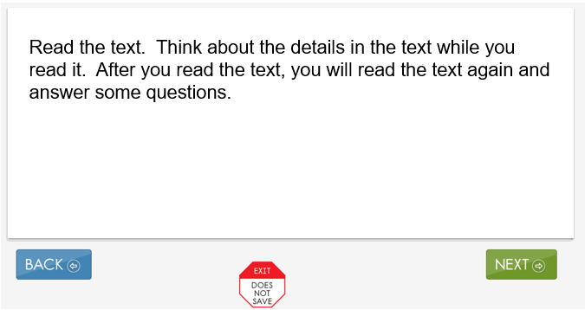
Engagement Activity
Notes:
This is an example of the beginning of an ELA testlet. Remember that ELA engagement activities involve reading a text twice. The text is presented a few sentences at a time across a number of screens. The first time, there are no items embedded in the engagement activity; it is only the text.

Slide 41
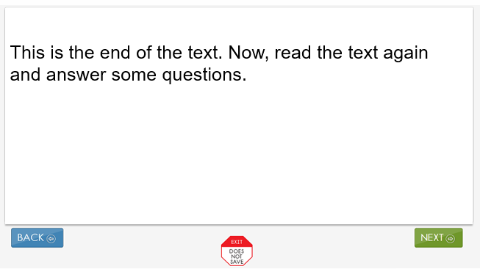
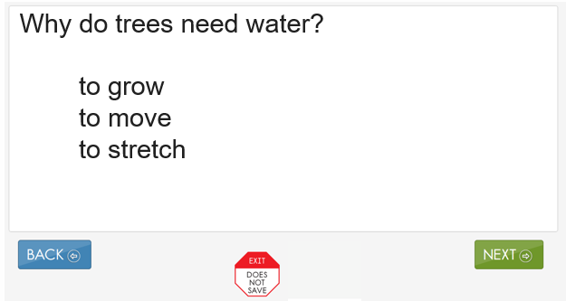
ELA Testlets
Transition Screen
ELA Items Presented During Second Read
Notes:
All testlets in ELA have a transition screen that appears at the end of the first reading of the text. In the computer-delivered testlets, the transition screen focuses student attention on reading to respond to testlet items or questions. As the student navigates through the second reading of the text, the text will be interspersed with testlet items.
This is an example of the type of item a student may encounter in a computer-delivered testlet during the second reading of the text. Recall from Module 2 that there are several different types of items, but single-select multiple-choice, as shown here, is the most common.

Slide 42
Practice Activity Log-In Information
Log-ins are located in the TAM

Slide 43
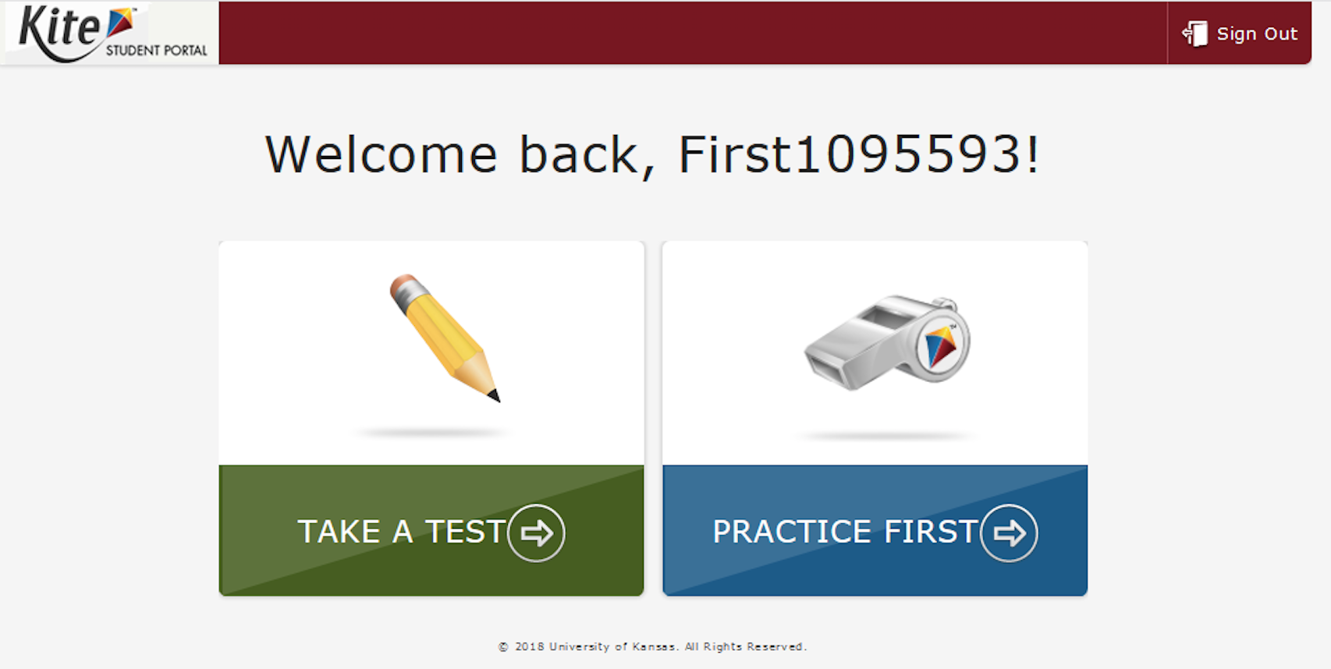
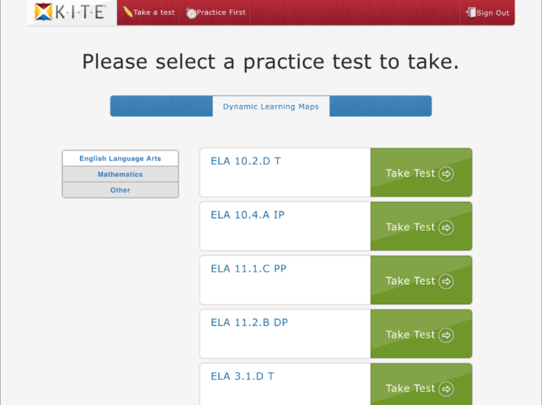
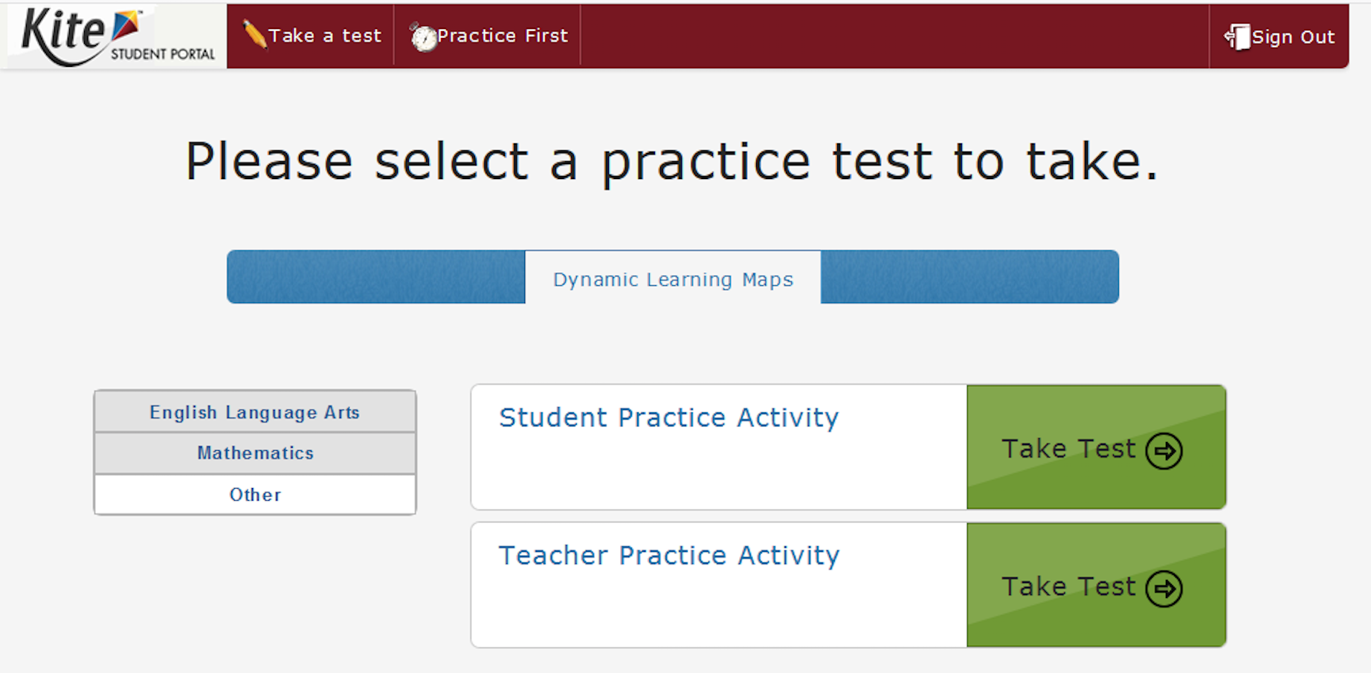
Practice and Released Testlets
Released testlets
Practice activities
Notes:
Several demo student profiles are available for practice purposes. Each demo student login has different accessibility supports in the PNP profile. Taking practice activities while logged in as different demo students allows the test administrator to see how different accessibility features impact a student’s experience in Student Portal.
The practice activities and released testlets are accessed by clicking the Practice First option when logged into Student Portal using one of the demo student usernames and passwords.
Recall from Module 2 that the Take a Test option is used only by students when they are logged in to Student Portal using their own usernames and passwords and are about to take an operational testlet.
After clicking “Practice First,” access released testlets by clicking the button for the desired content area. Each state’s page of the DLM website has an Educator Resource Page for ELA and Mathematics. Released testlets for ELA and mathematics are accessed using demo student credentials listed on the Educator Resource Page for ELA and Mathematics. Each testlet’s name indicates the content area, grade level, Essential Element, and linkage level of the testlet.
Use the button labeled Other to access the practice activities. There is one practice activity for students and one for teachers. Remember, the practice activity for students familiarizes students with the layout and navigation features of computer-delivered testlets. The practice activity for teachers familiarizes teachers with the procedures involved in teacher-administered testlets.

Slide 44
Available Accessibility Supports
Three categories:
Supports activated in Educator Portal
Supports requiring additional tools/materials
Supports provided by the test administrator
Notes:
The DLM alternate assessment is made accessible to students using various accessibility supports. The available accessibility supports are divided into three categories: supports that are activated by the test administrator in Educator Portal, supports that require additional tools or materials, and supports provided by the test administrator outside of Student Portal. All of these options regarding the student’s support needs are selected by the test administrator in Educator Portal in the Personal Needs and Preferences section, commonly referred to as the PNP.

Slide 45
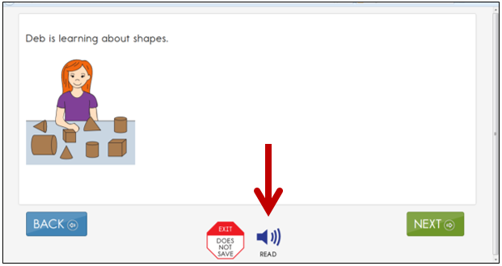
Category 1: Accessibility Supports Activated in Educator Portal
Supports indicated by the teacher through the PNP settings
Magnification
Invert color choice
Contrast color
Overlay color
Spoken audio
Text only
Text & graphics
Nonvisual
Notes:
Category 1 includes supports that change the computer display, such as magnification, invert color choice, contrast color, overlay color, and spoken audio. Test administrators can turn these supports on and off by logging into Educator Portal and customizing each student’s Personal Needs and Preferences settings. These supports change the way the testlets are displayed in Student Portal.

Slide 46
Category 2: Supports Requiring Additional Tools/Materials
Braille
Scanning
Single-switch
Two-switch system
Individualized manipulatives
Calculator
Braille:
Requires advance planning
Delivered in Educator Portal as Braille-Ready Files (BRF)
Must be downloaded and embossed locally
Should not be selected for emerging braille readers
Only available at upper linkage levels
Notes:
Category 2 includes supports requiring additional tools/materials. These supports include braille, switches to support scanning, including both single-switch and two-switch access, the use of individualized manipulatives, and the use of a calculator. Single-switch access is the only Category 2 support that changes the way the item is actually accessed in Student Portal.

Slide 47
Category 3: Supports Provided by the Test Administrator
Human read aloud
Sign interpretation of text
Test administrator enters responses for student
Partner-assisted scanning
Language translation of text
All math content may be translated
Only grades 3 & 4 ELA may be translated into Spanish as the alternate to the CSLA
Notes:
Category 3 supports are provided by the test administrator outside of Student Portal. These supports all require the active engagement of the test administrator during testing.
Test administrators may read aloud all parts of the DLM alternate assessment. The teacher can choose spoken audio in the student’s Personal Needs and Preferences, but the test administrator may read aloud for the student if the speech synthesis offered in spoken audio is not appropriate to the student’s need.
Test administrators may sign the content to the student using American Sign Language or any other sign language system that is meaningful to the student.
Test administrators may enter the students’ responses when they are unable to record their responses in Student Portal. In these cases, the students must clearly communicate a response that the test administrator enters for the student.
Test administrators may use partner-assisted scanning to present the response options to students who cannot use switches to scan independently and accurately. Partner-assisted scanning requires the test administrator to point to and/or say each of the response options displayed in Student Portal. The student then signals when the desired response is presented. After the student signals to indicate a response, the test administrator enters it into the system.
In some states, test administrators may translate the language for a student who is an English language learner or who responds best to a language other than English. Look for guidelines regarding the use of language translation in the appendix to the DLM Accessibility Manual.

Slide 48
Allowable Practices
General principle:
A student’s access to items and materials can be flexible as long as the student’s interaction with the concept being measured is consistent.
Offering breaks
Navigating across screens for the student
Using special equipment for positioning
Using interactive whiteboards
Defining terms generically
Notes:
In addition to offering a range of supports in the three categories just described, the DLM alternate assessment is designed to offer flexibility in the ways materials are presented to students, as long as the student’s interaction with the concept being measured is consistent. For example, the test administrator may read aloud any part of the assessment, including passages in ELA. The typical arrangement of the test administrator, student, and computer may also be adjusted based on a student’s needs and use of special equipment.
Other examples of the intended flexibility include the substitution of materials as needed. If the item calls for materials that are inappropriate or unavailable, the test administrator may usually substitute other materials. More information about substituting materials is covered in Module 3.
Testlets are taken one at a time, across multiple assessment sessions, but all testlets must be completed within the state-specific assessment window. While a testlet is designed to be completed in one sitting, students are allowed to take as many short breaks as needed. However, on occasion, a student may need an extended break while testing.
Students who qualify for the DLM alternate assessment require extensive, repeated individualized instruction and ongoing supports that are not of a temporary or transient nature. Many of these students have difficulty retaining information in working memory for extended periods of time. Studies have shown that students who experience an extended interruption or break during the administration of a testlet are likely to perform better when they are allowed to begin the testlet again from the beginning rather than picking up from where they left off. Therefore, if an incomplete testlet has been idle for more than 90 minutes, the system has been designed to log out and not save any responses, allowing the student to have a fresh start by starting the testlet from the beginning again at a later time.
In addition to offering breaks as needed, test administrators may navigate across screens of the testlet for the student. Students may also use special equipment for positioning to access the test material, and the assessment can be administered on a broad range of devices including computers, iPads, and interactive whiteboards.
Finally, if the student does not understand the meaning of a word used in the assessment, the test administrator may define the term generically and allow the student to apply that definition to the problem or item in which the term was used. Exceptions to this general rule will be noted on Testlet Information Page for specific testlets where the item is assessing a student’s knowledge of the particular word.

Slide 49
Practices Not Allowed
Prohibited practices:
Rephrase/repeat a question to influence a different response
Use prompts, hints, cues, or hand-over-hand guidance
Preview a testlet with a student before administering it
Remove/reduce the number of response options
Add pictures or communication symbols to response options that appear onscreen in print only
Speech to text
Whole word/sentence dictation on writing
Picture/symbol word bank for writing
Notes:
While maintaining flexibility in access to the items and materials, consistency with the concept being measured must also be preserved. Practices that should be avoided are those that interfere with students’ independent responses to the content of the item.
This means that after a student has selected a response, the test administrator cannot rephrase or repeat a question if the purpose is to influence the student in changing the response.
A test administrator may ask for clarification if a student has inconsistent responses or communicates in alternate ways because the test administrator’s intent is to clarify the student’s response. In contrast, the use of any prompts, hints, cues, or hand-over-hand guidance to responses is prohibited during the assessment.

Slide 50
Making Meaning from Words, not Pictures or Symbols
The focus of most Essential Elements is on the ability to make meaning from words, not pictures.
Many response options include adjectives or verbs that are not easily standardized to a universal symbol that all students recognize.
The display of simple symbols for more complex words may introduce confusion.
An attempt to use symbols can make content inaccessible for students who are blind or visually impaired.
Notes:
The focus of most Essential Elements is on the ability to make meaning from words, not pictures or symbols, to help prepare students for their future communication needs. When pictures or symbols are used in the DLM alternate assessment, care is taken to first teach the meaning of the pictures or symbols before being used as a response option, unless those pictures or symbols are highly transparent representations of nouns. Many ELA adjectives or verbs are used in response options that are not easily standardized to a universal symbol that all students recognize. The display of simple symbols for more complex words used in response options may introduce confusion for both students and test administrators. Additionally, the use of symbols can make content inaccessible for students who are blind or visually impaired. Additional documentation about why DLM alternate assessments do not use pictures or symbols as response options is elaborated on in the DLM Accessibility Manual and the Test Administration Manual.

Slide 51
CoAlt Science and Social Studies
Notes:
Remember also that there are a number of professional development opportunities provided to support test administrators with regards not only to assessment but instruction as well.

Slide 52
CoAlt: Science and Social Studies
Paper-based assessment
Individually administered
Scored locally by the Test Examiner
Scores are entered into the PearsonAccess^{next} portal
Test Examiners enter scores into PA^{next}
Score entry window closes the Wednesday after the test window closes
Test books are oriented to the Test Examiner and the student face each other
Two items
Selected Response
Supported Performance Tasks

Slide 53
Administering CoAlt: SC/SS
Student is presented with three or four answer options
CoAlt Test Examiners may not rephrase the prompt
Repeat the prompt at level four only when the student does not respond the first time
An additional prompt is included at level three to help engage the student
Student will work with the item until the correct answer is received or the maximum number of attempts is reached
Only one data point is recorded

Slide 54
CoAlt: SC & SS Preparing Materials for Assessment
Read through Examiner’s Manual
Preparation of Accommodations/Task Manipulatives
Read through Items
Cut out task manipulatives
Individual administration
(Only Test Examiner and Student in Testing Environment)
No time limits or restrictions on time
Allow time for breaks

Slide 55
Test Examiner Activities Before Testing
Write the student’s name on the test booklet
Write the student’s name on the secure return envelope
Cut apart the task manipulatives
Paper clip the task manipulatives to the corresponding page
Keep all materials for each student together
Administer practice items
Familiarizes student with the process
https://www.cde.state.co.us/assessment/CoAlt-Items.asp

Slide 56
CoAlt Materials
Examiner’s Manual
One shrink wrapped packet per student
CoAlt Test Booklet
Secure Return Envelope
Task Manipulatives Kit
Secure Return Form (Signed by Test Administrator)
Score Recording Form
Task Manipulatives
Student Response Form
Notes:
Districts receive one box of CoAlt materials for each student based on online enrollment in early October.
Districts will need to print and distribute test examiner manuals for each teacher.
This manual indicates other materials the test examiner will need to give the assessment.

Slide 57
Test Materials
Grade 5, 8, and 11 have two unique forms
Grades 4 and 7 have one form
Task manipulatives are shrink-wrapped with each test book
Each student must be assessed with “their” book and manipulatives
Notes:
Your school will get an even distribution of each form for each subject. It is not required that the student takes the same form for each subject.
Each student MUST be assessed with the same book and corresponding manipulatives per subject. The task manipulatives are shrink-wrapped together with the test book. Its important to keep the test materials that were shrink-wrapped, together.

Slide 58
Task Manipulatives
CoAlt Test Examiners should use the picture symbols in the test materials provided, except:
The student needs to use objects rather than pictures.
The student needs pictures of real objects rather than drawings.
The student has a personal lexicon with a specific representation for the concept or words in the student answer choices.
In this case, all answer choices must be from the student’s personal lexicon.

Slide 59
Task Manipulatives
The student facing pages of test items may need to be adapted:
Size
Color
Contrast levels
Dimension
Assistive technology / AAC
Tactile / Objects

Slide 60
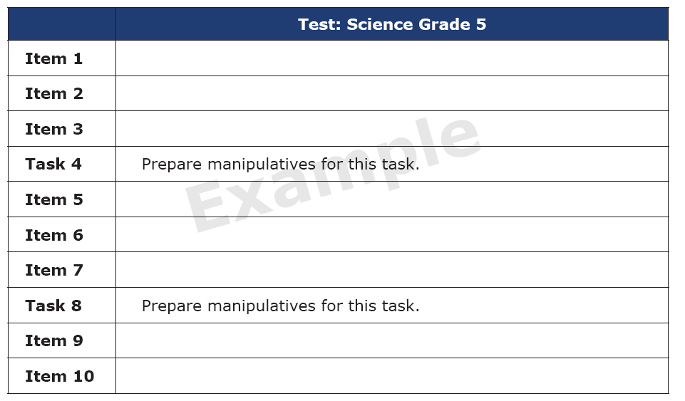
Test Layout
The beginning of each test shows the order of items and tasks.
Remember not all items have to be administered in one session.

Slide 61
Selected Response Items (SR)

Slide 62
Selected Response Scoring
Present the Primary Prompt
Student Responds Correctly
4
Student Does Not Respond
Repeat the Primary Prompt
Student Responds Correctly
4
Student Responds Incorrectly OR Student Does Not Respond (after repeating the Primary Prompt)
Present the Additional Prompt and then present the Primary Prompt again
Student Responds Correctly
3
Student Responds Incorrectly OR Student Does Not Respond
Present the Correct Answer and then present the Primary Prompt again
Student Responds Correctly
2
1
Student Does Not Respond
NR
Student Responds Incorrectly

Slide 63
Selected Response
Teacher Facing Page
Notes:
I am now going to walk through the 4th grade Social Studies Selected Response item with you.
This is the teacher facing page.
Read through the page to yourself before presenting the item to the student
What the Test Examiner says is in bold font highlighted in gray.
Notice in the instructions the Test Examiner is to point to the picture and answer options as they read them.
The correct answer is also provided.

Slide 64
Selected Response
Student Facing Page
Notes:
This is the student facing page.
I am going to read through the item with you as if you were the student, and I am the teacher. You will not see what I am reading.
Point to the picture at the top of the page.
Read the prompt: Colorado has geographic features such as lakes, mountains, and plains. Which geographic feature is shown on this map of Colorado?
Point to and read each answer option aloud:
Lakes, Mountains, Plains
Choose your answer.
Pause and allow the student time to respond.
If the student responds correctly you will mark a 4 on the score sheet for this item and move on to the next item in the book. Remember you will have to turn two pages to get to the next primary prompt – be sure to check that you are at the beginning of the next item before starting.
If the student does not respond – you may repeat the prompt once exactly as it appears– test examiners may not reword prompts or explain any of the words.
If the student responds incorrectly – you will turn the page and move to the additional prompt.

Slide 65
Selected Response
Student Facing Page
Notes:
If at this point the student picks Mountains, then the answer is correct. The Test Examiner marks the score sheet with 4 points.

Slide 66
Selected Response
Student Facing Page
Does not respond?
Notes:
In this case, after waiting several seconds, you determine the student is not going to respond.

Slide 67
Selected Response
Teacher Facing Page
Notes:
Read the primary prompt one more time – exactly as written. Make sure that you point to the answer choices again.

Slide 68
Selected Response
Student Facing Page
Notes:
Point to the picture at the top of the page.
Read the prompt: Colorado has geographic features such as lakes, mountains, and plains. Which geographic feature is shown on this map of Colorado?
Point to and read each answer option aloud:
Lakes, Mountains, Plains
Choose your answer.
Pause and allow the student time to respond.
If the student responds correctly you will mark a 4 on the score sheet for this item and move on to the next item in the book. Remember you will have to turn two pages to get to the next primary prompt – be sure to check that you are at the beginning of the next item before starting.
If the student does not respond – you may repeat the prompt once exactly as it appears.
If the student responds incorrectly – you will turn the page and move to the additional prompt.

Slide 69
Selected Response
Student Facing Page
Notes:
If the student responds on the second reading of the prompt, even thought they did not respond the first time, they can still score a 4.

Slide 70
Selected Response
Student Facing Page
Responds incorrectly?
Notes:
If the student responds incorrectly, the Test Examiner presents the alternate prompt to engage the student in testing.

Slide 71
Selected Response
Teacher Facing Page
Notes:
If the student responds incorrectly or does not answer at all, you will turn the page and read an additional prompt

Slide 72
Selected Response
Teacher Facing Page
Notes:
This is the teacher facing page for the additional prompt for level 3.
Notice the teacher words are still in bold and highlighted.
Also the instructions to point to the pictures are still here.

Slide 73
Selected Response
Student Facing Page
Notes:
This is the student facing page for the additional prompt.
Again, I am going to read through the item with you as if you were the student, and I am the teacher. You will not see what I am reading.
Point to the picture on the page.
Read the additional prompt: Here is an example of another geographic feature on a map of Colorado. Rivers are the geographic feature shown on this map of Colorado. Pause, and then turn back to the primary prompt.

Slide 74
Selected Response
Teacher Facing Page
Notes:
Now, read the primary prompt one more time, pointing to the answers.

Slide 75
Selected Response
Student Facing Page
Notes:
Once again, read the primary prompt. Point to the picture at the top of the page.
Read the prompt: Colorado has geographic features such as lakes, mountains, and plains. Which geographic feature is shown on this map of Colorado?
Point to and read each answer option aloud:
Lakes, Mountains, Plains
Choose your answer.
Pause and allow the student time to respond.
If the student responds correctly you will mark a 3 on the score sheet for this item and move on to the next item in the book.

Slide 76
Selected Response
Student Facing Page
Notes:
If the student responds correctly, score a 3.

Slide 77
Selected Response
Student Facing Page
Does not respond or responds incorrectly?
Notes:
If the student responds incorrectly the Test Examiner presents the correct answer to the student.

Slide 78
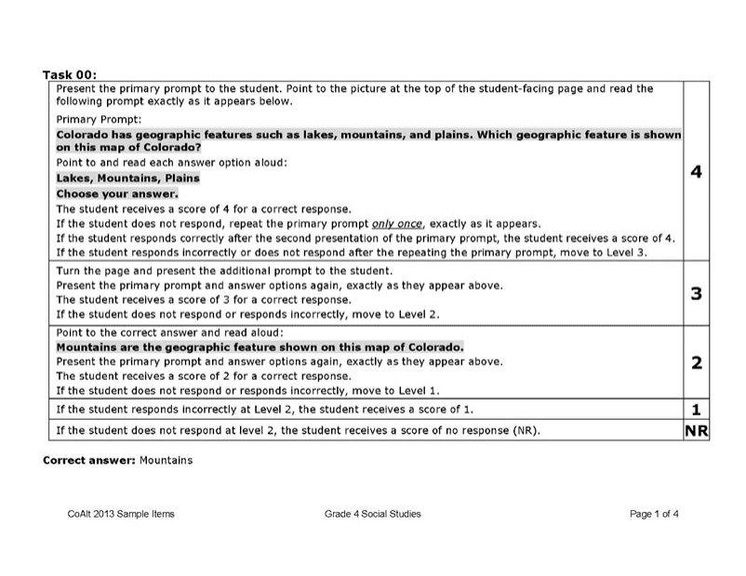
Selected Response
Teacher Facing Page
Notes:
At score level 2, the Test Examiner shows the student the correct response. The
Test Examiner then repeats the primary prompt and answer choices and allows the
student an opportunity to respond. The student receives a score of 2, 1, or NR
based on the response given.

Slide 79
Selected Response
Student Facing Page
Notes:
Mountains are the geographic feature shown on this map of Colorado.

Slide 80
Selected Response
Teacher Facing Page
Notes:
Now, read the primary prompt one more time, pointing to the answers.

Slide 81
Selected Response
Student Facing Page
Notes:
Point to the picture at the top of the page.
Read the prompt: Colorado has geographic features such as lakes, mountains, and plains. Which geographic feature is shown on this map of Colorado?
Point to and read each answer option aloud:
Lakes, Mountains, Plains
Choose your answer.
Pause and allow the student time to respond.

Slide 82
Selected Response
Student Facing Page
Notes:
If the student gets the answer correct, they score a two.

Slide 83
Selected Response
Student Facing Page
Responds incorrectly?
Notes:
If the student answers incorrectly, the student scores a one.

Slide 84
Selected Response
Student Facing Page
Does not respond?
NR
Notes:
Only if the student does not respond at all, they earn a “NR.”

Slide 85
Supported Performance Tasks (SPT)

Slide 86
Supported Performance Task
Identified as Task # within the test book
Three prompts related to one task
Student manipulates option cards by placing them on the student response page (or indicates location for placement)

Slide 87
Supported Performance Task Scoring
Present the Prompt
Student Responds Correctly
2
Student Responds Incorrectly
1
Student Responds Correctly
2
Student Does Not Respond
Repeat the Prompt
Student Responds Incorrectly
1
Student Does Not Respond
NR
Notes:
SPTs are identified as “Task ##” within the test book and are made up of three prompts related to an overall task. These items require the student to manipulate option cards by placing them on the student response page (e.g., placing option cards in designated boxes within a chart or diagram). As with Selected Response items, Test Examiners have flexibility for presentation (i.e., representative objects) and response (i.e., using the student’s particular mode of communication) with the SPTs. However, the scripted text and the order of the answer options and prompts within each item must be presented exactly as they appear in the test book.
CoAlt Test Examiners score the student’s performance on each of the three prompts using a two-point scoring rubric found on the examiner-facing pages. There are six total points possible for each SPT.

Slide 88
Task Manipulatives
Prepare task manipulatives prior to testing
Notes:
Each student must be tested using his or her own materials. These materials must be prepared a head of time. It is recommended that the teacher paper clip the response cards to the correct page in the book so that they are readily available when needed.

Slide 89
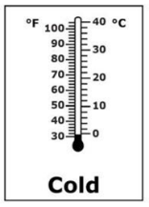
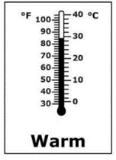
Supported Performance Task
Student Facing Page
Notes:
The prompt will only be presented one time.
If the student responds correctly, the student receives a score of 2.

Slide 90
Supported Performance Task
Teacher Facing Page
Notes:
I am now going to walk through the 5th grade Science Supported Performance task with you.
This is the teacher facing page. For supported performance tasks there are two teacher facing pages.
Read through the page to yourself before presenting the item to the student
The first portion of the task sets up the activity and tells the student what to do.
What the Test Examiner says is in bold font highlighted in gray.
Notice in the instructions the Test Examiner is to point to the picture and answer options as they read them.

Slide 91
Supported Performance Task
Teacher Facing Page
Notes:
After the set up is complete you will begin with the first prompt.
Remember the instructions are to point to the first column and answer options as they are referenced.
The prompt will only be presented one time.
If the student responds correctly, the student receives a score of 2.
If the student responds incorrectly, the student receives a score of 1.
If the student does not respond, the student receives a score of NR.
Leave the option card in place on the student-response page. If the student does not respond correctly, pick up and place the option card in the correct response box and read the text highlighted in grey at the end of the prompt.

Slide 92
Supported Performance Task
Student Facing Page
Notes:
The prompt will only be presented one time.
If the student responds correctly, the student receives a score of 2.

Slide 93
Supported Performance Task
Student Facing Page
Notes:
If the student answers incorrectly, the test examiner scores a 1 and reads the script. Pick up the incorrect answer and place the correct one on the page.

Slide 94
Supported Performance Task
Student Facing Page
Notes:
Always end with the correct answer on the document.

Slide 95
Supported Performance Task
Student Facing Page
NR
Notes:
If the student does not answer, the test examiner places the correct answer and reads the script.

Slide 96
Supported Performance Task
Student Facing Page
Notes:
If the student does not answer, the test examiner places the correct answer and reads the script.

Slide 97
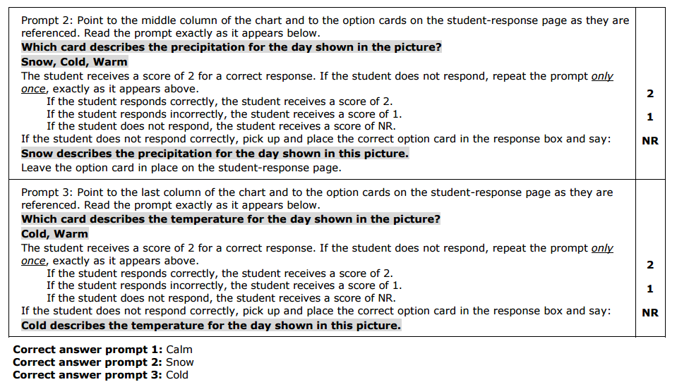
Supported Performance Task
Teacher Facing Page
Notes:
The same protocol is followed with the second prompt. Remember to leave the response card from the previous prompt on the student facing page.

Slide 98
Supported Performance Task
Student Facing Page

Slide 99
Supported Performance Task
Student Facing Page
Notes:
The student got the correct answer, so the Test Examiner scores a 2.

Slide 100
Supported Performance Task
Student Facing Page
Notes:
The student got the wrong answer, so the Test Examiner scores a 1 and reads the script.

Slide 101
Supported Performance Task
Student Facing Page
Notes:
Always end with the correct answers in the corresponding boxes.

Slide 102
Supported Performance Task
Student Facing Page
NR
Notes:
If the student does not answer, the test examiner places the correct answer and reads the script.

Slide 103
Supported Performance Task
Student Facing Page
Notes:
If the student does not answer, the test examiner places the correct answer and reads the script.

Slide 104
Supported Performance Task
Teacher Facing Page
Notes:
The same protocol is followed with the third prompt. Remember to leave the response card from the previous prompt on the student facing page.

Slide 105
Supported Performance Task
Student Facing Page

Slide 106
Supported Performance Task
Student Facing Page
Notes:
The student answered correctly so the Test Examiner scores a 2.

Slide 107
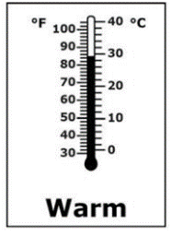
Supported Performance Task
Student Facing Page
Notes:
Present item and wait for a response.
If the student answers incorrectly they score a 1. The test examiner removes the incorrect card and places the correct answer in the box.

Slide 108
Supported Performance Task
Student Facing Page
Notes:
Always end with the correct answers in the corresponding boxes.

Slide 109
Supported Performance Task
Student Facing Page
NR
Notes:
If the student does not answer, the test examiner places the correct answer and reads the script.

Slide 110
Supported Performance Task
Student Facing Page
Notes:
Always end with the correct answers in the corresponding boxes.

Slide 111
Planning and scheduling for assessment administration days
Notes:
Since the test administrator must assess each student in a one-on-one setting, and since the whole assessment for each content area is divided into several testlets, test administrators need to consider how to ensure all students will complete all of their testlets before the assessment window closes.

Slide 112
Planning and Scheduling
Considerations
Number of students to be assessed
Administration time per testlet
Total administration time
Number of testing devices and assistive technologies needed
Assessment location (classroom vs. computer lab)
Consider unforeseen circumstances
Student absences
Test administrator absences
Longer than expected assessment sessions
School cancellations
Technology issues
Notes:
Consider the following when planning and scheduling test administration:
Determine the number of students to be assessed. Multiply that number by the number of testlets for the grades and content areas to be assessed. Most testlets take 5 to 15 minutes to administer, but that will vary from student to student since the population of students who participate in this assessment is so diverse. The average time to complete a testlet in Colorado is 7 minutes for math and 5 minutes for ELA. Using the released testlets as practice will provide some idea of how long each student will take to complete a testlet so plans may be made based on the total number of testlets being administered.
Consider the number of testing devices needed, the number of students who will complete testlets on a desktop or laptop computer versus a tablet, and the number of students who will need assistive technologies.
Determine where test administration will take place and whether students will be assessed in a classroom or if it is necessary to reserve space in a computer lab. Remember, the assessment cannot be administered to groups of students; even within the same grade, students will be taking different testlets at varying linkage levels with different TIPs. While this is a standardized assessment, it is individualized for students. It must be administered one-on-one.
Getting ready to administer an actual testlet requires a designated quiet area for testing clear from distractions. If it is necessary to assess a student in a classroom where other students are present, arrange the computer monitor or other testing display so it is only visible to the student being assessed. Also, set up any accessibility devices needed before initiating the testlet with the student.
Evaluate student behavior. Not every day is a good day to assess a student. Use professional judgment, and reschedule testing for another time if a student is not having a good day on the intended assessment day. If the student gets tired or distracted during a testlet sooner than expected, allow the student to take a short break. In some states, it is allowable to use the EXIT DOES NOT SAVE button to discontinue a testlet so a student can return to it and start over at a better time. Using the button erases all work on the current testlet. Therefore, the student will have to restart the testlet from the beginning. Follow state guidance regarding the use of the EXIT DOES NOT SAVE button.

Slide 113
Getting Ready
Designate testing location
Quiet area
Clear from distractions
Students are not to be tested in a room with other students.
Arrange the testing device so the display is only accessible to the student being assessed
Set up accessibility devices as needed
Stage materials as needed
Consult the TIP
Gather materials
Substitute as needed and allowed
Evaluate student behavior
Notes:
Getting ready to administer an actual testlet requires a designated quiet area for testing clear from distractions. If it is necessary to assess a student in a classroom where other students are present, arrange the computer monitor or other testing display so it is only visible to the student being assessed. Also, set up any accessibility devices needed before initiating the testlet with the student.
Evaluate student behavior. Not every day is a good day to assess a student. Use professional judgment, and reschedule testing for another time if a student is not having a good day on the intended assessment day. If the student gets tired or distracted during a testlet sooner than expected, allow the student to take a short break.
In Colorado, the Exit Do Not Save button should not be used for student behavior. Instead, it should only be used if the Test Administrator is called away and the student cannot return to finish testing. For example, a fire drill or another student has a medical issue that interrupts testing.

Slide 114
Wrap-Up

Slide 115
Notes
All parts of ELA and Math can be read to the student
All parts of Science and Social Studies are read to the student
Answer options can be accommodated for the student’s needs
Must remain in the same order
Cannot rephrase or use other words to describe them
Personal lexicon is allowed on Science and Social Studies
Reading and Writing testlets must be administered using the alphabet and not symbols
ELA and Math are stage adaptive
Science and Social Studies are scaffolded
Paras cannot give any portion of the assessment
May be in the room as support

Slide 116
Notes
DLM is only for ELA/Math
Do not roster a student to science
Will not receive a test through Educator Portal/KITE
Emphasize SC/SS is paper test
DLM ELA/Math is the alternate for 9, 10, and 11
Do not test these students on PSAT/SAT
CoAlt Monitoring
Used for training purposes
Not intended as a “gotcha”

Slide 117
Professional Development and Resources for Teachers
Notes:
Remember also that there are a number of professional development opportunities provided to support test administrators with regards not only to assessment but instruction as well.

Slide 118
Resources
Science and Social Studies Released items
https://www.cde.state.co.us/assessment/CoAlt-Items.asp
ELA and Math Resources
https://dynamiclearningmaps.org/colorado
Manuals and Blueprints Tab
Test Administration Manual
DLM Accessibility Manual
Educator Portal User Guide
Test Blueprints
ELA
Math
Resources for Educators and District Staff Tab
Educator Resource Page
Educator Resource Videos

Slide 119
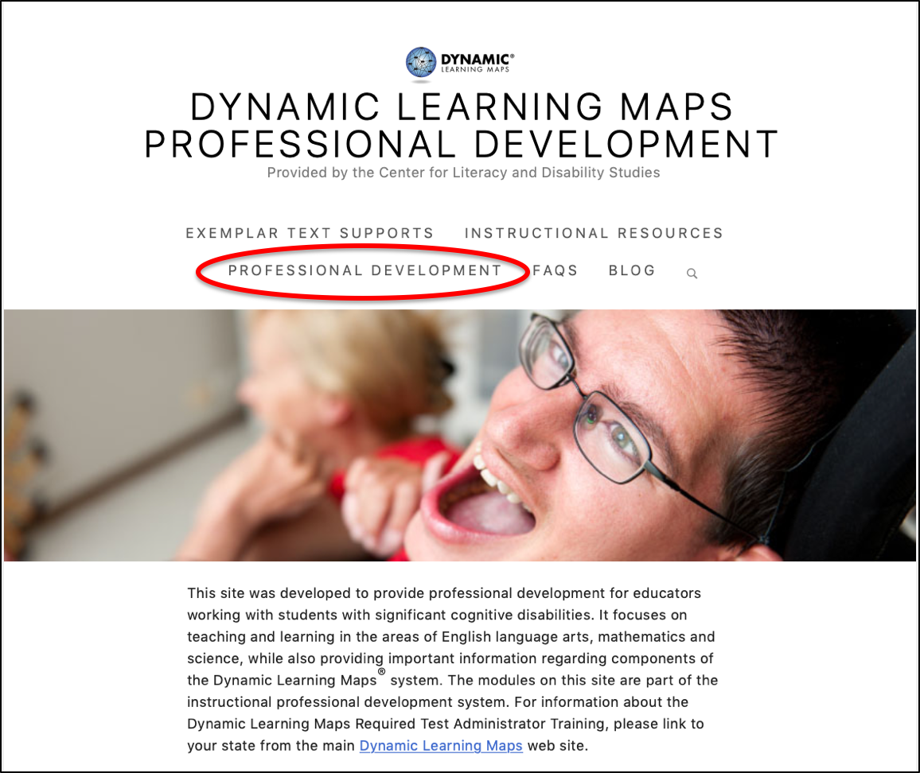
Professional Development
https://www.dlmpd.com
Notes:
Go to dlmpd.com or click the Professional Development tab of the DLM website home page. The University of North Carolina at Chapel Hill developed these professional development modules. They typically have a short running time.

Slide 120
CDE Resources
Instruction Questions
Gina Herrera
herrera_g@cde.state.co.us
Assessment Questions
Arti Sachdeva
sachdeva_a@cde.state.co.us
Pam Amato (EP, data)
amato_p@cde.state.co.us
Jasmine Carey (EP, data)
carey_j@cde.state.co.us

Slide 121
Thanks and remember to take your quiz! https://training.dynamiclearningmaps.org/login

