Slide 1
Spring 2024 CMAS Administration Training for Assessment Coordinators
Science, Math, and ELA including CSLA
November 2023

Slide 2
Welcome
Information presented in this training is current as of November 2023
These plans are subject to change
Any changes will be communicated to Superintendents and DACs as soon as possible
Use the PearsonAccess^{next} Training Site to practice different functions within the assessment data management system
Log in to confirm you have access
http://trng-co.pearsonaccessnext.com
If your account credentials do not work or you need assistance, notify the appropriate entity based on your role:
Official DAC → CDE
District-level staff and SAC → DAC

Slide 3
Agenda
General Information
Timeline & Assessment Structure
PearsonAccess^{next}
Before Testing
Registering Students, Ordering Materials & Setting Up PAnext Test Sessions
Technology Overview
Administrative Considerations, Accessibility Features, & Accommodations
Testing Environment
Receiving Materials & Test Security
During Testing
Administering Tests
Basic Technical Troubleshooting
Make-up Testing
After Testing
Returning Materials
PAnext Clean-up
Additional Information
Resources & Support

Slide 4
General Information

Slide 5
What is CMAS?
Colorado Measures of Academic Success (CMAS)
Colorado’s standards-based assessments designed to measure the Colorado Academic Standards (CAS)
English language arts/literacy (ELA)
Mathematics
Science
Social Studies*
Purposes
Indicate the degree to which students have mastered the expectations of the CAS in each content area at the end of the tested grade level
Results provide one measure of a student’s academic progress relative to the CAS
Districts and schools may use aggregated scores to monitor their programs’ effectiveness
CMAS Administrations
Science and social studies: 2013-14 was the 1st administration year
Math and ELA: 2014-15 was the 1st administration year
* Social studies assessments not administered in spring 2024

Slide 6
Resources
Spring 2024 CMAS Manuals
Procedures Manual
Assessment Coordinators use the Procedures Manual for instructions on test security, test administration, accessibility features and accommodations, and data management. The manual includes procedural steps that must be taken before, during, and after test administration.
Test Administrator Manuals (TAMS)
Test Administrators use TAMs for detailed instructions and general administration scripts to prepare for testing and administer tests in a standardized manner. There are two TAMs: one for computer-based testing and the other for paper-based testing.
Manuals are available at https://coassessments.com/manuals/

Slide 7
Resources
Resource
Quick Reference Materials
CMAS Overview
Technology Overview
Before Testing Checklist
Unit Testing Times and Testing Multiple Groups Guidance
State Assessment Acronyms
Creating Sample Students in the PAnext Training Site
CMAS and CoAlt Security Agreement
Sign and return to DAC/SAC
Throughout the training, click this icon to view resources relevant to the info on a slide.
Resources are available at http://www.cde.state.co.us/assessment/training-cmas

Slide 8
Resources
Modules and Guidance Documents
The following icons appear when a relevant module or guidance document is available. Click the button to view the linked module or document in your browser.
Pearson demonstration videos are embedded for some PearsonAccess^{next} tasks
Right click the image and select “preview” to play the video if not viewing as a slide show
Go to module
Go to Doc

Slide 9
Assessment Acronyms*
Resource
AO: Additional Order
CBT: Computer-Based Test
CMAS: Colorado Measures of Academic Success
CoAlt: Colorado Alternate
CSLA: Colorado Spanish Language Arts
CPR: Colorado Practice Resource
DAC: District Assessment Coordinator
DTC: District Technology Coordinator
ELA: English Language Arts/Literacy
ET: Extended Time
ML: Multilingual Learner
PAnext: PearsonAccess^{next}
PBT: Paper-Based Test
PII: Personally Identifiable Information
PM: Procedures Manual
SAC: School Assessment Coordinator
SASID: State Assigned Student Identifier
SR/PNP: Student Registration/ Personal Needs Profile
SWD: Students with Disabilities
TAM: Test Administrator Manual
TIR: Testing Irregularity Report
TTS: Text-to-Speech
UAR: Unique Accommodation Request
UI: User Interface
*See Assessment Acronyms resource for additional acronyms and definitions

Slide 10
Overview of What’s New this Year
CMAS and CoAlt social studies assessments will not be administered in spring 2024
Materials will arrive in a single initial shipment
CMAS secure return envelopes are not included in initial shipments
DACs can place an additional order if their schools want to use CMAS secure return envelopes
Proctor caching will be available for all content areas and grades on the same day
Grade 8 and grade 11 science test codes updated to SC08S/SC08A and SC11S/SC11A
Grade 11 science consists of two units instead of three units
Each grade 11 science unit is 60 minutes
All other CMAS tests continue to have three units
Find new and updated resources on the CMAS and CoAlt resource portal: http://coassessments.com

Slide 11
District Testing Selections
DACs complete the District Testing Information and Format Selections form
This is an online form – the link is shared with official (i.e., Superintendent-appointed) DACs after completion of the CDE-hosted virtual CMAS Administration Training for DACs
Testing window dates
Transfer request contact information
Test format selections by school, grade, and content area
Other district information (e.g., closure days, spring break dates, availability for receiving shipments)
Submit the online form by December 15, 2023
Common Question

Slide 12
Paper-based Testing §22-7-1013(6), §22-7-1006.3(1)(d-e)
Each LEP must adopt and implement a written policy by which it decides whether to request the paper form of the state assessments for its students
Decision must be made in consultation with schools and parents
Copy of policy must be shared with parents and posted on LEP website
LEP may make the decision by school or class (i.e., grade level and content area)
LEP will report to CDE the number of students who will take the paper form (indicated prior to initial order deadline)
Considerations
Technology capacity
Logistics
Must have the grade appropriate calculators for math (grades 6-8)
Paper form always available to individual students as an accommodation
Online form is also available as an accommodation
Must commit to meeting security requirements and accounting for all secure materials
Chain-of-custody documentation and reports for missing materials

Slide 13
Assessment Information and Calendar §22-7-1013(7)(a)
LEP will annually distribute to parents and post on its website, as early in the school year as possible, written information regarding its assessments, including:
The state and local assessments that the LEP will administer
Identify whether it is required by federal law, required by state law or selected by the LEP
Assessment calendar:
Estimated hours of testing each testing day for specific classes/grades for each assessment
Identify whether the assessment is required by state law, federal law or locally selected
The purposes of the assessments
The manner in which assessment results will be used
Quick Reference on Federal and State Required Assessments (includes applicable statutes and purposes): http://www.cde.state.co.us/communications/stateandfederalassessmentrequirements
Helpful Resource

Slide 14
Parent Excusals §22-7-1013(8)(a-c)
A student’s parent may excuse the student from participating in a state content assessment
Each LEP will adopt and implement a written policy and procedure by which a student’s parent may excuse the student from participating in one or more of the state content assessments.
If a parent excuses his or her student, the LEP shall not impose negative consequence on the student or parent including:
Prohibiting school attendance; imposing an unexcused absence; or prohibiting participation in extracurricular activities.
Prohibiting the student from participating in an activity or receiving any other form of reward that the LEP provides to students who participate in the state assessment.
LEP shall not impose an unreasonable burden or requirement on a student that would:
Discourage the student from taking a state assessment or
Encourage the student’s parent to excuse the student from taking the state assessment.

Slide 15
Personally Identifiable Information (PII)
State and Federal laws require protection of student PII
PII is any information that, alone or in combination, could identify an individual student (e.g., name, SASID, detailed demographics)
Emails can be intercepted, forwarded, and misrouted and are not secure methods for transmitting PII
It is CDE policy that any email with PII sent to, from, and within CDE must be encrypted
CDE strongly recommends that you encrypt emails with PII that are sent to other parties (other districts, within the district, vendors, etc.)
Additional Resources: http://www.cde.state.co.us/dataprivacyandsecurity

Slide 16
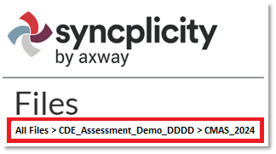
Syncplicity
The official DAC uses Syncplicity to transfer secure information and PII to CDE
User Guide available at http://www.cde.state.co.us/assessment/ausyncug
CDE Assessment folders and CDE Accountability folders are managed by different groups at CDE - CDE Assessment controls ONLY the CDE Assessment folders
All documents from previous years were removed and archived by CDE
When posting
Ensure documents are placed in correct folders
Provide notice of uploaded files to the appropriate contact at CDE
Email file path and include the file name
Helpful tip: Files loaded through the browser are shared/updated faster than those loaded through the desktop app
Optional: Each district may add one additional user who can access all CDE Assessment folders
Confirm the district allows the individual to access student PII, including assessment files and reports
Email Collin Bonner at bonner_c@cde.state.co.us to request/update
It is the DAC’s responsibility to contact CDE if the additional user should no longer have access to the CDE Assessment folders

Slide 17
Timeline & Assessment Structure

Slide 18
Spring 2024 CMAS Window
Assessment | Grade(s) | Official Window
CMAS and CoAlt: Science | 5, 8, 11¹ | April 8-26, 2024
CMAS: Math and ELA (CSLA²) | 3-8¹
CoAlt: DLM ELA and Math | 3-11 | Aligned to CMAS: Math and ELA schedule
¹See following slides for early and extended window options
²CSLA is for eligible Multilingual Learners in grades 3 and 4 only

Slide 19
Spring 2024 CMAS Window
Official window: April 8-26, 2024
All grade 5 and 8 science administrations must be completed within this window
All school-wide paper-based administrations for math and ELA must be completed within this window
Students requiring paper accommodations in schools utilizing the extended online window options may test at the same time as their peers (this includes CSLA)

Slide 20
Spring 2024 Early/Extended Window Options
Resource
Math and ELA
To compensate for technology capacity, the math and ELA window can open early and/or close late for online administrations only
Earliest start date: April 1, 2024
Latest end data: May 3, 2024
This is an extended window – total of 5 testing weeks
Grade 11 science
To accommodate high school assessment schedules including SAT, AP, and IB exams, the grade 11window can open and close early
Early window option for grade 11: April 1-19, 2024
This is an early window – total of 3 testing weeks
Indicate intent to participate in early/extended windows on the District Testing Selections form and submit by December 15

Slide 21
Spring 2024 Critical Dates – Tentative
Activity | Extended Math and ELA (CBT) | Early Grade 11 Science | Grades 5 and 8 Science and Math/ELA (PBT)
Submit updates through UI or SR/PNP for initial orders | January 8-26
Online test session set-up begins | January 8
Materials scheduled to arrive in districts | Week of March 19 Assessment Coordinator Kits, TAMs, student materials, student ID labels |  | March 24 Student materials, student ID labels
Proctor caching test content begins | March 18 |  | March 23
Prepare Test Sessions | March 29 | March 29 | April 3 | April 5

Slide 22
Spring 2024 Critical Dates – Tentative
Activity | During/After Testing
Additional Orders – Secure Materials | March 20-April 30
Additional Orders – Non-secure Materials | March 20-May 8
Deadline for UPS scorable pickups** | May 1*
Deadline for UPS nonscorable pickups | May 3*
*Districts testing beyond April 26 (i.e., using the extended online math and ELA window through May 3) will be provided alternate return dates if any students in the district require accommodated paper materials. Alternate return dates will not be provided to districts using only the front-end extension or to those that do not have any accommodated paper ELA/CSLA or math materials at schools testing online
**If scorable materials are not picked up by May 1, there is no guarantee that records for these PBT students will be included in SBD or scored.
24-48 hours in advance of the pickup, call 1-800-823-7459 to schedule a pickup request for Pearson using their “Return Service”

Slide 23
Spring 2024 Critical Dates – Tentative
Description | Post Testing Clean-up Tasks | Window Dates
PAnext Clean-up (School and District)* | Confirm Student Registrations and Demographics Update Used Accommodations Mark Complete Units Stop Sessions Indicate Not Test and Void Test Score Reasons/Codes Resolve Rejected Student Tests | Through May 8
Student Biographical Data (SBD) Review (District) | Demographics and invalidations cleaned in CDE’s Data Pipeline | May 16-29 (Tentative)
*Districts can set internal school-level clean-up deadlines by disabling PearsonAccess^{next} accounts prior to May 8
Procedures Manual Appendix K: Data
Data Section 2: Preparing Student Data Prior to and Following Assessment Administration https://www.cde.state.co.us/assessment/cmas_coalt_proceduresmanual_sp24#page=198

Slide 24
Colorado Spanish Language Arts (CSLA)
CSLA is a paper-based accommodated version of ELA
Follows the design, guidelines, and scheduling of ELA
Assign Test Code SLA03 or SLA04 instead of ELA03 or ELA04
Students previously registered by CDE: district/school removes ELA test assignment and adds SLA test assignment
Students registered by district (i.e., not included in October Count): district/school assigns SLA test instead of ELA
Because CSLA is an EL accommodation, other EL accommodations are not allowed on CSLA
Qualifying students
Multilingual Learners (NEP, LEP)
Grades 3 and 4
Language arts instruction in Spanish within the past 9 months
Students in an English language development program for less than five years
Connect with the district’s EL coordinator to determine which students may be eligible for CSLA and other Spanish forms
CMAS Spanish Assessments Decision Making Flowchart
http://www.cde.state.co.us/assessment/cmas_spaassessflowchart

Slide 25
First Year in US Multilingual Learners – ELA Only
Use the following guidance to determine if students who are Multilingual Learners, who enrolled in a United States (U.S.) school for the first time on or after April 10, 2023 (first year in the U.S.), will participate in CMAS ELA or CSLA, or if they are exempt from language arts testing this year
Students who are NEP, based on WIDA Screener and a local body of evidence, may be exempt from the ELA assessment
3rd and 4th grade NEP students whose primary or home language is Spanish and who have received language arts instruction in Spanish within the past 9 months are required to take CSLA
Students identified as NEP whose primary or home language is not Spanish, whose primary or home language is Spanish but have not received Spanish language arts instruction within the past 9 months, or whose primary or home language is Spanish but are in 5th through 8th grade, are exempt
A parent/guardian of a student who meets exemption guidelines may choose to have their child participate in ELA testing. Results for these students are included in accountability and growth calculations for the following year.
Students who are LEP, based on WIDA Screener and a local body of evidence, must take the state language arts assessment that best matches their instruction: CMAS ELA, CSLA (if eligible), or CoAlt (if eligible)

Slide 26
Guidelines for Administration Time
Task | Time to be Allotted for an Administration
Prepare for testing (includes reading SAY directions script from TAM and answering student questions) | 10 minutes (recommended)
Distribute test materials | 5 minutes (recommended)
ELA/CSLA unit testing time Math unit testing time Grades 5 and 8 Science unit testing time Grade 11 Science unit testing time | 90-110 minutes* 65 minutes 80 minutes 60 minutes
Complete end-of-unit activities, including closing units and collecting test materials | 5–15 minutes (recommended)
*Testing time depends on grade level/content area — refer to Unit Testing Times and Testing Multiple Groups resource

Slide 27
Guidelines for Administration Time
Schedule the entire amount of unit testing time
Once the unit testing time is met, the unit must end
A student is only allowed an extended time accommodation if listed in his or her IEP, 504, or ML plan
If all students complete testing before the unit testing time is met, the Test Administrator may end the unit (no minimum testing time)

Slide 28
Unit Testing Times: Grades 3-5
Resource
Assessment | # of Units | Section | Minutes
Math Grades 3-5 | Unit 1 | Non-calculator | 65
 | Unit 2 | Non-calculator | 65
 | Unit 3 | Non-calculator | 65
ELA Grades 3-5, incl. CSLA Grades 3-4 | Unit 1 |  | 90
 | Unit 2 |  | 90
 | Unit 3 |  | 90
Science Grade 5 | Unit 1 |  | 80
 | Unit 2 |  | 80
 | Unit 3 |  | 80

Slide 29
Unit Testing Times: Grades 6-8
Resource
Assessment | # of Units | Section | Minutes
ELA Grades 6-8 | Unit 1 |  | 110
 | Unit 2 |  | 110
 | Unit 3 |  | 110
Science Grade 8 | Unit 1 |  | 80
 | Unit 2 |  | 80
 | Unit 3 |  | 80

Slide 30
Unit Testing Times: Grades 6-8 Math
Resource
Assessment | # of Units | Section | Minutes
Math Grades 6-8 | Unit 1 | Non-calculator | 65
 |  | Calculator
 | Unit 2 | Calculator | 65
 | Unit 3 | Calculator | 65
Refer to the Calculator Policy at http://www.cde.state.co.us/assessment/cmas_calculator_policy

Slide 31
Unit Testing Times: Grade 11
Resource
Assessment | # of Units | Section | Minutes
Science Grade 11 | Unit 1 |  | 60
 | Unit 2 |  | 60

Slide 32
Calculating Unit Testing Times
Unit timing box included with each set of SAY directions in the TAM
Example: Grades 6-8 Math
¹Refer to the Unit Timing Guide in Appendix B for assistance calculating the stop time.
Reminder: Adjust warning and stop times by 3 minutes if a stretch break is taken during the unit.
Unit Timing Guide included in TAM Appendix B
Unit Timing (65 Minutes)
 | Unit 1 | Unit 2 | Unit 3
Start
20 Minute Warning |  | N/A | N/A
10 Minute Warning
Stop¹

Slide 33
Guidelines for Breaks
Scheduled breaks may occur between units
Students may not have access to cell phones during scheduled breaks
During each unit, a short “stand-and-stretch” break is permitted at the discretion of the Test Administrator
Time stops for the unit, but only for up to 3 minutes
Activity | Time
Unit 1 | 8:00 a.m. – 10:00 a.m.
Scheduled Break | 10:00 a.m. – 10:15 a.m.
Unit 2 | 10:15 a.m. – 12:15 p.m.

Slide 34
Scheduling Considerations
Administer all test units in consecutive order
All content areas
Includes make-up testing
Excluding make-ups, determine
Whether one content area will be completed before beginning the next, or if testing will alternate between the content areas
Whether the district will condense testing or spread throughout the state testing window
How many units students will take per day
Complete all tests by April 26, 2024*
Plan extra days at the end of the window to account for cancellations due to snow or other unexpected closures
Plan time for make-up testing
*May 3, 2024 for districts using the backend extension for CBT ELA/math.

Slide 35
Scheduling Considerations
Paper-based testing
PBT window does not open until April 8, 2024
Exception: Three-week grade 11 science window can open as early as April 1
A school must administer the same unit to all PBT students within the same day (e.g., all Grade 4 Math Unit 1 on Tuesday)
Schools must have the grade level appropriate calculator (grades 6-8) if administering math on paper
Grade level appropriate calculators should also be available, as needed, for students taking science on paper
Administer CBT accommodations on the paper schedule
Computer-based testing
Math and ELA CBT window can open as early as April 1, 2024
Three-week grade 11 science window can open as early as April 1
Grades 5 and 8 science CBT window cannot open until April 8
To the extent possible, assess all students within the school at the same time
If not possible, assess all students within the shortest timeframe practicable
Administer PBT accommodations on the online schedule

Slide 36
Scheduling Considerations
To the extent possible, a student taking CoAlt in a content area for which the student is participating in a general education class should be assessed at the same time as their peers to avoid missed instruction
Ensure students taking these assessments do not miss instruction from their general education class

Slide 37
Scheduling Sessions
Resource
If the unit testing time and directions are the same, different grades can test in the same room
A separate testing environment is needed for:
Paper-based and computer-based (administration SAY directions and materials are different)
ELA and mathematics (unit testing times and administration SAY directions are different)
Directions read aloud in a language other than English
English tests and Spanish accommodated forms
Science and ELA/math (unit testing times and administration SAY directions are different)
Grade 11 science and grades 5 and 8 science (different unit times)
Math grades 3-5 and math grades 6-8 (different administration SAY directions)
Math grades 6-8 unit 1 and math grades 6-8 units 2 and 3 (different administration SAY directions)

Slide 38
Afternoon Testing
If the school is having technology issues, do not start a unit unless there is enough time left in the day to complete the unit
It is a misadministration for a testing group to start the test and then stop and complete it the next day
This is only allowed for illnesses and unforeseen situations (e.g., school power outage)

Slide 39
After-hours Testing
If a school will start a test session after 4:30 p.m.
The official DAC must email the following information to CDE (loerzel_s@cde.state.co.us) ASAP
School name
Online test session name (not just the name of the test)
Anticipated testing dates
CDE will grant the test session(s) permission to test after hours
District or school must “prepare” and “start” the test session first

Slide 40
PearsonAccess^{next}

Slide 41
User Accounts
Go to module
User Roles – assigned to PAnext users
Permissions - each user role contains permissions that determine which tasks the user can perform in PAnext
Once a user has a specific role, they can grant that role to another user account
Reference the User Role Matrix (Appendix H in the Procedures Manual) for additional information on role assignment and permissions

Slide 42
User Accounts
CMAS roles and their coordinating “base roles” in PearsonAccess^{next}
Base roles provide access to system features needed to perform CMAS tasks
CMAS Role | PearsonAccess^{next} Base Role
District Assessment Coordinator (DAC) | LEA/District Test Coordinator
School Assessment Coordinator (SAC) | School Test Coordinator
District Technology Coordinator (DTC) | Technology Coordinator
CMAS Test Administrator | Test Administrator
Higher level roles, like LEA/District Test Coordinator, include permissions included in lower-level roles, like Test Administrator

Slide 43
User Account Add-on Roles
“Add-on roles” are assigned in addition to “base roles” to provide access to additional functionality in PearsonAccess^{next}
The following add-on roles are assigned to DACs
Sensitive Data Role – View and edit sensitive student data
Users with this PAnext role have access to PII
Must have this role to import SR/PNP files
Student Test Update – Allows export/import of STU file to batch update Void and Not Tested codes/reasons
OnDemand Admin Report Access – Provides access to post-test on-demand individual student reports – these reports do not include comparative data
Published Reports – Provides access to post-test reports (i.e., results) and data files
Note: Roles are added/removed from accounts throughout the year

Slide 44
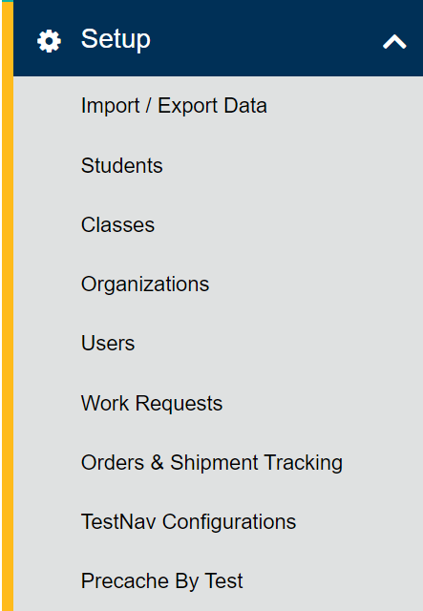
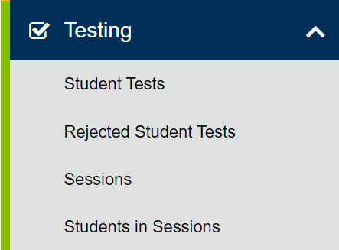
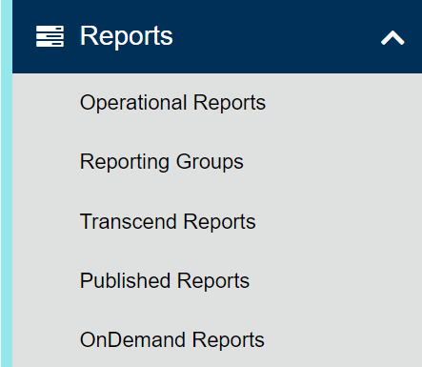
PAnext
Go to module
Administration:
CMAS or CoAlt
(back to 2013-2014)
Change your view
Colorado > 2023 – 2024 > CMAS Spring 2024 COLORADO (CO)
Menus
Organization:

Slide 45
PAnext – Setup Actions
Import/Export Data
Student Registrations (SR/PNP), Enrollment Transfers, Student Test Updates (STU), Users
Students
Create and edit student records
Register students for the current test administration - indicate demographic information
Manage student tests – add test assignments and update PNP
Classes
Create and edit classes to assign groups of students to online test sessions
Organizations
Check contact information
Verify student registrations and test assignments from January 8-26, 2024 before the initial orders pull (determines material quantities for shipments)

Slide 46
PAnext – Setup Actions (continued)
Users
Create and edit user accounts
Work Requests
Submit student record transfer requests to other districts
Review, approve, and reject student record transfer requests received from other districts
Orders & Shipment Tracking
Order additional materials
Track material shipments
TestNav Configurations
Configure TestNav settings
Precache By Test
Proctor cache test content

Slide 47
PAnext – Testing Actions
Student Tests
All tests assigned to students in the selected organization
Edit student tests (PNP)
Rejected Student Tests
After testing for PBT and CoAlt only
Resolve demographic mismatches for scanned test books
Sessions
Create and edit online test sessions
Add students to sessions
Lock all units for all tests in the selected organization
Students in Sessions
Print Student Testing Tickets and Session Rosters
Verify special form assignment
Manage live testing – start sessions, resume and unlock units, mark tests complete, move students between sessions

Slide 48
PAnext – Reports Actions
Operational Reports
Run live reports on student data, online testing, orders, etc.
Reporting Groups
For OnDemand Reports
Create and manage reporting groups of students
Assign and remove users from reporting groups
Published Reports
After testing
Results – data files and reports
OnDemand Reports
After testing
Preliminary student performance results
Comparative data not included (state-, district-, school-level)

Slide 49
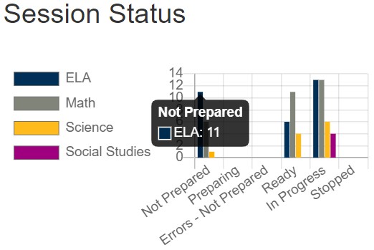
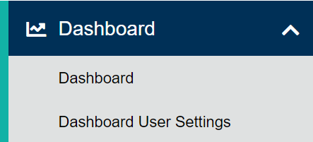
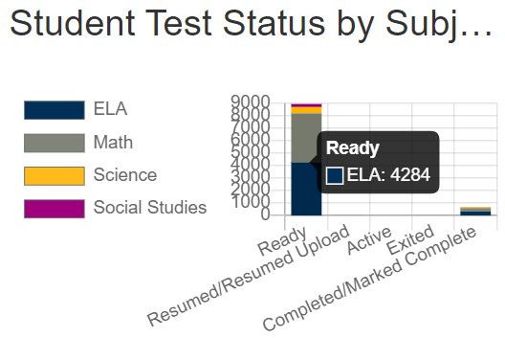
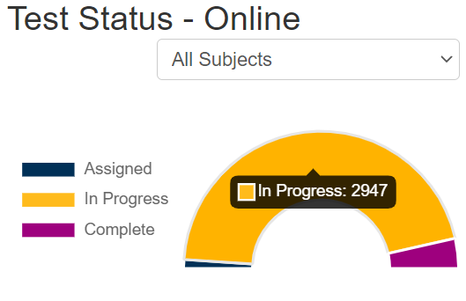
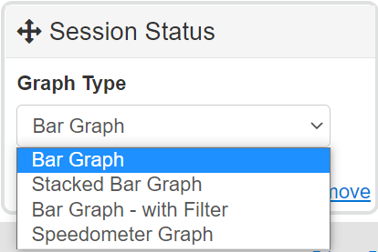
PAnext – Dashboards
Dashboards are available for users with DAC or SAC roles
Dashboards
Session Status
Student Test Status by Subject
Test Status – Online
Users can customize settings
Hide graphs
Change graph type

Slide 50
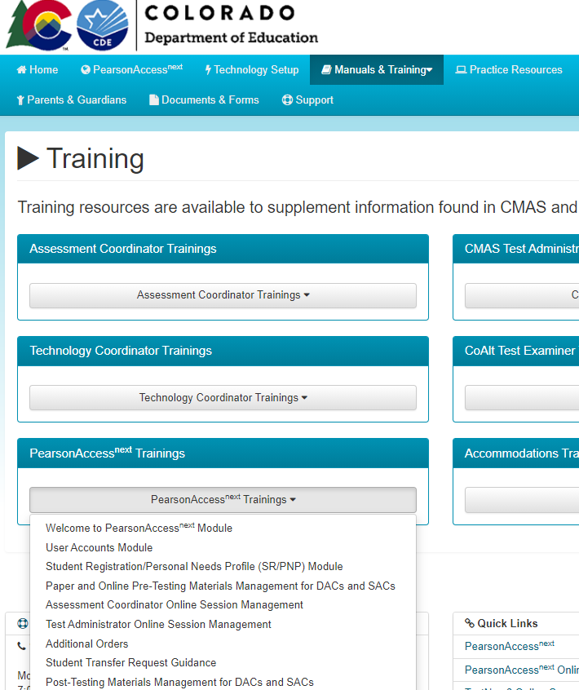
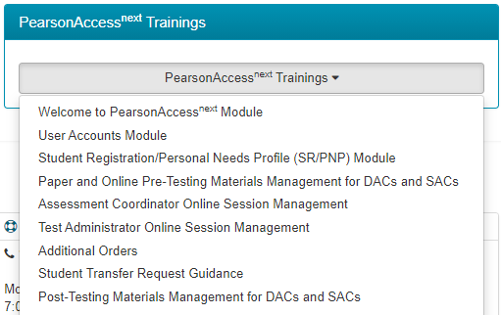
PAnext Training Modules
Reminder: PAnext is used for student test data management (and accessing results) for both online and paper-based testing
Short training modules are available for different PAnext activities: https://coassessments.com/training-mods/

Slide 51
Before Testing
Resource

Slide 52
Annual Training Requirement
Everyone involved in CMAS math, ELA/CSLA, and science administration must complete training each year
Includes DACs, SACs, Test Administrators, technology personnel, and any other school or district staff involved in administration
DACs and SACs are responsible for ensuring all individuals involved in test administration and/or handling secure materials receive training and sign the CMAS and CoAlt Security Agreement
Refer to the State Assessment Training Requirements at http://www.cde.state.co.us/assessment/annual_trng_requirements

Slide 53
Training
Comprehensive training must include:
Test Security
Standardized Test Environment
Test Administration
Test Session Management (for appropriate personnel)
Test Administrator Role vs. Teacher Role
Opportunity for personnel to ask questions
CDE provides a basic PPT that districts may update and use for Test Administrator trainings
Typically available in January
There are separate PPTs for CBT and PBT
Districts need to add district-specific instructions

Slide 54
Who Can Administer a Test?
Common Question
School and district employees who are trained on this year’s procedures and security
Substitute teacher requirements for CMAS administration
Colorado teacher or substitute teacher license is required. If a substitute teacher license is held, a three- or five-year license is recommended.
Students should be familiar with the substitute teacher.
Like all individuals involved in CMAS administration, substitute teachers serving as Test Administrators must be trained on the current year’s administration policies and procedures and must sign a current CMAS and CoAlt Security Agreement.
Student Teachers are NOT allowed to be the only person in the room or responsible for the administration of the assessment
Student teachers may be an additional person (proctor) in the room during testing

Slide 55
Student Readiness
Student practice resources are available on http://coassessments.com
Colorado Practice Resources (CPRs)
Computer-based testing
Paper-based testing
CPR Guides - include scoring information (e.g., answer keys and rubrics)
TestNav tutorial with a walk through of various item types and embedded tools
During testing, Test Administrators cannot help students with TestNav navigation and answering questions in test books
May not help with how to answer a question
May not show how to go to the next question or use the review screen
May not assist with drag and drop or other technology enhanced items
Strongly recommend students are provided access to CPRs prior to testing
Includes forms with accessibility features and accommodations

Slide 56
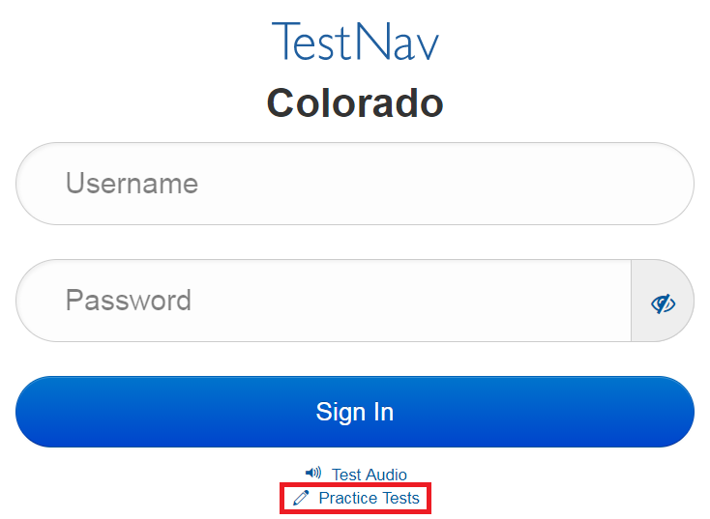
Student Readiness
Additional ways to access CBT CPRs:
TestNav App
Navigate to “Colorado” sign in page
Select “Practice Tests” link
PAnext Training Site
Requires login from student testing ticket
Secure practice sessions must be setup in advance

Slide 57
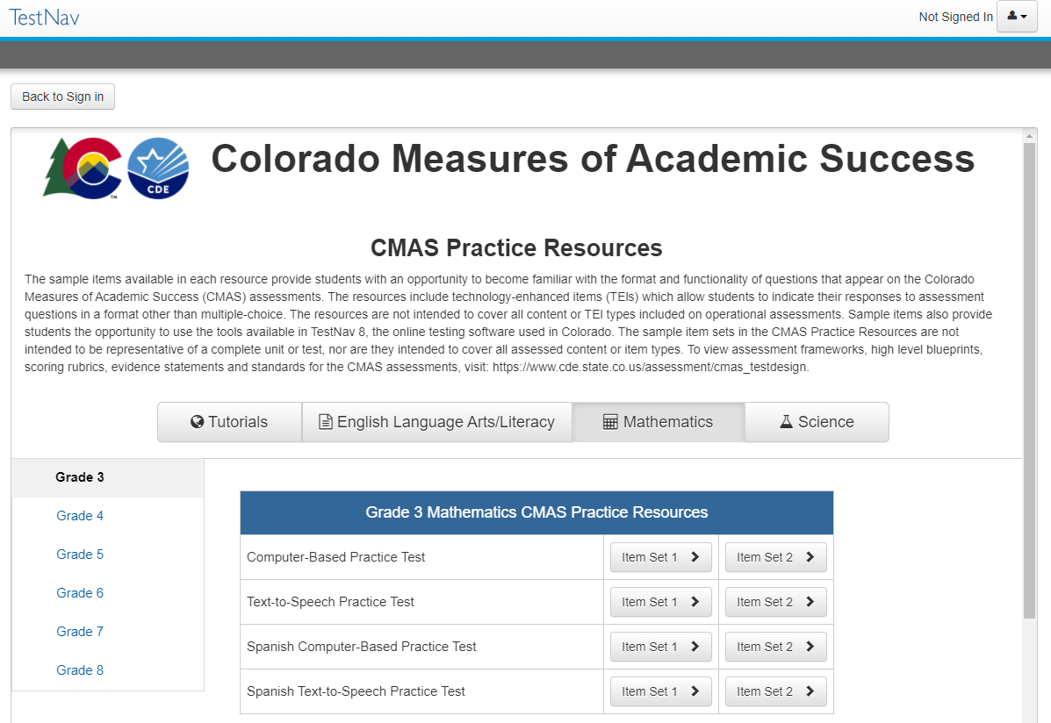
Student Readiness
App based CBT CPRs:

Slide 58
Registering Students, Ordering Materials & Setting Up PAnext Test Sessions

Slide 59
Student Registration Reminders
CDE initially registers students for districts using October Count data
Add new students into PAnext prior to testing, including for PBT
Do NOT use temporary SASIDs
Contact Sara Loerzel at CDE for help with SASIDs
There are several fields in the SR/PNP that are used to validate selected accommodations
If an error is received upon import, check cross-validation fields
These fields are only seen by PAnext users with the Sensitive Data role
Middle name field can be blank
Preferred First Name field is optional
If this field is populated, this name is used in place of the Legal First Name on student ID labels (PBT) and student testing tickets (CBT)

Slide 60
Registering for PBT
Initial orders for PBT materials are generated using information indicated for students in the SR/PNP as of January 26, 2024
PBT for district/school/grade/content area
Paper format is indicated for you if the intent to use PBT is submitted to CDE by December 15
If PBT selection is not provided to CDE by December 15, district/school needs to indicate
PAnext additional orders for whole districts/schools/grades/content areas are not approved (including when tests are not updated from English to Spanish)
Ensure charter school selections are indicated
Individual students using PBT accommodated forms
Indicate Spanish Transadaptation and other accommodations prior to January 26
CDE adds UEB (with Nemeth for math/science) registrations into the initial upload for students who were assigned braille last year (district/school adds grades 3 and 11)
Update math and science to UEB Math/Science, if needed

Slide 61
Accommodated Materials Ordering by January 26*
Ensure the following materials for individual students are in PAnext
Large print and braille registrations
Auditory/signed presentation scripts
CSLA and other Spanish forms
CDE indicates UAR-dependent accommodations
Must meet December 15 UAR deadline
* Exception for new students who arrive after January deadline – DACs need to place an additional order for PBT or accommodated materials after updating student registrations

Slide 62
Registering a Student in PAnext through a File Upload
Go to module
Select the Setup menu and choose Import/Export Data
Choose Import/Export Data and click Start

Slide 63
Registering a Student in PAnext through a File Upload
Under Type, select Student Registration Import
DURING the January 8-26 registration window, edits are allowed to the Unique Accommodation field
AFTER the January 8-26 registration window, edits are not allowed to the Unique Accommodation field
Find and select the locally saved file
Select Process

Slide 64
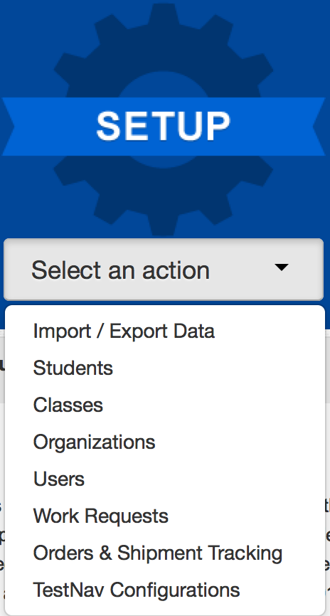
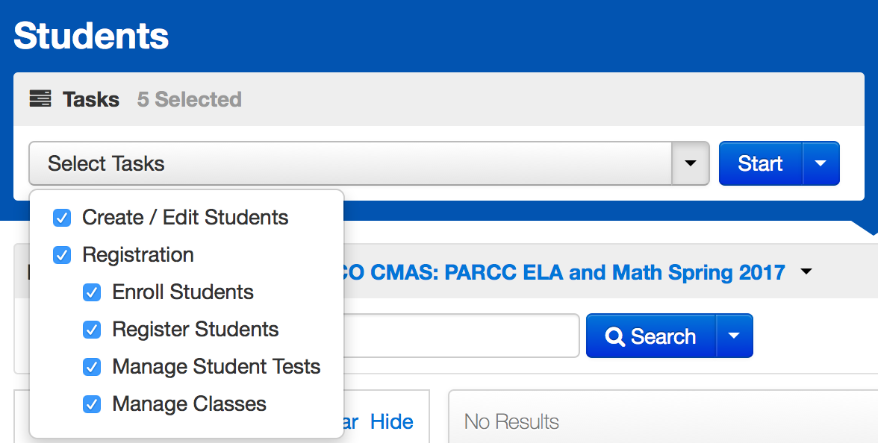
Registering a Student in PAnext Through the User Interface
Go to module
Select the Setup menu and choose Students
Choose the Tasks and click Start

Slide 65
Create or Edit a Student Record Through the User Interface

Slide 66
Register a Student
Create/Enroll, Register, and Assign Student Tests through the PAnext UI https://www.cde.state.co.us/assessment/cmas_coalt_proceduresmanual_sp24#page=173

Slide 67
Operational Reports within PAnext – Help with Registration
Recommended reports
PNP Report – accessibility features and accommodations for student tests
Students where responsible district/school is different from testing district/school
Students registered but not assigned to a test
Students with online test but not assigned to session
Students with multiple tests of same subject area
PearsonAccess^{next} Operational Reports https://www.cde.state.co.us/assessment/cmas_coalt_proceduresmanual_sp24#page=184

Slide 68
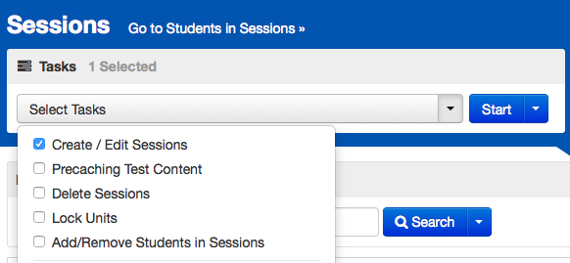
Online Testing Management
Go to module
Select the Testing menu and choose Sessions
Choose the Tasks and click Start

Slide 69
Create an Online Test Session
Need to edit online test session details? https://support.assessment.pearson.com/display/PAsup/Edit+a+Session

Slide 70
New Students
Whether new students who enroll during the state testing window are tested depends on the individual school’s testing status
Schools are encouraged to test all students who are enrolled in the school during the testing window within reason
Examples:
A student enrolls during the first week of the main window (April 8-12, 2024) – the school should typically administer the assessments
A student enrolls in the last week of the official window – the school is not required to administer the assessments
If this is the case, the new student should not be entered into PAnext
However, give special consideration for newly enrolled students who started testing in their previous school of enrollment but did not finish
Student started testing in the previous district but did not finish:
If the student started testing on paper, securely transfer the test book between districts through DAC-to-DAC handoff or via secure shipment requiring signatures so the student can complete testing
If the student started testing online, transfer the started test to the new district through PAnext so the student can complete testing

Slide 71
Add Students to Online Test Sessions

Slide 72
Work Request – Student Transfer Process
Go to Doc
Student transfers from District A to District B prior to beginning testing:
District B attempts to register student in PAnext, but receives an error stating, “The student can only be enrolled in 1 organization.”
District B completes a Work Request to transfer the student to District B (through UI or file import)
An email is sent to District A’s Work Request contact and a red bell appears at the top of District A’s home screen
District A confirms that student transferred and approves the request (through UI or file import)
The student’s record is moved to District B
District B must go into the student registration and test assignment screens and make any necessary changes
If District A does not approve the transfer – the student’s record remains with District A
Don’t forget!

Slide 73
Place a Work Request

Slide 74
Work Request – Student Transfer Process (CBT) During Testing
The student started an online test:
District B completes a work request within PAnext
District A approves the work request
The online tests assigned to the student are automatically transferred to District B
The tests are placed in test sessions named “Transferred [Grade - Subject]” at the new school
Required action: Move these tests into another test session
DO NOT add fake or temporary SASIDs into PAnext unless CDE approves their use; use the transfer process
If you cannot find the student in PAnext, contact CDE for assistance. Typical errors involve hyphenated names, nicknames instead of birth names (e.g., Liz instead of Elizabeth), and DOB format (yyyy-mm-dd)

Slide 75
Work Request – PBT Student Transfer
Complete a Work Request in PAnext
For a non-started test, no physical material transfers are necessary
The new school can provide a test book or can assign the student to an online assessment
If the transferred student started testing on paper:
Contact the other district and arrange for secure transfer of the test book
In-person DAC to DAC hand-off
Fed Ex or UPS – signature required – track shipment
Students may not retest a unit that they took in a previous school
Provide a chain of custody for the transferred test materials
Both districts must keep a copy of chain of custody documents

Slide 76
Work Request – Releasing District
Check email and PAnext regularly
Look for the red bell at the top of the PAnext home screen
Click on the bell to go to the pending requests
Verify the student listed in the Work Request moved away from your district
Approve the transfer
If the student did not move away from your district
Reject the transfer
Provide reason (e.g., student did not move)
The other district may have requested the wrong student
If there is an error in the school field upon opening the work request, reject the request (the student was previously removed from your district)

Slide 77
Review/Approve a Work Request

Slide 78
Work Request – Receiving District
Review the student registration and test assignments and update any necessary fields
Verify the student is assigned the correct test format and accommodations/accessibility features, by content area
Updates to a responsible school that is not in your district – completed via file upload or by CDE (call Sara Loerzel)
Updates to other schools in your district – completed through the UI or via file upload

Slide 79
Assessment in Special Circumstances
Expelled students
It is the district’s responsibility to ensure every effort is made to test expelled students receiving educational services
Identify students as expelled in PAnext
Results are included in district results; they are not included in aggregated school results
Foreign exchange students
All students enrolled in Colorado schools, including foreign exchange students, are required to take state assessments
Medical exemption
Students who are unable to complete or participate due to a documented, significant, and fully incapacitating medical condition or emergency (e.g., student is in the hospital after a car crash) that extends across the entire (or remaining) test window
The incident or condition must be so severe that it prevents the student from participating in instruction
Note: This does not apply to students who are absent during testing due to typical illnesses
Identify as “Medical Exemption” in the appropriate PAnext invalidation field

Slide 80
Assessment in Special Circumstances
Common Question
Home school students
Do not have to test (CRS, 22-7-1006.3 (3) (b))
Includes students who may also attend a public school for a portion of the school day and are therefore included in the enrollment of the LEP
However, a parent/guardian of a child in a home-based educational program may request that the child tests
Students must meet participant criteria for the requested assessment(s)
The parent/guardian must pay all costs associated with administration and providing assessment results, as determined by the district
If registered in PAnext and…
Will not test, code as Not Tested Reason 08
Will test, set the Responsible School to CO-DDDD-HHHH (where DDDD = district’s code - available in each district)
Refer to Section 2.5 in the Procedures Manual for more information

Slide 81
Technology Overview

Slide 82
Technology Overview
Resource
Online testing
Students cannot use browsers to test online
Use the TestNav app for student testing on the following device types:
Desktop/laptop computer
Chromebook
iPad
System requirements - https://support.assessment.pearson.com/display/TN/TestNav+System+Requirements
Proctor caching
Only Windows devices are supported for proctor caching https://download.testnav.com/
If using a MAC for proctor caching, Pearson offers legacy software that is not supported.
Verify the correct person is identified as the District Technology Coordinator for your district on the CDE website
http://www.cde.state.co.us/assessment/dtc
DTC receives technology updates and invitations to trainings via email
DTC Kick-off took place on October 11, 2023
TestNav Site Readiness Training for DTCs on December 13 or 15, 2023
DAC should regularly connect with DTC to ensure CBT readiness for Spring 2024

Slide 83
Technology Overview
Resource
Site Readiness Checks
DTCs use the Training Site (https://trng-co.pearsonaccessnext.com) to access the Site Readiness administration for CMAS
The Site Readiness form in this administration is used to verify performance of CMAS item types on the local network and devices
The form includes all types of items/questions used on CMAS assessments
CDE strongly suggests schools test their equipment with this form
There are explicit directions for setting up a CMAS Site Readiness Infrastructure Trial
http://www.cde.state.co.us/assessment/cmastrial
Device set up
https://support.assessment.pearson.com/display/TN/Set+up+and+Use+TestNav
DAC should regularly connect with DTC to ensure CBT readiness for Spring 2024

Slide 84
Administrative Considerations, Accessibility Features & Accommodations

Slide 85
Accessibility Features and Accommodations
Go to module
The following resources are posted at http://www.cde.state.co.us/assessment/trainings
Accommodations webinars
Recording
Slide deck
Accommodations Crosswalk
CMAS and CoAlt Procedures Manual Section 6.0
UAR Documents
Guidance
Forms

Slide 86
For Unique Accommodation Requests, students must have an active IEP or 504 and receive CDE approval
UARs
Students must have an active IEP/504/MLP
Accommodations
May include students with active IEP/504/MLP (but not required)
Accessibility Features
Administrative Considerations
All Students

Slide 87
Administrative Considerations
Changes to the conditions of testing that are available to any student who may benefit:
Adaptive and specialized equipment or furniture
Frequent breaks (do not stop the clock)
Noise buffers/headphones
Small group testing
Specified, separate, or alternate area or seating
Time of day
Administrative considerations are available as long as test security is not compromised and testing environment requirements are met.
Administrative considerations are not captured on the SR/PNP
Note

Slide 88
Accessibility Features
Accessibility feature are available to all students to increase the accessibility of the assessments
The following accessibility features must be identified in advance by indicating the need in the SR/PNP, otherwise they will not be available to a student during testing:
Auditory Presentation*
Text-To-Speech (CBT)
Oral Script (PBT)
Enlarged Pointer
The following accessibility features can be identified in the SR/PNP in advance, but a student can still access them during testing if they are not:
Color Contrast
Zoom Percentage
*Contact CDE Assessment regarding ELA/CSLA. Any modification of the assessment is a misadministration and will result in an invalid score.
While accessibility features are available to any student, they may not be appropriate for all students. Students should use similar access strategies during instruction.

Slide 89
Accommodations
Assessment accommodations are changes made to assessment procedures that provide a student with access to comprehensible information and an equal opportunity to demonstrate knowledge and skills without affecting the reliability or validity of the assessment
Available to students who have IEP, 504, or Multilingual Learner (ML) plans, based on the plan’s documented need for the accommodation(s)
Accommodations should not provide an unfair advantage to any student
Providing an accommodation for the sole purpose of increasing test scores is not ethical
The Accommodation Type field in the SR/PNP is used to validate assignment of accommodations for which a student qualifies based on their IEP/504 status and/or ML status

Slide 90
Unique Accommodation Requests (UARs)
A very limited number of students who meet specific criteria may qualify for unique accommodations
These accommodations might impact the construct measured by the assessment; additional documentation is required
CDE Assessment Division approval is required for use of unique accommodations
There must be a direct connection between the student’s disability and the ability to access the assessment, which is used to determine qualification for use of a unique accommodation
UARs are due to the CDE Assessment Division by December 15
Notify CDE once posted on Syncplicity
Post together if submitting for multiple students
Do not email the UARs, just that UARs are posted for review
An approved UAR is required for:
Calculation device on the non-calculator portions of the math assessment
Scribe on constructed response questions of the ELA or CSLA assessment
Any accommodations not listed in the Procedures Manual
UAR Guidance Documents - http://www.cde.state.co.us/assessment/training-accommodations
Common Question

Slide 91
UARs
Only use the 2024 forms
Complete all criteria on each form
Include data/test results from the current school year
CDE initially adds approved UARs (UA flag and corresponding UA) to PAnext
Districts can edit the Unique Accommodation flag field through the Student Registration Import file from January 8-26 only
Only CDE can update this field after January 26
If approved:
Student can use the accommodation during the state assessment and will receive a valid score
If not approved:
If student uses the accommodation during the state assessment the results will not be considered valid
The score will be invalidated as a misadministration or suppressed
This counts against participation
Reminder: Number lines are not allowed

Slide 92
Reminders
Districts must have a plan in place to ensure and monitor the appropriate use of administrative considerations, accessibility features, and accommodations
Any modification of the assessment fundamentally changes the assessment’s intended measure and, therefore, is a misadministration resulting in an invalid score
Auditory/signed presentation of the ELA or CSLA assessment (i.e., text-to-speech, oral script, signed presentation) is a modification
The 2020 Colorado Academic Standards (CAS) expect students to read (decode a printed or tactile code) and comprehend (make meaning of) literary and informational texts independently and proficiently. In accordance with the full implementation of the 2020 Reading, Writing, and Communicating CAS, CMAS will mirror the standards’ expectation that students combine their phonemic awareness, phonics, vocabulary, and text comprehension reading skills to demonstrate mastery of the 2020 CAS independent reading expectations.
Providing an auditory or signed presentation of printed or brailled text changes the ELA’s assessment’s focus from reading and comprehension of text to listening and comprehension of text. As such, both presentations are considered modifications.
For additional details, refer to the FAQ document at https://www.cde.state.co.us/assessment/elapolicyqa

Slide 93
Extended Time
Adjustments to the unit testing time may be made for students with a documented need for the accommodation in their IEP, 504, or ML plans
Administer extended time accommodations in a separate room from standard unit testing time administrations
CDE does not recommend providing more than double time
Complete a unit on the same day it was started
Extended time is not included in unit time for any content area
Note: Use the Unit Timing chart in the TAMs to accurately time extended time accommodations

Slide 94
Visual Accommodations
Visual accommodations are types of presentation accommodations that change the way the assessment is presented to a student with a documented need, but do not change the construct of the assessment
Students with visual impairments have several options for visual accommodations:
Large print
Braille
UEB (with Nemeth for math and science)
UEB Math/Science (math and science only)
Visual descriptions
PBT (included in large print test kits)
CBT
Tactile graphics for CBT
UEB with Nemeth
UEB Math/Science (math only)
Assistive Technology CBT form (math and ELA only)
Students can use visual descriptions and tactile graphics with this form
For use with screen readers

Slide 95
Response Accommodations
Common Question
Response accommodations are changes to the way the student responds to the assessment
Use the “Response Accommodation” fields in the PNP to indicate responses captured by a scribe, signer, speech-to-text, or other external AT device
Indicate use of speech-to-text under “Response Accommodation” fields, NOT “Assistive Technology”
Use of internet-based speech-to-text (STT) devices/software is not allowed
There are privacy and security issues with STT such as:
A student’s voice is PII
Exposure of test content to STT provider
Embedded operating system accessibility features are not allowed
Contact Arti Sachdeva (sachdeva_a@cde.state.co.us) with questions about using STT

Slide 96
Auditory Presentation
Text-to-speech and oral script both provide auditory presentation of the assessment
Auditory Presentation: Text-to-Speech (TTS) – TestNav reads the assessment content via the embedded TTS functionality
Computer-based testing
This form is not for blind or low-vision students
TTS is an accessibility feature for math and science
Auditory Presentation: Oral Script – Assessment content is read aloud by Test Administrator
Typically paper-based testing
Oral script is an accessibility feature for PBT math and science
Note: Contact CDE Assessment regarding ELA/CSLA. Any modification of the assessment is a misadministration and will result in an invalid score.

Slide 97
Auditory/Signed Presentation
Computer-based testing
Students use Text-to-Speech in English or Spanish
Math and science scripts are available for:
Signed presentations
Translation into language other than English or Spanish
Student responses translated and transcribed into TestNav
Paper-based testing
Math and science scripts are available for:
English
Spanish
Translation into language other than English or Spanish
Student responses translated and transcribed into test book
Signed presentations

Slide 98
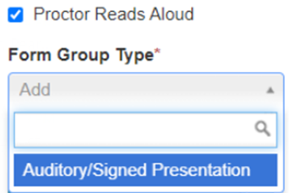
Auditory/Signed Presentation
Auditory/signer presentation script guidelines:
A trained Test Administrator may be provided to sign or read the entire test orally to a student who is unable to decode text
Individual words must not be read to students
Auditory/signer scripts should be provided to students on an individual basis
A student should have the option of asking a reader/signer to slow down or repeat text
The Test Administrator must follow the script and not read from a test book or device screen
Scripts are secure and must be returned to Pearson
CBT with auditory/signer script
Must be in a separate test session in PAnext (cannot be in same online test session as tests not requiring auditory/signed presentation)
Test session Form Group Type must be set to Auditory/Signed Presentation or student’s test will not match the script

Slide 99
Technology for Medical Monitoring
Students who use a phone, tablet, or other device to monitor a medical condition may have the device in the testing room
Documentation of medical necessity must be kept at the school and district
District plan for use of these devices must include:
Where the device is located and who has control of the device
If the student has control, the device must be visible at all times and may not be used for any other purpose
Procedures for if/when the device alerts and what action is necessary
If student must leave the testing environment, follow procedures for students who become ill

Slide 100
Accommodations for MLs
The following accommodations are available to students learning English as documented on Multilingual Learner plans (student-, school-, or district-level)
Extended Time
Admin (SAY) Directions Read Aloud, Clarified, and Repeated in Native Language
Spanish Transadaptation – Math and Science
CSLA in Grades 3 and 4 - ELA
Auditory Presentation Script in Native Language – Math and Science
Non-English Response
Speech-to-Text
Word-to-Word Dictionary
Word Prediction
Note: ML accommodations are not available on CSLA or other Spanish forms as the student is testing in his or her native language

Slide 101
Administering Language Accommodations
Spanish forms - CSLA, Math, and Science
Test Administrators must be bilingual to administer assessments in Spanish
To assign Spanish forms:
Without TTS – indicate in PNP “Spanish Transadaptation” field
With TTS – indicate in PNP “Auditory Presentation: Text-to-Speech” field
ELA
Only SAY directions can be provided in languages other than English
Auditory presentation of ELA in other languages is not allowed
Math and Science may be translated into other languages using the provided auditory/signer script (CBT or PBT)
For CBT, an auditory/signer script is ONLY available for translation as TTS is used for English and Spanish presentations
SAY directions are available in English and Spanish
Spanish directions are found at https://coassessments.com/manuals/
All other languages require local translation
Note

Slide 102
Non-English Responses
Math and Science
If Spanish responses are identified, they are scored by a scorer proficient in Spanish
If a student responds in a language other than English or Spanish, local translation and transcription are required for scoring
ELA and CSLA
On ELA, only English responses are scored
On CSLA, only Spanish responses are scored
Translation of student responses on ELA and CSLA is not allowed

Slide 103
Transcription Guidelines
Common Question
PBT and CBT Transcription
Requires presence of at least two individuals during transcription of student responses
One person to transcribe
One person to verify the transcription
Transcribe the student’s responses verbatim into the test book or TestNav
Note for braille transcription: Only a braille certified Test Administrator may transcribe student responses
After transcription, shred any responses printed from an assistive technology device
Complete the Secure Data Removal form (Procedures Manual Appendix G)
Refer to the Transcription Guidelines in Section 6.1.6 in the Procedures Manual

Slide 104
Transcription Guidelines
For CBT transcription, complete the following steps:
Student:
Responds to constructed response (CR) questions on their assistive device
Student may respond to selected response items in TestNav
Device with saved responses is secure until student responses are removed
Exits the unit, but the student should not submit the unit
Test Administrators transcribe student responses to CR questions into TestNav before the next unit
Transcriber:
Resumes the student’s test in PAnext
Logs-in as the student and transcribes the CR responses
Submits responses for the transcribed unit
Student continues testing in the next unit
Note: Because units cannot be administered out of order, transcription must take place before the student can take the next unit

Slide 105
Prior Access to Secure Test Materials
Prior access must be supervised by the SAC
Access to test questions and test materials prior to testing is limited to the following:
4 days for Auditory/Signed Presentation: Script for translation into a language other than English/Spanish, including sign language
24 hours for Auditory Presentation: Script in English or Spanish
Paper-based testing only
24 hours for braille
TVIs may review Teacher Notes 24 hours prior to testing
TVIs may NOT review test content
Test materials must be secure at all times – follow chain of custody protocols
Test items may not be copied or discussed

Slide 106
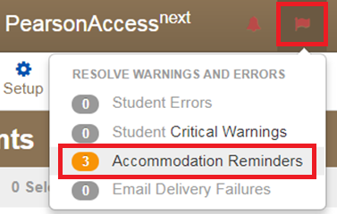
Accommodation Reminders
PAnext displays reminders for all students identified with the following accommodations:
Scribe for CRs on ELA/CSLA
Calculation Devices and/or Math Charts and/or Counters
Reminders cannot be removed unless the accommodation is removed
If these reminders appear, check the students with reminders against the following list(s):
CDE-approved UARs
District-approved UARs for math charts and counters

Slide 107
Form Assignment Markers in PAnext
A marker appears next to a SASID on the Students in Session screen if a form-dependent accommodation/accessibility feature was identified for the student on the Manage Student Tests screen or through an SR/PNP import
Indicator | Accommodation/Accessibility Feature
 | Text-to-Speech
 | Spanish
 | Spanish Text-to-Speech
 | Assistive Technology (Math and ELA)
TTS
SPA
SPA
TTS
AT

Slide 108
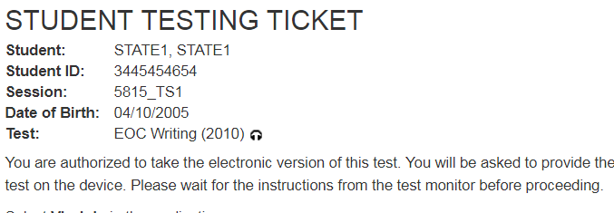
Form Assignment Markers on Testing Ticket
A marker appears next to a SASID on a student’s testing ticket if they were assigned a TTS or Auditory/Signer Script form
Indicator | Accommodation/ Accessibility Feature
 | Text-to-Speech
 | Auditory/Signer Script

Slide 109
Emergency Accommodation
Common Question
A student needs a new accommodation immediately due to unforeseen circumstances
Cases could include students who have a recently-fractured limb (e.g., arm, wrist, or shoulder); whose only pair of eyeglasses have broken; or a student returning from a serious or prolonged illness or injury
Permission is not needed from CDE
Complete the Emergency Accommodation Form (Appendix G) and maintain in the district
Do not send this form to CDE unless it is requested
Emergency Accommodations are identified in PAnext on the Manage Student Tests screen (through the UI or SR/PNP file upload)
Scribe
Other

Slide 110
Testing Environment

Slide 111
Test Environment
The testing environment must:
Be adequately lit, quiet, free of distractions, and heated or cooled
Provide an adequate writing surface (paper-based)
Be free of electronic devices and music
Have a “Do Not Disturb/Only Authorized Personnel Allowed” sign placed on the door during test sessions
Note: Food and drinks are not allowed on desks or near test materials

Slide 112
Test Environment
Do not display/allow any content related posters or aids that suggest possible answers to students in the testing environment such as:
Word walls
Steps for solving math equations
Any resource that defines, explains, or illustrates terminology or concepts
General rule: When in doubt, cover it.
Do display unit testing time for students
Posters that do not include content specific definitions, content related processes or solutions may remain on the wall
Unit Name: | Grade 8 Science, Unit 1
Unit Testing Time: | 80 Minutes
Start Time: | 9:00
Stop Time: | 10:20

Slide 113
Headphones
Text-to-Speech (TTS)
Students must wear headphones if they are in a room with other students
Test students separately if they are unable to wear headphones
Note: CMAS assessments do not contain audio unless TTS is assigned

Slide 114
Calculators
Calculators by grade
Math
Grades 6 & 7 – Five function with square root and percentage functions
Grade 8 – Scientific
Science
Grade 5 – Four function with percentage function
Grades 8 & 11 – Scientific
Availability
Computer-based testing
The correct calculators are automatically provided to students by TestNav. The school must supply students requiring specialty or handheld calculators with the appropriate grade-level calculator.
Paper-based testing
The school must supply students with the appropriate grade-level calculator, including specialty calculators, as needed by individual students.
CMAS Mathematics Calculator Policy:
http://www.cde.state.co.us/assessment/cmas_calculator_policy

Slide 115
Mathematics Materials
Optional Geometry Tools: Schools may provide the following tools to students for Grade 8 Math:
Tracing paper
Reflection tools
Straight edges
Compasses
Protractors
Rulers and protractors
Computer-based testing:
Rulers and protractors are available to all students automatically through TestNav, as appropriate by assessment
Handheld rulers are not allowed on CBT
Paper-based testing:
Rulers and protractors are provided in the test kits sent by the vendor, as appropriate by assessment

Slide 116
Additional Materials
Mathematics Reference Sheets
Computer-based testing:
Automatically available to all students taking mathematics tests in grades 5 – 8 through TestNav
Optional: Schools can provide printed copies to students for use during testing (download at https://coassessments.com/practice-resources/math/)
Paper-based testing:
Included in all mathematics test kits for grades 5 – 8
Grade 11 Science Periodic Table
Computer-based testing:
Automatically available to all students taking grade 11 science through TestNav
Optional: Schools can provide printed copies to students for use during testing (download at https://coassessments.com/practice-resources/science/)
Paper-based testing:
Included in all grade 11 science test kits

Slide 117
Student-to-Test Administrator Ratio
Student-to-Test Administrator ratio must not exceed 30 to 1
Test Administrator must be able to actively monitor the space within the physical testing environment
Consider room configuration
Make special considerations for large testing environments or environments with complicated configurations
Test Administrators must:
Actively proctor
Remain attentive and in the room during the entire testing unit
Circulate throughout the room during the test
Should be able to see students working, not student work

Slide 118
Room Configuration
Students should not be able to see each other’s work from a normal testing position
Consider the following seating configurations to maintain test security:
Seat students in every other seat (useful in a computer lab setup)
Arrange monitors back-to-back
Seat students back-to-back
Seat students in a semicircle (useful for schools using laptops)
Seat students in widely spaced rows or in every other row (appropriate for a classroom setup)
Dividing screens or other privacy materials may be used if students cannot be placed far enough away from each other

Slide 119
Unauthorized Visitors and the Media
Only students, Test Administrators/Examiners, and authorized school, district, state personnel, or state-sanctioned test monitors are allowed in testing areas during administration
Media are not allowed to have access to the tests before, during, or after test administration, or take pictures or video of testing materials or testing students
Parents are not allowed in the testing room with their child

Slide 120
Receiving Materials & Test Security

Slide 121
Test Security Protocols
The security of the assessments is important for the following reasons:
Protection of student information and data
Protecting the validity of the state assessments
Financial considerations
It is in state law that CDE must maintain the integrity of the assessments – this is done through security measures detailed in this section

Slide 122
Security Plan
Successful Security Plan requirements:
All personnel have appropriate annual training
All involved personnel understand security protocols
All involved personnel have signed security agreements
Think about anyone who may be in/enter the testing environment
Test environments are secured against unauthorized personnel
Establish a documented/physical chain of custody form process
Materials are kept in a central, secure, and locked location with limited access
If materials are missing, follow up will be needed
Ensure that barcodes are identified

Slide 123
Test Materials Security
Secure
Student Testing Tickets
Paper-based test books
Auditory/signer scripts
Visual description documents
Used scratch paper
Any student work/responses
Math reference sheets and grade 11 science periodic tables just prior to testing
If written on, cannot be reused
Non-Secure
Test Administrator Manuals (TAM)
Procedures Manual
Unused scratch paper
Math reference sheets and grade 11 science periodic tables if not written on

Slide 124
Maintaining Security of the Assessments
All secure test materials must be secured while in the Test Administrator’s possession
No duplication of secure CMAS materials is permissible
No cell phones or other communication, reproduction, or recording devices are allowed during test sessions unless required for accessibility
Students should be aware that cell phones or other electronic devices are prohibited. Having these devices during testing (including if a student finishes testing but other students have not) or during a break may lead to the invalidation of not only that student’s test, but to the invalidation of others’ tests as well.
All individuals are strictly prohibited from taking photos or video of TestNav screens and paper test materials. Ensure all individuals in your district are aware of this critical instruction.

Slide 125
Receiving Test Materials
Go to module
Initial shipments of materials will arrive in a single distribution (no longer separate Wave 1 and Wave 2 material shipments)
Materials are packaged by school and shipped to the district
Reminder: CMAS Secure Return Envelopes will not be sent in initial shipments. Districts that would like to use these envelopes may place an additional order for envelopes.
No overages are sent

Slide 126
Contents of Shipments
Labels are used to return all secure materials. DACs may want to take labels out of the school kits.
Assessment Coordinator Kits
Re-sealable plastic bag (holds all materials)
Paper bands
Pearson orange scorable and blue nonscorable shipping return labels
UPS return labels for scorable and nonscorable materials
Test Administrator Manuals
Packing list and chain of custody form
Student test materials (if indicated by January 26 in PAnext)
Test books
Math kits reference sheets, rulers, and protractors, if applicable
Grade 11 science kits include periodic tables
Accommodated test books: large print, braille, Spanish including CSLA
Auditory/signer scripts
Student ID labels and rosters (with corresponding student materials)

Slide 127
DAC – Receipt of Test Materials
Upon Receipt of Test Materials, DACs:
Remove packing list, chain of custody form, and DAC Kit from Box 1
Inventory materials immediately to verify all were received and that there is an adequate number for administration
Official DAC may order additional material, if necessary
Keep all test materials in a centrally locked storage area with limited access until distributing to schools
Ensure chain of custody procedures are followed at all times
Deliver materials to schools no more than one week in advance of school testing window

Slide 128
SAC – Receive Materials & Chain of Custody
Receive materials from DAC no more than one week in advance of school testing window
Document any movement of secure materials before, during, and after testing
Schools inventory materials using the provided security checklist
Deliver test materials to Test Administrators only on the day of testing
Must use a chain of custody process
Distribute only the content area being assessed
As close to testing time as possible
Store materials in a designated secure location
As soon as possible after the unit is complete
Materials must not be stored in classrooms
Return secure materials to DAC after testing is completed
Includes auditory/signed presentation scripts
Includes CoAlt test kits and the CoAlt envelope containing task manipulatives

Slide 129
Chain of Custody Form
Districts may use the forms that are shipped with the materials or create their own to track all secure materials
If creating a district/school chain of custody form, for each day of testing the form must include:
Security barcode/number
Test Administrator signature
Date and time checked out
SAC (or designee) signature
Date and time returned
Chain of custody forms are kept on file for three years
If materials are missing, these will be sent to CDE

Slide 130
Documenting and Storing Test Materials
Keep all boxes in which the test materials were delivered and use them to return scorable and nonscorable materials after testing is completed
Report the following occurrences immediately to Pearson Customer Service using the Form to Report Contaminated, Damaged, or Missing Materials:
Non-receipt of any materials listed on the School Packing List
Discovery of damaged test material
Discovery of missing or duplicate sequence numbers on any test books
Form to Report Contaminated, Damaged, or Missing Materials: https://forms.gle/BQYg7WXkKQgdrSoi9

Slide 131
Steps to Order Additional Materials
Go to module
Only the official DAC can submit additional orders
Quick Reference Guide to Additional Orders (Appendix H: PAnext)
PAnext Additional Orders Training Module
Note: CDE only reviews/approves AOs for materials if:
Placed no more than two weeks before the district’s selected test window (by test)
The ordered materials match a student registration in PAnext
The registration/accommodation information must be entered on the student’s PNP before placing the AO

Slide 132
Key Information to Order Additional Materials
Keep in mind when ordering additional material:
Do not submit AOs prior to receiving the initial shipment of test materials
All test materials must be inventoried prior to placing an AO
Ancillary materials for return shipping are not automatically included in the AO
Shipping labels
Extra boxes
You can edit submitted AOs that are not yet approved
Add on to submitted orders, do not create new, separate orders
Once an AO is approved, allow 4-5 business days for shipment delivery
AOs are packaged by district and shipped to the district

Slide 133
During Testing (Administering Tests)

Slide 134
CBT Task “Prepare” Test Sessions
This step assigns forms to each student in the test session
Prior to completing this step, ensure students are assigned to the appropriate form-dependent accommodations and accessibility features (e.g., TTS)
If not indicated prior to this step, remove student from the test session, update PNP, then add back to the test session
“Prepare” sessions at least one school-day prior to starting a test session
Allows for the starting of multiple test sessions at one time
Only users with LEA or STC roles (DAC, SAC) can “prepare”
Once the session is “prepared” and the window is open, “start” the test session

Slide 135
CBT Task “Prepare” Test Sessions
Preparing Sessions in PAnext Quick Guide:
http://www.cde.state.co.us/assessment/preparesessionspanext

Slide 136
Incorrect Form Assignment
Check form assignments before students log in
Incorrect forms must be identified before students log in to test
If errors are identified after students log in to test, the options are:
Continue with the test and suppress the score
Student receives SPR, but the scores are not aggregated
Counts against participation for the school and district
Stop the test and invalidate with Void 06
Misadministration = the student does not receive SPR
Counts against participation for the school and district

Slide 137
PAnext Online Test Session Life Cycle
Create
Session Form Group Type can be set to Auditory/Signed Presentation if the session is not in prepared status
Prepare
Test forms are assigned when session is prepared
Start
Must be started prior to student being able to test
Can be started on the day the state window opens
Stop
Students’ PNPs can be updated if session is not in prepared status
DAC or SAC can prepare sessions (TA cannot prepare)
Students can be added to a prepared session through the UI only
Students can be added to a started session through the UI only
Stop sessions once all students complete testing
All units for all students in the session must be in “complete” or “marked complete” status to stop the session
Remove and code students with all units in “ready” status

Slide 138
PAnext “Prepare” Test Session
Checklist Prior to Preparing a Session
 | All students’ PNP attributes are correct
 | Students requiring auditory/signed presentation of tests with scripts are added to separate sessions and those sessions are set to Auditory/Signed Presentation
 | Test content is proctor cached

Slide 139
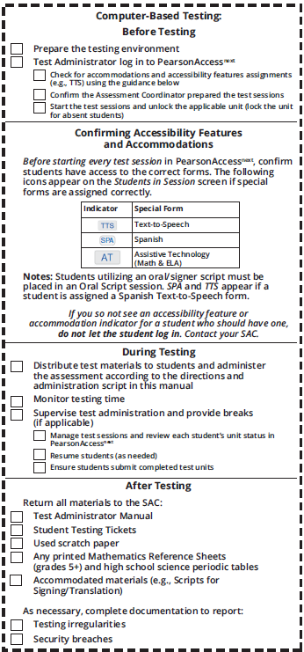
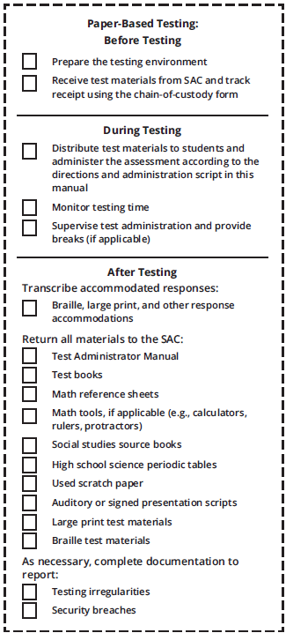
TAM Reminders
These check lists appear on the back of the TAMs for Test Administrators to quickly reference

Slide 140
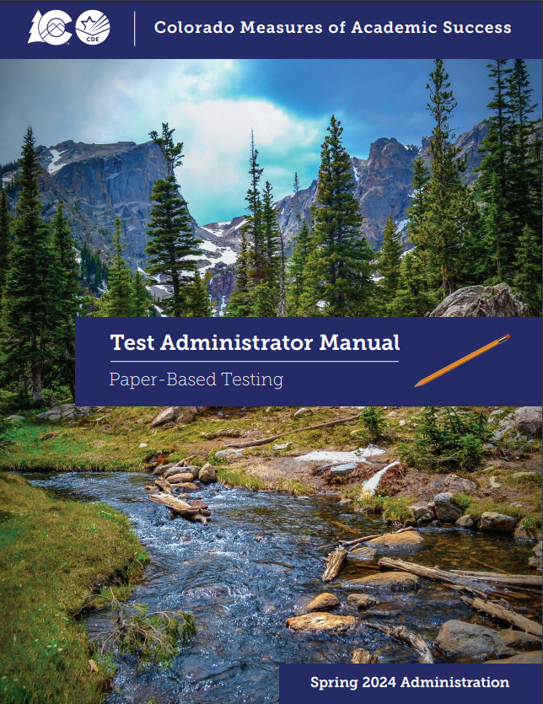
Tasks to Complete During Testing
On the Day of Testing (CBT):
Distribute test materials
Ensure TAMs have 2024 on the cover
Ensure Test Administrators have a computer or tablet available
Check form assignment
Ensure accessibility features and accommodated forms are assigned to appropriate students
Monitor test activity
Be available to Test Administrators and Proctors
Investigate security breaches and testing irregularities
Follow protocol for contaminated or damaged test materials, safety threats, and severe weather
Respond to all technology related issues
Collect materials from Test Administrators after each test unit

Slide 141
During Testing – Security Breaches and Irregularities
Monitor and Report Security Breaches and Testing Irregularities
Immediately report all instances of security breaches and testing irregularities to the SAC, and subsequently the DAC
DAC must immediately contact CDE upon receiving notification of a security breach
Testing Irregularity or Security Breach
SAC completes the Testing Irregularity or Security Breach Form (Appendix E)
SAC adds incident to the TIR spreadsheet (linked below)
DAC submits completed form and updated spreadsheet through CDE Assessment Syncplicity in the Assessment Forms folder
Notify Sara Loerzel of posted form (loerzel_s@cde.state.co.us)
Testing Irregularity or Security Breach Form:
http://www.cde.state.co.us/assessment/cmas_coalt_tir_security
Testing Irregularity or Security Breach Tracking Spreadsheet:
http://www.cde.state.co.us/assessment/cmas_coalt_tir_trckngsprdsht

Slide 142
During Testing – Security Breaches and Irregularities
When to submit TIR form and spreadsheet to CDE via Syncplicity:
Students were grouped incorrectly – not same directions or time
Students were given an incorrect amount of time (more or less)
Students were cheating or using an unapproved electronic device
Students used an unapproved accommodation or were not provided an accommodation according to IEP, 504, or ML plan
Example: Test read aloud to students without the auditory/signed presentation script
Test Administrator did not follow procedures
PBT student goes past stop sign at the end of the unit
Large number of students involved in a technology related irregularity
If technology issues cause testing to not be completed on one day
Student goes back into a unit on a different day and changes answers
Test security breach – contact CDE immediately

Slide 143
During Testing – Contaminated & Damaged Materials
If necessary, replace contaminated or damaged materials
Place student ID label on replacement document or complete demographic data grid
Record security barcode number of the damaged and new documents
Submit the Form to Report Contaminated, Damaged, or Missing Materials
If possible, transcribe responses from contaminated test material into the replacement
If not, contact Sara Loerzel
Destroy contaminated material according to local biohazards protocols
A school nurse/health aide is a good resource if unsure of these protocols
Form to Report Contaminated, Damaged, or Missing Materials: https://forms.gle/BQYg7WXkKQgdrSoi9

Slide 144
During Testing – Safety Threats and Severe Weather
Create a plan and train staff for safety threats and severe weather
Test Administrators and Proctors must:
Note the time of the disruption
Secure test materials as specified in the School Security Plan
When testing can continue, prepare students for the continuation of the unit and resume tests
Document the situation in writing
If the disruption caused the unit to be carried over into the next day, notify CDE

Slide 145
Test Administration Materials
2024 Test Administrator Manual (TAM)
Select district/school options for after the test session
Read SAY directions exactly as written (may clarify after)
Practice in advance
Each unit is submitted independently
Student Testing Tickets (CBT) and Test Books (PBT)
Hand out and collect in the test environment
Have a master list of students including accommodations
Like test books, Student Testing Tickets are secure
The same ticket is used for all three units

Slide 146
District Decisions – After Students Finish Unit
District Decisions:
Are students to remain in the testing room and read silently when they finish testing?
Cannot use any electronic reading devices
Cannot read material related to the assessed content area
Are students able to leave the testing room when they finish testing? (there is no minimum testing time)
What to do when all students have completed the unit?
School Site Considerations:
Where do students go if they are released?
To whom are students released?

Slide 147
Active Administration
Active Test Administrators:
Ensure students have all necessary materials for each unit
Ensure a standardized testing environment
Read SAY directions exactly as written
Move throughout the room during testing
Re-read/clarify SAY directions to students when asked
Use proximity to keep students on task
Use “continue working” script
Test Administrations May Not:
Provide feedback
Clarify test questions
Answer content related questions
Interfere with students’ demonstration of skills
Interact with students in any way that would impact student responses
Engage in other tasks during test sessions
Read sources, passages, questions, or student responses
Help with TestNav navigation

Slide 148
Administration Steps for CBT
Prepare the test environment and situate students
Start test session (SAC must “prepare” first)
Unlock the unit through PAnext
Follow directions and read SAY script from TAM
Distribute Student Testing Tickets and scratch paper when directed
Assist students with logging into TestNav 8
Actively administer each test unit
Collect Student Testing Tickets and scratch paper
Confirm students submitted the unit
Lock the unit – each day
Stop test session in PAnext after last unit only

Slide 149
Start a Session and Unlock Units

Slide 150
Resume a Test
Need to stop an online test session? https://support.assessment.pearson.com/display/PAsup/Stop+a+Session

Slide 151
Basic Technical Troubleshooting

Slide 152
Error Codes
Error codes are received on a student’s device when TestNav identifies an issue. Examples:
1001: “Your test has been saved. Please notify your test administrator.”
This is an Early Warning System initial message, which does not indicate the issue, so another error code will follow
1009: “Unable to download test content”
Network connection issue between the testing device and Pearson servers
3005: “TestNav has detected that another application attempted to become the active window…”
Could be caused by pop-ups in the background or power saving features
TestNav exits the test and displays the following errors when a student types certain key combinations while testing – the test must be resumed before the student can sign in again:
3020: “TestNav has detected that Command+Option+Esc has been typed...”
3022: “TestNav has detected that Ctrl+Alt+Del has been typed...”
8026: “Unable to connect to the proctor caching computer. Please contact your administrator.”
Network connection issue between the testing device and the local proctor caching device

Slide 153
Error Codes – Next Steps
Resume the student’s test in PAnext
Have the student log in again on the same testing device
Do not move the student to another testing device unless the student safely exits the test using the “sign out” feature in TestNav
If the same error occurs repeatedly, or if the same error is affecting multiple students, contact the Technology Coordinator
Full searchable directory of error codes: https://support.assessment.pearson.com/display/TN/Error+Codes

Slide 154
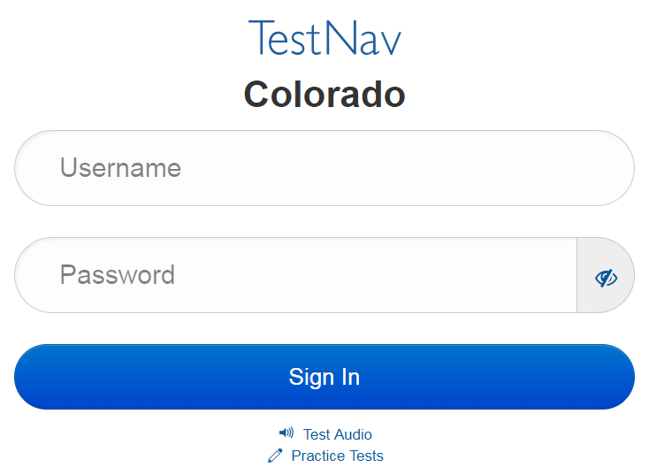
Common Errors – 9059
9059: “The username or password you entered is incorrect.”
If the username and password being used are accurate, the student may be on the incorrect login page
“Colorado”

Slide 155
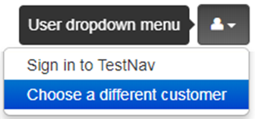
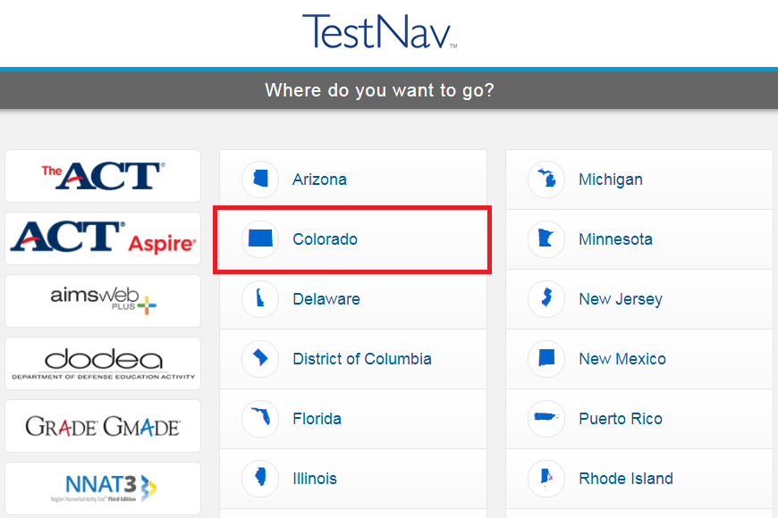
TestNav
Note: The Sign In page should say “Colorado” above the Username and Password fields. If it doesn’t, click the User Icon and select “Choose a different customer”.

Slide 156
“Early Submission” of Test
There are no confirmed cases of a student getting “kicked out” of TestNav and the test submitting itself
In all cases where a student’s test was submitted and the log files were sent to Pearson, the student followed the on-screen logout procedures and selected the submit button
CDE unsubmits tests for:
3rd graders one time only
Transcription
Other grades: If log files sent to Pearson show the student did not submit the test

Slide 157
Student Logs into Another Student’s Test
Student A logs into Student B’s test
Immediately exit the test
Do not have Student A or Student B continue/ start testing
School immediately contacts DAC
DAC immediately contacts CDE
If Student B hasn’t touched the test, CDE may be able to move the test into Student A’s name
Moves the whole test
Individual units cannot be moved
If Student B has taken one unit or more, CDE may have to void the unit taken by Student A to allow Student B to complete their test
Responses cannot be transferred to Student A’s test
Student A’s test may need to be invalidated as a misadministration
Not allowed to access test questions more than once
For PBT, if a student uses another student’s test book, the SAC immediately contact the DAC who contacts CDE.

Slide 158
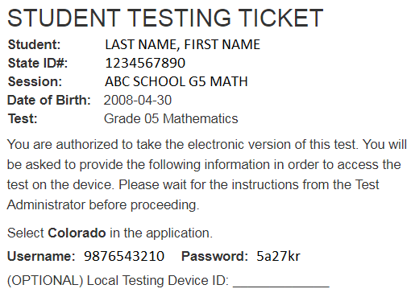
Technology Tip
Document the specific device on which each student tests for each unit
There is a space for this on the Student Testing Ticket
This aids in response recovery if it becomes necessary (SRF)
If not identified, may not be able to recover responses
If a student receives an error do not immediately move them to a new device
Sign in using the same device again, then click the User icon in the top right screen corner to “sign out”
This sends all responses saved on the device to the testing server
Always have the student “sign out” if they are not submitting their test
Never just power-off a device

Slide 159
Student Response Files (SRF)
If the device cannot send a response to Pearson, it saves the response on the device and in a secondary save location (if set up by Technology Coordinator)
Test Administrator should check item progress/response receipt in PAnext
If there is a discrepancy, call Pearson
May need to manually move the SRF
Additional SRF documentation
https://support.assessment.pearson.com/x/DAACAQ

Slide 160
Make-up Testing

Slide 161
Make-up Testing
Common Question
Students who are absent, become ill, or can no longer test because of classroom, school, or technical interruptions during originally scheduled units, may utilize make-up testing
This includes students who had to leave unexpectedly in the middle of a unit (e.g., parent picks up for appointment)
Students may not return to previously answered questions
Test security and administration protocols apply
SACs establish make-up testing schedules for their schools
Units may not be taken out of order for any test
Priority: Minimize risk of prior exposure to test content that could result in an invalidation

Slide 162
Make-up Testing
Online testing make-ups can be facilitated in two ways:
Option 1: Keep student(s) in their original session(s)
Option 2: Move student(s) to a different session

Slide 163
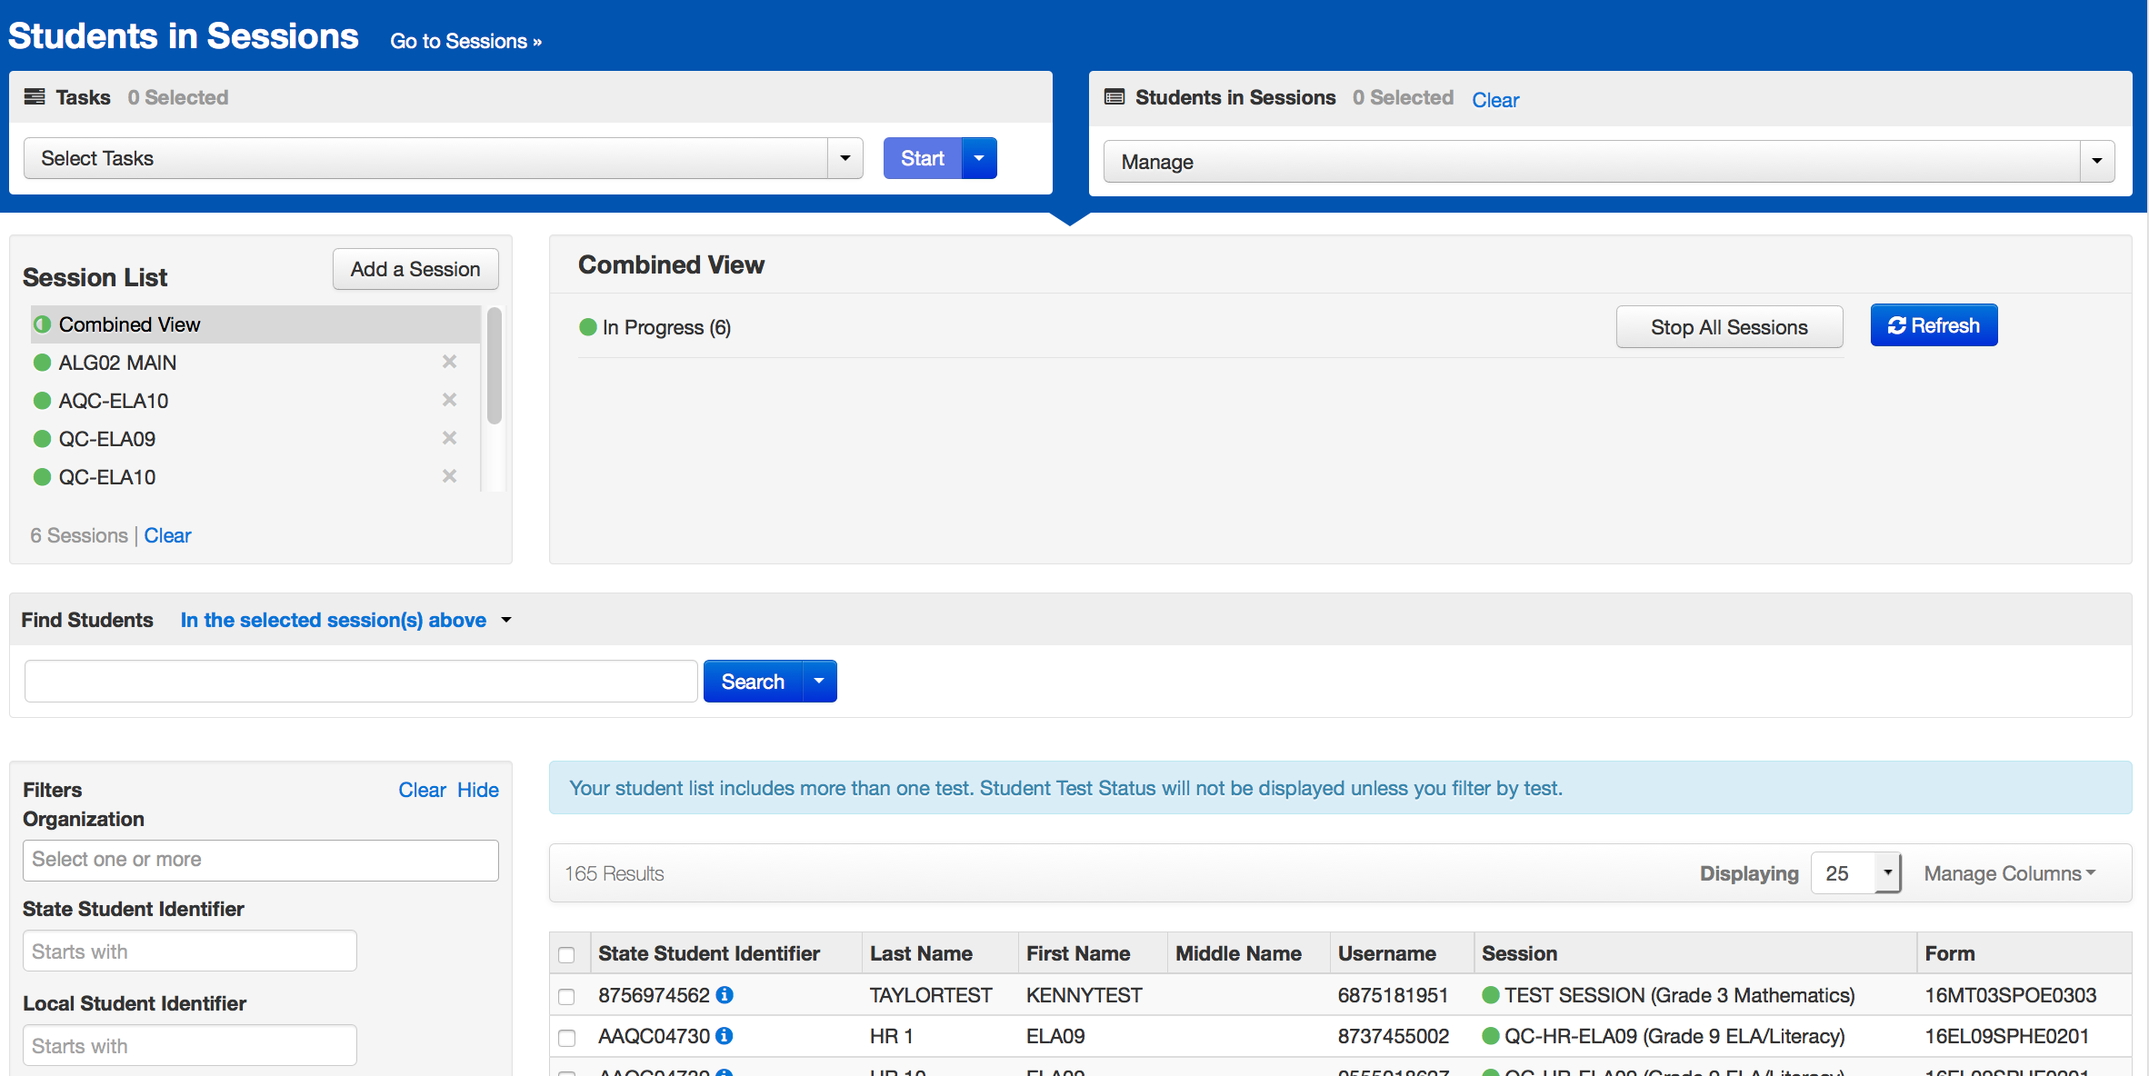
Online Test Management
Option 1: Keep student(s) in original test session(s)
To facilitate make-up sessions for students with tests in different online sessions, PAnext users can manage multiple sessions at the same time using “Combined View”

Slide 164
Online Test Management
Option 2: Move student(s) making up tests to a different test session
If moving multiple students into the same new session, they must be taking the same grade level and content area test
Passwords are tied to the test session in which the student’s test is located, so new testing tickets are required when tests are moved to a different session

Slide 165
After Testing

Slide 166
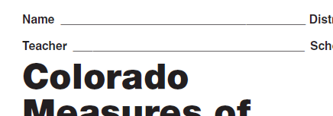
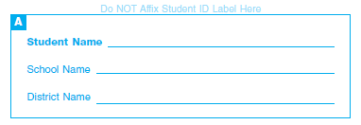
Tasks to Complete After Each Testing Session
CBT – After Testing
The day of testing:
Collect materials (Student Testing Tickets, scratch paper, etc.)
Ensure students logged out of TestNav correctly
Return materials to SAC using chain of custody form
Notify SAC of absent students and/or needed transcriptions
PBT – After Testing
The day of testing:
Collect materials (test books, scratch paper, etc.)
Ensure names are on test materials
Return materials to SAC using chain of custody form
Notify SAC of absent students and/or needed transcriptions
Front and/or back

Slide 167
Final Day – Tasks to Complete After Testing
Go to module
CBT – After Testing
The final day of testing:
Collect materials (Student Testing Tickets, scratch paper, etc.)
Ensure all student test units are submitted/completed
Ensure all test sessions are stopped
Purge the cached test content
Securely destroy/recycle used scratch paper and AT printouts
PBT – After Testing
The final day of testing:
Collect materials (test books, scratch paper, etc.)
Ensure labels are affixed or demographic data grids are completed
Return scorable PBT materials to Pearson as soon as possible (by May 1)
Use the Scorable Materials Return Checklist to ensure boxes only contain scorable materials
Securely destroy/recycle used scratch paper and AT printouts

Slide 168
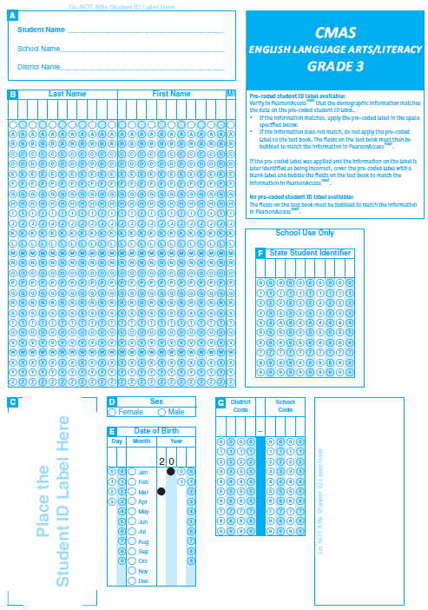
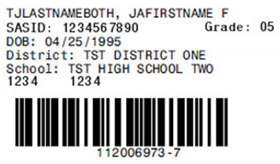
Student ID Labels
The student ID label overrides any bubbled demographic information on the test
Set aside unused student ID labels for secure destruction/recycling
May need to code these tests in PAnext (e.g., student left district, parent excuse)
If an ID label is not available, complete all fields on the demographic data grid
ID label goes here

Slide 169
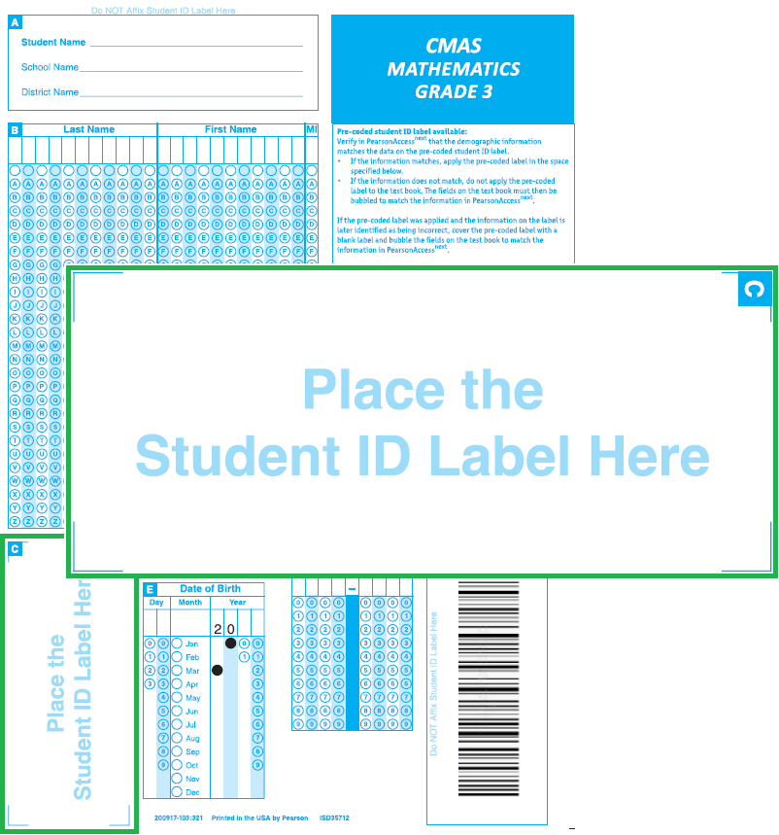
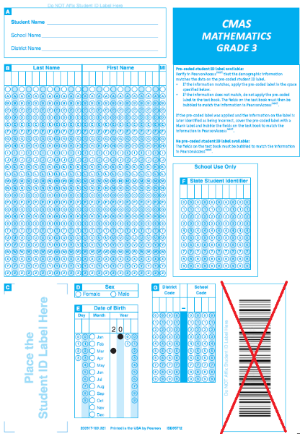
Student ID Labels
“Do NOT Affix Student ID Label Here”
(indicated above Box A and in the security barcode box)

Slide 170
Demographic Data Grid
Common Question
Back of the paper test book
Complete all fields if a pre-printed ID label is unavailable
Must match data in PAnext
Incomplete or incorrect bubbling leads to rejected student tests that must be resolved by the district
There is no area to indicate invalidation coding on a test book
Indicate in PAnext

Slide 171
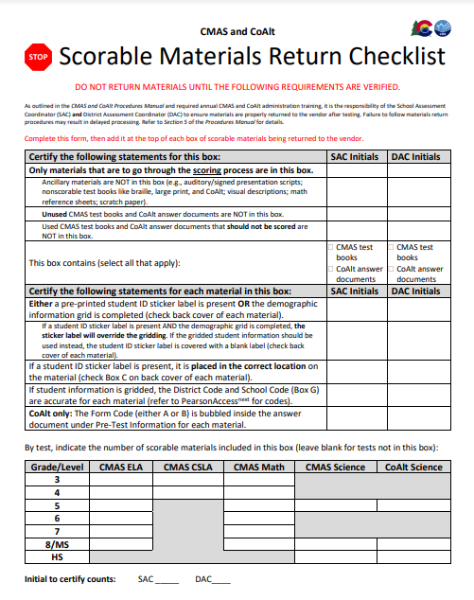
Packing Scorables
Scorable materials
Used CMAS test books
Organized by grade and subject
Lowest grade on bottom, highest grade on top
Tests books do not need to be in alphabetical order by student name
Used CoAlt answer documents are returned with used CMAS test books
Place CoAlt answer documents at the very top of the box
Paper Band
Used Test Book Grade 8 Math
Paper Band
Used Test Book Grade 8 ELA
Paper Band
Used Test Book Grade 7 Math
Paper Band
Used Test Book Grade 7 ELA
Scorable Materials Return Checklist: http://www.cde.state.co.us/assessment/cmas_coalt_scorablereturns

Slide 172
Packing Nonscorables
Nonscorable materials
Organize by material type
Unused test books (e.g., absent students, parent excuse)
Used test books marked “Do Not Score” including:
Large print test books (student responses transcribed into regular print (scorable) test book included in kit)
Braille test books (student responses transcribed into regular print (scorable) test book included in kit)
Other used test books that should not go through scoring (e.g., student withdrew after the student started testing)
Auditory/signed presentation scripts
CoAlt science materials, including unused CoAlt answer documents
Optional: used scratch paper
Order of nonscorable materials in the box does not matter

Slide 173
Packing Materials Checklist
Science, math, ELA, and CSLA materials are returned together
Confirm each scorable test book has a student ID label or hand-gridded student demographic data
Do not mix scorable and nonscorable materials in the same box
Use the Scorable Materials Return Checklist at http://www.cde.state.co.us/assessment/training-cmas
One school per box – do not combine materials from multiple schools in one box
Do not overfill boxes (pack under-filled boxes with crumpled paper)
DAC receives materials from the SAC
Confirm packing
Verify presence of all secure materials (i.e., materials with barcodes/security numbers)

Slide 174
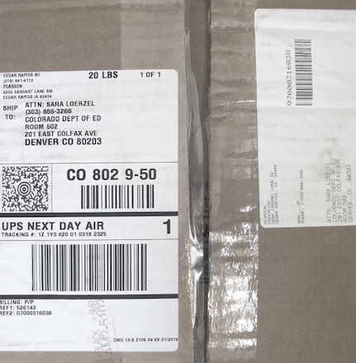
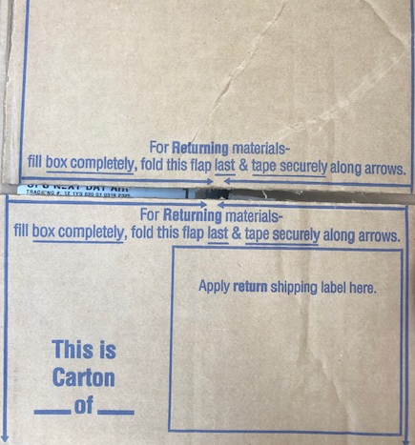
Packing Materials Checklist
Use appropriate shipping labels
One return shipping label (orange scorable or blue nonscorable) and one corresponding UPS label is placed on the top of each box
Once all materials are in boxes, indicate the sequence of boxes for each school (e.g., Box 1 of 3, Box 2 of 3, and Box 3 of 3) on each return label
Tape along arrows printed on box
Inbound to district
Outbound from district
Apply UPS label
Reverse box flaps
Apply orange/blue label

Slide 175
Arrange for Pickup
Scorable materials must be picked up by May 1, 2024*
Nonscorable materials must be picked up by May 3, 2024
Contact UPS at 800-823-7459 to schedule pickup:
Pickups must be scheduled at least 24 hours in advance
UPS customer service is available 24/7 - tell UPS you are calling about a pickup request for Pearson and will be using their “Return Service”
Once pickup is confirmed, you will get a confirmation number from UPS that can be referenced if questions or changes arise
Reminder: Verify labels are received in the initial shipment
Included in DAC and SAC kits
Additional orders for return materials are not overnighted
*If scorable materials are not picked up by May 1, 2024 there is no guarantee that records for these PBT students will be included in SBD or scored.

Slide 176
Tasks to Complete After Testing
After returning materials:
Resolve critical warning/alerts, including PBT Rejected Student Tests, in PAnext
Confirm all testing irregularities and security breaches were reported and posted on Syncplicity by May 3, 2024
Testing Irregularity or Security Breach Form - http://www.cde.state.co.us/assessment/cmas_coalt_tir_security
Corresponding TIR spreadsheet - http://www.cde.state.co.us/assessment/cmas_coalt_tir_trckngsprdsht
Complete post-testing forms, as applicable:
Scratch Paper Verification - http://www.cde.state.co.us/assessment/cmas_scratchpaperverification
Secure Data Removal Verification (Appendix G)
Post-test Compliance Form for all CMAS and CoAlt content areas - https://na3.docusign.net/Member/PowerFormSigning.aspx?PowerFormId=409225c4-78cf-43c3-a95b-03d1323139b3&env=na3&acct=817055f0-3029-4189-9800-b6196aa6512b&v=2
Keep records for three years

Slide 177
PBT Rejected Student Tests
Rejected student tests are paper tests that were returned for scoring but were not matched to a student registration in PAnext
Notification received through PAnext
Tests are not scored if left unresolved
Created when:
All student fields on the paper test demographic grid do not match data in PAnext
First name, last name, SASID, sex, date of birth
Organization code does not match
If student is registered for a CBT test but took the PBT version
Remove any form-dependent CBT accommodations and change the test to PBT

Slide 178
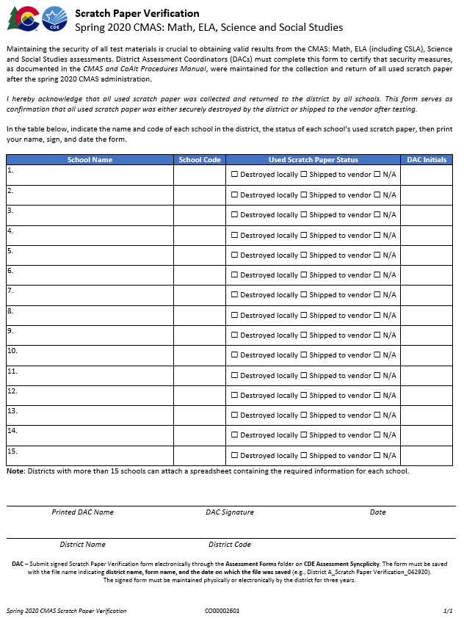
Scratch Paper Verification
Administration may require CMAS students to use scratch paper
Scratch paper is secure and must be treated as such
If used scratch paper is not returned to Pearson secure destruction/recycling is required
It is the DAC’s responsibility to ensure all used scratch paper is handled appropriately after CMAS testing
Complete the Scratch Paper Verification form (Appendix C)
Scratch Paper Verification Form
http://www.cde.state.co.us/assessment/cmas_scratchpaperverification

Slide 179
Secure Data Removal Verification
Administration may require temporary storage of CMAS student responses on local devices
These materials are secure and must be treated as such
Transcribe student responses saved on secondary devices into online or paper test forms for scoring
Remove all student responses from the secondary device or flash drive immediately following transcription or printing for transcription purposes
It is the DAC’s responsibility to ensure all secure electronic content is deleted in a secure manner after CMAS transcription
Secure Data Removal Verification form (Appendix G)

Slide 180
Additional Documentation - Missing Materials
If secure materials are not returned/missing after testing, CDE requires the following documentation for each item that is missing :
Signed statement by the DAC
Signed statement by the SAC
Signed statements by any other involved personnel
Chain of custody documentation
Search documentation
Copies of signed Security Agreement forms for all involved persons
Form to Report Contaminated, Damaged, or Missing Materials
Training materials relating to test security may also be requested
CDE maintains records of missing materials to identify patterns across individual organizations
PBT reminder: Must commit to meeting security requirements, accounting for, and returning all secure materials
Form to Report Contaminated, Damaged, or Missing Materials https://forms.gle/BQYg7WXkKQgdrSoi9

Slide 181
Remember - Secure Materials Must be Returned
Make sure all materials are accounted for and returned
Every test book and auditory/signed presentation script has a secure barcode and is tracked by Pearson and CDE
Every secure test item must be returned
If any material is destroyed locally (e.g., due to contamination), complete Form to Report Contaminated, Damaged, or Missing Materials and notify CDE
Keep track of UPS tracking numbers when returning materials to Pearson
Form to Report Contaminated, Damaged, or Missing Materials https://forms.gle/BQYg7WXkKQgdrSoi9

Slide 182
CMAS Forms
Return all district level PDF forms through CDE Assessment Division Syncplicity – Assessment Forms folder, then notify Sara Loerzel (loerzel_s@cde.state.co.us)
The following forms are found at the indicated links or in the Procedures Manual:
Prior to testing
SAC, DTC, Sensitive Data, and TA Security Agreements (Appendix B) - maintained locally
DAC Security Agreement (link shared in DAC training)
Verification of District Training (Appendix C) - requires Superintendent’s signature
During Testing
School Chain of Custody - maintained locally
Testing Irregularity or Security Breach (Appendix D)
Test Incident Report spreadsheet (CMAS Training Page)
Contaminated, Damaged, or Missing Materials (Appendix E)
After Testing
Post-test Compliance (Appendix C)
Scratch Paper Verification (Appendix C)
Secure Data Removal (Appendix G) - maintained locally
Only use Spring 2024 forms with CDE logo

Slide 183
PAnext Clean-up

Slide 184
PAnext Clean-up Activities – CBT and PBT
Student demographic data in PAnext is used for reporting (i.e., individual student performance reports, school/district-level reports, data files)
Use Operational Reports to ensure data accuracy:
Reports > Operational Reports > Students & Registrations >
Not Tested Student Tests (students with a NT Code/Reason applied)
Void Score Tests (students with a Void Code/Reason applied)
Students Registered but not Assigned to a Test
Student Tests that have been Assigned but Not Yet Completed
Students where Responsible District/School is Different from Testing District/School
Students with Multiple Tests of Same Subject Area
Reports > Operational Reports > Online Testing >
Online Student Tests Marked Test Complete
For School/District records only – Mark Test Complete Reason does not invalidate
Must enter Void Code/Reason separately

Slide 185
Coding Invalidations
There are two categories of invalidation codes:
Not Tested Reasons/Codes
Void Test Score Reasons/Codes
Indicate coding in PAnext in two ways:
Student-by-student through User Interface (Sensitive Data role)
- or -
Batch loaded through Student Test Update process (STU role)
Coding is unique to each test
Does not transfer across math, ELA, and science tests
Entered for each test as appropriate
“Marked Complete” does not invalidate tests
“Mark Test Complete Reasons” are for district/school use only
They do not “flow” into scoring/reporting

Slide 186
Not Tested Students
Students who were absent or not tested (did not access any part of the test):
PBT: Return test materials in nonscorable boxes with unused materials
ACTION: Indicate the Not Tested Reason/Code in PAnext
CBT: DO NOT mark complete students who did not start testing
ACTION: Remove students from prepared/started test sessions
To find these tests:
Go to PAnext > Reports > Operational Reports > Online Testing
Select Session Roster
Request the report
Download Report
Filter Test Status column and look for tests in Testing status
Remove students from sessions if all three units are Ready
If test session is not prepared/started, do not have to remove students (on Session Roster report, Test Status = Assigned)
ACTION: Indicate the Not Tested Reason/Code in PAnext
Common Question
Not Tested Reason/Codes are in PM Appendix K: Data Section 3

Slide 187
Stop Test Sessions
By May 8, 2024, stop any test sessions that were started
Started test sessions cannot be stopped unless all units for all students are either “Completed” or “Marked Complete”
If incomplete units of started tests are not marked complete by EOD May 8, CDE and Pearson will complete this task
Click to stop
Need to
mark complete
PM Appendix H: Mark Complete Units of an Incomplete Online Test https://www.cde.state.co.us/assessment/cmas_coalt_proceduresmanual_sp24#page=182

Slide 188
Combined Unit Statuses
Started sessions:
ACTION: SACs/DACs “mark complete” units for students who started, but did not complete testing
To find these tests:
Go to PAnext > Reports > Operational Reports > Online Testing
Select Session Roster
Request the report
Download Report
Filter Test Status column and look for tests in Testing
“Mark complete” tests with varying unit statuses
“Marked Complete Reasons” do not invalidate student tests
ACTION: If invalidation is needed, apply Void Reasons/Codes in PAnext
Common Question
Void Reason/Codes are in PM Appendix K: Data Section 3

Slide 189
Void Test Score and Not Tested Coding
 | Void Test Score Reason/Code | Not Tested Reason/Code
For tests that were NOT started… | Not allowed | Use Not Tested coding
For tests that were started but should NOT be scored… | Use Void coding | Do not apply as this coding type is ignored on started/completed tests
When can I apply this type of code? | CBT: Once all test units are in completed/marked complete status PBT: Once tests are scanned into PAnext* | CBT: As long as test is not in started/stopped session PBT: Any time unless scanned into PAnext*
*If a PBT test was started/completed but should not be scored, write “Do Not Score” on material, return in nonscorable box, and indicate Not Tested coding in PAnext.
Note: “Marked Complete Reasons” do not invalidate tests or flow into scoring/reporting. MCRs are only for internal district/school use. Enter Voids separately.

Slide 190
Coding Parent Excusals
Go to Doc
Districts/schools must maintain documentation of parent excusals
Never code parent excusals unless documentation was received from a parent/guardian
Apply the following coding in PAnext or during SBD:
Students who never started the test:
Not Tested Code of 09
Students who started but did not complete the test, or were “Marked Complete” by the school:
Void Test Score Code of 09
Reminder: “Marked complete” text box “reason” does not indicate parent excusal for accountability purposes.

Slide 191
Suppressions
Suppressions allow a student to receive a score when their score should not be aggregated with school and district results
They are used in the following instances:
Home school students – students with CO-DDDD-HHHH indicated as their Responsible School in PAnext
Misadministrations – students included on the district-submitted TIR spreadsheet for whom a testing irregularity was documented
If indicated/requested by the district, CDE will add suppression codes and actions
Individual student performance reports (SPRs) are produced
Individual student test scores are excluded from school and district aggregations
Note: Post-testing, changes made to data used for cross-validations, such as IEP/504 or ML status when the student had accommodations, will result in invalidation of student scores. CDE will apply suppression coding in these cases.
Suppression Reason | Receives Student Report | Impact to Participation
Home School | Yes | Does not impact participation
Misadministration | Yes | Impacts school and district

Slide 192
Additional Information

Slide 193
Student Biographical Data – Tentative Dates
Early 2024
SBD Manual to be available
Training provided by CDE
Clean-up in PAnext
Through May 8
Districts can set internal school-level clean-up deadlines by disabling PearsonAccess^{next} accounts prior to May 8
SBD via Data Pipeline
CMAS and CoAlt SBDs are together
May 16-29 (tentative)

Slide 194
Typical Reporting Timeline
Common Question
Student data files are typically expected in June
OnDemand student reports available at this time (no comparative data)
Individual student performance reports and summary data files
District- and school-level reports
All state assessment results will be embargoed and must not be publicly disseminated, distributed, or published by any means until they are publicly released by the state; however, districts and schools may:
Share confidential individual student performance reports with parents/guardians
Use aggregated and individual student level results internally for informational and planning purposes before results are publicly released
Ensure any data you release after the embargo lifts includes appropriate suppressions to meet federal and state data privacy requirements
Reminder: Colorado statute requires that LEPs ensure appropriate personnel provide and explain assessment results to the parent/guardian of each student enrolled in the district or charter school (C.R.S. §22-7-1006.3 (8)(a))

Slide 195
Reporting Information
Looking for information about reports?
CMAS and CoAlt Procedures Manual Section 7.0 Reporting
7.1 PearsonAccess^{next} Reports
Operational Reports
OnDemand Reports
Published Reports
7.2 Public Assessment Reports
State Level Results
District and School Level Results
District and School Disaggregated Summary Results
7.3 Accountability Reports
Growth
Performance Frameworks
http://www.cde.state.co.us/assessment/cmas-dataandresults
CMAS and CoAlt Interpretive Guide to Assessment Reports
Publicly posted data and results
http://www.cde.state.co.us/assessment/resources
Understanding CMAS Score Reports
Using CMAS Score Reports to Support Your Student’s Success

Slide 196
Accountability Questions
Participation:
District and School Overall Results
http://www.cde.state.co.us/assessment/cmas-dataandresults
All students included in participation calculations
State accountability purposes
Parent excusals removed from participation calculations
The Assessment Division does not produce growth data or performance frameworks
Contact the Accountability and Data Analysis Unit with questions about how participation is calculated, growth, performance frameworks, or where these are found:
accountability@cde.state.co.us

Slide 197
Upcoming CMAS Due Dates
December 15
UAR spreadsheets due to CDE Assessment
Submit District Testing Information and Format Selections form (sent to official DACs upon completion of the virtual CMAS Administration Training for DACs and submission of the DAC Security Agreement through DocuSign)
Notification for use of extended/early testing windows
Notification of schools/grades/subjects that will test on paper to have CDE load student registrations as PBT for the initial load into PAnext
Transfer/Work Request contact information
Complete by January 26
All test assignments requiring physical materials in PAnext
School/grade/subject PBT selections
PBT accommodated forms
Large print, braille, visual descriptions, tactile graphics
CSLA
Spanish math and science
Auditory/signed presentation scripts

Slide 198
CMAS Checklists
Manuals contain checklists in each section:
Before Testing – Section 3
During Testing – Section 4
After Testing – Section 5

Slide 199
Reminder: Complete Security Agreement
Each year, each DAC must submit a signed Security Agreement to CDE
The link to the online DAC Security Agreement was shared with official DACs by CDE
All non-DACs must use the Security Agreement in Appendix B of the Procedures Manual
Security Agreement
http://www.cde.state.co.us/assessment/cmas_coalt_securityagreement

Slide 200
CoAlt Assessments
Colorado Alternate (CoAlt) assessments are for students with significant cognitive disabilities
CoAlt Science
CoAlt ELA and Math (Dynamic Learning Maps (DLM))
Corresponding assessment to CMAS math and ELA for grades 3-8 and PSAT/SAT for grades 9-11
Same window as CMAS
DLM for grades 9-11 in same window as PSAT/SAT
Training information is available through the Assessment Division Training webpage
http://www.cde.state.co.us/assessment/training-coalt
Annual training is required

Slide 201
Colorado PSAT and SAT
All 9th graders take PSAT 8-9
All 10th graders take PSAT 10
All 11th graders take SAT
Webinar trainings are presented by College Board

Slide 202
Get Involved!
Educator participation is critical to Colorado's state assessment development and validation process
Educators may sign up to serve on committees related to the following state assessments:
CMAS: Science, Mathematics and English Language Arts/Literacy (ELA), including Colorado Spanish Language Arts (CSLA)
CoAlt: Science
Join the Colorado Educator Pool for assessment development committee selection
http://coassessments.com > Educator Involvement

Slide 203
Resources & Support

Slide 204
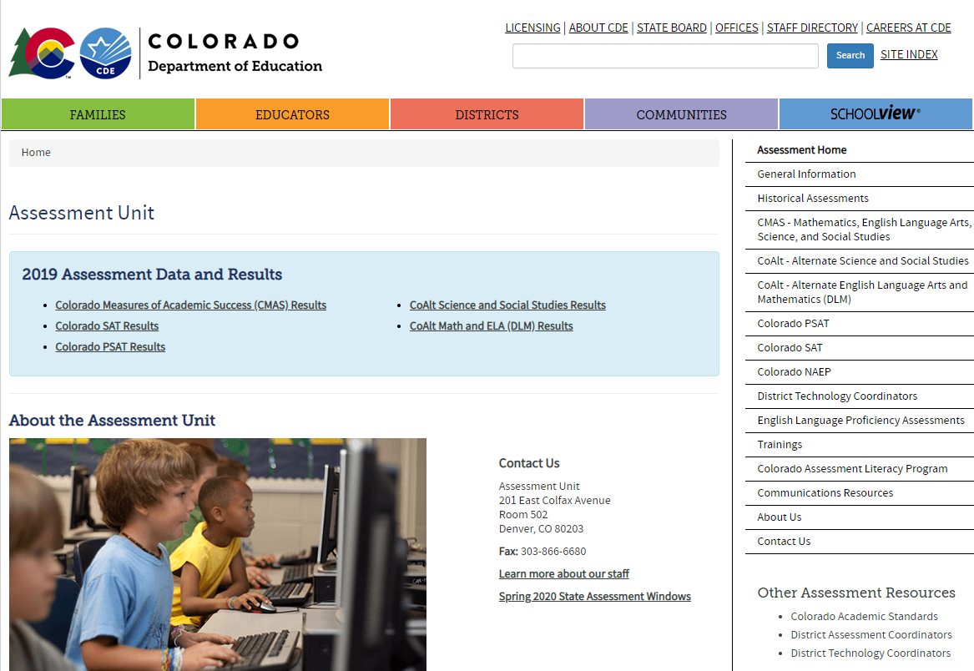
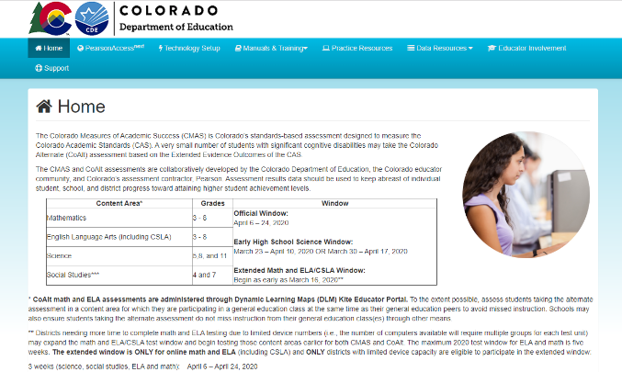
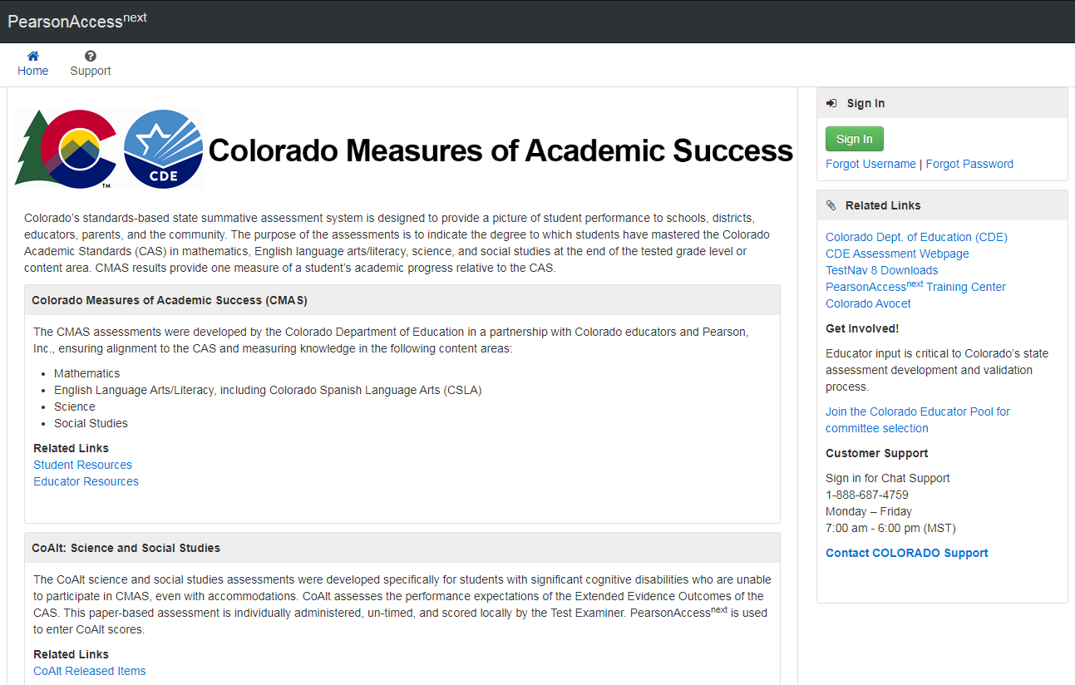
Resources - Websites
Colorado Department of Education - Assessment
http://www.cde.state.co.us/assessment
Colorado Assessments Portal
http://coassessments.com
PearsonAccess^{next}
Live Site: https://co.pearsonaccessnext.com
Training: http://trng-co.pearsonaccessnext.com/
Tip: PearsonAccess^{next} sites can be accessed through the Colorado Assessments Portal (bookmark the portal!)

Slide 205
Resources – Portal
PearsonAccess^{next}
Links to the live and training site
Technology Setup
Technology Guidelines
Manuals and Training
CMAS and CoAlt Procedures Manual
CMAS Test Administrator Manuals
Computer-based Testing
Paper-based Testing
Spanish SAY Directions
CoAlt Test Administrator Manual
Training Videos
Additional Documentation
Practice Resources
TestNav 8 Tutorials
Computer-based Testing CPRs
Paper-based Testing CPRs
CPR Scoring Guides and Rubrics
Data Resources
File Layouts
Reporting Resources
Interpretive Guide
Spanish Report Shells and PLDs
Educator Involvement
Register for educator committee development meetings
Parents and Guardians
Score Report Resources
Documents and Forms
Policy Documents
Before, During, and After Testing forms and guidance

Slide 206
Resources – PAnext Training Modules
The following modules are suggested for use by districts:
Welcome to PearsonAccess^{next}
User Accounts
Student Registration/Personal Needs Profile (SR/PNP)
Paper and Online Pre-Testing Materials Management for DACs and SACs
Assessment Coordinator Online Session Management
Test Administrator Online Session Management
Additional Orders
Post-Testing Materials Management for DACs and SACs
Post-Testing Data Clean-up

Slide 207
Customer Support
Contact Support for assistance with:
Navigating PearsonAccess^{next}
Navigating the Training Site
Managing student registration data
Setting up test sessions
Managing user IDs and passwords
Accessing resources
Setting up proctor caching
Submitting additional orders
Inquiring about shipments
CMAS Support
Call Toll Free: 1-888-687-4759
Monday – Friday
7:00 am - 6:00 pm (MST)
https://co.pearsonaccessnext.com > Contact COLORADO Support
Chat is available

Slide 208
Resources
CMAS Administration Office Hours
Thursdays from 3-4
Office hours dates:
December 7
January 11 and 25
February 15 and 29
March 14 and 28
Weekly April 4-May 9
Topics include
PearsonAccess^{next}
Policies and procedures
Updates
Packaging materials for return
Invalidation coding
*DAC* Emails
Assessment Division updates and information emailed to DACs, as needed (typically weekly in the spring)
Some districts set up auto-forwarding rule based on *DAC* in subject line
Office hours are not recorded. Any “new” information discussed during office hours is included in *DAC* emails. If you have a question and cannot attend, email or call CDE.

Slide 209
CDE Assessment Division Contacts
Questions | Contact | Phone | Email
CMAS & PAnext | Sara Loerzel | 720-316-3065 | loerzel_s@cde.state.co.us
CoAlt & Accommodations for Students with Disabilities | Arti Sachdeva | 720-316-7184 | sachdeva_a@cde.state.co.us
ACCESS & Accommodations for Multilingual Learners | Heather Villalobos Pavia | 303-653-9749 | villalobospavia_h@cde.state.co.us
CO PSAT & SAT | Melissa Carpenter | 720-413-8876 | carpenter_m@cde.state.co.us
Technology, NAEP & International Assessments Coordinator | Collin Bonner | 303-895-5750 | bonner_c@cde.state.co.us
Psychometrics & Data | Jasmine Carey | 720-537-0973 | carey_c@cde.state.co.us

Slide 210
Thank you!

