Slide 1
ACCESS for ELLs Suite of Assessments Training for 2021-2022
October 2021

Slide 2
This training is to support District Assessment Coordinators prepare their district for the annual administration of the WIDA ACCESS suite of assessments including ACCESS for ELLs 1-12 (online & paper), Kindergarten ACCESS for ELLs, and Alternate ACCESS for ELLs.

Slide 3
District level logistics of the WIDA ACCESS assessments
CONTENT
Law | Security & Training Requirements
About WIDA ACCESS | Materials
Participation | Accommodations
Important Dates | Online Testing Reminders
What’s New & Reminders | Preparing Students
Resource Documents | Contacts

Slide 4
About WIDA ACCESS
WIDA
Colorado uses the WIDA English language development standards for the Colorado English language proficiency (CELP) standards (adopted in 2009).
In Colorado, the standards based English language proficiency assessments are the ACCESS for ELLs, Kindergarten ACCESS, and Alternate ACCESS assessments.
Data Recognition Corporation (DRC)
The assessment vendor/publisher/online test platform for WIDA ACCESS suite of assessments .

Slide 5
Testing requirements
All English Learners (NEP and LEP), including students with disabilities, must participate in the state English language proficiency assessment system (WIDA ACCESS).
An English language proficiency assessment is required by federal and state law and is guaranteed to students under Civil Rights law of 1964 and The Office for Civil Rights Memorandum of 1970.
Federal Law
Title IA
20 U.S.C. 6301 §1111(b)(2)(C)(v)(II)(dd)
20 U.S.C. 6301 §1111(b)(3)(C)(ix)(III) & (x)
20 U.S.C. 6301 §1111(b)(6) & (7)
Title IIIA
State Law
Colorado Senate Bill 109 – C.R.S. 22-24-106 ELP Assessment
Colorado House Bill 14-1298 – C.R.S. 22-24-101 English Language Proficiency Act (ELPA)

Slide 6
Remote/Online Learners
Districts completed Remote Learning Plans for 2021–2022 school year. The guiding document is available through the link below. As part of the plan, districts agreed to series of instructional assurances.
Instructional Assurance #7:
The district will remain responsible for administering the state assessments to its students as required by state and federal law. The district must have a plan for how to meet that obligation for its remote students, while taking into consideration health and safety needs at the time of state testing, as well as respecting parental decision-making regarding state content assessments
100% Remote Learning Option (K–12) for the 2021–2022 School Year as a Result of COVID-19 Health Concerns

Slide 7
Testing NEP or LEP students with an IEP or 504 Plan
The educational team (EL and IEP or 504 as applicable), which must include the parents, determines whether the student will take ACCESS for ELLs or Kindergarten ACCESS with or without accommodations or, for a student with the most significant cognitive disability, meets the participation requirements for the alternate assessment.
According to federal requirements, there must be evidence of alignment between a student’s educational plan, instruction, and the accommodations provided on any of the state assessments, as well as any determinations for students to participate in Alternate ACCESS.

Slide 8
WIDA ACCESS participation options
Three participation options exist:
The student participates in ACCESS for ELLs or Kindergarten ACCESS without an accommodation.
The student participates in ACCESS for ELLs or Kindergarten ACCESS with an accommodation*.
The student participates in Alternate ACCESS only for students with the most significant cognitive disabilities.
Note: It is not appropriate or ethical to give the Alternate ACCESS to students who do not qualify to take the assessment.
*Accommodations are practices and procedures that provide equitable access during instruction and assessment for students who have a documented need. In order to use accommodations on ACCESS for ELLs accommodations must be determined by the student’s educational team and documented in the student’s IEP or 504.

Slide 9
Dates

Slide 10
WIDA ACCESS State established dates
CDE training: October 2021
Materials order window: 10/20/21 – 11/05/21
Districts only order paper grades 1-12 test materials via WIDA-AMS
Online, K and Alternate ordered through the State Pre-ID File upload
UAR (scribe) submission: 12/01/21
WIDA AMS opens: 12/01/2021
Materials arrive: 12/16/21
Additional Materials Order Window: 12/16/21*– 02/04/22
Opportunity to order handwriting response booklets
Test Window: 01/10/22 – 02/11/22
Enrollment testing cutoff: 02/04/22
Return materials: 02/16/22
Results (tentative): 05/02/22 (downloadable reports)
05/12/22 (printed reports)
*When placing an additional materials order be sure the district will be open to
receive the secure materials

Slide 11
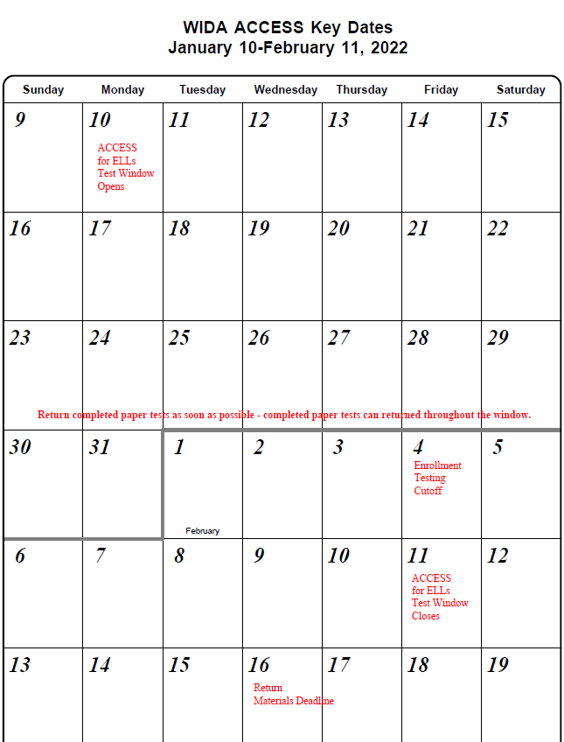
Test window
WIDA ACCESS Test Window:
01/10/22 – 02/11/22
Return completed paper forms as soon as possible
Enrollment testing cutoff 02/04/22
Deadline to return all materials 02/16/22

Slide 12
WIDA ACCESS District established dates
District/Site Level trainings
Local testing schedule
Submitting the verification of district training form to CDE
Submit before your district begins testing.
Distribution of results
ISRs are to be shared with parents/guardians as soon as practicable. Please keep in mind, the reports are confidential and distribution of both electronic and/or hard copy reports must be in accordance with state and federal privacy laws, and local school board policy.

Slide 13
What’s new? & Reminders

Slide 14
New this year
For CDE
Security and Policy Supplement
Security Agreement
Post Test Compliance Report
From WIDA/DRC
Redesigned WIDA Secure Portal
About the new portal
WIDA AMS - Student Status Dashboard
WIDA AMS User Guide p.75

Slide 15
Reminders
Submit a verification of district training form to CDE before your district begins testing.
Student transfers are through CDE
When 1 online test session has been completed and needs to be transferred to the new district.
Only district/school email addresses should be used in WIDA AMS and in WIDA.wisc.edu
WIDA ACCESS Office Hours-
Wednesdays at 3:30
November 10, 2021 – February 16, 2022
(Cancelled on 11/24, 12/22, and 12/29)

Slide 16
Resources Documents

Slide 17
Resource Documents
WIDA/DRC
District and School Coordinator Manual
WIDA AMS User Guide
Test Administrator Manual
Test Administrator Essentials
Accessibility and Accommodations Manual
CDE Assessment Division
Colorado Specific Information
Colorado Checklist
Security and Policy Supplement
DAC Forms
Security Agreement
Verification of District Training
Post Test Compliance Report
Testing Irregularity or Security Breach Report
Report Contaminated, Damaged, or Missing Materials
Transfer Request Form
Accommodations Crosswalk

Slide 18
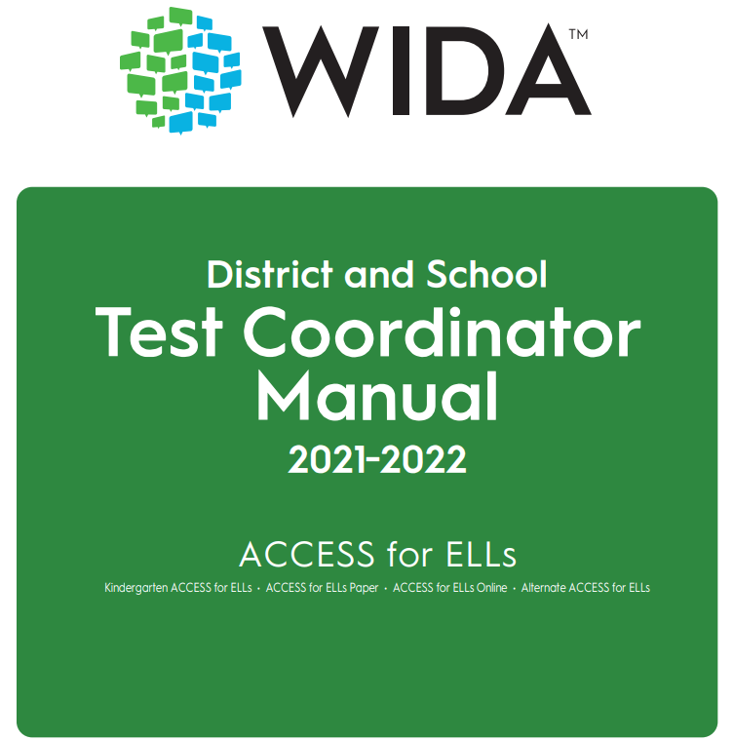
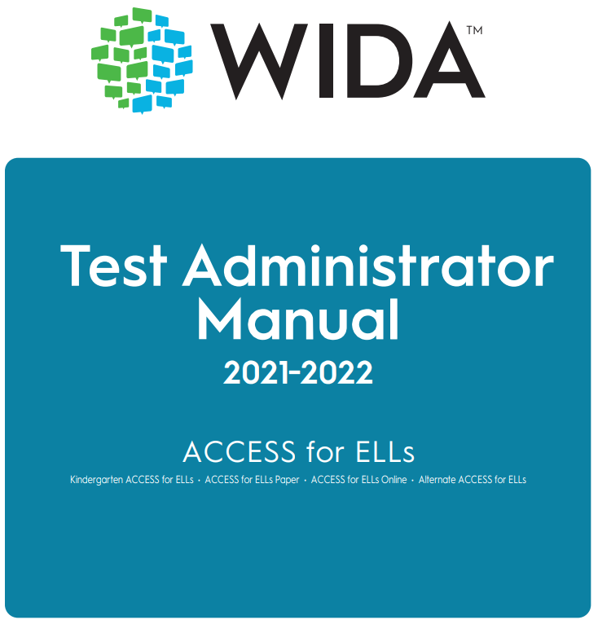
WIDA Role Specific Manuals
Test Administrator Manual (TAM)
For Test Administrators
District and School Manual (DSM)
For Test Coordinators

Slide 19
Test Administrator Essentials

Slide 20
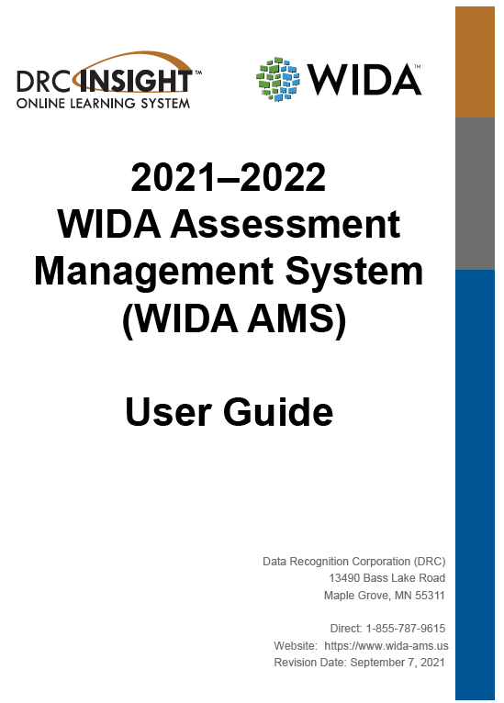
WIDA AMS User Guide

Slide 21
WIDA Assessment Management System (WIDA AMS)
Within the system, designated staff may:
Access any needed user guides or software downloads
Add students
Designate accommodations
Create test sessions
Print test tickets
View/print reports
Access the Student Status Dashboard
Limit the number of staff who have district level permissions.

Slide 22
Break & Check WIDA AMS District Level Users
15 minutes

Slide 23
Colorado Checklist

Slide 24
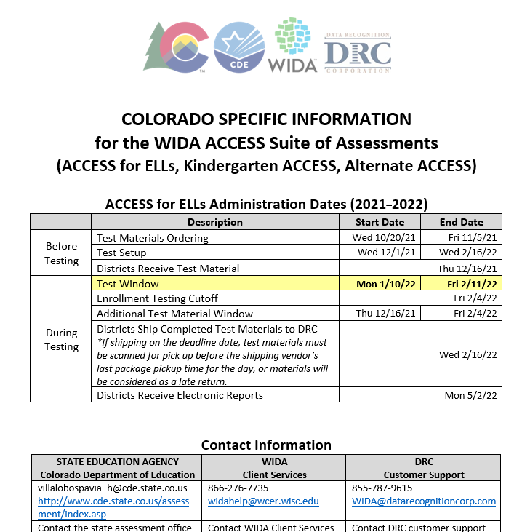
Colorado Specific Information

Slide 25
Security & Training Requirements

Slide 26
WIDA ACCESS Security
WIDA ACCESS Assessments
are secure tests
Security and Policy Supplement
Colorado Security Agreement

Slide 27
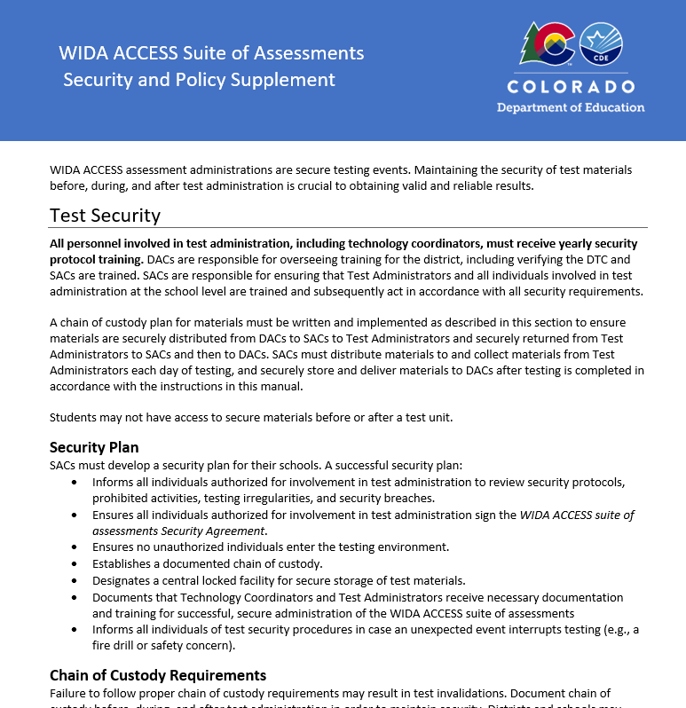
Security and Policy Supplement

Slide 28
Who can administer WIDA ACCESS
TAs must be employed by the school or district.
Preferably, TAs will be:
licensed teachers, licensed administrators, instructional support para-professionals, substitute teachers who hold a teaching certificate, school psychologists, school social workers, school librarians, school counselors, or speech pathologists
School/district employees may administer assessments at the grade levels of their own children, but they may not administer the test to their own children or relatives, nor be in the testing environment during testing.
For Kindergarten ACCESS or Alternate ACCESS, the TA needs to be able to model clear standard pronunciation of the English phonemes that may impact student responses.
TAs administering the Alternate ACCESS must hold a State of Colorado educator license.

Slide 29
Training requirements
Test Administrators must:
Be trained annually
Complete the requirements of the district/school annual WIDA ACCESS training
Participate in WIDA’s online training modules
Independently pass the quiz(zes) that correspond(s) to the assessment being administered
Read instructions in the TAM and familiarize themselves with test administration procedures prior to administering the test
Be trained on specific accommodations if administering assessments in which students are provided accommodations
Submit to their SAC a signed Security Agreement
Note: Student teachers may not serve as Test Administrators who are in charge of administering WIDA ACCESS. They may serve as proctors who assist the Test Administrators.

Slide 30
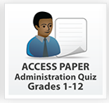
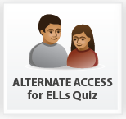
Quizzes
Quizzes in the WIDA secure portal, available after completing the modules.

Slide 31
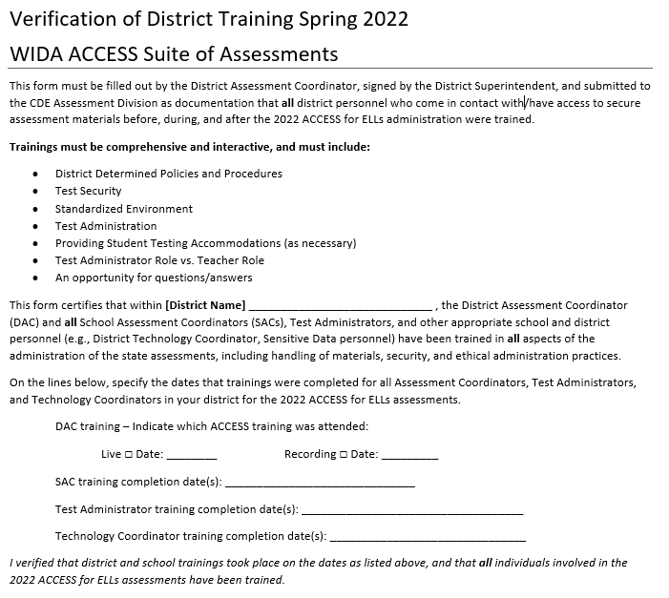
Verification of district training

Slide 32
Before administering WIDA ACCESS
Order necessary materials (paper materials)
Annual training needs to be held
Complete the Security Agreement
Verification of district trainings
Test administrators need to pass the quiz/quizzes that align to the assessment that will administer.
TAs who administer paper Speaking only need to pass the quiz for the grade level that they administer (completing this for Screener counts)
TAs who administer Kindergarten need to pass that quiz
TAs who administer Alternate ACCESS need to pass that quiz
All online districts need at least one person who is prepared to administer paper should it be needed for an accessibility or accommodation

Slide 33
Materials

Slide 34
Materials ordering
Online, Kindergarten, and Alternate test materials are ordered automatically through the Pre ID file
Data is pulled from the initial October Count snapshot in the Student Interchange
Students must be indicated as NEP or LEP under Language Proficiency
Alternate testers are indicated using the “Alternate Assessment Participation” field
DAC orders materials – the following require active order placement
1-12 paper
Accommodated forms (i.e., large print, braille)
Test Administrator Scripts and Listening and Speaking CDs (as applicable) will now be included in the Large Print & Braille kits. When ordering, there is no need to also order a script or CD.
If you need the script for human reader (L, W, S) – order it through DRC help desk it is not available for order through WIDA AMS.
Ordering support is in the WIDA AMS User Guide p. 45

Slide 35
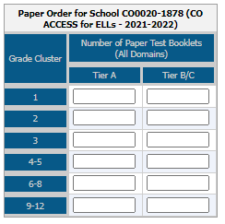
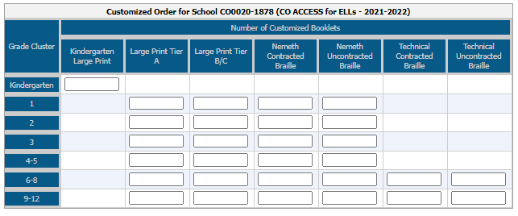
Complete materials ordering – notice these images are of the paper materials that you may need to order. No other materials need to be ordered during the initial material order window.

Slide 36
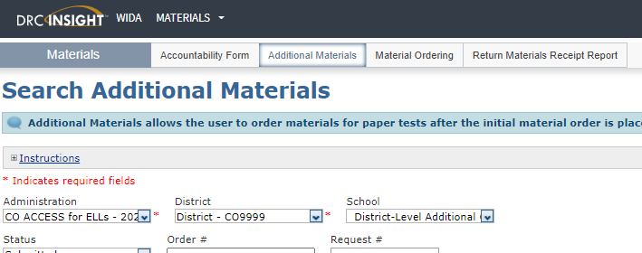
Ordering additional materials
Additional Order window: December 16, 2021 – February 4, 2022
Use the “District-Level Additional Orders Only Site – WWWW” do not place additional material orders at the school level.
School level additional materials will not be processed (p. 50 of the WIDA AMS User Guide )

Slide 37
Reminders
Remind staff to keep all Pre-ID or District/School labels until the end of the window. Even if they think they are not needed.
When placing an additional material order –
For sites that did not initial need paper materials when and if a paper test is ordered later, be sure to order the Speaking test booklet (this is the book that has the pictures to accompany the Speaking CD).
Reference the Speaking Test Materials list on page 46 of the WIDA TAM.

Slide 38
Forms shipped to district
District Packing List (white)
School Box Range Sheet (white)
Use this list to support record keeping of book barcode assigned to each student
School Packing Lists–District Set (white)
District Security Checklist (white)
Copy of School Security Checklists (white)
Agreement to Maintain Confidentiality (blue)

Slide 39
Materials shipped to district
Plastic Bags and Ties for Materials Return
Return Materials Instruction Packet
Labels
Student (reported as NEP/LEP) in the Student Interchange
District/School (3 pages)
Do Not Process
Testing Materials including Overage
Reminder:
Alternate materials are combined with Online, Paper, and Kindergarten ACCESS for ELLs. Boxes with Alternate materials have a blue label.

Slide 40
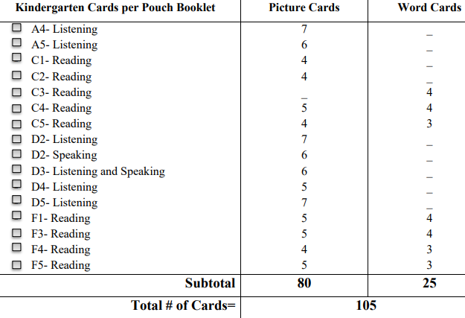
Kindergarten materials
Kindergarten
Student Storybook
Student Response Booklet
Test Administrator's Script
Student Activity Board
Cards
Card Pouch Booklet
A label - all scorable materials must have a label, either PreID or District/School
At least two number 2 pencils

Slide 41
Alternate materials
Alternate ACCESS
Test Administrator's Script
Test Booklet
Student Response Booklet
(make sure it is the correct grade level)
A label - all scorable materials must have a label, either PreID or District/School
At least two number 2 pencils

Slide 42
Accommodations IEP or 504 plan

Slide 43
Accommodations
Monitor accommodation assignment so that only students with an IEP or 504 are afforded accommodations on an English language proficiency assessment

Slide 44
Accommodations Unique Accommodation Request (UAR)
Only one Unique Accommodation applies to ACCESS for ELLs.
Scribe (which includes Speech-to-Text) for the Writing Domain
UAR for ACCESS is due December 1st
ACCESS for ELLs
Scribe for Writing Domain
Guidance
Form*
*Do not email completed UAR forms, supporting data, and spreadsheets to CDE. DACs send UAR files to CDE through Syncplicity. Notify sachdeva_a@cde.state.co.us when all ACCESS UAR files are posted for review.

Slide 45
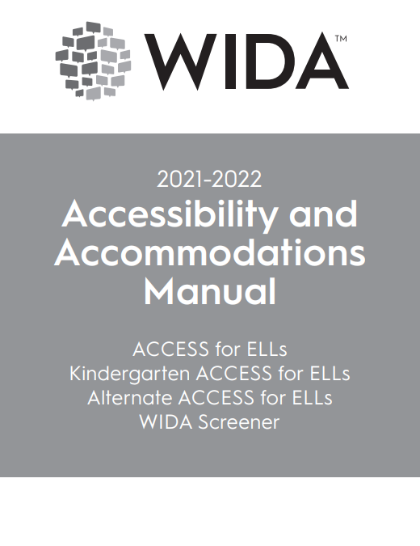
Accessibility and Accommodations
WIDA Accessibility and Accommodations Manual
Colorado Accommodations Crosswalk
CDE Accommodations Training webpage

Slide 46
Online accommodations
Accommodations that must be pre-assigned via WIDA AMS
Manual Control of Item Audio
Repeat Item Audio
Extended Speaking Response Time
Do not broadly assign extended speaking time to all IEP/504 students who have extended time – be intentional about assigning this accommodation to students who need extended time specifically for speech issues.

Slide 47
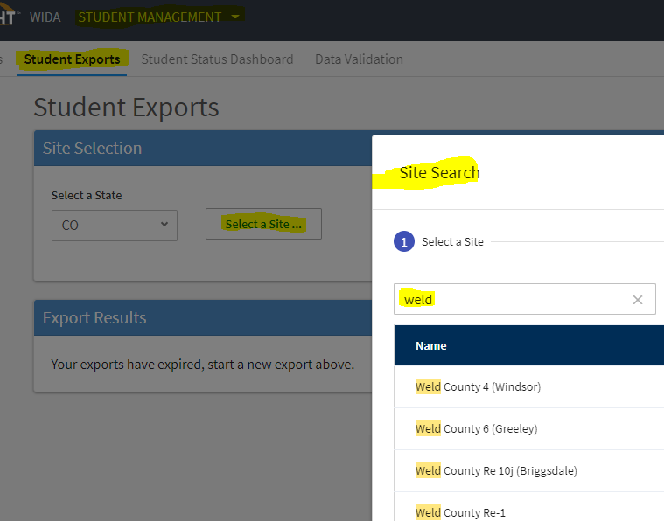
Checking accommodation assignment
To check accommodations assignment, use the Student Export feature in WIDA AMS.
Exporting Student Records instructions begin on page 67, of the WIDA AMS User Guide.

Slide 48
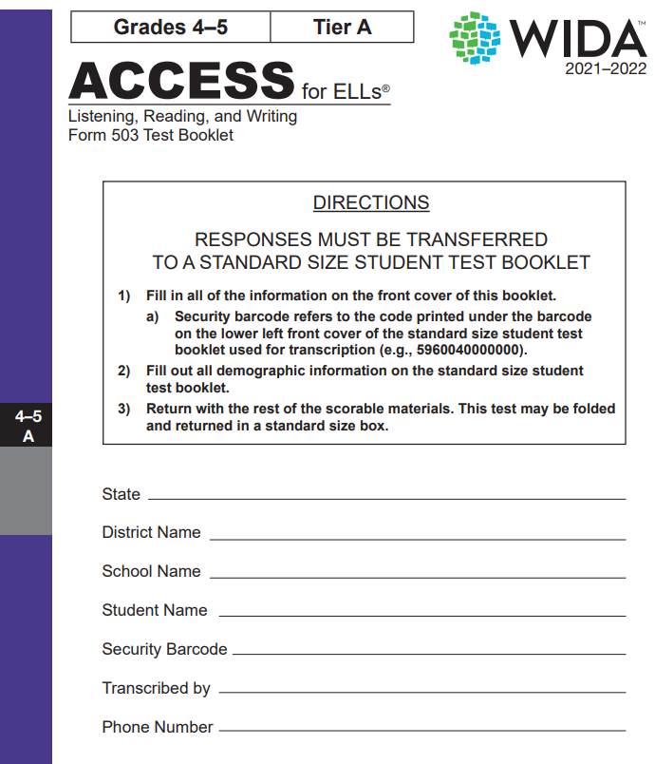
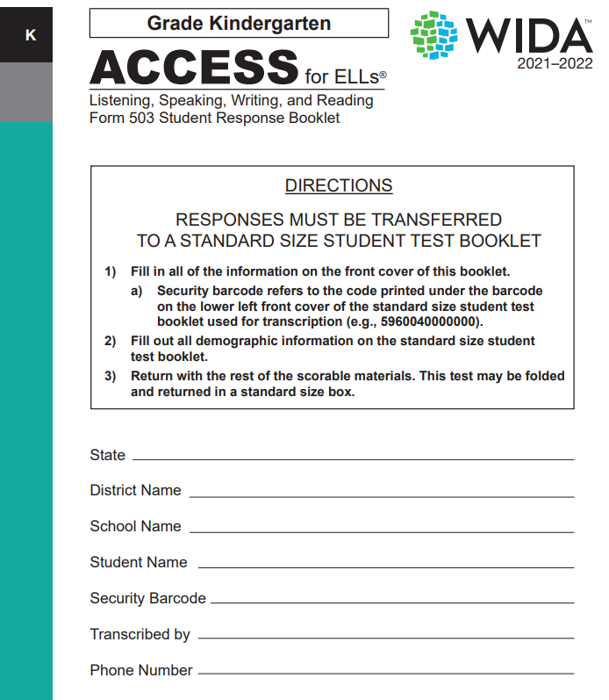
Paper accommodated form (grades 1-12) Large Print

Slide 49
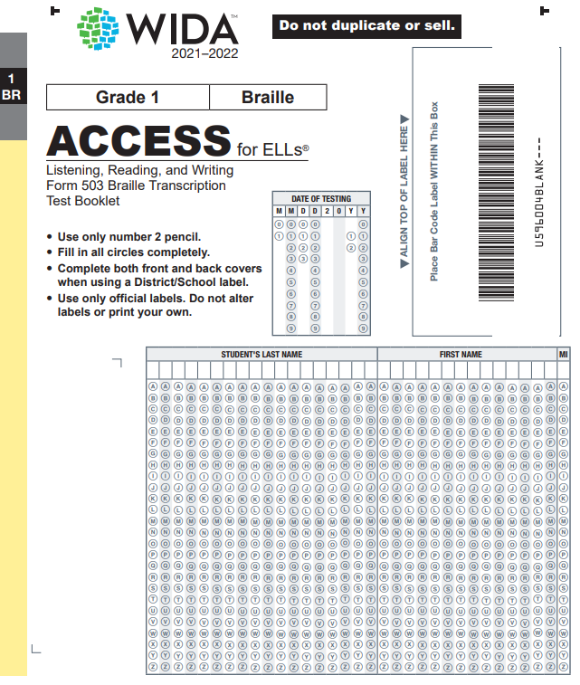
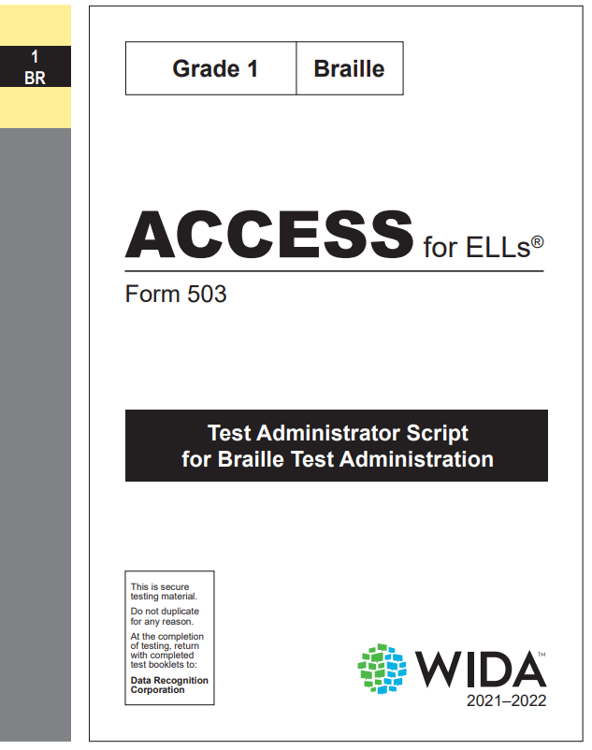
Paper accommodated forms (grades 1-12) Braille
CDE has a checklist available for students who cannot read Braille or cannot access signing.

Slide 50
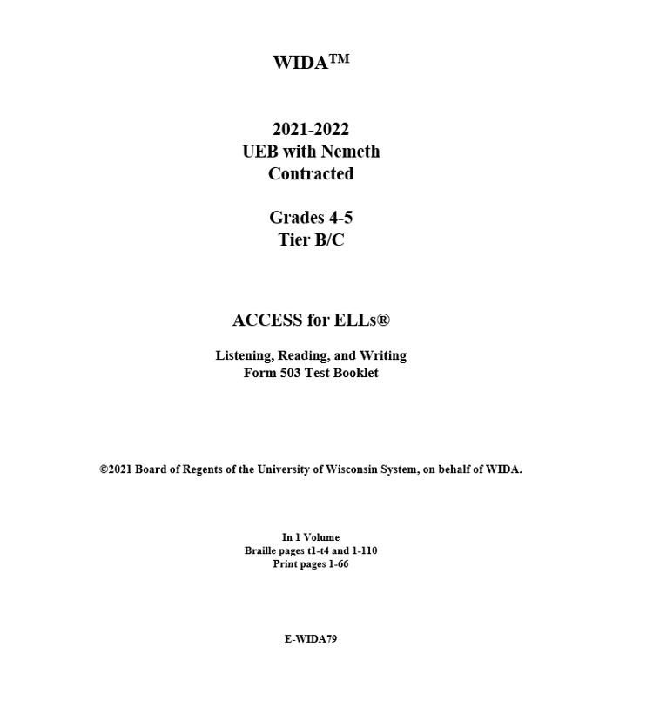
Paper accommodated forms (grades 1-12) Braille
CDE has a checklist available for students who cannot read Braille or cannot access signing.

Slide 51
Online Testing Reminders

Slide 52
Online testing
Reminders
Double check test tickets are for the correct students
Make sure testing devices are charged
Headphones and microphones work
Have back up devices (computer/Chromebook/tablets, and headphones/microphone) available
Have a plan in place incase of internet outages
How long/how many test attempts are appropriate
When to stop and try again the next day
Follow DRC guidelines, do not overtax the system

Slide 53
Online testing order
In either order but first
Listening and Reading
Listening and Reading determine Writing and Speaking tier
In either order after Listening and Reading
Writing and Speaking

Slide 54
Student transfers through CDE
Student transfers during testing – only when 1 online test session has been completed and needs to be transferred to the new district.
New district emails Heather and the former district.
Email subject line: STUDENT TRANSFER REQUEST
The former district must “reply all” confirming that the student is no longer in their district.
The new district must upload the student information to Syncplicity.
DAC email addresses and phone numbers are found at http://www.cde.state.co.us/assessment/dac

Slide 55
Preparing Students

Slide 56
Standards Based Assessment
The WIDA ACCESS assessments are standards based
The assessment is criterion-based
Colorado adopted the WIDA standards as the Colorado English Language Proficiency (CELP) Standards
For support with English language development standards and instruction connect with the Office of Culturally and Linguistically Diverse Education.
WIDA has eLearning courses available to all educators in the Colorado public K-12 school system.

Slide 57
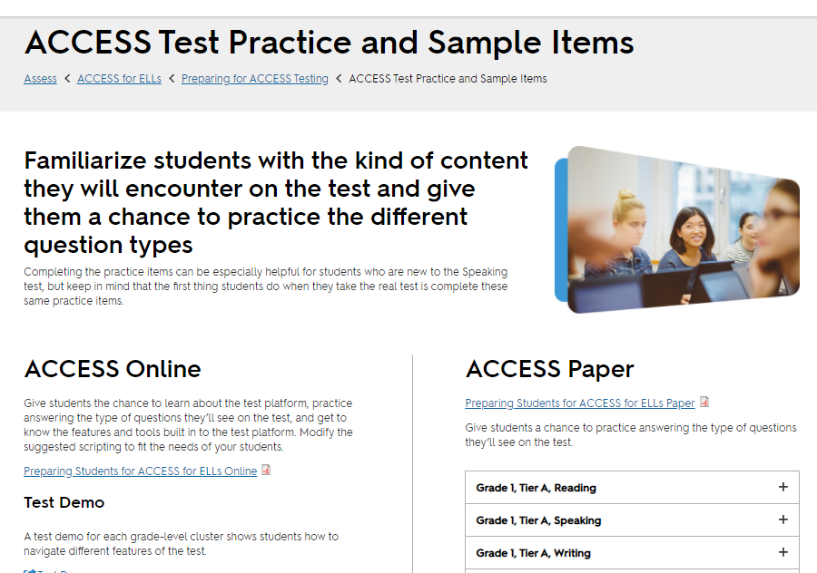
Preparing students
https://wida.wisc.edu/assess/access/preparing-students
https://wida.wisc.edu/sites/default/files/resource/Preparing-Students-ACCESS-ELLs-Online.pdf
https://wida.wisc.edu/assess/access/preparing-students/practice?utm_source=CR-WW092320&utm_medium=email&utm_campaign=WIDAWednesday&utm_content=text-ACCESS-Test-Practice-and-Sample-Items

Slide 58
Contacts

Slide 59
Assessment Vendor
Contact the WIDA Client Services Center for questions regarding:
ACCESS for ELLs quizzes and certification
WIDA account usernames and passwords
WIDA eLearning
WIDA ACCESS Kindergarten placement test (K W-APT) materials
WIDA Screener Online and Paper quizzes and materials
help@wida.us​
1-866-276-7735​
Contact Data Recognition Corp (DRC) for questions regarding:
WIDA AMS
WIDA AMS logins
Test ordering and returning
Printing and unlocking test tickets
Editing student grade information
Generic test sessions
Tier reports
Pre ID labels
Entering accommodations
Using Chromebooks and iPads
DRC Central Office Services (COS) Device
​
WIDA@datarecognitioncorp.com
1-855-787-9615

Slide 60
Colorado Department of Education
State Standardized Summative Assessments
ACCESS for ELLs and CMAS EL accommodations
Heather Villalobos
villalobospavia_h@cde.state.co.us
PA^{next} and CMAS logistics
Sara Loerzel
loerzel_l@cde.state.co.us
CoAlt (DLM) and CMAS and WIDA ACCESS IEP and 504 Plan accommodations
Arti Sachdeva
sachdeva_a@cde.state.co.us
PSAT and SAT (College Board Assessments)
Jared Anthony
anthony_j@cde.state.co.us
Assessment Data Contact
Jasmine Carey
Carey_j@cde.state.co.us
English Learner Coding, Program and Instruction
EL Coding and October Count
Brooke Wenzel
wenzel_b@cde.state.co.us
EL Identification (W-APT & Screener)
Doris Brock-Nguyen
brock-nguyen_d@cde.state.co.us
EL Programing and Instruction Support
Morgan Cox
cox_m@cde.state.co.us
ACCESS Growth
Dan Jorgensen
jorgensen_D@cde.state.co.us

Slide 61
CDE Assessment Team
Joyce Zurkowski
Chief Assessment Officer
Will Morton
Director of Assessment Administration
Christina Wirth-Hawkins
Director of Assessment Development
Jared Anthony
College Board Suite of Assessments
Jasmine Carey
Psychometrics
Collin Bonner
NAEP, TIMSS & ICILS, Technology Support
Sara Loerzel
CMAS Administration & PA^{next}
Arti Sachdeva
CoAlt, DLM, SPED Accommodations
Molly Mund
Content Development (Math & Science)
Heather Villalobos Pavia
ACCESS, CSLA, EL Accommodations
Nathan Redford
Content Development (ELA & Social Studies)
Angela Landrum
Colorado Assessment Literacy Program

