Slide 1


2024-25
District Assessment Coordinator
Kickoff Meeting
CDE Assessment Division
August 20, 2024

Slide 2
Welcome and Agenda
General Information
ACCESS for ELLs
CMAS
CoAlt
Colorado PSAT and SAT
National and International Assessments
Data and Reporting
Comprehensive Assessment System Initiatives & Resources
Tech Tips
Communication
Additional Local Education Provider Responsibilities
Resources

Slide 3


General Information

Slide 4
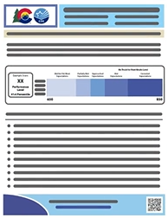
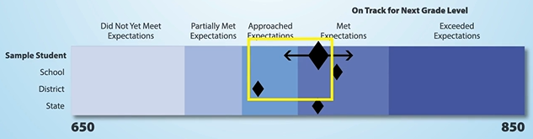
State Content Assessments: Purpose and Uses
For Students/Parents
Serve as only statewide indicators of student mastery of the Colorado Academic Standards
Provide student achievement information to parents beyond their child’s school
SAT provides a nationally recognized indicator of academic college readiness
As always, parents should consider multiple data points and sources of information when making decisions regarding student achievement and plans for instruction.

Slide 5

State Content Assessments: Purpose and Uses in the Classroom
For Educators
Provide information on student performance compared to school, district and state peers towards the end of the school year
Allow teachers to see student performance against the standards and identify areas for consideration for future program and instructional adjustment
Provide sources of data to support ongoing decision-making on curricula, scope and sequence, and the allocation of supports and resources
Serve as comparison points as schools/districts evaluate the effectiveness of adjustments they made to address lost opportunities to learn in prior years
As always, educators should consider multiple data points and sources of information when making decisions regarding student achievement and plans for instruction.

Slide 6

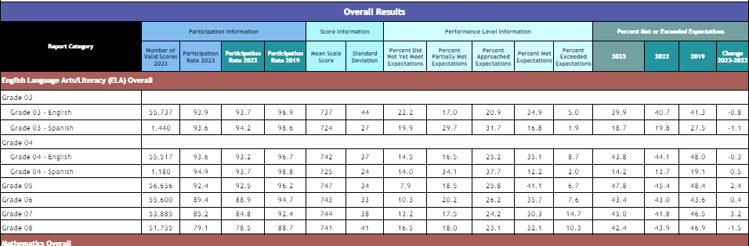
State Content Assessments: Purpose and Uses in the Community
For Stakeholders, Policy Makers and the Community
Provide information to be used to inform the allocation of resources and evaluate the impact of policy

Slide 7
Wrapping Up Spring 2024
Over the summer, CDE provided DACs access to results and individual student performance reports for all state assessments
  DACs provide access to other district and school personnel (Pearson)
  Student performance reports should be shared with parents as soon as possible
    Colorado statute requires local education providers to ensure that appropriate personnel provide and explain assessment results to the parent or legal guardian of each student enrolled in the school district or the institute charter school (C.R.S. §22-7-1006.3 (8)(a)).
  CDE Assessment is working with Pearson to develop a parent portal that will help facilitate faster and easier distribution of CMAS student performance reports, perhaps as early as after the spring 2025 administration
Communication resources are available to help parents and other audiences understand state assessment results
  Resources for communicating with educators
  Sample Family Letters
  Fact Sheets
Communication Resources:
CDE Assessment Division Resources

Slide 8
Spring 2024 State Content Assessment
Reporting Timeline
Type | Information
CMAS | 2024 individual student-level CMAS and CoAlt ELA, Math and Science results Student level files: June 17th ▪ Preliminary reports: June 17th Other confidential files and reports containing personally identifiable information were made available throughout June and July District and School Summary Files Participation Summary Reports Performance Level Summaries Content Standards Rosters and District Summary of Schools Evidence Statement and Item Analysis Reports Individual Student Level Reports – electronic versions July 3rd Individual Student Level Reports – hard copies delivered the week of July 22nd
PSAT/SAT | Individual students had access to their scores through their online College Board accounts or in the BigFuture School app on May 14th Educators had access to scores through College Board portal on June 7th
Public Release | Results presented to State Board of Ed. Preliminary results: June 13th ▪ Embargo lifts: August 29th Final results: August 20th (state level)

Slide 9



QR code on individual student level performance reports linking to online videos
Visit CMAS Parent and Guardian Resources
to access all video reports
9

Slide 10
Meet the CDE Assessment Team
Joyce Zurkowski
Chief Assessment Officer
Lisa Oliver
Director of Assessment Administration
Christina Wirth-Hawkins
Executive Director
Collin Bonner
Technology, NAEP, International Assessment
Jasmine Carey
Psychometrics and Data
Melissa Carpenter
PSAT 9, PSAT 10, SAT
Sara Loerzel
CMAS Administration and PearsonAccess^{next}
Leon Merker
Data and SBDs
Molly Mund
CMAS Content Development
Arti Sachdeva
CoAlt and SPED Accommodations
Nathan Redford
CMAS Content Development
Heather Villalobos Pavia
ACCESS, CSLA, Linguistic Accommodations
Angela Landrum
Assessment Literacy and Performance Assessments

Slide 11
Spring 2025 Colorado Assessments
Colorado Measures of
Academic Success
(CMAS)
Colorado Alternate (CoAlt)
Assessments
CO PSAT/SAT
SAT – Grade 11
PSAT – Grades 9 and 10
Math
Math (DLM)
Math
ELA
ELA (DLM)
Reading and Writing
Optional SAT Essay
Science
Science
Social Studies*
Social Studies*
*Social Studies administered in a representative sample of schools as required by state statute
**Reading and math administered in grades 4 and 8 in selected schools
NAEP **
and International Assessments
ACCESS
for ELLs

Slide 12
2024-25
Winter State Assessments:
Grades K through 12
Grade | Kindergarten ACCESS | ACCESS for ELLs | Alternate ACCESS
K | ✔ |  | ✔
1 |  | ✔ | ✔
2 |  | ✔ | ✔
3 |  | ✔ | ✔
4 |  | ✔ | ✔
5 |  | ✔ | ✔
6 |  | ✔ | ✔
7 |  | ✔ | ✔
8 |  | ✔ | ✔
9 |  | ✔ | ✔
10 |  | ✔ | ✔
11 |  | ✔ | ✔
12 |  | ✔ | ✔

Slide 13
2024-25
Spring State Assessments:
Grades 3 through 8
Grade | ELA | Math | Science | Social Studies
3 | ✔ | ✔
4 | ✔ | ✔ |  | ✔*
5 | ✔ | ✔ | ✔
6 | ✔ | ✔
7 | ✔ | ✔ |  | ✔*
8 | ✔ | ✔ | ✔
Note: CoAlt science and social studies and CoAlt DLM assessments are the corresponding assessments to CMAS science, social studies, math and ELA for students with the most significant cognitive disabilities.
*Administered at selected schools only

Slide 14
2024-25
Spring State Assessments:
Grades 9 through 11
Grade | CO PSAT* | CO SAT* | CMAS Science*
9 | ✔
10 | ✔
11 |  | ✔ | ✔
Note: The student-selected writing portion of the SAT will be administered during the school day. Details about the ordering process will be shared later this fall.
*CoAlt eligible students take the corresponding CoAlt assessment at each grade level.

Slide 15
Tentative 2024-25 State Assessment Calendar
Assessment | Grade(s) | Tentative Window
ACCESS for ELLs® | K through 12 | January 13 through February 14, 2025
CMAS and CoAlt: Science CMAS and CoAlt: Social Studies¹ CMAS: Math and ELA (CSLA²) | 5, 8, 11¹ 4 and 7 3 through 8¹ | April 7 through 25, 2025
CoAlt: DLM ELA and Math | 3 through 8 | Aligned to CMAS: Math and ELA schedule
CO PSAT CO SAT | 9 and 10 11 | April 14 through April 25, 2025 Dates may be selected based on district/school preference within this window
CoAlt: DLM ELA and Math | 9 through 11 | Aligned to PSAT and SAT schedules
¹Social studies administered at selected schools only
²CSLA is for eligible multilingual learners in grades 3 and 4 only

Slide 16
Annual Training Requirement
CDE Assessment Division Training Page
Assessment specific training (CMAS, CoAlt, ACCESS, CO PSAT and SAT) for all district and school personnel involved in any aspect of Colorado’s state assessments is required on an annual basis
DACs must be trained on each assessment each year
DACs must meet with School Assessment Coordinators (SACs) to ensure a training plan is in place for training Test Administrators, Technology Coordinators and any other school staff handling secure materials
Districts are required to collect signed documentation from those who work with test materials that demonstrates an understanding of the policies and procedures set forth by the State of Colorado and the district

Slide 17

Requirements & District Responsibilities
Parent Excusals §22-7-1013(8)(a-c)
A student’s parent may excuse the student from participating in a state content area assessment
Each Local Education Provider (LEP) will adopt and implement a written policy and procedure by which a student’s parent may excuse the student from participating in one or more of the state content area assessments.
  If a parent excuses his or her student, the LEP shall not impose negative consequence on the student or parent including:
    Prohibiting school attendance; imposing an unexcused absence; or prohibiting participation in extracurricular activities.
    Prohibiting the student from participating in an activity or receiving any other form of reward that the LEP provides to students who participate in the state assessment.
LEP shall not impose an unreasonable burden or requirement on a student that would:
  Discourage the student from taking a state assessment or
  Encourage the student’s parent to excuse the student from taking the state assessment.

Slide 18
Parent Excusals
Districts must have procedures for parents to be able to independently excuse their children from content area testing
Districts and schools may not encourage or pressure parents to excuse their children from testing
Follow parent excusal coding guidance to indicate parent excuse on a student record
CDE does not provide a parent excusal form
  §22-7-1013(8)(a) Each LEP will adopt and implement a written policy and procedure...

Slide 19
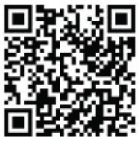


Get Involved!
Educator input is critical to Colorado's state assessment development and validation process. Educators may participate in committees related to the following state assessments:
  Colorado Measures of Academic Success (CMAS): Science, Social Studies, Mathematics and English Language Arts/Literacy (ELA)
  Colorado Spanish Language Arts (CSLA)
  Colorado Alternate (CoAlt) Assessment: Science and Social Studies
  State Assessment Development Flyer
  Join the Colorado Educator Pool for
  assessment development committee selection:
  CDE Assessment Educator Database
Scan Here!

Slide 20
Thanks to educators from the following districts for participating in
Colorado’s 2024 assessment development work!
Participating Districts
Academy 20 | Custer County SD C-1 | Garfield RE-2 | Monte Vista C-8 | School District 27J
Adams 12 Schools | Delta County 50(J) | Gilpin County RE-1 | Montrose County RE-1J | St Vrain Valley RE 1J
Adams County 14 | Denver County 1 | Harrison 2 | Otis R-3 | Steamboat Springs RE-2
Adams-Arapahoe 28J | District 49 | Hinsdale County RE-1 | Peyton 23 JT | Summit RE-1
Aguilar RE-6 | Dolores RE-4A | Holly RE-3 | Plateau Valley 50 | Thompson R2-J
Archuleta County 50 JT | Douglas County RE-1 | Jefferson County R-1 | Platte Valley RE-7 | Weld County 4 (Windsor)
Arriba-Flagler C-20 | Durango 9-R | Julesburg RE-1 | Poudre R-1 | Weld County 6 (Greeley)
Boulder Valley RE 2 | Eagle County RE-50J | Lamar RE-2 | Pritchett RE-3 | Weld County RE-1
Branson RE-82 | East Otero R-1 | Lewis-Palmer 38 | Pueblo City 60 | Weld County RE-3(J)
Centennial R-1 | Ed reEnvisioned BOCES | Littleton 6 | Pueblo County 70 | Weld RE-5J
Charter School Institute | Ellicott 22 | Manitou Springs 14 | Ridgway R-2 | Westminster Schools
Cherry Creek 5 | Estes Park R-3 | Mapleton 1 | Roaring Fork RE-1 | Widefield 3
Cheyenne Mountain 12 | Fountain 8 | Mesa County Valley 51 | Salida R-32-J | Wiley RE-13 JT
Colorado Springs 11 | Fremont RE-2 | Moffat County RE-1 | Sangre De Cristo RE-22J | Yuma 1

Slide 21
ACCESS for ELLs

Slide 22
ACCESS for ELLs: Overview
Test forms:
  Kindergarten (paper-based)
  ACCESS grades 1 through 12 (online with Writing domain via paper in grades 1 through 3 or paper as needed per IEP or 504 plan)
  Alternate ACCESS grades K through 12, for students with IEPs written to the Extended Evidence Outcomes (paper-based)
All Test Administrators need to participate in WIDA’s quizzes and have an opportunity to ask questions to their school or district assessment leaders
  Use checklists to track assessment activities

Slide 23
ACCESS for ELLs® Key Dates
ACCESS Testing Window
  Monday, January 13 through Friday, February 14, 2025
Test Ordering through CDE
  October 1 through November 1, 2024
WIDA AMS Test Setup Available
  December 3, 2024 through February 19, 2025
Districts Receive Test Materials
  December 17 through 19, 2024
Material Return Deadline
  February 19, 2025

Slide 24

ACCESS Training and Office Hours
Training Resource | Date and Location
Online Office Hours Wednesday 3:30 to 4 p.m. | October 23 through February 5 Cancelled 11/20 and 12/25 Sent as a calendar invite to all DACs
DAC Administration Training | September (virtual) Each district is invited to a specific training A make-up date and recording will be available
Training registration information will be emailed to DACs

Slide 25
WIDA Screener/Identification of Students for ELD Programs
Standardized Identification Procedures questions need to be addressed to the Office of Culturally and Linguistically Diverse Education (CLDE)
  Doris​ Brock‑Nguyen
  Brock-Nguyen_D@cde.state.co.us

Slide 26
CMAS
Mathematics, English Language Arts, Colorado Spanish Language Arts, Science and Social Studies

Slide 27




CMAS Administration
Window: April 7 through 25, 2025
Science
Grades 5, 8 and 11
Math
Grades 3 through 8
ELA
CSLA: ELA accommodation for eligible multilingual learners
in grades 3 and 4
Social Studies
Grades 4 and 7
Grades 3 through 8
Administered only at selected schools

Slide 28
CMAS Early Grade 11 Science Window Option
To accommodate high school assessment schedules including SAT, AP and IB exams, the grade 11 science window can open and close early
  Early window option: March 31 through April 18
  This is an early window – total of 3 testing weeks
By December 15, DACs notify CDE of intent to participate in the early grade 11 science window through the District Testing Information and Format Selections Form
  The form is distributed to official DACs upon completion of the Spring 2025 CMAS Administration Training for DACs
Scheduling consideration: In 2024, 87.7% of grade 11 science tests were completed in one day (all units)

Slide 29
Scheduling Considerations: Online Administration
Valid online CMAS administrations in 2024:
Grades 3 through 8
  101 schools completed administration of more than 50% of their CMAS tests before the official window opened
  Percent of schools to complete all CMAS testing by the end of:
    Week 1: 9.3%
    Week 2: 58.4%
    Week 3: 98.4%
    The remaining 1.6% of schools with incomplete tests include
      Districts that elected to use the back-end extension
      Marking complete tests that students did not submit properly

Slide 30
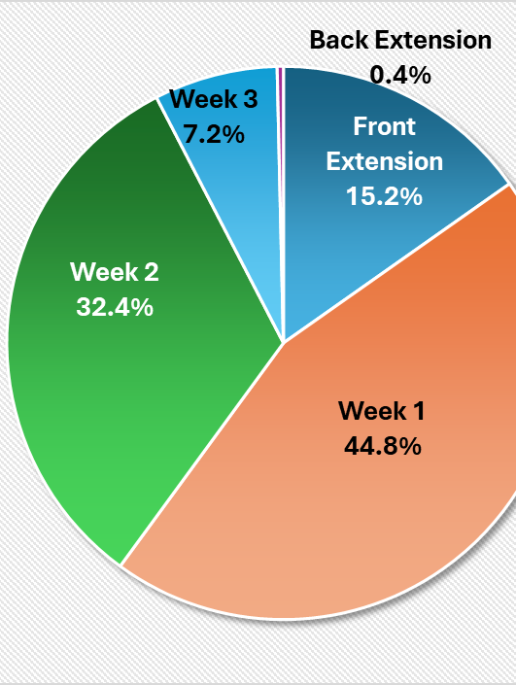
Scheduling Considerations
CMAS Grades 3 through 8
Total ELA, math, and science tests completed by week (state level)
CDE also looks at district and school completion
Extended window historically offered due to "limited device capacity"
  Would expect to see relatively equal testing across all weeks for this reason

Slide 31

CMAS Window Flexibility
Upon completion of CMAS Administration Training for DACs, districts that desire flexibility for testing start and/or end dates must contact CDE Assessment to discuss options
DACs schedule meetings with CDE Assessment by November 15 to discuss their desire to adjust window start and/or end dates

Slide 32
Scheduling Considerations: Accommodated Forms
Colorado Spanish Language Arts (CSLA)
  An accommodated version of the ELA assessment
  Administered in the same window as ELA
CoAlt and accommodated CMAS forms
  To the extent possible, a student taking CoAlt or CMAS with accommodations in a content area for which the student is participating in a general education class should be assessed at the same time as their peers to avoid missed instruction
    Ensure students taking these assessments do not miss instruction from their general education classes

Slide 33
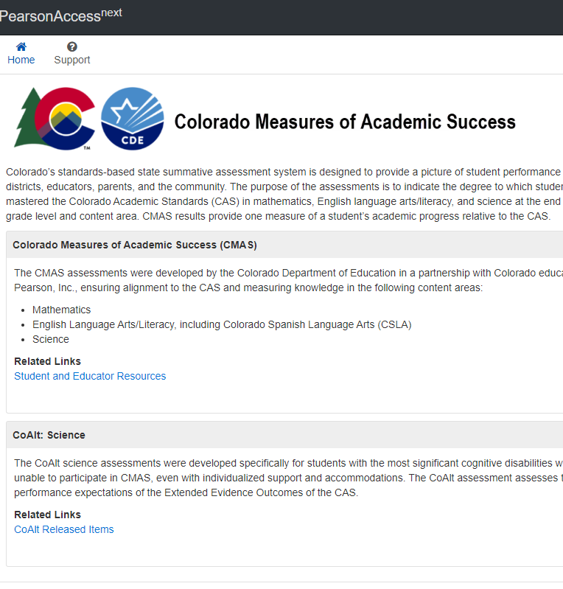
PearsonAccess^{next}
The online platform used for CMAS data management, administration, and reporting
  CDE updates DAC permissions throughout the year
PearsonAccess^{next} use is covered during DAC training
Training modules available at
CDE Assessment Training Resources
  Welcome to PearsonAccess^{next}
  User Accounts
  Student Registration/Personal Needs Profile (SR/PNP)
  Paper and Online Pre-Testing Materials Management
  Assessment Coordinator Online Session Management
  Test Administrator Online Session Management
  Additional Orders
  Post-Testing Materials Management
  Post-Testing Data Clean-up

Slide 34
Technology Readiness Activities 2024-25
CDE recommends:
  Conduct CMAS test simulator through the PearsonAccess^{next} Training Site
    Provides a way to test the local online assessment environment to verify the network, proctor caching devices (if using) and student testing devices are configured correctly using CMAS items
    Highly recommended for districts and schools using virtualized device solutions

Slide 35

High Level CMAS Activities for DACs
CDE pulls from October Count Collection in Data Pipeline
CMAS and CoAlt SR/PNP updates in PearsonAccess^{next} (January 6 through 24)
  Confirm/assign paper-based materials including accommodations
Create/update user accounts in PearsonAccess^{next}
Train SACs and Test Administrators
Create test sessions for online assessments in PearsonAccess^{next}
Verify proper form assignment (including form-dependent accommodations and accessibility features) in PearsonAccess^{next}
Distribute/collect manuals and materials
Administer assessments
Ship materials back to Pearson
  Scorable secure materials must be shipped by April 30*
  Non-scorable secure materials shipped by May 2
*CDE encourages districts to return scorable materials as soon as possible to help get results back earlier

Slide 36
CMAS Training and Office Hours
Training Resource | Date and Location
Online Office Hours Thursday 3 to 3:30 p.m. | December 5 January 9 and 23 February 13 and 27 March 13 and 27 Weekly April 3 through May 1
DAC Administration Training | Late October (virtual)
Training registration information and office hour URL will be emailed to DACs
Note: Dates are subject to change

Slide 37
CMAS Assessments
Accommodations

Slide 38
CMAS Accommodations: Overview
Refer to the CMAS and CoAlt Procedures Manual (Section 6.0) for all accommodations information
Assessment Accommodations Webinar
  Tuesday, September 10 from 1 to 3 p.m.
  Thursday, September 12 from 10 a.m. to 12 p.m.
  Wednesday September 18 from 2 to 4 p.m.
  Webinar recording and FAQ will be posted on Accommodations Training webpage at the end of September
Updated Accommodations Crosswalk available on CDE Assessment webpage
Students registered for CMAS braille last year will be registered for braille in the initial file upload into PearsonAccess^{next}
  Confirm braille assignments
  Districts need to identify and register all 3rd graders and any new or additional students needing braille
  Districts may need to pay special attention to students who were not identified or did not test last year due to special circumstances

Slide 39
Accommodations Using Secondary Devices
Any program accommodation requiring a secondary device requires CDE program approval annually
  Speech-to-text
  Word prediction
  Generative text*
District program submission and supporting documentation is due to CDE by December 15, 2024
More information will be available during the CDE Assessment Accessibilities and Accommodations Training in September
*Only a significantly limited number of students may qualify for this accommodation. If you have a student who may qualify, contact Arti Sachdeva for more information and eligibility criteria.

Slide 40
Unique Accommodation Requests (UARs)
A very limited number of students who meet specific criteria may qualify for unique accommodations
  The requested UAR must be listed on the IEP and tied to an instructional goal
  These accommodations might impact the construct being measured. For that reason, additional documentation is required.
  ACCESS for ELLs UARs are due to CDE by December 1 for enrolled students with IEPs/504s
  CMAS UARs are due to CDE by December 15 for enrolled students with IEPs/504s
    UARs for students who arrive in the district after January or are newly placed on IEPs/504s are due by March 15
Accommodations requiring CDE approval:
  Scribe Accommodation for ACCESS for ELLs Writing Domain
  Scribe Accommodation for ELA/CSLA constructed responses (CMAS)
  Calculator on non-calculator sections of math (CMAS)
Use of unique accommodations without CDE approval may result in invalidation or score suppression

Slide 41
Primary/Home Language Accommodations
Primary/home language accommodations may be used for up to 5 years, when appropriate (language of instruction should match primary/home language accommodation selection, see flowchart).
Online Spanish text version (with and without TTS)
  Math
  Science
  Social Studies
CSLA is available for eligible MLs (NEP and LEP) in grades 3 and 4 (paper-based accommodation to ELA) who are currently receiving or recently received Spanish language arts instruction
  Eligibility flowchart: Eligibility Flowchart
  Connect with the district’s ML coordinator

Slide 42
First Year in US – ELA Only
Enrolled in a U.S. school for fewer than 12 months
  Non-English Proficient (NEP) students, based on state Standardized Identification Procedures, are only exempt from the CMAS ELA assessment. A student’s parent/guardian may opt their child into testing. Results will be used for accountability and growth calculations.
  Limited English Proficient (LEP) students, based on state Standardized Identification Procedures, are assessed on the CMAS ELA assessment
First year in U.S. NEP and LEP students in grades 3 and 4 whose primary/home language with current or recent language arts instruction is Spanish should take CSLA
  Students are exempt from ELA testing only when an equivalent primary/home language assessment is not available
  Students who take CSLA do not take ELA; students who take ELA do not take CSLA
  Students taking CSLA also take math (Spanish versions available, if appropriate)

Slide 43
CoAlt
Science and Social Studies
English Language Arts and Mathematics (DLM)

Slide 44
CoAlt Assessment Administration
Eligible students with the most significant cognitive disabilities take the Colorado Alternate (CoAlt) Assessments
Less than 1% of students
Science (Colorado-developed)
Grades 5, 8 and 11
ELA and Math (DLM-developed)
Alternate for CMAS math and ELA, PSAT and SAT
Social Studies (Colorado-developed)
Grades 4 and 7
Administered only at selected schools
Grades 3 through 11

Slide 45
CoAlt Assessment Administration
Administered during the same testing window as CMAS for all content areas
CoAlt Science and Social Studies
Science (Grades 5, 8 and 11)
Social Studies (Grades 4 and 7)
Paper-based assessment
Individually administered
DACs/SACs use PearsonAccess^{next} for student management
Student answers recorded on CoAlt Answer Document by the Test Administrator
CoAlt Answer Documents returned to Pearson with scorable materials
CoAlt ELA and Math (DLM)
Grades 3 through 11
Computer-based assessment
Individually administered
Test Administrators/DACs use Educator Portal for student management
Students test using KITE Student Portal

Slide 46
CoAlt Assessment Administration – Grades 9 through 11
Any grade 9, 10 or 11 student with the most significant cognitive disability whose IEP indicates participation in alternate assessments will take the appropriate CoAlt assessment and not PSAT, SAT or CMAS Science
Alternate assessments are individually administered
  CoAlt Science
    Grade 11
  CoAlt ELA and Math (DLM)
    Grades 9, 10 and 11
If the parent wishes for the student to take PSAT or SAT, the IEP team must convene a meeting and change the IEP
CDE recommends that the testing window for the alternate assessments fit within the PSAT/SAT administration dates
  For CoAlt eligible students who are also integrated into the general education environment, CDE recommends a CoAlt testing schedule be used that allows these students to remain with their grade level peers as much as possible and reduce interruption to their regular instruction

Slide 47
CoAlt Training and Office Hours for SWD
Training Resource | Date and Location
Office Hours Wednesdays 3 to 3:30 p.m. | December 4 January 22 February 12 and 26 March 12 and 26 Weekly beginning April 2
Office Hour for TVIs Wednesday 4 to 5 p.m. | January 8
Accessibility and Accommodations Training | September 10 September 12 September 18
CoAlt Training for DACs | November (Virtual)
CoAlt Training for TAs | Through Educator Portal DLM Training – September 3 CoAlt Science – December Hosted Virtually by CDE Social Studies – December
Training registration information will be emailed to DACs

Slide 48
CoAlt Training
Train teachers in all parts of the CoAlt assessments
  Separate modules
  ELA/math – available through Kite Educator Portal
  Science – available through Kite Educator Portal
  Social Studies – DACs with selected schools will be contacted for training
  Educators will be required to take and pass a quiz based on the information presented in each module
DAC-specific training
  Will be posted on CDE Training page at CoAlt Assessment Training

Slide 49
Colorado PSAT and SAT

Slide 50
Colorado PSAT and SAT Administration
PSAT 9
Administered to all* students in 9th grade
SAT
PSAT 10
Administered to all* students in 10th grade
Administered to all* students in 11th grade
*Students who participate in CoAlt take the DLM ELA and Math assessment instead of PSAT/SAT

Slide 51
Digitally-based Colorado PSAT and SAT
Assessment | Grade | Administration Dates*
PSAT 9 PSAT 10 SAT | 9 10 11 | April 14 through 25, 2025 Dates may be selected based on district/school preference within this window
*To the extent practicable, students taking the CoAlt DLM ELA/Math assessments who participate in a general education class should be assessed at the same time as their general education peers to avoid missed instruction. Schools may also ensure students taking the alternate assessment do not miss instruction from their general education class(es) through other means.

Slide 52
Digital Testing Information
PSAT 9, PSAT 10 and SAT tests are administered online
  Paper-based testing is reserved for accommodated students who require paper testing, students with religious exemptions to technology use, or in a situation where a facility does not allow internet access for students – must be known in advance
Testing platforms
  Test Day Toolkit – Test administration website used by testing staff
  Bluebook – Testing application used by students
  SDMS- Student data management system used by DACs
Digital Test Structure
Test Section | Question Count | Assessment
Reading and Writing | 54 questions | PSAT 9, PSAT 10, SAT
Math | 44 questions | PSAT 9, PSAT 10, SAT
Essay (optional) | 1 prompt | SAT only

Slide 53
PSAT 9, PSAT 10, SAT Test Times
Standard Test Times
Test | Digital |  | Paper- (Accommodated | based Only)
Section | Test Times | Test Times + Breaks (10 min) | Test Times | Test Times + Breaks (10 min)
PSAT 9 | 134 minutes | 144 minutes | 164 minutes | 174 minutes
PSAT 10 | 134 minutes | 144 minutes | 164 minutes | 174 minutes
SAT | 134 minutes (without essay) 184 minutes (with essay) | 144 minutes (without essay) 204 minutes (with essay) | 164 minutes (without essay) 214 minutes (with essay) | 174 minutes (without essay) 229 minutes (with essay)
***To reduce the risk of misadministration, it is recommended to choose a specific day to assess your paper-based students

Slide 54
Colorado PSAT and SAT Updates
SAT with and without Essay will be administered during the school day
  Taking the optional SAT Essay is a student choice.
  The process for requesting the Essay will be similar to last year. More information will follow this Fall.
  NOTE: College Board no longer forwards Essay scores to colleges/universities. Please be sure students understand this before registering them to take the Essay.
Online schools for PSAT
  Must establish a testing center for 9th and 10th grade students to test.
Online schools for SAT
  May establish a testing center for 11th grade students to test OR
  11th grade students can test on the national SAT test date of March 8.
    The process for registering students for the Weekend Test date will be similar to last year. More information will be presented in a webinar later this Fall.
    Schools must establish a testing center for the make-up date session within the PSAT/SAT state testing window.

Slide 55
Colorado PSAT and SAT Accommodations
Students who tested using College Board-approved accommodations for the PSAT or AP exams last year continue to be approved for 2025*
  A crosswalk from paper-based to digitally-based accommodations is forthcoming.
Accommodations requests must be submitted for
  9th grade students
  Students whose accommodation needs have changed
  Students who have not been previously approved by the College Board for testing accommodations
State-allowed accommodations must be requested and approved each year
  Very few students utilize state-allowed accommodations (First year in U.S. MLs, math only)
The default Braille code for College Board assessments will be UEB and UEB with Nemeth for math. UEB Technical math code will be available on request by contacting the College Board SSD office.
  *As long as there are no changes to student’s primary disability or accommodations
  listed in the student’s IEP

Slide 56
Difference Between CMAS and PSAT/SAT in Colorado
Home Schooled Students
  Full-time home-schooled students are permitted to take CMAS but are NOT permitted to take the state sponsored PSAT or SAT (see C.R.S. 22-7-1006.3(9)(b))
  Full-time home school students who contact the school or district should be directed to take the PSAT or SAT on a national (Saturday) test date at their own expense

Slide 57
Colorado PSAT and SAT Training
College Board Fall workshops for SACs, Test Coordinators, SSD Coordinators and other testing staff will be virtual during the fall
Registration links for the first set of workshops will be sent out shortly after Labor Day
DAC Office Hours, Test Coordinator Office Hours, Virtual School Office Hours and SSD Coordinator Office Hours
Like previous years, we will have more frequent office hours as test day becomes closer
Office Hours invites will be sent to DACs in October for all sessions

Slide 58
Colorado PSAT and SAT Reminders for 2024-25
School Staff Confirmation
  Survey will be e-mailed to DACs on September 4 – ensure this is completed no later than September 13
School Onboarding Survey
  This replaces the Establishment Survey
  Survey e-mailed to DACs on September 18 – ensure this is completed no later than October 4
Online Test Day Training
  Test Coordinators are required to complete the online test day training and related quizzes in the Spring prior to the testing window
  Proctors and hall and room monitors can be trained using online modules or via a local training but are required to pass the online quiz related to their role
  All testing staff must complete training even if they completed training for prior administrations
Colorado Help Line - 1-866-917-9030
  This line is specific to Colorado’s Spring testing window and will provide you with the most reliable state-specific information

Slide 59
PSAT/SAT Resources
Check the CDE Assessment PSAT/SAT webpage: Colorado School Day SAT and PSAT
Check the College Board Colorado website: College Board: Colorado
Check the College Board Resource Repository
College Board's CO Customer Service: 1-866-917-9030
Contact the College Board Field Team
ColoradoSchoolDaySupport@collegeboard.org
Sarah Orlowski | Noah Hurianek | Lindsay Scurto
sorlowski@collegeboard.org | nhurianek@collegeboard.org | lscurto@collegeboard.org
720-470-2343 | 720-582-6735 | 720-315-8233

Slide 60
National and International Assessments
Selected Schools Only

Slide 61

National Assessment of Educational Progress (NAEP)
2025 NAEP Assessment Schedule
Program | Colorado NAEP | National NAEP | International Assessments
Assessment | Field Test Reading and Math | Long-Term Trend Reading and Math | Program for International Student Assessment (PISA)
Grade/Age | Grades 4 and 8 | Ages 9, 13 and 17 | Born in 2009
Mode | Digitally Based Assessment | Digitally Based Assessment | Digitally Based Assessment
Sampling | State | National | National
Status | January 27 to March 7, 2025 | October 7 to May 23, 2025 | March 17 to May 9, 2025
Notes:
Since 2003, participation in NAEP for grades 4 and 8 schools in reading and mathematics has been linked to Title I funding by the federal Elementary and Secondary Education Act (ESEA)

Slide 62
Data and Reporting

Slide 63
Assessment Data Collections
DACs: Know who your data respondent is for each assessment collection
Assessment collections include two types of Data Pipeline activities
  Pre-ID student data are pulled from the October Count Collection
    WIDA ACCESS data are pulled from students reported as ML – NEP and LEP after the snapshot soft deadline (November 1)
      Make sure your data respondents have all NEP and LEP students and alternate testers identified, or they will not be loaded into WIDA AMS by the state
    All other assessment data are pulled from the final approved data in January
      Make sure data respondents have all alternate testers identified, otherwise they will be registered for CMAS/PSAT/SAT and not CoAlt
  Student Biographical Data (SBD) reviews
    WIDA ACCESS for ELLs: late March
    CMAS, CO SAT/PSAT and DLM: late May through June

Slide 64
Assessment Data Trainings
Training materials (updated annually before the ACCESS SBD)
  Assessment Division Data Pipeline Manual for SBD
    Student Biographical Data (SBD) Process Manual
  SBD file layouts and definitions will be posted as they are finalized
    Periodic Collections
SBD Training Webinars
  ACCESS Training in March
  SAT-PSAT/CMAS/CoAlt DLM Training the first week of May
IMS Town Hall virtual meetings
  Assessment will present and answer questions during active collections Upcoming Data Pipeline Townhalls and Trainings

Slide 65
Reporting of Results
Publicly posted State, District and School overall, and disaggregated results will be available after the embargo at CDE Assessment Division
Refer to the following Data and Results pages for each program:
Program | Data and Results Webpage | Location of Confidential District and School Reports and Data Files
WIDA ACCESS for ELLs | ACCESS for ELLs - Data Summary | WIDA AMS
CMAS (all content areas) | CMAS Mathematics, English Language Arts, Science, and Social Studies Data and Results | PA^{next}
PSAT and SAT | Colorado PSAT and SAT Data and Results | Reports: CB Reporting Portal Data Files: CDE Assess. Sync.
CoAlt ELA and Math | CoAlt: English Language Arts and Mathematics Data and Results | Reports: Educator Portal Data Files: CDE Assess. Sync.
CoAlt Science and Social Studies | CoAlt: Science and Social Studies Data and Results | PA^{next}

Slide 66
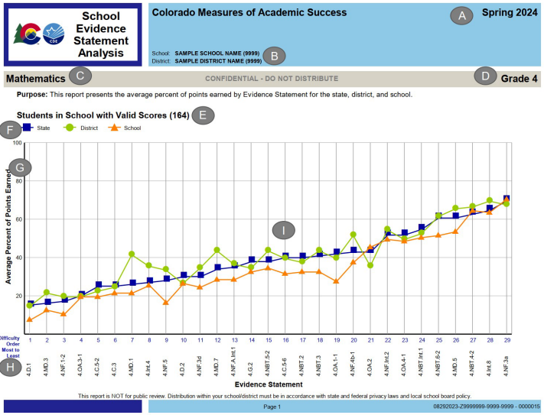
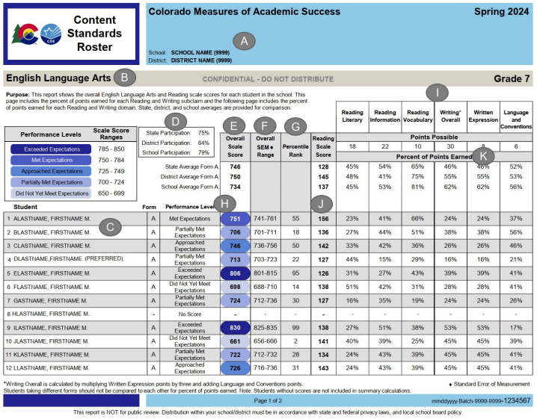
Report and Data Interpretation
CMAS reports interpretive guide
  CMAS Interpretive Guide to Assessment Reports
CMAS data interpretation training
  Recorded webinar: CMAS Data Interpretation Training

Slide 67
Comprehensive Assessment Systems
Initiatives and Resources

Slide 68
Colorado Assessment Literacy Program
Online Professional Learning Modules and Customized Workshops to Support Local Systems of Assessment
  Achieving a Balanced Assessment System
  Assessment Inventory and Decision-making Tools
  Customized Classroom Assessment Workshop
  Designing for Instructional Relevance
1. What is the Language of Assessment?
2. Why are Success Criteria Important to Assessment Design?
3. Why are Success Criteria Important to Instruction?
4. Why are Instruction and Assessment Integral to Each Other?
5. Why is Formative Practice Critical?
6. How do You Collect the Evidence of Student Learning that Best Fits Your Needs?
7. How Do You Know What Your Students Learned?
8. How Do You Know if Instruction Was Effective?
9. What Action is Needed?
Colorado Assessment Literacy Program

Slide 69
Expanding Assessment Options
Collaboratively-developed, Standards-based Performance Assessments
Performance Assessment Defined: An authentic demonstration of student knowledge and skills through the creation of a complex product or presentation. The product and process are relevant to the student and prepare them for success in the postsecondary and workforce world. Performance assessments are an iterative process where students apply their knowledge and improve their skills through feedback and revision in order to reflect on and demonstrate growth.
State-wide Scoring Criteria Framework and Resources
Design Elements signal the attributes of a high-quality performance assessment:
Aligned – Accessible – Authentic – Relevant - Transferable - Iterative
Performance Outcomes are observable behaviors linked to Essential Skills by which students can demonstrate each competency:
Adaptability and Reflective Practice – Communication - Career Development - Credible and Ethical Research - Social Responsibility - Time and Work Management - Inquiry and Problem Solving - Self-Efficacy and Self-Care - Team Building
Performance Assessment Development tools and templates to design and score performance tasks, culminating events, and graduation defenses:
Performance Assessment Planning Template - Validation Protocol - Calibration Protocol
System Recommendations focus on aspects of district and school systems that set students up for success in performance assessment:
School Systems & Structures - Leadership & Professional Learning – Pedagogies - School Culture
Guidelines for Sufficiency describes how a student’s body of evidence will be collected, how much evidence will be collected, what types of evidence will be collected, when evidence will be collected, and the local process to be utilized to support both students and educators.
Online Learning Modules provide access to all resources in one place, allow users to track their learning, and connect with educators from across the state. Gain FREE access to these modules here.
Collaboratively-developed, Standards-based Performance Assessments

Slide 70
Expanding Assessment Options:
Revising District Capstone Assessment Guidance
Stakeholder Committee develops Capstone Implementation Criteria
Criteria is designed to elicit Evidence of:​
*Alignment to the Colorado Academic Standards and Essential Skills *Student Agency *Shared Definition of Success *Deliberate School Design
*Student Learning is Public *Community Involvement *Professionalism
*Data Collection, Self-Analysis and Continuous Improvement
2024-25 Capstone and Performance Assessment Workshops
Oct 16: Durango
Oct 28: Glenwood Springs
Nov 15: Lamar
Dec 12: Greeley
Jan TBD: Denver
Feb TBD: Colorado Springs
Informal Capstone Pilot
CDE to partner with school/district leaders and staff to pilot the Capstone Criteria in the 2024-25 school year
Purpose: To evaluate the feasibility and functionality of the criteria in practice
Activities: Review existing capstone processes against draft criteria, identify areas of strength and growth
Feedback: Surveys, focus groups, and/or interviews
Outcomes: Refine the criteria and develop associated supports
Graduation Guidelines - Capstone

Slide 71
Expanding Assessment Options:
Aligned Initiatives
Student-Centered Science Assessment Toolkit & Learning Series
  Supports ongoing, embedded learning for science educators in the development of 3-dimensional performance assessments
  Supports school and district leaders in using assessments as a way to cultivate relationships and use classroom-generated bodies of evidence as a primary driver of instructional improvement strategies
  2-Track Learning Series: Check & Connect and Transfer Tasks
Capstone and Performance Assessment Case Studies
  Carried out by CADRE at CU Boulder
  Multi-site case study with educators using curriculum-embedded classroom performance assessment and/or capstone assessment as a primary means for evaluating student learning
  Performance Assessment Research can be found here
  Capstone Assessment Research can be found here

Slide 72
Tech Tips
All State Assessments

Slide 73
District Technology Coordinator (DTC)
Check the CDE website to verify the appropriate person is listed as DTC
  Assessment Division District Assessment Coordinators
It is important to identify a DTC for the district – make sure this position is updated if there is a change
  Superintendent-appointed
DTC receives emails from CDE with information about required training and technology updates throughout the year

Slide 74
District Technology Coordinator (DTC) Additional Information
DTC responsibilities and privileges
  Primary technology contact for the district who works with CDE Assessment Division regarding online administration of state assessments
    Attend CDE- and vendor-provided technology training (required)
    Receive critical, in-depth testing vendor communications directly from CDE during administrations
    Communicate pertinent technology information to district stakeholders concerning the online administration of state assessments
  DTC support for CMAS
    DTCs are escalated to Pearson’s Level 2 Technical Support when contacting the help desk with questions regarding the online assessment system
    Only the one officially identified DTC for each district is escalated
  Request support directly from Collin Bonner in the CDE Assessment Division

Slide 75




Online Assessment Platforms
Assessment | Test Engine | Student Info System | Features
ACCESS for ELLs® |  | WIDA AMS | Caching server Clients for Windows, Linux, Mac OSX, Chromebooks, iPads and Android
CMAS |  |  | Caching server available Installable apps for desktop, Chromebooks, Androids and iPads
CoAlt Science/ Social Studies | N/A
CoAlt ELA and Math (Dynamic Learning Maps) | Student Portal | Educator Portal | KITE Student Portal installed on each student device
PSAT and SAT | Student Portal: Bluebook App | Test Day Toolkit (TDTK) | Bluebook is an installable app for Windows, Mac, iPad or school-managed Chromebooks TDTK is accessed through an established College Board account

Slide 76
Disable Background Processes
For test security and device performance, disable unnecessary background processes and software during testing, for example:
    Instructional Software
    Automatic Updates
    Intelligent Personal Assistant (IPA)
    iPadOS, Chrome OS, Netbook Devices
    Collaboration Tools
    Microsoft Game Bar and Other Screen Capture Software
Update processes or unnecessary applications and features running in the background on testing devices consume CPU and memory
  Can affect the testing experience
    If they become active, they can “kick out” students while they take secure online tests (ex: low battery)
    ACCESS for ELLs:
      Audio playback may be choppy
      Speaking test responses may be distorted

Slide 77
Technology Requirements
During required training, DTCs are provided:
  Device requirements, including minimum hardware specifications
    Processor
    Memory
    Free disk space
    Screen size
    Resolution
  Operating system requirements
    ChromeOS
    Windows
    iPadOS
    Linux
    MacOS
  Visit our Assessment Technology Readiness website for information about requirements, checklists, test engine software, documentation, and training for all our state assessments.

Slide 78
Assessment Technology Minimum Hardware Specifications Example
Minimum Hardware Specifications
CMAS TestNav | ACCESS Insight | PSAT/SAT Bluebook
External keyboard: Windows: required iOS: recommended | Headset with microphone | External keyboard: iPad: required
External mouse/touchpad: Windows: required iOS: recommended | Windows and ChromeOS: Both touchscreen and non-touchscreen devices
Convertible Chromebooks: no tablet mode. | macOS and Linux: Non-touchscreen devices only
External Input Devices

Slide 79
Communication

Slide 80
District Assessment Coordinator (DAC)
District Assessment Coordinator http://www.cde.state.co.us/assessment/DAC
  Serves as point person for CDE Assessment Division communication
    Communicates information to School Assessment Coordinators
  Attends all required trainings
    Trains district and school level staff involved in assessment administration and materials handling
  Submits Unique Accommodations Requests (UARs)
  Notifies CDE of the district’s desire to use:
    Early CMAS test window for grade 11 science
    Flexibility for start and/or end dates
    District/school level online or paper administration mode

Slide 81
District Assessment Coordinator (DAC)
Continued
District Assessment Coordinator (continued)
  Interacts with assessment vendor systems
    Manages student test registration and material ordering
    Manages user accounts
    Manages and monitors administration
    Has access to demographic and reporting files and reports*
  Reports, investigates and contains administration and security issues/concerns (i.e., misadministrations and breaches)
  Works with Data Respondents on final student demographics, especially invalidation/reason not tested codes
  Shares report and score interpretation information throughout district
  Works with District Technology Coordinator
*DACs have access to sensitive personally identifiable information through vendor management and administration systems. At the DAC’s discretion, others given sensitive data permissions also have access.

Slide 82
Communication Structure
CDE Assessment works with the official superintendent-appointed DAC and DTC
  School-level staff, including Test Administrators and school leadership, refer questions to the SAC
  SACs and district-level staff refer questions to the DAC and DTC
  Official DACs and DTCs refer questions to CDE Assessment
DACs and DTCs share information from CDE with district- and school-level staff, as appropriate
Using this communication structure ensures local policies and procedures are communicated
Note: CDE Assessment and CDE Accountability are separate groups
  The District Accountability Contact list is maintained by CDE Accountability
  Refer questions about Performance Frameworks and Growth to CDE Accountability

Slide 83
Assessment Systems Access
Due to the sensitive nature of the information available through state assessment systems, CDE Assessment manages user accounts for official superintendent-appointed DACs only
  CDE cannot verify an individual’s employment status or their ability to view sensitive assessment information
If an individual requires access to one of the systems, access is provided by the DAC or other authorized local user
If other authorized local users do not have access and the DAC is unavailable, requests for access must be emailed to the appropriate CDE Assessment contact by the superintendent
  Example:
    A DAC is out of office when CMAS student data files become available in June.
    Another district user needs access to PearsonAccess^{next} to download the files.
    The superintendent must email Sara Loerzel to enable access for the non-DAC employee.
    That individual can then enable other local accounts, as appropriate.

Slide 84
Office Hours Schedule (dates subject to change)
ACCESS for ELLs Administration
  Wednesdays from 3:30 to 4 p.m.
  Weekly – October 23 through February 5
    Holiday cancellations 11/20, 12/25
Students with Disabilities (SWD)
  Support for CoAlt administration
  Support testing students with IEP/504 plans
  Wednesdays from 3 to 3:30 p.m.
    Monthly – December
    Bi-monthly – January, February, March
    Weekly – April through May
  TVI Office Hour on January 8
CMAS Administration
  Thursdays from 3 to 3:30 p.m.
    Monthly – December
    Bi-monthly – January, February, March
    Weekly – April through May
PSAT and SAT Administration
  Tuesdays from 3:30 to 4 p.m.
    Monthly – Beginning in November
    More frequent closer to testing

Slide 85

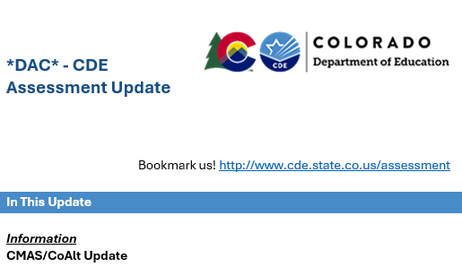

Assessment Emails (*DAC*)
CDE sends out DAC emails (greater frequency in the spring)
  Emails include information about:
    Important updates for the week and coming weeks by assessment program
      Tasks for DACs
      Results posted
    Office hours
      Agenda (if predetermined)
      Applicable assessment program topics covered in the email are discussed during office hours if additional clarification is needed
  If there are no new updates, an email is not sent

Slide 86

Transmitting Secure Information
Use Syncplicity to send secure information to CDE
  Two users per district can access the CDE_Assessment folder
    The official DAC
    One additional individual, if requested
  CDE will email a list of users to each district
    Respond with updates
    New users must create/access their accounts within 90 days
  During SBD, the Data Respondent has access to a separate SBD folder
Reminder: Do not send personally identifiable information (e.g., SASID, name, free and reduced lunch status, disability status, test scores, etc.) through email
CDE Assessment will not respond to emails containing PII
The email will be deleted
Remind all staff who may communicate with CDE

Slide 87
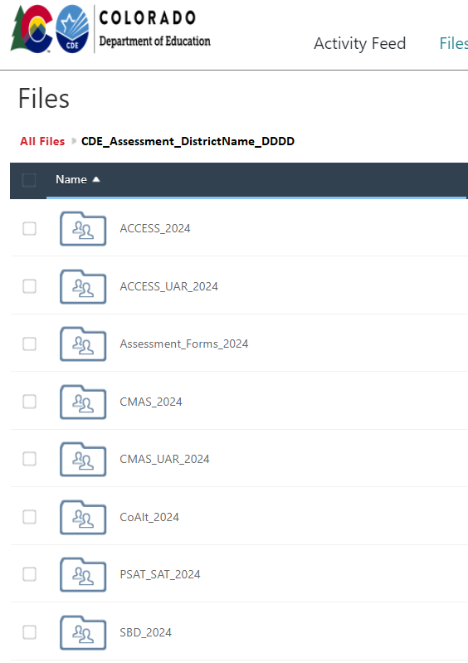
Syncplicity
All documents from previous years will be removed and archived externally by CDE by September 16
Locally retain copies of any needed documents
  Remember to save the DLM and PSAT/SAT data files for 2024
Folder structure
  Ensure documents are placed in the correct folders
  Provide notice of uploaded files to the appropriate contact at CDE

Slide 88
CDE Assessment Contacts
Questions | Contact | Email
CMAS & PearsonAccess^{next} | Sara Loerzel | loerzel_s@cde.state.co.us
CO PSAT & SAT | Melissa Carpenter | carpenter_m@cde.state.co.us
CoAlt & Accommodations for Students with Disabilities | Arti Sachdeva | sachdeva_a@cde.state.co.us
ACCESS & Accommodations for Multilingual Learners | Heather Villalobos Pavia | villalobospavia_h@cde.state.co.us
Technology, NAEP, & International Assessments | Collin Bonner | bonner_c@cde.state.co.us
Assessment Literacy & Performance Assessments | Angela Landrum | landrum_a@cde.state.co.us
Psychometrics & Data | Jasmine Carey | carey_j@cde.state.co.us
Data and SBD Collections | Leon Merker | merker_l@cde.state.co.us

Slide 89
Thank you!

Slide 90
Additional Local Education Provider Responsibilities

Slide 91
Charter Schools
Charter Schools are considered their own LEP (Local Education Provider) for purposes of the following state laws:
  Paper-based testing options: §22-7-1013(6), §22-7-1006.3(1)(d-e)
  Assessment information for parents: §22-7-1013(7)(a)
  Parent excuse information: §22-7-1013(8)(a-c)
DACs are responsible for:
  Training SACs at charter schools in the district
  Communicating charter school paper-based testing selections to CDE
  Ensuring updates to student data are made during SBD if needed (schools do not have access to Data Pipeline)

Slide 92
SAT Scores on Transcripts
SB20-175: Student Score on Transcript
  This act prohibits a student's level of performance on the readiness assessment administered pursuant to 22-7-1006.3 (SAT) or on a national assessment (any assessment administered throughout the United States to measure postsecondary or workforce readiness) from being indicated on the student's high school transcript.

Slide 93
Requirements and District Responsibilities
Paper-based Testing §22-7-1013(6), §22-7-1006.3(1)(d-e)
Each LEP must adopt and implement a written policy by which it decides whether to request the paper form of the CMAS assessments for its students
  Decision must be made in consultation with schools and parents
  Copy of policy must be shared with parents and posted on LEP website
  LEP may make the decision by school or class (i.e., grade level and content area)
  LEP will report to CDE the number of students who will take the paper form (indicated prior to initial order deadline)
Considerations
  Technology capacity
  Logistics
  Must have the grade appropriate calculators for math (grades 6 through 8)
Paper and online form always available to individual students as an accommodation
Must commit to meeting security requirements and accounting for all secure materials
  Chain-of-custody documentation and reports for missing materials

Slide 94
Requirements and District Responsibilities
Assessment Information §22-7-1013(7)(a)
LEP will annually distribute to parents and post on its website, as early in the school year as possible, written information regarding its assessments, including:
  The state and local assessments that the LEP will administer
  Identify whether it is required by federal law, required by state law or selected by the LEP
  Assessment calendar:
    Estimated hours of testing each testing day for specific classes/grades for each assessment
    Identify whether the assessment is required by state law, federal law or locally selected
  The purposes of the assessments
  The manner in which assessment results will be used

Slide 95
Requirements and District Responsibilities
Parent Excusals §22-7-1013(8)(a-c)
A student’s parent may excuse the student from participating in a state content assessment
Each LEP will adopt and implement a written policy and procedure by which a student’s parent may excuse the student from participating in one or more of the state assessments.
  If a parent excuses his or her student, the LEP shall not impose negative consequence on the student or parent including:
    Prohibiting school attendance; imposing an unexcused absence; or prohibiting participation in extracurricular activities.
    Prohibiting the student from participating in an activity or receiving any other form of reward that the LEP provides to students who participate in the state assessment.
LEP shall not impose an unreasonable burden or requirement on a student that would:
  Discourage the student from taking a state assessment or
  Encourage the student’s parent to excuse the student from taking the state assessment.

Slide 96
Additional Resources

Slide 97
CMAS ELA/CSLA Accommodations Policy
CMAS English language arts accommodations policy was updated in 2020 to align with the CAS reading standards’ expectations that students read (decode a printed or tactile code) and comprehend (make meaning of) literary and informational texts independently and proficiently.
The following assessment administration adjustments would change this expectation and were to have been phased out in the 2020-21 school year:
    Auditory Presentation Accommodation, including:
      Text-to-speech (TTS) for ELA
      Oral script for ELA/CSLA
    Human Signer Accommodation for ELA
  This policy is reviewed in more detail during the accommodations training.

Slide 98
Fall Checklist (1 of 3)
Fulfill district policy legislative requirements
  Adopt and implement a policy by which the LEP decides whether to request the paper form of the CMAS assessment for its students
  Adopt and implement a written policy and procedure by which a student’s parent may excuse the student from participating in one or more of the state content assessments
  Distribute to parents and post on LEP’s website written information regarding assessments, including an assessment calendar
CMAS – Upon completion of CMAS Administration Training for DACs
  Send to CDE through the District Testing Information and Format Selections form by December 15
    Determine mode of testing (online or paper) by test for each school, grade and content area
    Determine if an early window is needed for grade 11 science
  If testing window start/end date flexibility is desired, schedule meeting with CDE Assessment by November 15
PSAT and SAT
  Complete the School Staff Confirmation by September 13
  Complete the School Onboarding Survey by October 4

Slide 99
Fall Checklist (2 of 3)
Gather accommodation information for assessments
  CMAS paper-based accommodations (braille, large print, auditory/signed presentation scripts (for math and science), CSLA, etc.)
  CMAS computer-based accommodations (text-to-speech (TTS), Spanish, etc.)
  Determine the need for and submit ACCESS for ELLs UARs by December 1
    Scribe for ACCESS for ELLs Writing Domain
  Determine the need for and submit CMAS UARs by December 15
    Scribe for constructed response items on the ELA/CSLA assessment
    Calculator on non-calculator sections of the math assessment
  CMAS Student Registration files with Personal Needs Profile information updated in PearsonAccess^{next} in January 2025
  Start submitting PSAT and SAT accommodations requests for approval by College Board

Slide 100
Fall Checklist (3 of 3)
Attend virtual trainings
  Accommodations
  ACCESS
  CoAlt
  CMAS
  CO PSAT and SAT
Schedule and plan district/school trainings
  Accommodations
  ACCESS
  CoAlt
  CMAS
  CO PSAT and SAT

Slide 101
2024-25 Training Dates – All Virtual
(dates subject to change)
Assessment | Description | Timeline
All | Accommodations | September 10 @ 1 p.m. September 12 @ 10 a.m. September 18 @ 2 p.m.
CO PSAT and SAT | College Board DAC Kickoff | September
ACCESS for ELLs® | Administration | September
CMAS Math, ELA, CSLA, Science, and Social Studies | Administration | Late October
CoAlt ELA and Math (DLM), Science and Social Studies | Administration | September November
DACs must be trained on all state assessments each year.

