Slide 1
Together We Can
Vision
All students in Colorado will become educated and productive citizens capable of succeeding in society, the workforce, and life.
Mission
The mission of the Colorado Department of Education is to ensure that all students are prepared for success in society, work, and life by providing excellent leadership, service, and support to schools, districts, and communities across the state.
Notes:
Note to Speaker….we are leaving these foundational CDE slides in the slide deck in the event that you want to reference them.
We’re going to start today with some very basic information to help put our work into context. Let’s start with – “What is CDE and what do you do?”
To answer that, we have to look no farther than our Mission and Vision statements. While you all can read exactly what our Vision and Mission statements are, let’s boil it down to its most basic meaning.
First, with our vision statement we’re telling you about our ultimate goal for why CDE does what it does. We’re doing our work so all kids are fully prepared after they leave school.
Our mission tells you what we’re about and in this statement we’re essentially explaining that we’re the “official” state level support of schools and what you do for kids. (That’s the broadest explanation of CDE.)
Those are laymen explanations for what is CDE and why we do what we do. Those encompass the biggest and most basic picture of what CDE is.

Slide 2
CDE Strategic Goals: Every Student Every Step of the Way
Start strong
Read by third grade
Meet or exceed standards
Graduate ready

Slide 3
Driving Questions | What do we want students, educators, schools, and districts to know and be able to do? | How will we know if expectations are met? | How will we respond when help is needed and to support continued growth?
Colorado Academic Standards |  | Assessments | RTI PBIS Targeted interventions IEPs
Educator quality standards |  | Educator evaluations | Induction Mentoring Professional development plans Remediation plans
Performance indicators |  | School and district performance frameworks | Unified planning Priority Turnaround
Students
Educators
Schools/
Districts

Slide 4
Expanding Student Learning
When we intentionally integrate…
Coherent and rigorous academic standards
Innovative and engaging learning options
Supported and effective educators
Aligned and meaningful assessments
Statewide and district accountability
We can personalize learning and ignite the potential of every student.
Notes:
This visual represents what we just discussed. That the power of Colorado’s education improvement efforts lies in the integration and connection of key efforts:
relevant and rigorous standards
innovative and engaging learning opportunities
excellent teachers and school leaders
aligned and meaningful assessments
These elements are all connected and aimed at helping students succeed in a globally competitive workforce.

Slide 5
CoAlt: Science & Social Studies Administration Training
2013 - 2014

Slide 6
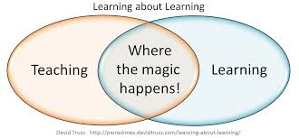

Slide 7
Training
Assessments 101
Overview
Preparing for Testing
Accommodations
Administration
After Testing
Notes:
Here is what we will be covering during our time together today.

Slide 8
Assessments 101
2013 – 2015
Communication
Who to ask
Webpage

Slide 9
Assessment Unit
Academic Achievement
TCAP
CoAlt: R, W & M
College Entrance
Colorado ACT (CO ACT)
11th grade Alternate
National and State Trends
NAEP
English Language Proficiency
ACCESS for ELLs
W-APT
CMAS: S & SS
CoAlt: S & SS
Alternate ACCESS for ELLs
2013 - 2014
Notes:
These types of assessments are managed through the Office of Student Assessment. Different assessments have different purposes, thus students may be taking multiple assessments in one academic year.
For example, a student identified as an English Language Learner will take the ELP assessment in addition to an academic achievement assessment. One does not replace the other, but the data from both provide valuable information on the student’s progress towards the Colorado Academic Standards and the Colorado English Language Proficiency Standards.

Slide 10
Assessment Unit
PARCC and DLM Consortia (anticipated)
English Language Arts: Grades 3 – 11
CMAS: Science and Social Studies and CoAlt: S & SS
Science: Grades 5, 8 & 12
Mathematics: Grades 3 – 8, End of Course (PARCC)
Social Studies: Grades 4, 7 & 12
CO ACT and 11th Grade Alternate
ACCESS for ELLs and Alternate ACCESS for ELLs
English language proficiency
College Readiness
NAEP
National and State Trends
Mathematics: Grades 3 – 11 (DLM)
2014 - 2015

Slide 11
Communication Protocol
Test Examiner
School Assessment Coordinator
DAC
Pearson, Inc.
CDE

Slide 12
Who to ask at CDE
Assessment
Unit
Test administration
Allowable accommodations
Exceptional Student Services Unit
Data interpretation
Test materials
Logistics
Instructional guidance
IEP documentation
Eligibility
Notes:
Depending on the question, DACs may need to go to different contacts at CDE.
Qualification for the alternate assessment is an IEP decision, and these questions should be directed to the Exceptional Student Services Unit who provide guidance on IEPs.
Administration of the CoAlt comes from the Assessment Unit.

Slide 13
http://www.cde.state.co.us/assessment/newassess-coaltsss

Slide 14
Overview
Eligibility
What is CoAlt
What is different
Standardization

Slide 15
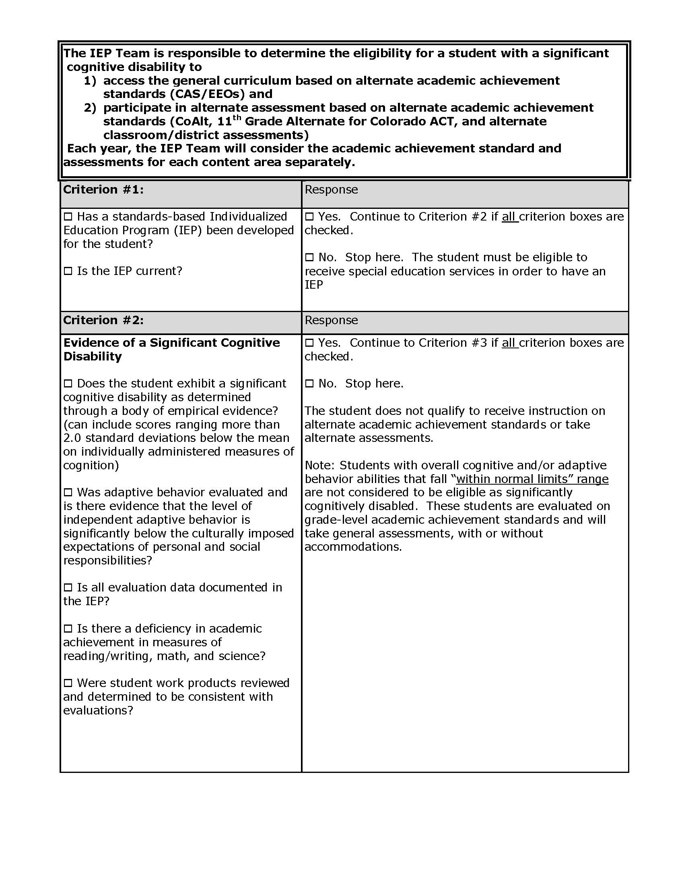
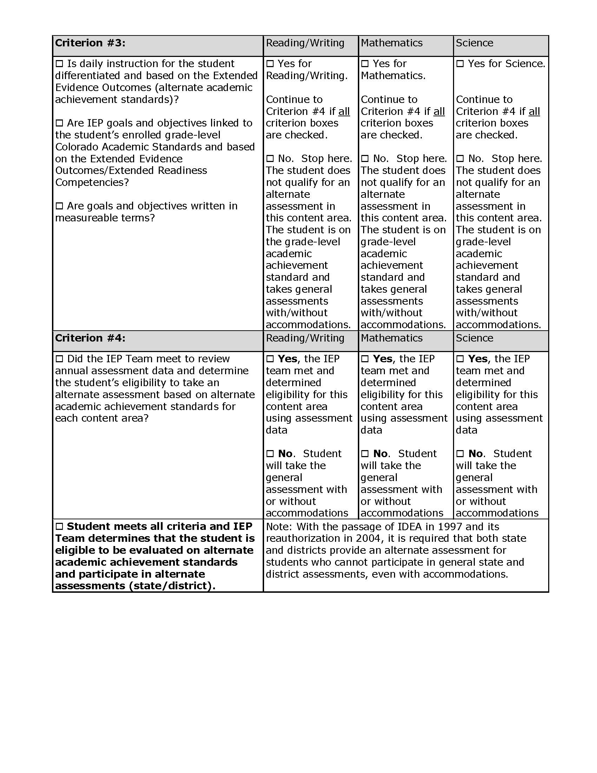
Alternate Standards and Assessment Eligibility Criteria Worksheet
Eligibility is determined by the IEP team
1st Determine Academic Standard
2nd Determine Assessment
Linda Lamirande
303-866-6863
General Standards → TCAP
Alternate Standards → CoAlt
http://www.cde.state.co.us/cdesped/assessmentdisability
Notes:
The eligibility worksheet has been updated with clarifications. Students who were qualified based on last year’s worksheet will still qualify based on this worksheet.
One difference is the emphasis that this decision-making and documentation tool is about qualifying for which standards a student’s educational program will be based on. A student who qualifies for the educational programing based on alternate standards will take the CoAlt. A student who does not meet this criteria will take the TCAP.

Slide 16
Eligibility – Dual Assessment
Typically a significant cognitive disability is pervasive in nature and the student will take an alternate assessment in each content area tested. In rare cases, the IEP team may submit a Request for Dual Assessment in order for the student to take the general summative assessment in certain content areas with or without accommodations.
Notes:
The worksheet is available in the Colorado Accommodations Manual, or on the Website.
Students must meet all the eligibility criteria.
Questions? Contact Linda Lamirande

Slide 17
Eligibility – Dual Assessment
Typically a significant cognitive disability is pervasive in nature and the student will take an alternate assessment in each content area tested. In rare cases, the IEP team may submit a Request for Dual Assessment in order for the student to take the general summative assessment in certain content areas with or without accommodations.
DLM will not allow for split testing, thus next year splitting English Language Arts and Mathematics is not an option
Notes:
The worksheet is available in the Colorado Accommodations Manual, or on the Website.
Students must meet all the eligibility criteria.
Each content area is looked at individually
Questions? Contact Linda Lamirande

Slide 18
Eligibility – Dual Assessment
Typically a significant cognitive disability is pervasive in nature and the student will take an alternate assessment in each content area tested. In rare cases, the IEP team may submit a Request for Dual Assessment in order for the student to take the general summative assessment in certain content areas with or without accommodations.
Email Secure PDF to monroe_m@cde.state.co.us or
Fax: 303-866-6680
Notes:
The worksheet is available in the Colorado Accommodations Manual, or on the Website.
Students must meet all the eligibility criteria.
Each content area is looked at individually
Questions? Contact Linda Lamirande

Slide 19
CoAlt: S & SS
Standards-based assessment
Measures students progress towards the Extended Evidence Outcomes
Provides a picture of student performance
Indicates individual student progress towards the academic content areas of Science and Social Studies
Notes:
This assessment is part of a body of evidence of student achievement.
CDE understands that for students in the population performance may change quickly. Therefore, this assessment is a snapshot in time of how the student is progressing towards academic content standards.

Slide 20
CoAlt: S & SS
What is different:
The student is presented with three answer options rather than four.
The student will work with the test item until they provide the correct answer or the maximum number of attempts is reached.
The scoring rubric incorporates the level of independence and answer, which will no longer be collected as two separate score points.
.
Notes:
This assessment is part of a body of evidence of student achievement.
CDE understands that for students in the population performance may change quickly. Therefore, this assessment is a snapshot in time of how the student is progressing towards academic content standards.

Slide 21
CoAlt: S & SS
What is different:
CoAlt Test Examiners may not reword prompts, but must follow the script exactly as written.
A cue for the student to engage is included as the additional prompt, and will no longer need to be created by the CoAlt Test Examiner.
CoAlt Test Examiners may mark student scores on the score recording form or in the test book, but final student scores must be entered online via PearsonAccess.
Notes:
This assessment is part of a body of evidence of student achievement.
CDE understands that for students in the population performance may change quickly. Therefore, this assessment is a snapshot in time of how the student is progressing towards academic content standards.

Slide 22
CoAlt: S & SS
What is different:
Test book layout
In grades 4, 5 & 7 there is one form
In grade 8 there are two forms (students only take 014 or 024)
Item types
Selected Response
Supported Performance Tasks
Score Monitors
Notes:
This assessment is part of a body of evidence of student achievement.
CDE understands that for students in the population performance may change quickly. Therefore, this assessment is a snapshot in time of how the student is progressing towards academic content standards.

Slide 23
Standardized
This means…
all students will have the same test content, resources, directions, testing conditions, and rating procedures
one score obtained by one student in a part of Colorado will mean the same as the same score obtained by another student in another part of Colorado
There is flexibility in the assessment within the standardization through the use of CoAlt Accommodations
Notes:
In order for the assessment to provide meaningful information it must be given in a standardized manner. This allows for a comparison with other students taking the same assessment. There is flexibility built into the assessment through the use of expanded accommodations.

Slide 24
2014 Test Window
April 14 – May 2
grades 5 & 8 Science
grades 4 & 7 Social Studies
Science and Social Studies
Grade 12 will be in the Fall of 2014

Slide 26
Preparing for the Assessment
Preparing Students
DAC/SAC Before Testing
Scheduling
Environment
Security / Chain of Custody
Ethics
Test Examiner Qualifications
Score Monitor
Materials
Test Examiner Before Testing

Slide 27
Preparing students for the CoAlt
Academic Content Standards
Extended Evidence Outcomes
Curriculum Instruction and Practices
Alternate Assessment
Notes:
This diagram shows the connection between the academic content standards, the extended standard, and the way this will interface with instruction and the alternate assessment.
It is therefore CRITICAL that students are provided with instruction that prepares them for the alternate assessment.

Slide 28
Preparing students for the CoAlt
Help students approach testing in a relaxed positive way
Encourage students to put forth their best efforts
Ask the student if they have other needs prior to beginning testing
Administer available sample items from CDE website
Notes:
Discuss with the student what they will be asked to do so they are not learning at the time of the test.

Slide 29
DAC/SAC Before Testing
Check student data in PearsonAccess
Set up Score Entry Accounts in PearsonAccess
Attend live webinars and/or watch PearsonAccess trainings
Train Test Examiners
Ensure they understand the new format
Train in a format that allows for questions to be asked and answered
Receive CoAlt materials from Pearson

Slide 30
Scheduling
Read through Examiner’s Manual
posted on PearsonAccess and CDE website
Preparation of Accommodations/Task Manipulatives
Read through Items
Student materials are also available electronically to DACs via Pearson
Cut out task manipulatives
Individual administration
No time limits or restrictions on time
Allow time for breaks

Slide 31
Breaks
May be taken at any time
Must complete the item the student started
Return to the next item

Slide 32
Environment
Space for giving the assessment
Remove or cover reference materials
Adequate lighting
Adequate work space
Distraction free
Space for storing accommodations
These are secure materials
Notes:
Space and time for the assessment must be planned for in advance.

Slide 33
Security
The following items must be secured:
Item Protocols
Student Materials
Accommodated student materials
Score recording form
Any electronic student materials or student answers must be securely removed from technology used.
Notes:
Test items must be checked in and out with the school assessment coordinator before and after testing.
Student answers are secure testing materials and may not be recorded anywhere except on testing documents. If student materials and answers have been placed on assistive technology specifically for the purpose of the assessment, they must be removed after testing.

Slide 34
Security
Test Examiner’s sign the Certification Form and give to SAC before they receive materials
Notes:
Test items must be checked in and out with the school assessment coordinator before and after testing.
Student answers are secure testing materials and may not be recorded anywhere except on testing documents. If student materials and answers have been placed on assistive technology specifically for the purpose of the assessment, they must be removed after testing.

Slide 35
Documented Chain of Custody
The SAC is responsible for the distribution and collection of CoAlt: S & SS materials to and from test examiners immediately before testing and after testing.
Test materials must not be stored in classrooms.
CoAlt: S & SS accommodated materials must be returned to the SAC and secured with the other assessment materials.
Only materials for the student being assessed at the time should be distributed.

Slide 36
Documented Chain of Custody
The SAC is responsible for the distribution and collection of CoAlt: S & SS materials to and from test examiners immediately before testing and after testing.
Test materials must not be stored in classrooms.
CoAlt: S & SS accommodated materials must be returned to the SAC and secured with the other assessment materials.
Only materials for the student being assessed at the time should be distributed.
Test Examiners will need access to the test materials to make appropriate accommodations. This will need to be documented in the chain of custody.
*Remember two different forms at grade 8

Slide 37
Ethics
It is a breach of professional ethics for school personnel to provide verbal or nonverbal clues or answers, teach items on the test, share writing prompts, coach, hint or in any way influence a student’s performance during the test administration.

Slide 38
Ethics
It is a breach of professional ethics for school personnel to provide verbal or nonverbal clues or answers, teach items on the test, coach, hint or in any way influence a student’s performance during the test administration.
A breach of ethics may result in invalidation of test results and school, district or CDE disciplinary action.

Slide 39
Test Examiner
Test examiner must be a certified educator
Test examiner should be the person who knows the student best
Test examiners must be trained annually
Para professionals may be present but may not administer the assessment
(anyone in the assessment environment should be trained)
Notes:
Test examiners make decisions related to scoring on this assessment. CDE requires that test examiner’s have a valid teaching license to administer this assessment.
Para-educators who also hold a valid teaching license may administer the assessment.

Slide 40
NOTE
Any adult touching testing materials must be trained on
Ethics
Test Security (including security of student responses)
Any adult touching testing materials should sign a confidentiality statement.

Slide 41
Score Monitors
Pearson will be hiring score monitors to assist in monitoring testing.
They will be provided a list of students they are responsible to monitor
They will contact the district to determine the date the student will be testing
They will be trained by CDE and Pearson as to their role
They will be observing the testing
Note procedures followed
Score behind testing

Slide 42
Score Monitors
Pearson will be hiring score monitors to assist in monitoring testing.
They will be provided a list of students they are responsible to monitor
They will contact the district to determine the date the student will be testing
They will be trained by CDE and Pearson as to their role
They will be observing the testing
Note procedures followed
Score behind testing
We appreciate you working with these monitors so they may observe in the least disruptive (for the student) way possible.
You need to make determinations based on what is best for your students and their instructional time.

Slide 43
Materials
Examiner’s Manual
One shrink wrapped packet per student
CoAlt test book
Secure return envelope
Task manipulatives (for SPT items)
Secure return form
Score recording form
Certification form
Notes:
Districts receive one box of CoAlt materials for each student based on online enrollment in early October.
Districts will need to print and distribute test examiner manuals for each teacher.
This manual indicates other materials the test examiner will need to give the assessment.

Slide 44
Test Examiner or SAC Before Testing
Ensure every student has their own book and write their name on the front of the book
Ensure every student has their own set of task manipulatives, score recording form, and secure return envelope
Write the student’s name with a black marker on the secure return envelope

Slide 45
Test Examiner Before Testing
Read through the items and consider the specific needs of the student
Review the EEOs being assessed
Identify and secure any accommodations the student may need
Cut apart task manipulatives, and paperclip to corresponding pages

Slide 47
Accommodations
Accommodations
Options for English Learners
“All Accommodations”

Slide 48
Assessment accommodations are about accessing the assessment without changing the construct.

Slide 49
Accommodations
Provide Access and Maintain Construct
What does the student need to access the assessment?
What is being measured?

Slide 50
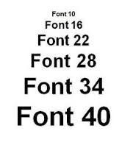
Accommodations
The student facing pages of test items may need to be adapted.
Size
Color
Contrast levels
Dimension
Assistive technology
Tactile

Slide 51
Accommodations
The student facing pages of test items may need to be adapted.
Size
Color
Contrast levels
Dimension
Assistive technology
Tactile

Slide 52
Accommodations
The student facing pages of test items may need to be adapted.
Size
Color
Contrast levels
Dimension
Assistive technology
Tactile

Slide 53
Accommodations
The student facing pages of test items may need to be adapted.
Size
Color
Contrast levels
Dimension
Assistive technology
Tactile

Slide 54
Accommodations
The student facing pages of test items may need to be adapted.
Size
Color
Contrast levels
Dimension
Assistive technology
Tactile

Slide 55
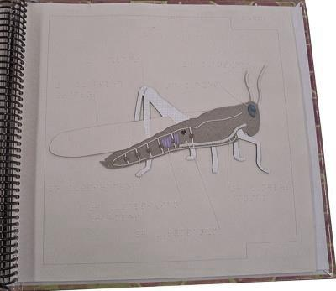
Accommodations
The student facing pages of test items may need to be adapted.
Size
Color
Contrast levels
Dimension
Assistive technology
Tactile

Slide 56
Accommodations
The picture symbols/ icons provided in the CoAlt assessment should be used, except in the following circumstances:
The student needs to use objects rather than pictures
The student needs pictures of real objects rather than drawings
The student has a personal lexicon with a specific representation for the concept or words in the student answer choices – in this case, all answer choices must be from the student’s personal lexicon
Notes:
The personal lexicon would come from a specific symbol being used during instruction for a specific concept.
All of these symbols mean “girl” but the student may know one specific symbol.

Slide 57
Remember
Accommodations used during instruction should be the accommodations used during assessment as long as they do not invalidate what is being measured.
Notes:
Accommodations should never be introduced for the first time on the assessment.

Slide 58
Options for English learners
Presentation in students native language
Response in students native language
Other accommodations that provide the linguistic support the student needs and do not invalidate what is being assessed.
Notes:
The district may choose to translate the assessment into a students native language in writing, math and science. The test examiner will need to be proficient in that language to assess the student.
Students must answer in English for the writing assessment in what ever modality they usually write. Linguistic scribes are not allowed on CoAlt.

Slide 59
With your partner note similarities and difference between the alternate assessments to be given this year.
CoAlt: Reading, Writing and Mathematics
CoAlt: Science and Social Studies
How will you train this to your Test Examiners?

Slide 60
Selected Response
Administration

Slide 61
Selected Response
Notes:
Teacher facing page:
Again Teachers read the words that are shaded – this is the teacher script.
For these items the teacher and student work with the item until a correct answer or the maximum number of attempts is achieved.
Level of independence is built into the item.

Slide 62
Selected Response
Notes:
The student facing page has the answer choices and a stimulus

Slide 63
Selected Response
Notes:
Teacher facing page:
Again Teachers read the words that are shaded – this is the teacher script.
For these items the teacher and student work with the item until a correct answer or the maximum number of attempts is achieved.
Level of independence is built into the item.

Slide 64
Selected Response
Notes:
Teacher facing page:
Again Teachers read the words that are shaded – this is the teacher script.
For these items the teacher and student work with the item until a correct answer or the maximum number of attempts is achieved.
Level of independence is built into the item.

Slide 65
Selected Response
Notes:
The student facing page has the answer choices and a stimulus

Slide 66
Selected Response
Notes:
Teacher facing page:
Again Teachers read the words that are shaded – this is the teacher script.
For these items the teacher and student work with the item until a correct answer or the maximum number of attempts is achieved.
Level of independence is built into the item.

Slide 67
Selected Response
Notes:
Teacher facing page:
Again Teachers read the words that are shaded – this is the teacher script.
For these items the teacher and student work with the item until a correct answer or the maximum number of attempts is achieved.
Level of independence is built into the item.

Slide 68
Selected Response
Notes:
Teacher facing page:
Again Teachers read the words that are shaded – this is the teacher script.
For these items the teacher and student work with the item until a correct answer or the maximum number of attempts is achieved.
Level of independence is built into the item.

Slide 69
Selected Response
Alternate Prompt
Notes:
If the student does not respond at level 4, there is a built in alternate prompt to help engage the student in the task.

Slide 70
Selected Response
Notes:
The student facing page has the answer choices and a stimulus

Slide 71
Selected Response
Notes:
Teacher facing page:
Again Teachers read the words that are shaded – this is the teacher script.
For these items the teacher and student work with the item until a correct answer or the maximum number of attempts is achieved.
Level of independence is built into the item.

Slide 72
Selected Response
Notes:
Teacher facing page:
Again Teachers read the words that are shaded – this is the teacher script.
For these items the teacher and student work with the item until a correct answer or the maximum number of attempts is achieved.
Level of independence is built into the item.

Slide 73
Selected Response
Notes:
Teacher facing page:
Again Teachers read the words that are shaded – this is the teacher script.
For these items the teacher and student work with the item until a correct answer or the maximum number of attempts is achieved.
Level of independence is built into the item.

Slide 74
Selected Response
Notes:
The student facing page has the answer choices and a stimulus

Slide 75
Selected Response
Notes:
The student facing page has the answer choices and a stimulus

Slide 76
Selected Response
Notes:
Teacher facing page:
Again Teachers read the words that are shaded – this is the teacher script.
For these items the teacher and student work with the item until a correct answer or the maximum number of attempts is achieved.
Level of independence is built into the item.

Slide 77
Selected Response
Notes:
Teacher facing page:
Again Teachers read the words that are shaded – this is the teacher script.
For these items the teacher and student work with the item until a correct answer or the maximum number of attempts is achieved.
Level of independence is built into the item.

Slide 78
Selected Response
Notes:
Teacher facing page:
Again Teachers read the words that are shaded – this is the teacher script.
For these items the teacher and student work with the item until a correct answer or the maximum number of attempts is achieved.
Level of independence is built into the item.

Slide 79
Selected Response
Notice no repeating of the prompt.
Notes:
Teacher facing page:
Again Teachers read the words that are shaded – this is the teacher script.
For these items the teacher and student work with the item until a correct answer or the maximum number of attempts is achieved.
Level of independence is built into the item.

Slide 81
Find your manipulatives and cut them out.
Paperclip them to the appropriate pages

Slide 82
Supported Performance Task
Administration

Slide 83
Supported Performance Tasks
Notes:
Teacher facing page:
Teachers read the words that are shaded – this is the teacher script.
For Supported performance tasks, each prompt is scored separately – 2 points for a correct response, 1 point for an incorrect response, and NR for no response.

Slide 84
Supported Performance Tasks
Positive Consequences | Negative Consequences
Notes:
Actions have consequences. Place each action onto the chart to show whether the action will have a positive consequence or a negative consequence. Fighting at school, Having perfect attendance, leaving class without permission
Hand the student the card:
Will fighting at school have a positive consequence or a negative consequence?
The student places the card on the chart.
Hand the student the next card:
Will having perfect attendance have a positive consequence or a negative consequence?
The student places the card on the chart.
If the student places it wrong, there is a script to correct it, and the TE moves the card.
Having perfect attendance will have a positive consequence.
Hand the student the final card:
Will leaving class without permission have a positive consequence or a negative consequence?
The student answers.

Slide 85
Supported Performance Tasks
Notes:
Teacher facing page:
Teachers read the words that are shaded – this is the teacher script.
For Supported performance tasks, each prompt is scored separately – 2 points for a correct response, 1 point for an incorrect response, and NR for no response.

Slide 86
Supported Performance Tasks
Positive Consequences | Negative Consequences
Notes:
Actions have consequences. Place each action onto the chart to show whether the action will have a positive consequence or a negative consequence. Fighting at school, Having perfect attendance, leaving class without permission
Hand the student the card:
Will fighting at school have a positive consequence or a negative consequence?
The student places the card on the chart.
Hand the student the next card:
Will having perfect attendance have a positive consequence or a negative consequence?
The student places the card on the chart.
If the student places it wrong, there is a script to correct it, and the TE moves the card.
Having perfect attendance will have a positive consequence.
Hand the student the final card:
Will leaving class without permission have a positive consequence or a negative consequence?
The student answers.

Slide 87
Supported Performance Tasks
Notes:
Teacher facing page:
Teachers read the words that are shaded – this is the teacher script.
For Supported performance tasks, each prompt is scored separately – 2 points for a correct response, 1 point for an incorrect response, and NR for no response.

Slide 88
Supported Performance Tasks
Positive Consequences | Negative Consequences
Notes:
Actions have consequences. Place each action onto the chart to show whether the action will have a positive consequence or a negative consequence. Fighting at school, Having perfect attendance, leaving class without permission
Hand the student the card:
Will fighting at school have a positive consequence or a negative consequence?
The student places the card on the chart.
Hand the student the next card:
Will having perfect attendance have a positive consequence or a negative consequence?
The student places the card on the chart.
If the student places it wrong, there is a script to correct it, and the TE moves the card.
Having perfect attendance will have a positive consequence.
Hand the student the final card:
Will leaving class without permission have a positive consequence or a negative consequence?
The student answers.

Slide 89
Supported Performance Tasks
Notes:
Teacher facing page:
Teachers read the words that are shaded – this is the teacher script.
For Supported performance tasks, each prompt is scored separately – 2 points for a correct response, 1 point for an incorrect response, and NR for no response.

Slide 90
Supported Performance Tasks
Positive Consequences | Negative Consequences
Notes:
Actions have consequences. Place each action onto the chart to show whether the action will have a positive consequence or a negative consequence. Fighting at school, Having perfect attendance, leaving class without permission
Hand the student the card:
Will fighting at school have a positive consequence or a negative consequence?
The student places the card on the chart.
Hand the student the next card:
Will having perfect attendance have a positive consequence or a negative consequence?
The student places the card on the chart.
If the student places it wrong, there is a script to correct it, and the TE moves the card.
Having perfect attendance will have a positive consequence.
Hand the student the final card:
Will leaving class without permission have a positive consequence or a negative consequence?
The student answers.

Slide 92
After testing
Entering Scores
Test Examiner Returning Materials
DAC/SAC Returning Materials
Score Reports

Slide 93
Scoring
Enter scores into PearsonAccess
Districts set up user accounts
Pearson emails original password
Teachers can change password
Teacher can reset password if forgotten
Notes:
During the assessment Test Examiners are making judgment calls and assigning levels of independence and recording answers; however, scores are calculated at CTB.
In order to obtain scores, teachers must ensure accurate transfer from the test protocol to the scannable rating form.
Once the forms have left the district, there is no further opportunity to fix invalid combinations so it is important this happened accurately.

Slide 94
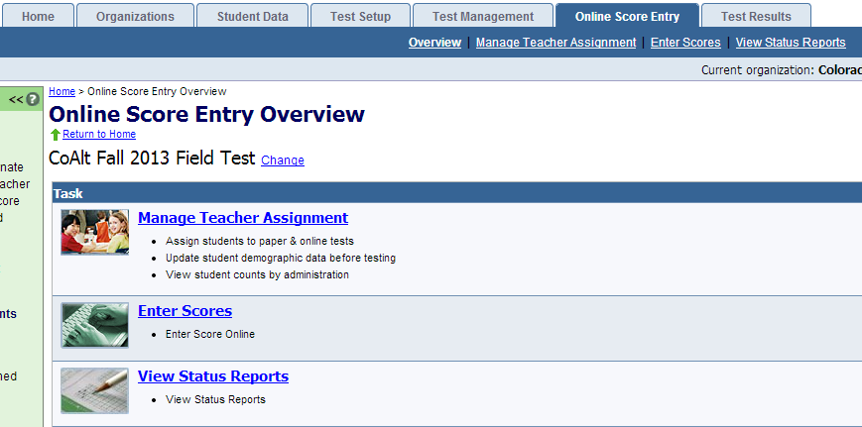
Scoring
Log in to PearsonAccess with User ID
Click on the Online Score Entry tab
Verify Test
Click on Enter Scores
Notes:
During the assessment Test Examiners are making judgment calls and assigning levels of independence and recording answers; however, scores are calculated at CTB.
In order to obtain scores, teachers must ensure accurate transfer from the test protocol to the scannable rating form.
Once the forms have left the district, there is no further opportunity to fix invalid combinations so it is important this happened accurately.

Slide 95
Scoring
Verify Current Organization is School
Notes:
During the assessment Test Examiners are making judgment calls and assigning levels of independence and recording answers; however, scores are calculated at CTB.
In order to obtain scores, teachers must ensure accurate transfer from the test protocol to the scannable rating form.
Once the forms have left the district, there is no further opportunity to fix invalid combinations so it is important this happened accurately.

Slide 96
Scoring
Click on name of the student in the box on the side
Select test
Notes:
During the assessment Test Examiners are making judgment calls and assigning levels of independence and recording answers; however, scores are calculated at CTB.
In order to obtain scores, teachers must ensure accurate transfer from the test protocol to the scannable rating form.
Once the forms have left the district, there is no further opportunity to fix invalid combinations so it is important this happened accurately.

Slide 97
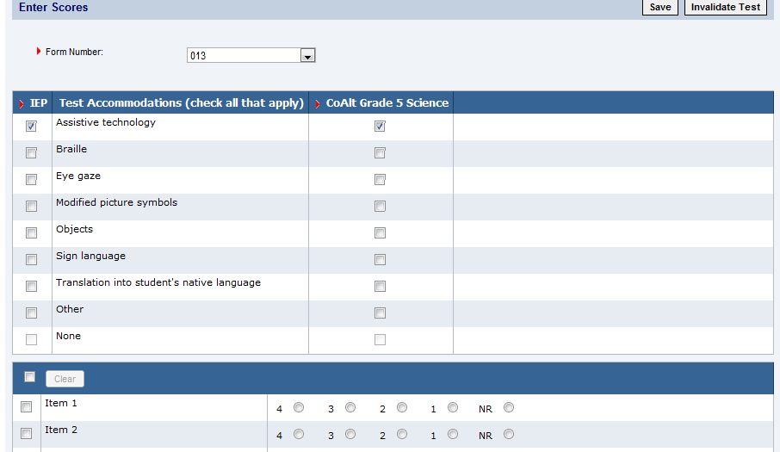
Scoring
Enter form number
Enter accommodations for the student
IEP
Used
Notes:
Something must be entered into both columns

Slide 98
Scoring
Enter student answers
Each item needs to have a response
Notes:
You are able to save student scores and finish entering later if you wish.

Slide 99
Scoring
Answer Validity Questions
How familiar are you with this student?
Very familiar, somewhat familiar, familiar, somewhat unfamiliar, unfamiliar
How many hours per week does this student spend in instruction on this content area?
<1 hour, 1 to < 2 hours, 2 to <3 hours, 3 to < 4 hours, 4 to < 5 hours, >= 5 hours, Do not know
Approximately how much of instructional time for this content area is in the general education classroom?
25%, 50%, 75%, 100%, none
This student’s primary receptive communication is:
oral language (spoken or sign), reading, picture communication (including symbol systems), tactile (tactile graphics or braille), other, do not know
Notes:
DAC’s may use these slide to create a page for test examiner’s use complete immediately after testing if the scores will be entered later.

Slide 100
Scoring
Answer Validity Questions
This student primary expressive communication is:
oral language (spoken or sign), writing, picture communication (including symbol systems), tactile (tactile graphics or braille), other, do not know
I feel that the student’s responses accurately reflect their understanding of the material.
Strongly agree, agree, neutral, disagree, strongly disagree, do not know
How much time did this student take on the assessment?
[# minutes]

Slide 101
Scoring
Click Save
Not Started
In Progress
Completed
We want everyone to be a gold star.
Notes:
During the assessment Test Examiners are making judgment calls and assigning levels of independence and recording answers; however, scores are calculated at CTB.
In order to obtain scores, teachers must ensure accurate transfer from the test protocol to the scannable rating form.
Once the forms have left the district, there is no further opportunity to fix invalid combinations so it is important this happened accurately.

Slide 102
Test Examiner Returning Materials
Test Examiner returns all testing materials to the SAC including accommodated manipulatives
Test Examiner returns the following to the SAC in the unsealed secure return envelope.
Task manipulatives
Score recording forms
Security form

Slide 103
SAC Returning Materials
Check materials to ensure all materials for the school have been returned
Security forms
CoAlt secure materials envelope
Ensure all scores are entered into PearsonAccess
All sessions are in Completed status
All enrolled students are accounted for
Group materials:
Secure return envelopes
Used test books
Unused test books
Accommodated materials
Sign the Certification Form
Return materials to DAC

Slide 104
DAC Returning Materials
Check materials to ensure all materials for the school have been returned
Security forms
CoAlt secure materials envelope
Ensure all scores for the district are entered into PearsonAccess
All sessions are in Completed status
All enrolled students are accounted for
Securely destroy (shred) CoAlt accommodated materials
Erase memory sticks that contain PDFs of student materials
Pack-up boxes
Schedule pick-up of test materials with UPS by May 2
Sign the Certification Form – ONLY the DAC form is sent to Pearson – the teacher/SAC certification forms are kept at the District for 12 months

Slide 105
Score Reports
The same time as CMAS: Science and Social Studies score reports.
2014 will be a little later than in future years due to standard setting.
Notes:
do not wait several months and call to ask where they are.

Slide 106
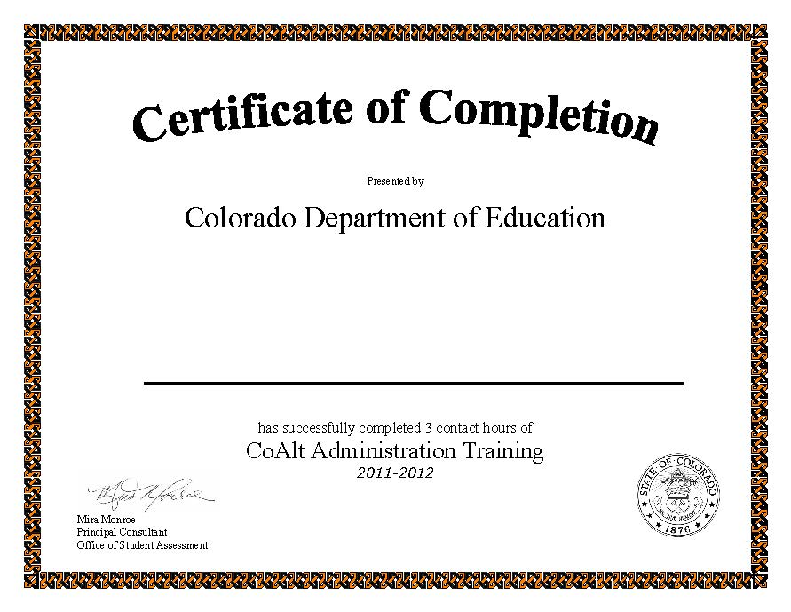
Contacts at CDE
Program and instruction for students with disabilities
11th grade Alternate
Linda Lamirande, ESSU
lamirande_l@cde.state.co.us
303-866-6863
CoAlt administration
Mira Monroe, AU
monroe_m@cde.state.co.us
303-866-6709

