Slide 1
Technical Advisory Panel Meeting
August 31, 2023

Slide 2
Welcome & Introductions
Welcome from CDE
The purpose of the TAP is to provide non‐binding technical recommendations to CDE regarding the Colorado Growth Model, state accountability, and other topics as needed.
Meeting Logistics:
Non‐members, please add your Name/Affiliation to the chat box.
Everyone please mute your sound.
We ask all non‐TAP members to hold any comments until the end of the meeting. We do this to ensure we have sufficient time to address all meeting agenda items.
Introductions with Ryan Marks, TAP Chair

Slide 3
Agenda for Today
Welcome and Introductions
Information Item
Accountability Updates – Lisa Medler
Information Item
New Higher Bar Sub Indicators – Marie Huchton
Feedback Item
Wrap-Up

Slide 4
Accountability Updates Information Item Lisa Medler

Slide 5
Current State Accountability

Slide 6
Overarching Accountability Timeline
2023 Frameworks Released
1241 Task Force Begins*
Fall 2023
2023 Supplemental Framework Report
Winter 2024
Spring 2024
Interim Report Due
2024 Framework with New Measures for Points
Final Report Due
Fall 2024
* Per HB23-1241

Slide 7
2023 State Accountability Timeline
Anticipated Timeframe | Activities/Actions
June 29 | Districts Receive ACCESS Growth Data
August 14 | Districts Receive CMAS and P/SAT Achievement, Growth, Participation Data; UIP Data Dashboards available
August 17 (SBE Meeting) | Public Release of Colorado Growth Data Results; Alternative Education Campus (AEC) Designations Finalized
August 21 | Districts Receive Matriculation Data
August 23 | Preliminary Performance Frameworks Released to Districts. Public release August 29.
Early September | ESSA Identifications (i.e., CS, TS, A-TS) Released to Districts. Districts will need to notify schools.
Mid-September | AEC Performance Frameworks Released
September 22 | Accreditation Form Submissions Due for ALL Districts
October 16 | Unified Improvement Plan (UIP) Submissions Due Final Request to Reconsider Materials Due (for participating districts)
November 8-9 (SBE Meeting) | District Accreditation Ratings & School Plan Types Finalized for Districts/Schools not participating in request to reconsider
December 13-14 (SBE Meeting) | District Accreditation Ratings & School Plan Types Finalized for Districts/Schools participating in request to reconsider
By December 31 | District Accreditation Contracts Due
Late January | Informational reports release to districts with new measures (e.g., PWR Higher Bar measures).

Slide 8
Timeline for Upcoming Accountability Discussions with the State Board of Education
Anticipated Timeframe | Activities/Actions
September 13 & 14 | CDE presents on statewide trends of 2023 Preliminary Performance Frameworks (informational) AND CDE presents on New framework measures (informational)
October 11 & 12 | CDE presents on statewide framework targets for 2024 including anticipated new measures (informational)
November 8 & 9 | SBE votes on 2024 statewide framework targets (vote) AND SBE finalizes District Accreditation Ratings & School Plan Types not participating in request to reconsider (consent item)
December 13-14 | SBE finalizes District Accreditation Ratings & School Plan Types Finalized for Districts/Schools participating in request to reconsider (vote)

Slide 9
Distribution of 2023 Preliminary District Performance Frameworks
Plan Types | # in 2023 (Out of 182) - Prelim | # in 2022 (Out of 184)
 |  | 2022 Prelim | 2022 Final (after Request to Reconsider)
Accredited with Distinction | 12 (7%) | 11 (6%) | 11 (6%)
Accredited | 70 (38%) | 47 (26%) | 50 (27%)
Accredited with Improvement | 46 (25%) | 41 (22%) | 40 (22%)
Accredited with Priority Improvement | 19 (10%) | 12 (7%) | 10 (5%)
Accredited with Turnaround | 3 (2%) | 1 (<1%) | 1 (<1%)
Accredited with Insufficient State Data | 32 (18%) | 72 (39%) | 72 (39%)
Note: Plan types for two districts have not yet been published as the department re-calculates their data. This was an isolated incident impacting the DPF calculations for the two districts and did not impact the school plan type assignments.

Slide 10
Distribution of 2023 Preliminary School Performance Frameworks
Plan Types | # in 2023 (Out of 1773) - Prelim | # in 2022 (Out of 1876) - Prelim
 |  | 2022 Prelim | 2022 Final (after R2R)
Performance | 1035 (58%) | 1015 (54%) | 1061 (57%)
Improvement | 349 (20%) | 323 (17%) | 327 (17%)
Priority Improvement | 163 (9%) | 132 (7%) | 120 (6%)
Turnaround | 40 (2%) | 43 (2%) | 40 (2%)
Insufficient State Data | 139 (8%) | 319 (17%) | 309 (17%)
New Schools | 12 (<1%) | 25 (1%) | 0 (All were assigned a plan type)
Closed Schools | 35 (2%) | 19 (1%) | 19 (1%)
Note: AECs are not yet included. One school has not yet been assigned a plan type as the department reviews their data.

Slide 11
Task Force Updates

Slide 12
H.B. 23-1241: Accountability, Accreditation, Student Performance, and Resource Inequity Task Force
Link to Bill: https://leg.colorado.gov/bills/hb23-1241
Purpose: Creates a representative task force of 26-members that studies academic opportunities, inequities, promising practices in schools, and improvements to the accountability and accreditation system.
Task Force Website: https://www.cde.state.co.us/accountability/accountability-task-force
Builds upon: Accountability Audit and the Local Accountability System Grant
Timeline:
July 1, 2023: Task force members appointed
August 15, 2023: Department contracted with a facilitator
August 24, 2023: Convened first meeting
March 1, 2024: Interim report
November 15, 2024: Final report reflecting findings and recommendations to the education committees of the house of representatives and senate, the governor, the state board, the commissioner of education and the department.

Slide 13
H.B. 22-1215: Study Of Expanding Extended High School Programs
Link to Bill: https://leg.colorado.gov/bills/hb22-1215
Purpose: Develop and recommend policies, laws and rules to support the equitable and sustainable expansion and alignment of programs that integrate secondary, postsecondary and work-based learning opportunities in every region of the state.
Task Force Website: https://www.cde.state.co.us/postsecondary/secondary_postsecondary_and_work-based_learning_integration_task_force
Timeline:
July 2022: Convened first meeting
December 1, 2022: Interim report
December 1, 2023: Final report reflecting findings and recommendations to the governor, the Education Leadership Council, the State Board of Education, the Colorado Commission on Higher Education, and the Education Committees of the Senate and the House of Representatives, or any successor committees.

Slide 14
Break
(10 minutes)

Slide 15
New Higher Bar Sub Indicators Feedback Item Marie Huchton

Slide 16
Two New PWR Sub-Indicators
S.B. 17-272- Higher Bar for ELA & Math
Higher achievement levels in ELA and Math, as defined by the State Board, on certain graduation guidelines measures
(Accuplacer, ACT, ACT Work Keys, AP, ASVAB, Concurrent Enrollment, IB, SAT).
H.B. 18-1019- Higher Bar for Non-ELA/Non-Math
Successful completion of AP, IB, and/or Concurrent Enrollment for non-ELA and non-Math courses.
AP examination score of 3 or higher
IB examination score of 4 or higher
CE course grade of B or higher

Slide 17
PWR Sub-Indicator Calculation Methodology
At the February 2021 meeting, TAP recommended using the same calculation methodology for both sub-indicators: Graduation Guidelines reporting is required for graduates Consistency in the denominator between the two sub-indicators Counting at graduation allows for a complete dataset across the state
About 85% of IB examinations are taken in the final year of high school About 65% of AP examinations are taken in the final two years of high school A graduate is counted in the numerator if they met the requirement at any time during grades 9-12.
Notes:
Ensures that concurrent enrollment data collected via graduation guidelines includes all students who met the requirement at any time during high school will be counted as a success

Slide 18
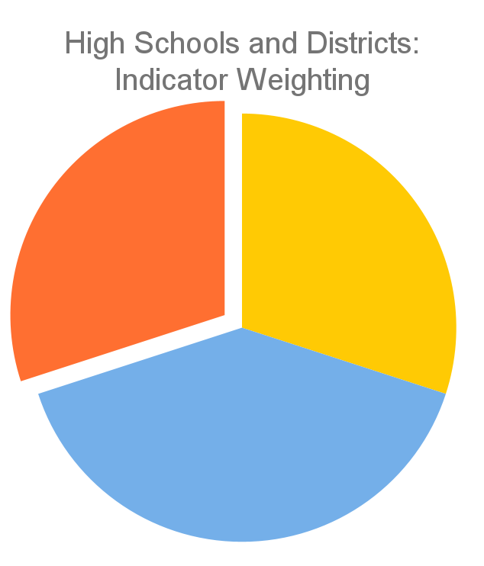
Current PWR Indicator Points
Only available for high schools and districts
Contributes 30% of the points in determining overall high school or district plan types
Currently consists of five sub-indicators:
SAT Evidence-Based Reading/Writing
SAT Math
Dropout Rates
Matriculation Rates
Graduation Rates
PWR 30%
Achievement
30%
Growth
40%
Current PWR Indicator: Points by Sub-Indicator & Level
SAT EBRW (8 points): Mean Scale Score [All Students (4) & Disaggregated (1 each)]
SAT Math (8 points): Mean Scale Score [All Students (4) & Disaggregated (1 each)]
Dropout (16 points): Rate [All Students (8) & Disaggregated (2 each)]
Matriculation (4 points): Rate [All Students (4)]
Graduation (16 points): Rate [All Students (8) & Disaggregated (2 each)]

Slide 19
Options for Points on the Performance Framework
At the May 2023 TAP Meeting, TAP discussed weighting scenarios for the Higher Bar sub-indicators:
Setting 2 points for both Higher Bar sub-indicators
Equivalent to matriculation
Setting 1 point for both Higher Bar sub-indicators
Half the points as matriculation
Advocate 1 point and take 1 point from matriculation
Advocate 0 points, shouldn’t be included in the framework

Slide 20
TAP Recommendation
Which option does the TAP recommend for the Higher Bar sub-indicators?
Recommend a weighting scenario for each of the Higher Bar sub-indicators (e.g., 1 point each or 2 points each)
Submit a recommendation letter from the TAP to the State Board of Education for their consideration
This letter can include:
Concerns about calculations/data collection
Reasons why this measure should not be included in the frameworks
Both: recommend one weighting scenario and include a recommendation letter

Slide 21
Public Comments and Meeting Close

Slide 22
Technical Advisory Panel
Meeting Summary
Suggested future analysis
TAP recommendations from this meeting
Public Comment
Close Meeting
Next Scheduled Meeting: October 5, 1-4pm

Slide 23
Supplemental Material:
Slides from 5/10/23 TAP Meeting on Higher Bar

Slide 24
Two New PWR Sub-Indicators
SB17-272- Higher Bar for ELA & Math
Higher achievement levels in ELA and Math, as defined by the State Board, on certain graduation guidelines measures
(Accuplacer, ACT, ACT Work Keys, AP, ASVAB, Concurrent Enrollment, IB, SAT).
HB18-1019- Higher Bar for Non-ELA/Non-Math
Successful completion of AP, IB, and/or Concurrent Enrollment for non-ELA and non-Math courses.
AP examination score of 3 or higher
IB examination score of 4 or higher
CE course grade of B or higher

Slide 25
PWR Sub-Indicator Calculation Methodology
At the February 2021 meeting, TAP recommended using the same calculation methodology for both sub-indicators: Graduation Guidelines reporting is required for graduates Consistency in the denominator between the two sub-indicators Counting at graduation allows for a complete dataset across the state
About 85% of IB examinations are taken in the final year of high school About 65% of AP examinations are taken in the final two years of high school A graduate is counted in the numerator if they met the requirement at any time during grades 9-12.
Notes:
Ensures that concurrent enrollment data collected via graduation guidelines includes all students who met the requirement at any time during high school will be counted as a success

Slide 26
Data Build for Higher Bar and Non-ELA/Math Metrics
Advanced Placement Exams
Aggregated student level file. Contains 1 student record from each contributing file that provides “best-of” outcome for that data stream.
International Baccalaureate Exams
Unique by Student ID. Includes “best-of” numerator value from all available files for Higher Bar metric and Non-ELA/Math metric
Concurrent Enrollment from CDHE
Grad Guidelines Collection
Matriculation File to establish denominator
CO SAT

Slide 27
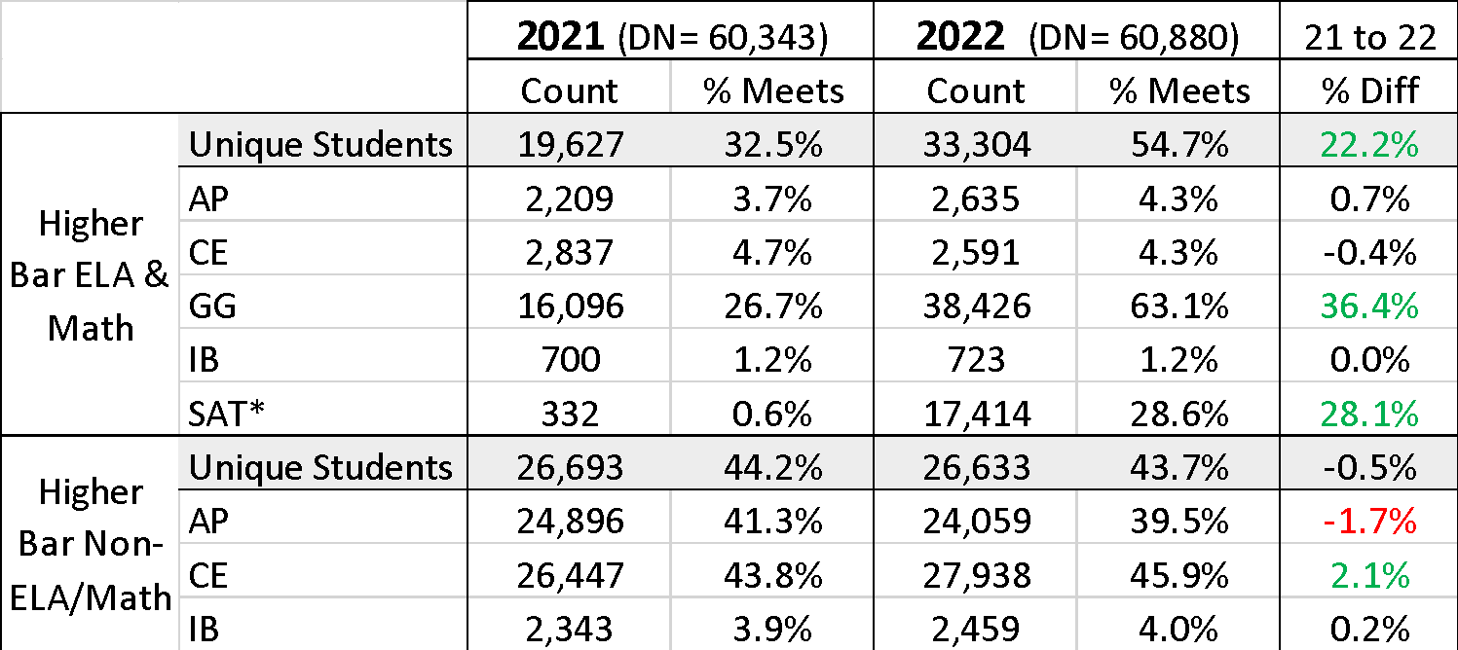
SASID counts for 2021 and 2022 Cohorts by Measure
* the 2021 cohort SAT counts are so low because state testing was canceled in spring 2020 due to the pandemic when most 2021 grads would have been in 11th grade
Also note that measure counts include duplicate records and do not add up to the unique student total

Slide 28
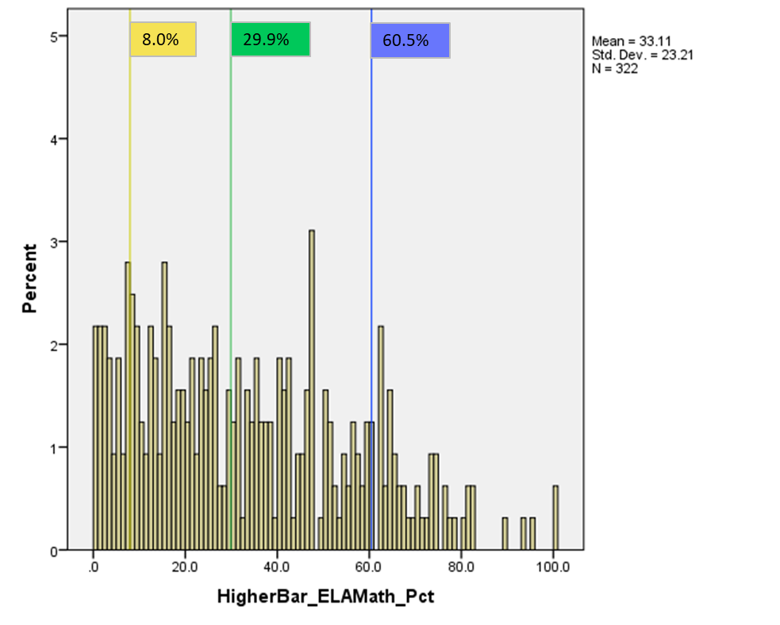
2021 Distribution of Schools by Percent of Students Meeting ELA & Math Higher Bar
Note that AECs and schools with less than 16 graduates in 2021 are excluded

Slide 29
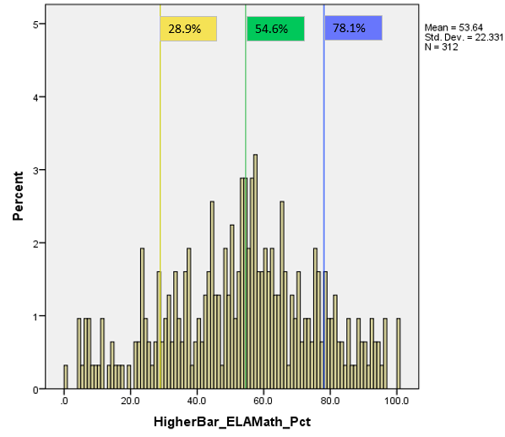
2022 Distribution of Schools by Percent of Students Meeting ELA & Math Higher Bar
Note that AECs and schools with less than 16 graduates in 2022 are excluded

Slide 30
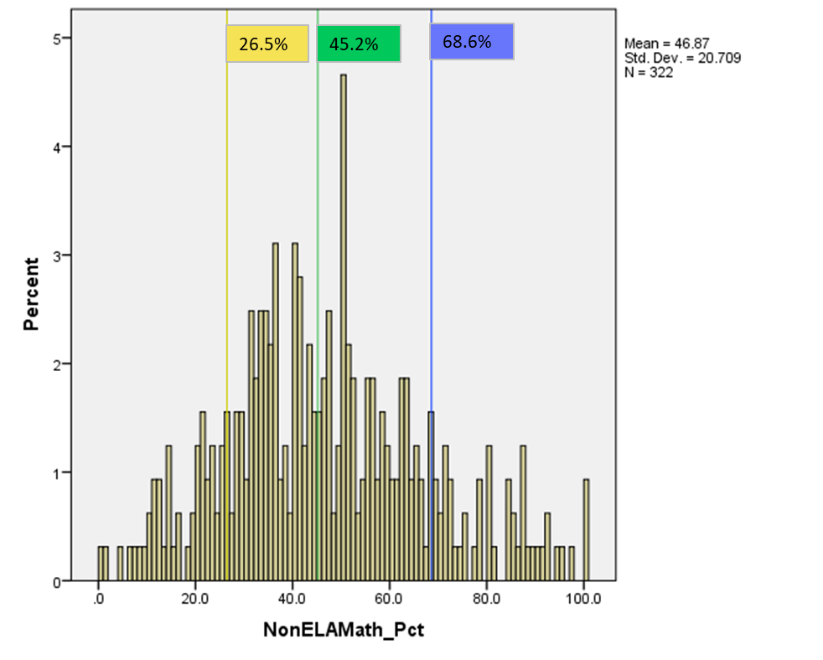
2021 Distribution of Schools by Percent of Students Meeting Non-ELA/Math Higher Bar
Note that AECs and schools with less than 16 graduates in 2021 are excluded

Slide 31
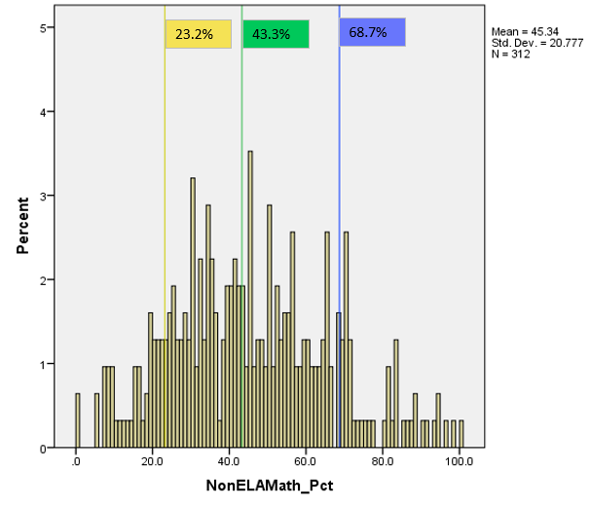
2022 Distribution of Schools by Percent of Students Meeting Non-ELA/Math Higher Bar
Note that AECs and schools with less than 16 graduates in 2022 are excluded

Slide 32
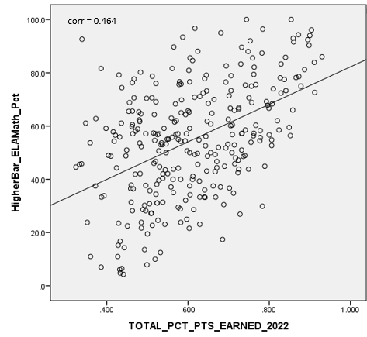
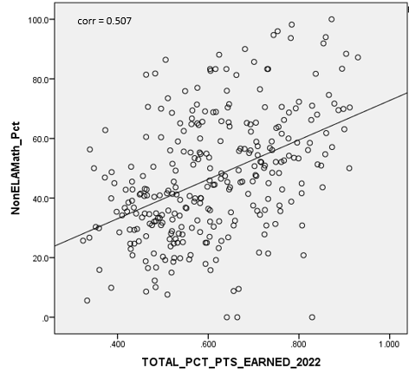
2022 Higher Bar Correlations to Framework Total Percent of Points Earned
Note that AECs and schools with Insufficient State Data ratings in 2022 are excluded
Notes:
Don’t talk through in detail- compared to 2021 HB results, 2022 show higher correlations with overall framework outcomes,

Slide 33
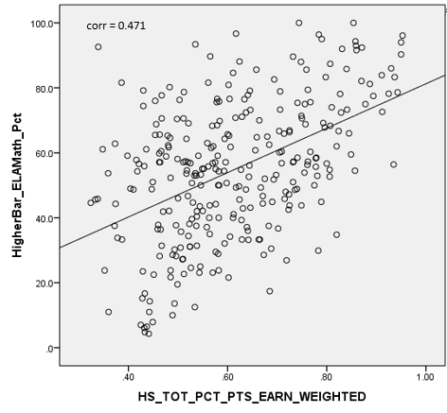
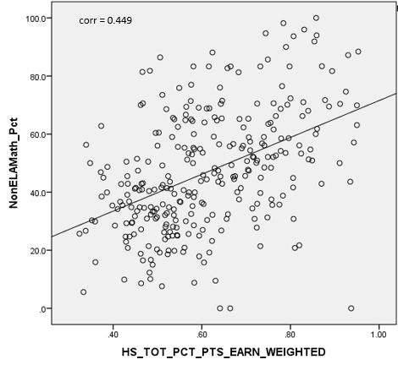
2022 Higher Bar Correlations to High School Total Percent of Points Earned
Note that AECs and schools with Insufficient State Data ratings in 2022 are excluded

Slide 34
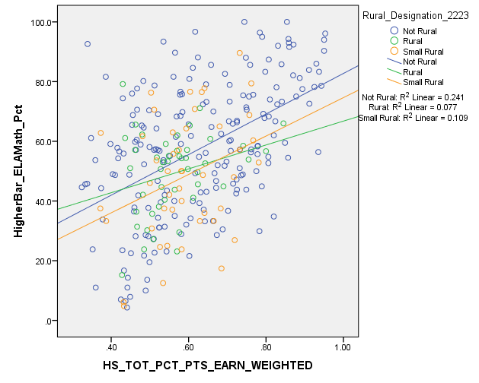
2022 Higher Bar Correlations to Framework Total Percent of Points Earned by Rural Designation
Note that AECs and schools with Insufficient State Data ratings in 2022 are excluded

Slide 35
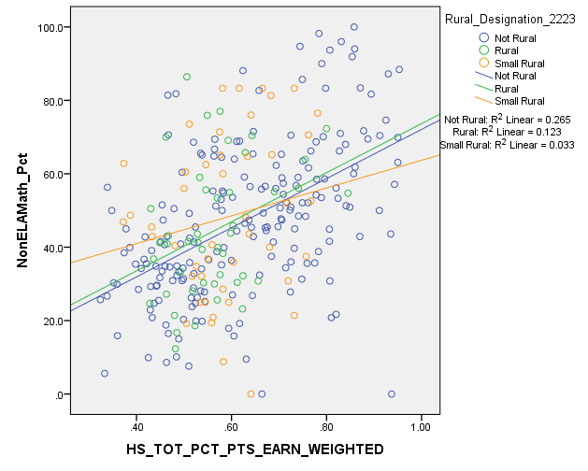
2022 Higher Bar Correlations to Framework Total Percent of Points Earned by Rural Designation
Note that AECs and schools with Insufficient State Data ratings in 2022 are excluded

Slide 36
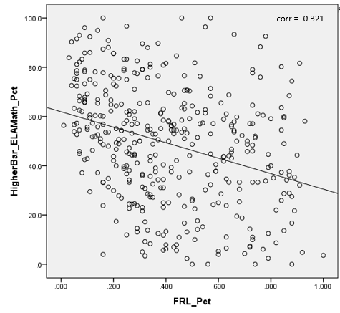
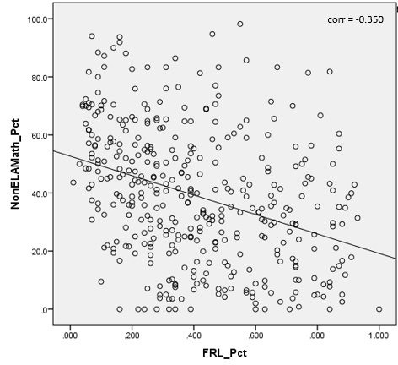
2022 Correlations to School Demographics- Percent Eligible for Free- or Reduced-Price Lunch Programs
Note that AECs are included

Slide 37
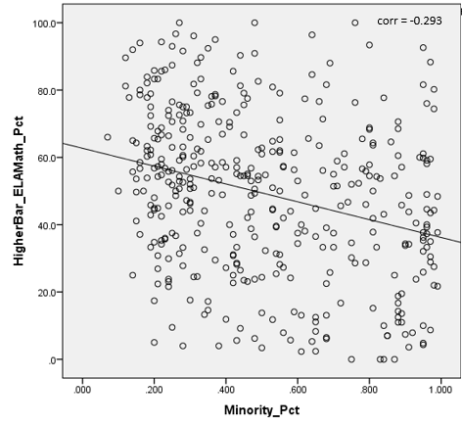
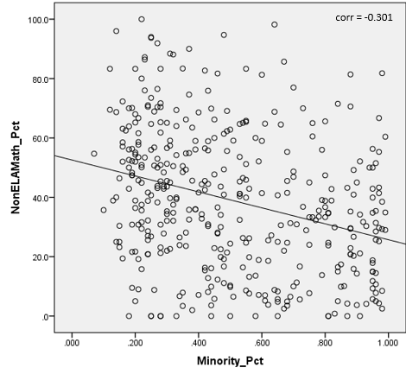
2022 Correlations to School Demographics- Percent of Minority Students
Note that AECs are included

Slide 38
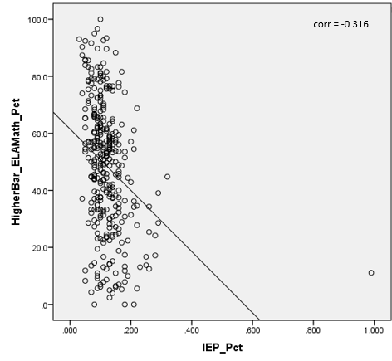
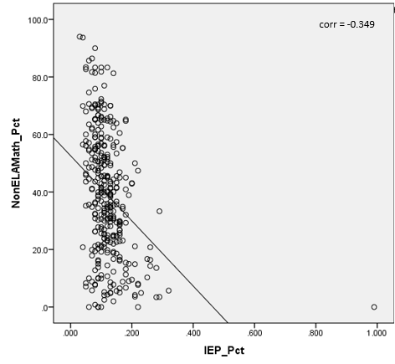
2022 Correlations to School Demographics- Percent of Students with Disabilities
Note that AECs are included

Slide 39
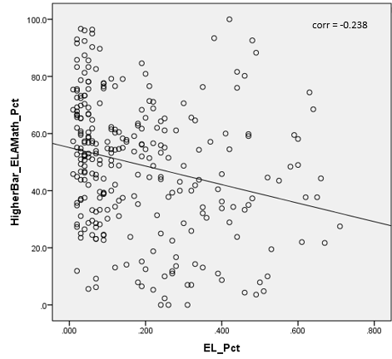
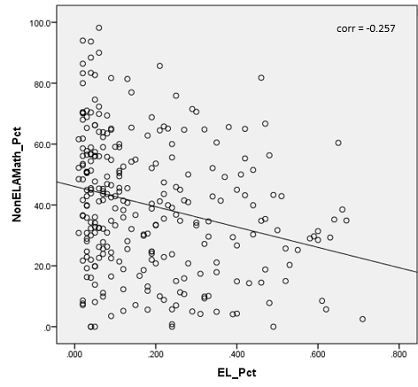
2022 Correlations to School Demographics- Percent of English Learners
Note that AECs are included

Slide 40
Potential PWR Weighting Scenarios
Investigated 3 potential scenarios for incorporating the new PWR metrics- 1 point, 2 points, or 4 points for All Students Group and no points for disaggregated groups
 | All Students |  | Disaggregated
SAT EBRW | 4 |  | 4
SAT Math | 4 |  | 4
Dropout Rate | 8 |  | 8
Matriculation Rate | 4 |  | --
Graduation Rate | 8 |  | 8
 | Current | 1 Point | 2 Points | 4 Points
Higher Bar ELA & Math | -- | 1 | 2 | 4
Higher Bar Non-ELA/Math | -- | 1 | 2 | 4
Total PWR Points | 52 | 54 | 56 | 60

Slide 41
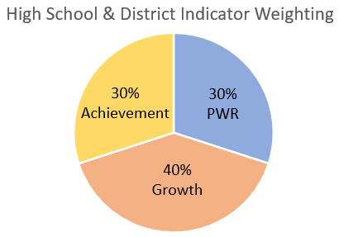
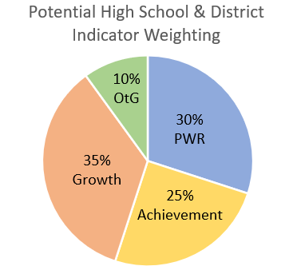
High School & District Indicator Weightings
Weightings used in the current analyses.
Don’t forget, something like this may be coming in future years.

Slide 42
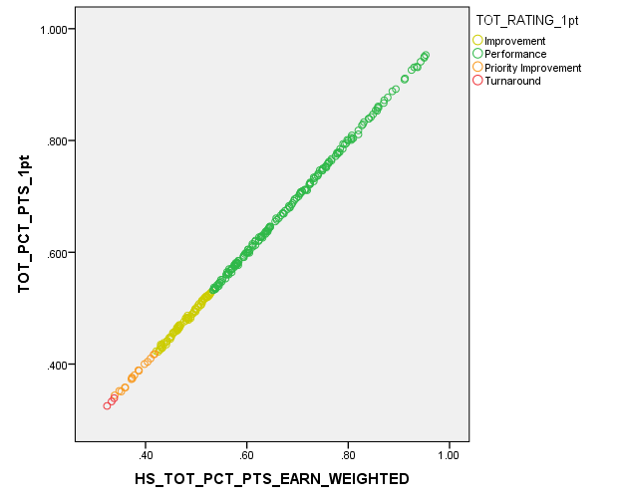
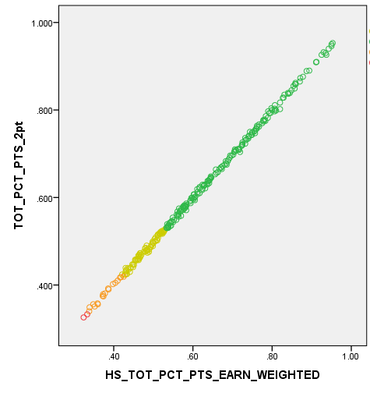
2022 School Level Impact Data by Potential Weighting Scenario (adding 2022 Higher Bar Data)
1 Point
2 Points
4 Points

Slide 43
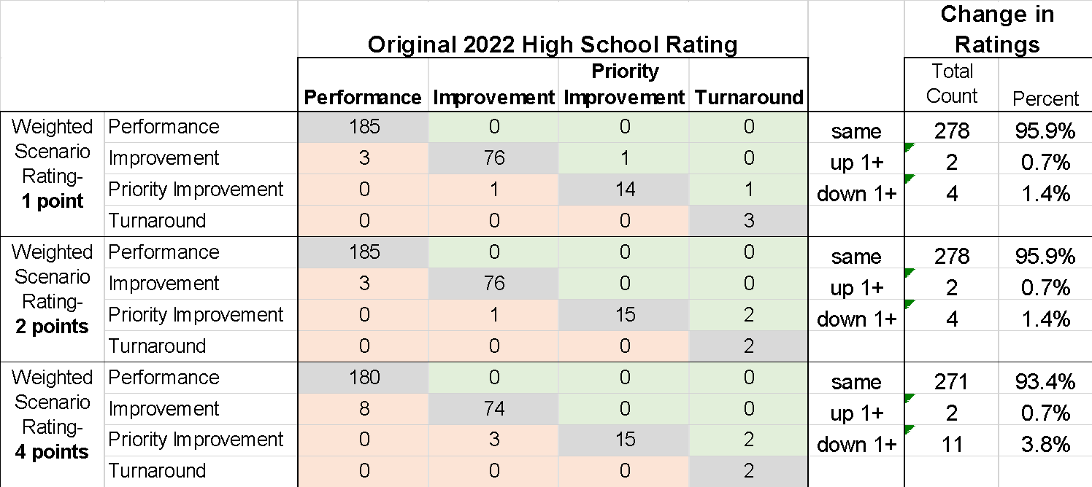
2022 School Level Impact Data by Potential Weighting Scenario (adding 2022 HB Data)

Slide 44
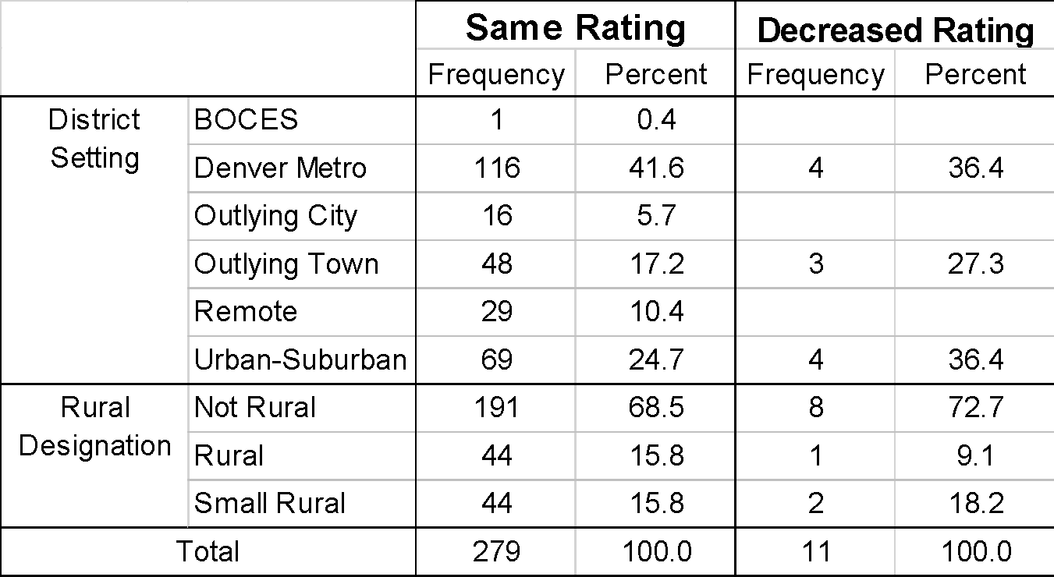
Comparison of Demographic Characteristics based on 4pt Higher Bar Impact Results

Slide 45
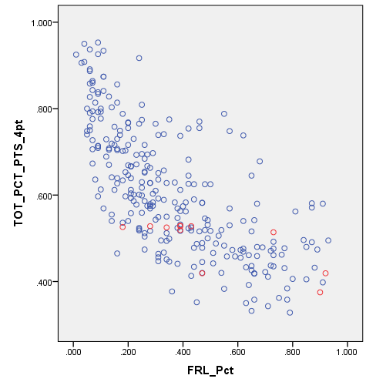
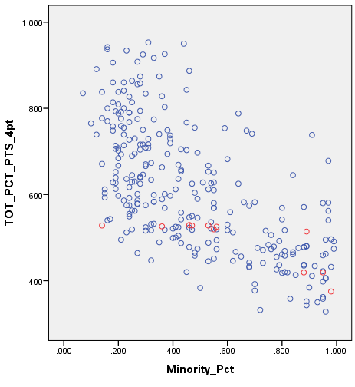
Comparison of Demographic Characteristics based on 4pt Higher Bar Impact Results
% Free- or Reduced-Price Lunch
% Minority
Same Avg = 49.2%
Decrease Avg = 54.5%
Same Avg = 59.8%
Decrease Avg = 65.7%

Slide 46
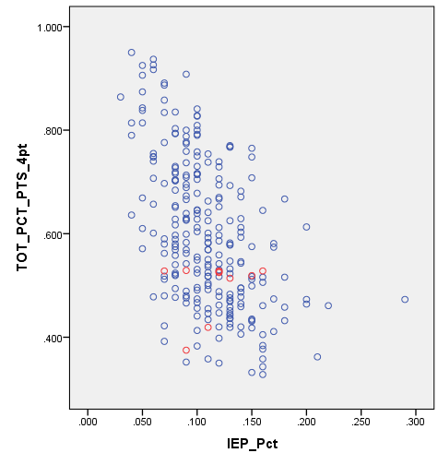
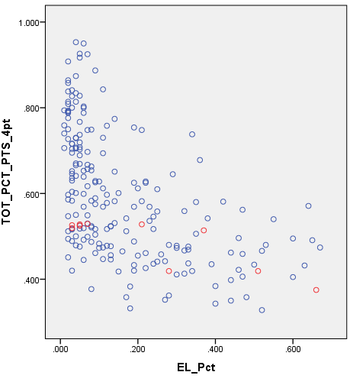
Comparison of Demographic Characteristics based on 4pt Higher Bar Impact Results
% Students with Disabilities
% English Learner
Same Avg = 11.3%
Decrease Avg = 12.3%
Same Avg = 29.7%
Decrease Avg = 41.9%

Slide 47
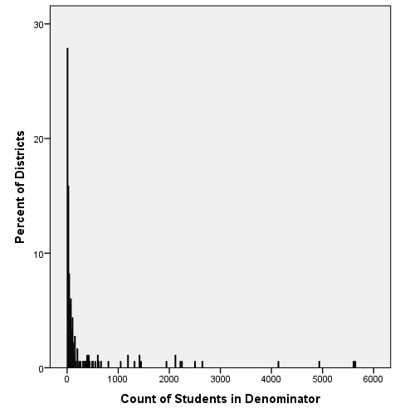
2022 Distribution of District N-counts Included in Matriculation Rate
Note that almost 30% of districts did not meet the minimum reporting N of 16 for matriculation rate.
This means these districts will not have results for either of the new Higher Bar measures

Slide 48
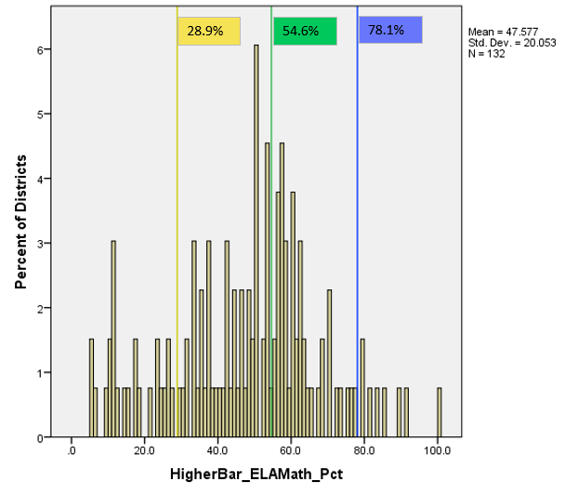
2022 Distribution of Districts by Percent of Students Meeting ELA & Math Higher Bar
Note that the 2022 school level cut-scores have been applied

Slide 49
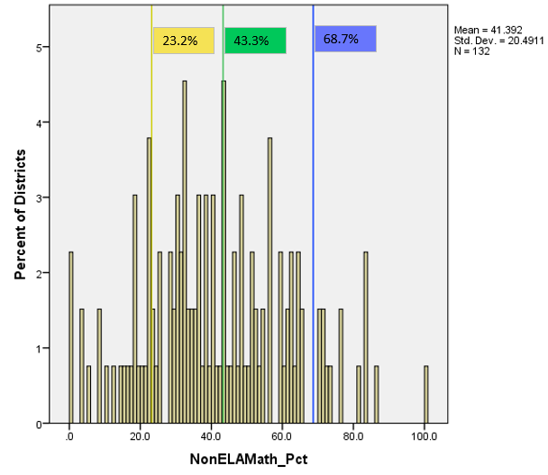
2022 Distribution of Districts by Percent of Students Meeting Non-ELA/Math Higher Bar
Note that the 2022 school level cut-scores have been applied

