Slide 1
Technical Advisory Panel Meeting
May 10, 2023

Slide 2
Welcome & Introductions
Welcome!
The purpose of the TAP is to provide non‐binding technical recommendations to CDE regarding the Colorado Growth Model, state accountability, and other topics as needed.
Meeting Logistics:
Non‐members, please add your Name/Affiliation to the chat box.
Everyone please mute your sound.
We ask all non‐TAP members to hold any comments until the end of the meeting. We do this to ensure we have sufficient time to address all meeting agenda items.
Thank you, Dan Jorgensen, for 10 years facilitating the TAP!

Slide 3
Agenda for Today
Welcome and Chair Selection
Feedback Item
Accountability Updates – Lisa Medler
Information Item
On-Track Growth – Marie Huchton
Feedback Item
New Higher Bar Sub Indicators – Marie Huchton
Feedback Item
Request to Reconsider – Lisa Medler & Aislinn Wales
Feedback Item
Bonus Content (if time): Participation Descriptor – Lisa Medler
Wrap-Up

Slide 4
Chair Selection Feedback Item David Bahna

Slide 5
Accountability Updates Information Item Lisa Medler

Slide 6
Updates - Legislative
H.B. 23-1241: Task Force to Study K-12 Accountability System
Link to Bill: https://leg.colorado.gov/bills/hb23-1241
Purpose: Creates a representative task force of 26-members that studies academic opportunities, inequities, promising practices in schools, and improvements to the accountability and accreditation system.
Builds upon: Accountability Audit and the Local Accountability System Grant
Timeline:
July 1, 2023: Task force members appointed
August 15, 2023: Department contracts with a facilitator
No later than September 1, 2023: Convene first meeting
March 1, 2024: Interim report
November 15, 2024: Final report reflecting findings and recommendations to the education committees of the horse of representatives and senate, the governor, the state board, the commissioner of education and the department.

Slide 7
Updates - Resources and UIP
2023 Resource Updates
Resources (e.g., On-Track Growth, Higher Bar, Summary Changes, Participation and Accountability) are available.
Coming soon: Accountability Handbook, Priority Improvement Supplement, …
UIP
2023-24 UIP template rollover occurred on April 14.
Resources (e.g., updated Quality Criteria, UIP Handbook, District User Dashboard) are available.

Slide 8
On-Track Growth Feedback Item Marie Huchton

Slide 9
High School On-Track Growth Considerations
Limitations in analyses presented in March:
Differences in proficiency expectations and number of levels for CMAS v. PSAT
Lower participation than usual in 2021 (58% g8 Math, 73% g9 and 10 PSAT) with over-representation of higher achieving students
Student progress and projections were baselined against a composite academic peer group with scores from 2017, 2018, and 2019
2018 was the first-year grade 9 PSAT was administered, so baseline projections for grade 9 Math were not available
Awaiting spring 2023 to be able to run cohort-referenced growth percentiles, projections and On Track Growth targets for all high school grades
PSAT/SAT has been confirmed as the vendor for Colorado’s high school assessments starting in spring 2024

Slide 10
Considerations for the 2024 Digital SAT
The digital test will be adaptive, so it can continue to measure the same core reading, writing, and math knowledge and skills much more efficiently, shortening the overall length of the test while also allowing students more time per question.
This means that for the digital SAT Suite, each test section (Reading and Writing, Math) is divided into two parts called modules. Students answer a set of questions in the first module before moving on to the next. The questions that students are given in the second module depend on how they performed on the first module. Students will be able to practice with the new digital adaptive format starting this fall.
Many large-scale assessments use adaptive testing, and more than 30 years of research shows the benefits of adaptive testing, including:
More precise measurement
Tailored questions to meet students’ needs
Shorter tests
More secure testing
From: https://satsuite.collegeboard.org/digital/faq
Note that the digital PSAT will also be adaptive starting in 2023-2024!

Slide 11
Considerations for the 2024 Digital SAT
The SAT will still be scored on a 1600 scale, and educators and students can continue to monitor growth across the suite over time. And scores on the SAT will mean the same thing, so a score of 1050 on the digital SAT corresponds to a score of 1050 on the paper and pencil SAT.
We expect that the digital SAT will maintain strong reliability and predictive validity. We’re conducting extensive research and analysis, including comprehensive predictive validity studies, as we transition to a digital SAT:
Spring/summer 2022: Validity study examining digital SAT relationships with other educational measures
Fall 2023: Preliminary predictive validity study examining college outcomes
Ongoing: Extensive research to ensure the digital SAT offers comparable levels of reliability to the current paper and pencil SAT
From: https://satsuite.collegeboard.org/digital/faq

Slide 12
TAP Recommendation
Does the TAP recommend postponing implementation of the new high school On Track Growth metric?
At the earliest, include in state accountability for informational purposes in fall 2024 and potentially for points in 2025?

Slide 13
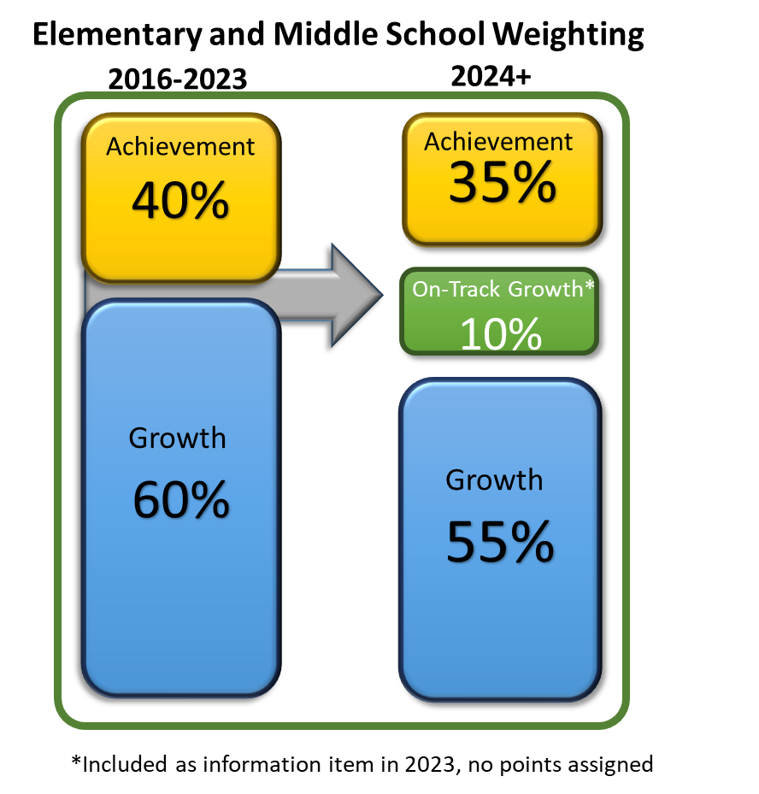
Approved Indicator Weightings for Elementary & Middle School
Points Eligible for On-Track Growth will be the same as for the Achievement and Growth metrics. (All Disaggregated groups combined = ½ All Students group weight)
ELP On-Track measures will move into On-Track Growth indicator.
State board approved revised indicator weightings for elementary & middle schools (see graphic)
Starting to look at high school P/SAT.

Slide 14
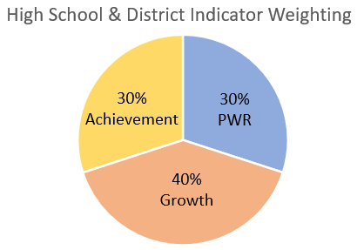
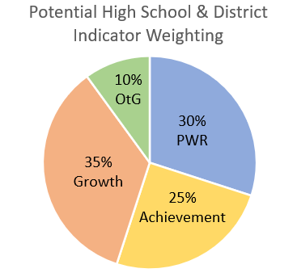
High School & District Indicator Weightings
Current weightings
Would need to investigate and get SBE approval for any revised weightings before adding On-Track to framework

Slide 15
TAP Recommendation
Knowing that On-Track Growth will take longer to roll out at the high school and district levels, how does the TAP recommend moving forward in incorporating the new elementary and middle school On-Track Growth metrics into performance frameworks? Any rationale for a recommendation will be helpful.
Add On-Track Growth to elementary and middle school performance frameworks for informational purposes in 2023 and then for points in 2024.
Note that districts and schools serving high school grades would be unlikely to get informational ratings that include On-Track Growth as indicator weightings still need to be established.
OR
2. Postpone implementation of the new On-Track Growth metric for elementary and middle schools until On-Track Growth is also available for high schools and districts.
Note that student and school/district summary On-Track Growth data could be shared in 2023 but not included on the supplementary 2023 framework calculations and reports which will be released for informational purposes.
OR
3. Some other option?

Slide 16
Break
(5 minutes)

Slide 17
New Higher Bar Sub Indicators Feedback Item Marie Huchton

Slide 18
Two New PWR Sub-Indicators
SB17-272- Higher Bar for ELA & Math
Higher achievement levels in ELA and Math, as defined by the State Board, on certain graduation guidelines measures
(Accuplacer, ACT, ACT Work Keys, AP, ASVAB, Concurrent Enrollment, IB, SAT).
HB18-1019- Higher Bar for Non-ELA/Non-Math
Successful completion of AP, IB, and/or Concurrent Enrollment for non-ELA and non-Math courses.
AP examination score of 3 or higher
IB examination score of 4 or higher
CE course grade of B or higher

Slide 19
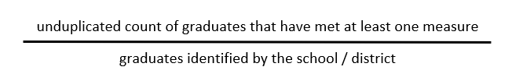
PWR Sub-Indicator Calculation Methodology
At the February 2021 meeting, TAP recommended using the same calculation methodology for both sub-indicators: Graduation Guidelines reporting is required for graduates Consistency in the denominator between the two sub-indicators Counting at graduation allows for a complete dataset across the state
About 85% of IB examinations are taken in the final year of high school About 65% of AP examinations are taken in the final two years of high school A graduate is counted in the numerator if they met the requirement at any time during grades 9-12.
Notes:
Ensures that concurrent enrollment data collected via graduation guidelines includes all students who met the requirement at any time during high school will be counted as a success

Slide 20
Data Build for Higher Bar and Non-ELA/Math Metrics
Advanced Placement Exams
Aggregated student level file. Contains 1 student record from each contributing file that provides “best-of” outcome for that data stream.
International Baccalaureate Exams
Unique by Student ID. Includes “best-of” numerator value from all available files for Higher Bar metric and Non-ELA/Math metric
Concurrent Enrollment from CDHE
Grad Guidelines Collection
Matriculation File to establish denominator
CO SAT

Slide 21
SASID counts for 2021 and 2022 Cohorts by Measure
* the 2021 cohort SAT counts are so low because state testing was canceled in spring 2020 due to the pandemic when most 2021 grads would have been in 11th grade
Also note that measure counts include duplicate records and do not add up to the unique student total

Slide 22
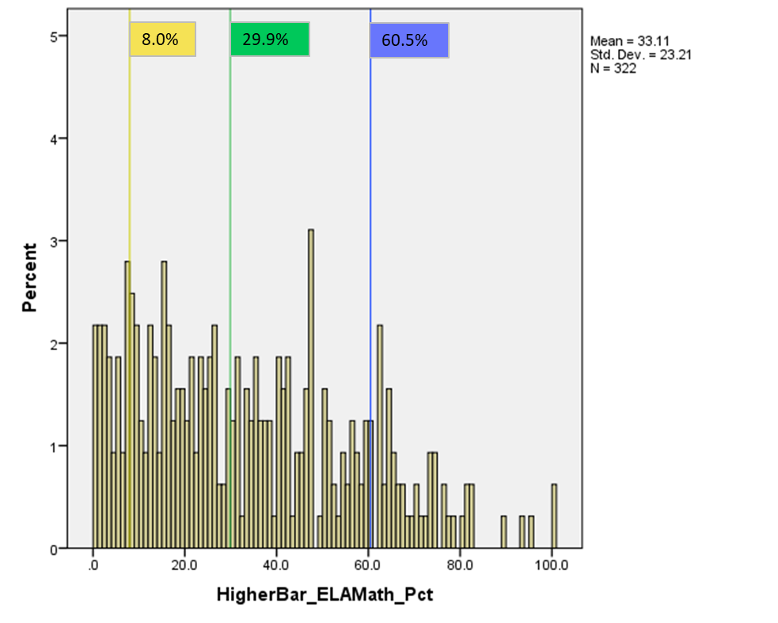
2021 Distribution of Schools by Percent of Students Meeting ELA & Math Higher Bar
Note that AECs and schools with less than 16 graduates in 2021 are excluded

Slide 23
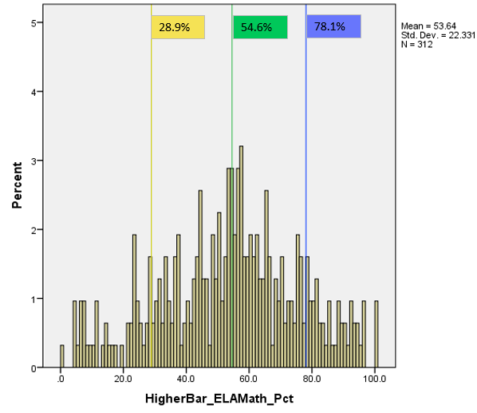
2022 Distribution of Schools by Percent of Students Meeting ELA & Math Higher Bar
Note that AECs and schools with less than 16 graduates in 2022 are excluded

Slide 24
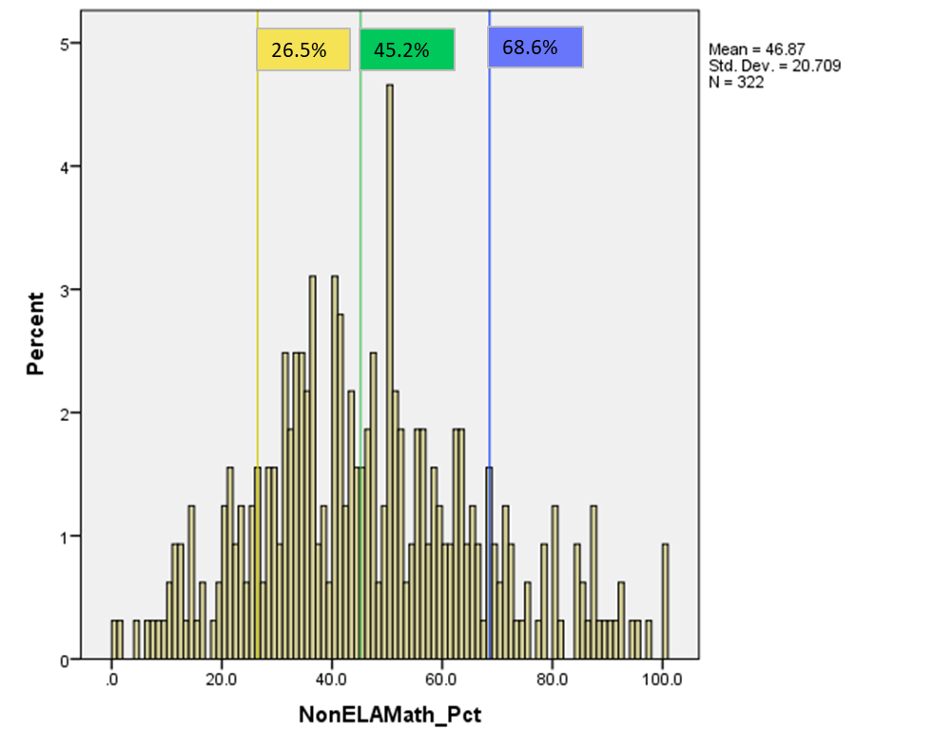
2021 Distribution of Schools by Percent of Students Meeting Non-ELA/Math Higher Bar
Note that AECs and schools with less than 16 graduates in 2021 are excluded

Slide 25
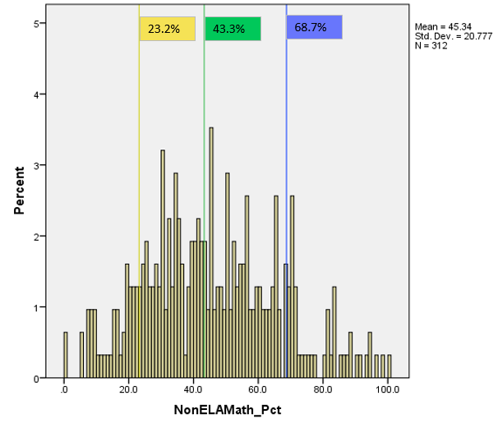
2022 Distribution of Schools by Percent of Students Meeting Non-ELA/Math Higher Bar
Note that AECs and schools with less than 16 graduates in 2022 are excluded

Slide 26
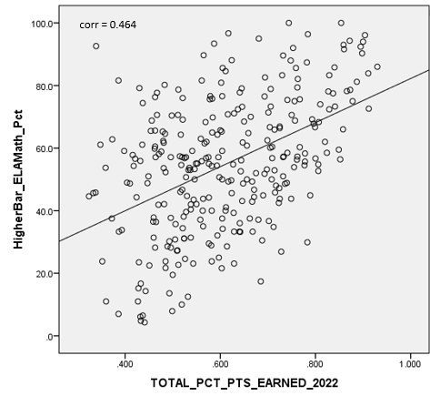
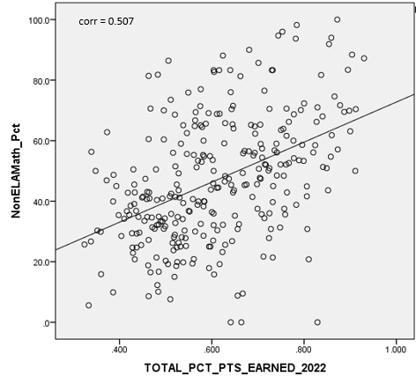
2022 Higher Bar Correlations to Framework Total Percent of Points Earned
Note that AECs and schools with Insufficient State Data ratings in 2022 are excluded
Notes:
Don’t talk through in detail- compared to 2021 HB results, 2022 show higher correlations with overall framework outcomes,

Slide 27
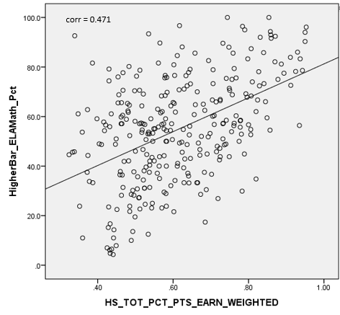
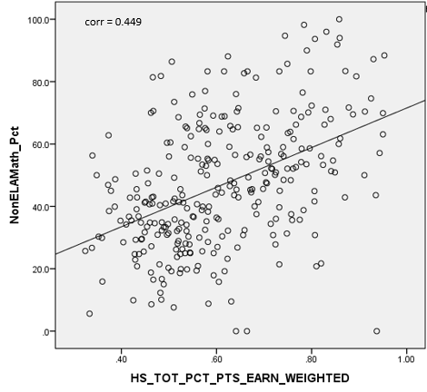
2022 Higher Bar Correlations to High School Total Percent of Points Earned
Note that AECs and schools with Insufficient State Data ratings in 2022 are excluded

Slide 28
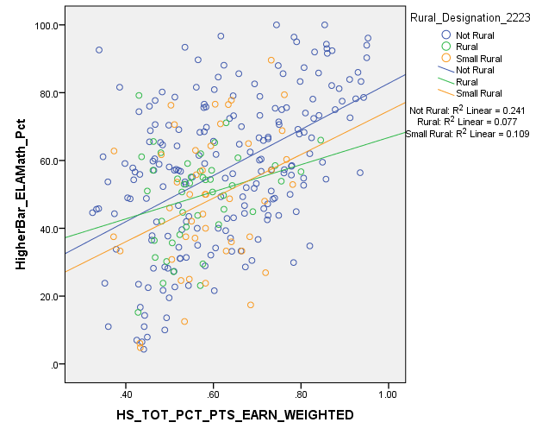
2022 Higher Bar Correlations to Framework Total Percent of Points Earned by Rural Designation
Note that AECs and schools with Insufficient State Data ratings in 2022 are excluded

Slide 29
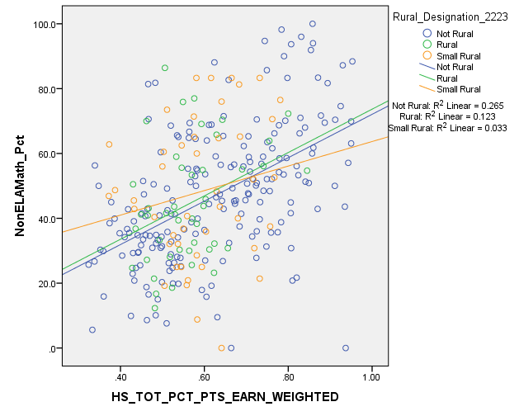
2022 Higher Bar Correlations to Framework Total Percent of Points Earned by Rural Designation
Note that AECs and schools with Insufficient State Data ratings in 2022 are excluded

Slide 30
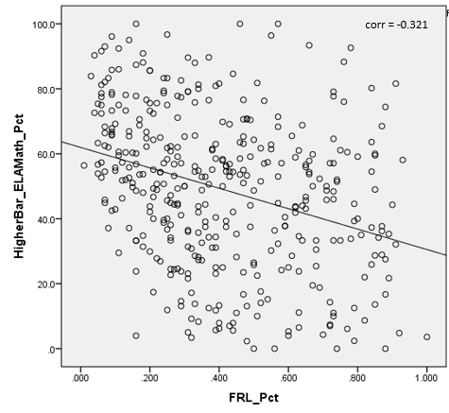
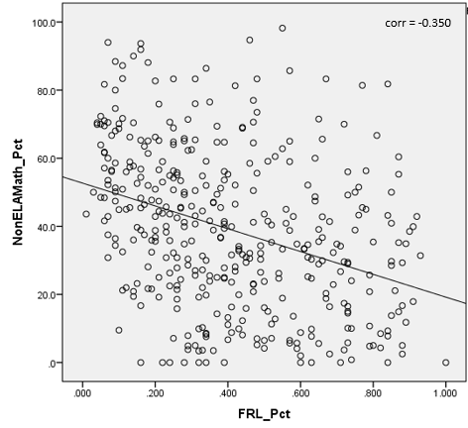
2022 Correlations to School Demographics- Percent Eligible for Free- or Reduced-Price Lunch Programs
Note that AECs are included

Slide 31
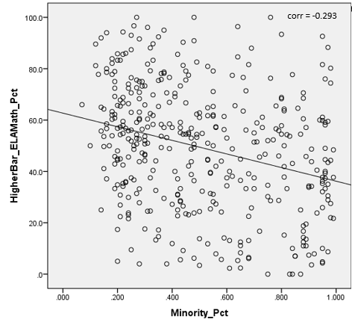
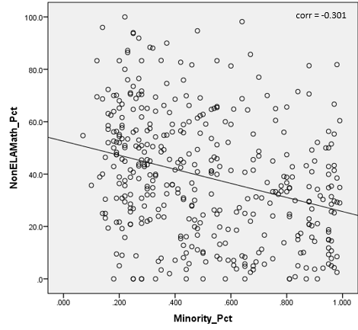
2022 Correlations to School Demographics- Percent of Minority Students
Note that AECs are included

Slide 32
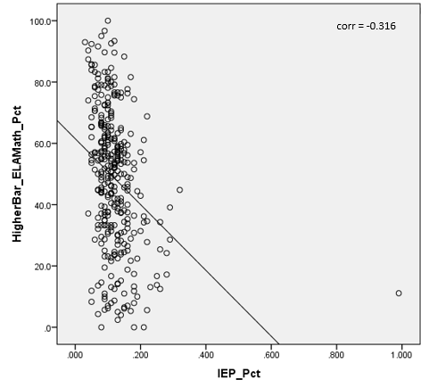
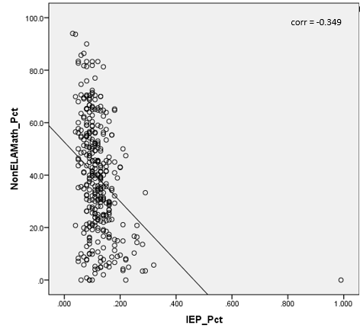
2022 Correlations to School Demographics- Percent of Students with Disabilities
Note that AECs are included

Slide 33
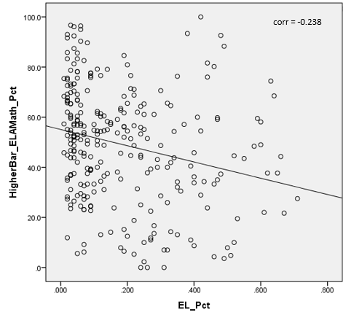
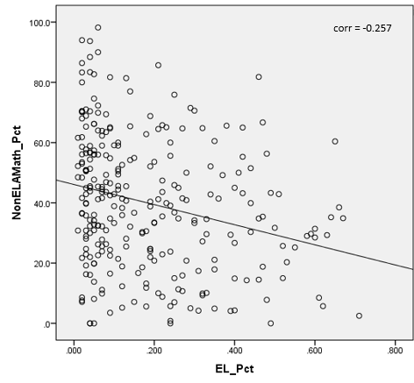
2022 Correlations to School Demographics- Percent of English Learners
Note that AECs are included

Slide 34
Potential PWR Weighting Scenarios
Investigated 3 potential scenarios for incorporating the new PWR metrics- 1 point, 2 points, or 4 points for All Students Group and no points for disaggregated groups
 | All Students |  | Disaggregated
SAT EBRW | 4 |  | 4
SAT Math | 4 |  | 4
Dropout Rate | 8 |  | 8
Matriculation Rate | 4 |  | --
Graduation Rate | 8 |  | 8
 | Current | 1 Point | 2 Points | 4 Points
Higher Bar ELA & Math | -- | 1 | 2 | 4
Higher Bar Non-ELA/Math | -- | 1 | 2 | 4
Total PWR Points | 52 | 54 | 56 | 60

Slide 35
High School & District Indicator Weightings
Weightings used in the current analyses.
Don’t forget, something like this may be coming in future years.

Slide 36
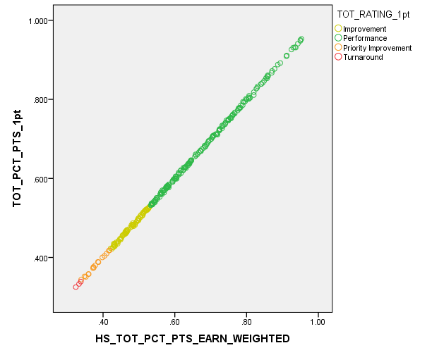
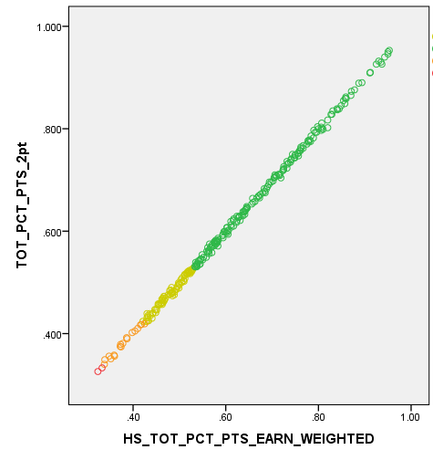

2022 School Level Impact Data by Potential Weighting Scenario (adding 2022 Higher Bar Data)
1 Point
2 Points
4 Points

Slide 37
2022 School Level Impact Data by Potential Weighting Scenario (adding 2022 HB Data)

Slide 38
Comparison of Demographic Characteristics based on 4pt Higher Bar Impact Results

Slide 39
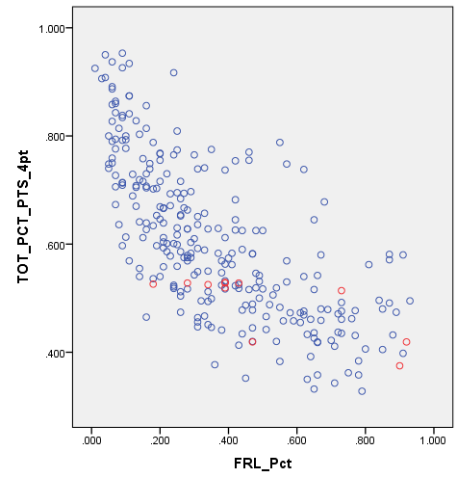
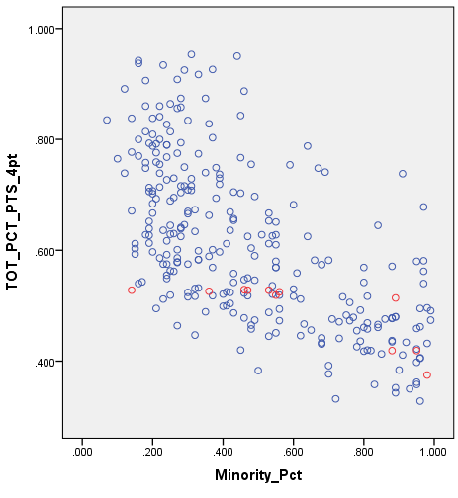
Comparison of Demographic Characteristics based on 4pt Higher Bar Impact Results
% Free- or Reduced-Price Lunch
% Minority
Same Avg = 49.2%
Decrease Avg = 54.5%
Same Avg = 59.8%
Decrease Avg = 65.7%

Slide 40
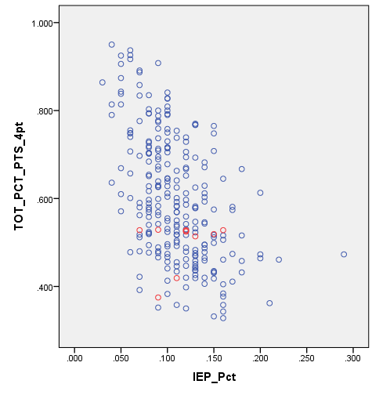
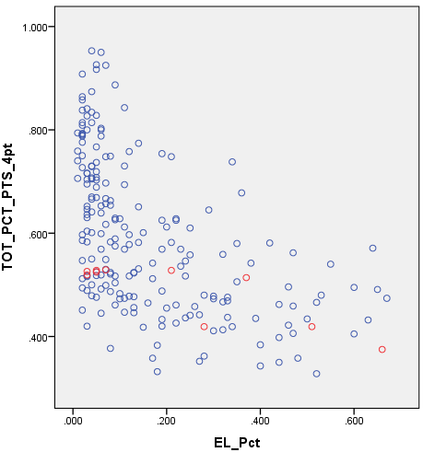
Comparison of Demographic Characteristics based on 4pt Higher Bar Impact Results
% Students with Disabilities
% English Learner
Same Avg = 11.3%
Decrease Avg = 12.3%
Same Avg = 29.7%
Decrease Avg = 41.9%

Slide 41
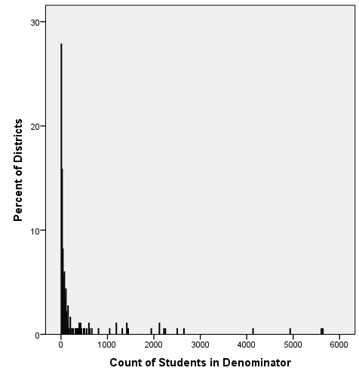
2022 Distribution of District N-counts Included in Matriculation Rate
Note that almost 30% of districts did not meet the minimum reporting N of 16 for matriculation rate.
This means these districts will not have results for either of the new Higher Bar measures

Slide 42
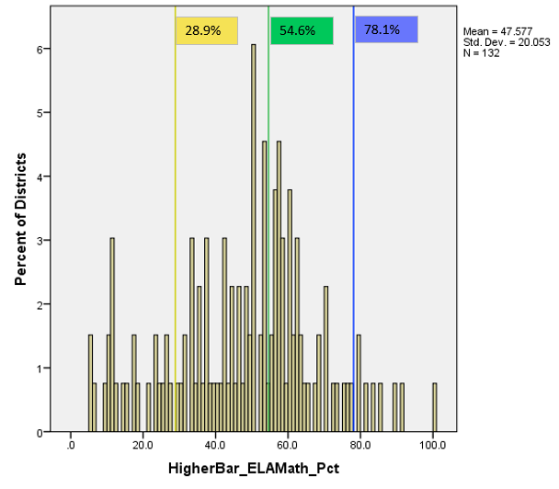
2022 Distribution of Districts by Percent of Students Meeting ELA & Math Higher Bar
Note that the 2022 school level cut-scores have been applied

Slide 43
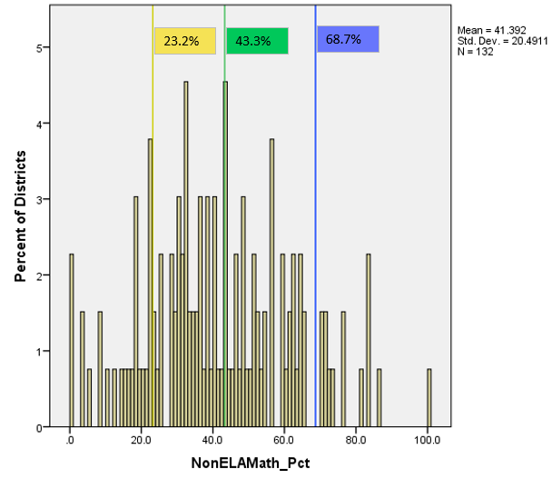
2022 Distribution of Districts by Percent of Students Meeting Non-ELA/Math Higher Bar
Note that the 2022 school level cut-scores have been applied

Slide 44
TAP Recommendation
Does the TAP recommend incorporating the proposed Higher Bar metrics into state accountability reporting for informational purposes in 2023 and for points in 2024?
Which weighting scenario does the TAP recommend?
1 point
2 points
4 points

Slide 45
Request to Reconsider Feedback Item Lisa Medler & Aislinn Wales

Slide 46
Objectives
Given transitions (e.g., pandemic, Commissioner search) and intentional effort from CDE to refine and streamline the request to reconsider process, CDE wants to consult TAP on CDE’s guiding principles for request to reconsider
Do these principles make sense?
Is there any principle that needs to be removed or added?

Slide 47
Guiding Principles of the Request to Reconsider (R2R) Process
CDE will ensure the request to reconsider process will be…
Principle 1: Clear, transparent and accessible
Principle 2: Rigorous and upholds state accountability expectations
Principle 3: Logical and provides feasible pathways for districts to submit their request
Principle 4: Evaluated often to ensure the least amount of burden for districts
Principle 5: Timely (CDE will provide recommendations to the SBE by the December board meeting so ratings can be considered final)

Slide 48
Principle 1: Clear, transparent and accessible
Examples of this principle in practice:
State Board of Education provides the parameters through SBE rules. CDE provides additional detail and instruction through guidance (e.g., R2R Handbook).
CDE staff is responsive to questions or concerns about the process. Office hours and individual technical assistance is available.
Guidance clearly outlines all conditions, deadlines, and their criteria for success.
Local Assessment Tool and Matriculation Body of Evidence Request Template clearly identifies whether a request meets the required conditions.
Increases transparency on whether data is sufficient for an improved plan type
Minimizes the level of effort required for sites with clearly identified criteria and reduces time
Clarifies what assessment data (if applicable) is accepted for this process and sets up Local Education Agencies (LEAs) to submit accurate and valid forms of data
Shortens the timeline for CDE to approve requests

Slide 49
Principle 2: Rigorous and upholds state accountability expectations
Examples of this principle in practice:
State assessment data ensures comparability between districts and alignment to state standards. Local data is not appropriate to supplant state data.
CDE should consult with stakeholder groups (e.g., TAP) on the guiding principles and changes in the pathways before the request to reconsider process begins.
Growth data must be interpreted alongside achievement data to provide an accurate picture of school and district performance. CDE does not accept growth data from local assessments for any grades tested with state assessments (including 3rd grade).
Updated Local Assessment Tool:
Does not accept locally-produced interim assessments, interim assessments must be nationally normed and aligned with Colorado Academic Standards to be included
95% participation required on local assessments
New Matriculation Body of Evidence Request Template:
Calculations reflect unduplicated student counts in the numerator and must include appropriate documentation of matriculation (e.g., transcript, email, letter)

Slide 50
Principle 3: Logical and provides feasible pathways for districts to submit their request
Examples of this principle in practice:
Differentiation between requests to reconsider (e.g., Body of Evidence, Calculation Error), district actions (e.g., New Schools, Insufficient State Data: Small Tested Population, Insufficient State Data: No Students At Grade Levels Tested), and CDE actions (i.e., “administrative changes” – only in special circumstances).
Changes to framework ratings are tracked internally in CDE’s data warehouse and externally with the district using the Accreditation Portal
Include criteria for success in guidance documents and provide examples of previous requests.

Slide 51
Principle 4: Evaluated often to ensure the least amount of burden for districts
Examples of this principle in practice:
Initial accreditation form submission includes an assurance instead of Superintendent and Board Chair signatures.
LEAs are not required to submit a draft request.
LEAs can determine whether their request meets the required conditions through the CDE website materials on their own, which informs the decision on whether to invest resources and time.
Wherever possible, CDE will provide calculations to LEAs and lift the burden of providing state data (e.g., impact of Alternative Education Campus data on the District Performance Framework).

Slide 52
Principle 5: Timely (CDE will provide recommendations to the SBE by the December board meeting so ratings can be considered final)
Examples of this principle in practice:
Increasing transparency for LEAs and schools makes the review process less burdensome for CDE staff.
Allows CDE leadership to view decision rationale weeks before the deadline for board materials
Allows CDE staff to complete board materials in advance of the deadline
CDE staff communicates decisions in advance of the board meeting to LEA and school staff.

Slide 53
TAP Recommendation
Do these principles make sense?
Is there any principle that needs to be removed or added?

Slide 54
Participation Descriptor Feedback Item Lisa Medler

Slide 55

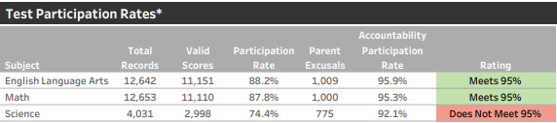
Participation Reporting Changes on Framework
Note: “Decreased Due to Participation” will still be listed with the plan type.
Current Framework:
Sample Changes:
Accredited
Test Participation Rates and Total Participation Descriptor*
Total
Total Participation Rate Descriptor for informational purposes
Low Participation
(*) Under state accountability policy, 95% of students must participate in state assessments. Students who are excused from testing by a parent or guardian do
not impact the Accountability Participation Rate that is used to determine whether districts and schools meet this requirement.
(*) Under state accountability policy, 95% of students must participate in state assessments. Students who are excused from testing by a parent or guardian do not impact the Accountability Participation Rate that is used to determine whether the overall rating is reduced by one level. Districts or schools with less than 95% total participation in ELA and Math receive a “Low Participation” descriptor to help readers consider when interpreting accountability data. This descriptor does not impact framework calculations.
Images for discussion - not approved changes

Slide 56
TAP Recommendation
Does the TAP recommend incorporating these participation changes in state accountability reporting for 2023?

Slide 57
Technical Advisory Panel
Meeting Summary
Suggested future analysis
TAP recommendations from this meeting
Public Comment
Close Meeting
Next Scheduled Meeting: TBD

