Slide 1
Technical Advisory Panel Meeting
April 18, 2024

Slide 2
Welcome & Introductions
Welcome from CDE
The purpose of the TAP is to provide non‐binding technical recommendations to CDE regarding the Colorado Growth Model, state accountability, and other topics as needed.
Meeting Logistics:
Non‐members, please add your Name/Affiliation to the chat box.
Everyone please mute your sound.
We ask all non‐TAP members to hold any comments until the end of the meeting. We do this to ensure we have sufficient time to address all meeting agenda items.
Introductions with Ryan Marks, TAP Chair

Slide 3
Agenda for Today
Welcome and Introductions
Information Item
CMAS Science - Marie Huchton & Aislinn Wales
Feedback Item
Accountability Updates – Lisa Medler
Information Item
Taskforce Updates and Stakeholder Discussion – Lisa Medler & Ryan Marks
Feedback Item
On Track Growth Reporting - Aislinn Wales & Lisa Steffen
Feedback Item
Wrap-Up

Slide 4
CMAS Science Feedback Item Marie Huchton & Aislinn Wales

Slide 5
Setting the Stage for Science in 2024 Performance Frameworks
In November 2023, the State Board of Education voted to re-introduce science achievement in the 2024 frameworks.
Last included in frameworks in 2019. Paused due to pandemic, and adoption of new state standards and launch of new science assessment.
In January 2024, CDE released informational data to districts to see how 2023 plan type assignments would have shifted if science achievement had been included. A commitment was made to further examine the impact of the participation data and consult with the TAP.
CDE has already announced that science participation will not be used in calculating accountability participation in 2024. This means a plan type will be decreased one level only if both ELA and math are below 95% accountability participation after parent excusals are removed.

Slide 6
Defining “For Informational Purposes”
For informational purposes only:
Informational data does not get reported in performance frameworks and is not eligible for inclusion in the request to reconsider process.
Example process:
Informational Data is Shared with Districts
Measure is Included for Points in Frameworks
Measure Continues to be Reported in Frameworks
1 year later
1 year later
Measure is not included in frameworks. It is up to the district’s discretion whether to share informational data more broadly.
Request to reconsider will not consider informational data. New measures may be removed through request process.
Data is included for points. No request to reconsider option.

Slide 7
TAP Recommendation
TAP Feedback-
Does the TAP agree with CDE’s proposed definition of “for informational purposes”?

Slide 8
Accountability Takeaways from Last TAP Meeting
About 96% of schools and districts would receive the same rating when including Science Achievement data. About 3% would see increased ratings and 1% decreased ratings.
For high schools, white, female and non-FRL students opted out at disproportionately higher rates. In general, these demographic groups show higher levels of achievement than historically disadvantaged student groups.
As the accountability sub-indicator ratings are normed based on the observed tested population, it's likely that the high school cuts from 2023 are lower than they would have been if all students tested.
This also means schools/districts with better representativeness may receive slightly higher Science Achievement ratings.
This aligns with the general finding that more schools and districts would receive increased ratings with the inclusion of science.

Slide 9
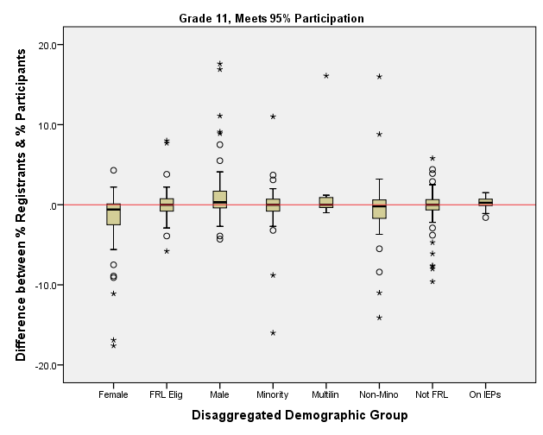
Follow Up Analysis- Distribution of the Difference between % Registrants and % Participants (School-Level, Meets 95% Participation)
Schools with 95% or more of registered students participating in testing tend to have good representativeness among demographic groups
Males and students on IEPs were slightly over-represented
Females were slightly under-represented

Slide 10
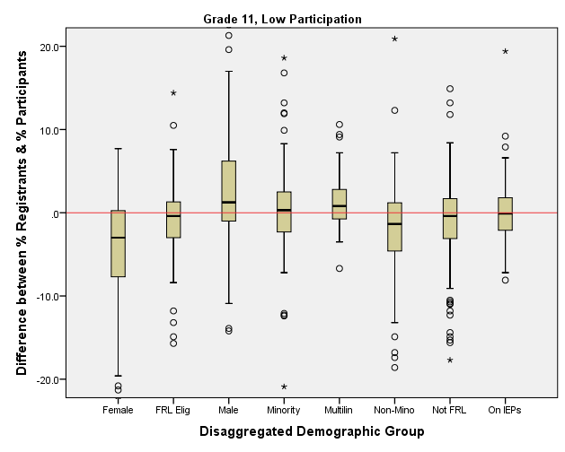
Follow Up Analysis- Distribution of the Difference between % Registrants and % Participants (School-Level, Less than 95% Participation)
Schools with less than 95% of registered students participating in testing have more variable representativeness among demographic groups
Females and non-Minority students were likely to be under-represented

Slide 11
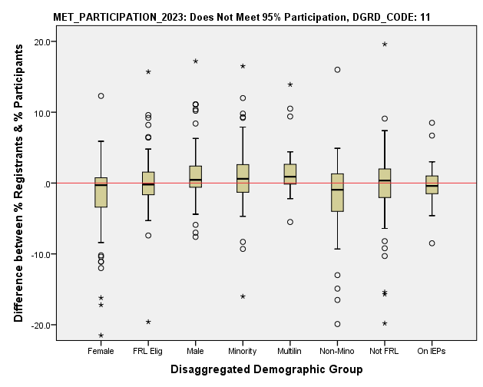
Follow Up Analysis- Distribution of the Difference between % Registrants and % Participants (School-Level, Decreased due to Participation)
Schools that had their overall rating decreased due to low participation have more variable representativeness among demographic groups
Males, Minority and Multilingual learners were likely to be over-represented
Non-Minority students were likely to be underrepresented

Slide 12
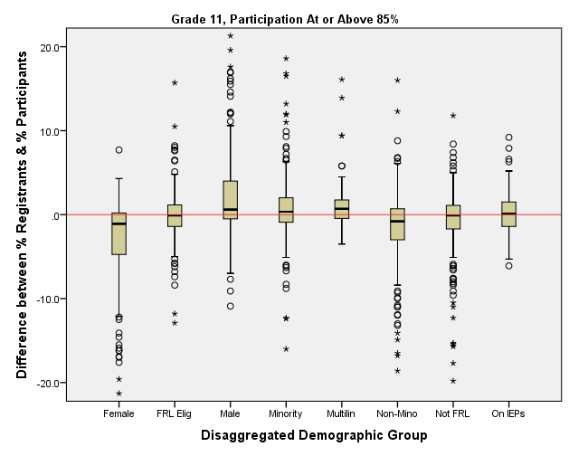
Follow Up Analysis- Distribution of the Difference between % Registrants and % Participants (School-Level, At or above 85% Participation)
Schools with 85% or more of registered students participating in testing tend to have good representativeness among demographic groups
Females and non-Minority students were somewhat under-represented
Males, Minority students, and multilingual learners were slightly over-represented

Slide 13
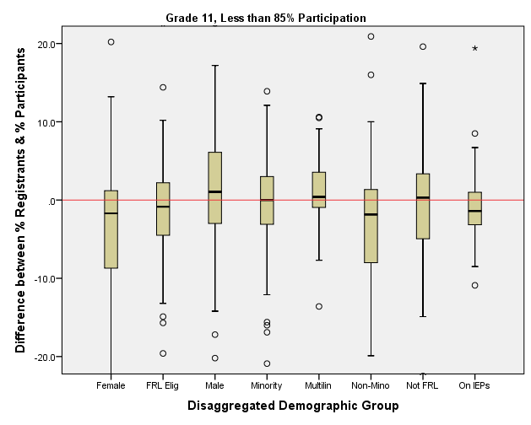
Follow Up Analysis- Distribution of the Difference between % Registrants and % Participants (School-Level, Below 85% Participation)
Schools with less than 85% of registered students participating in testing had more variable representativeness among demographic groups
Females, non-Minority, and students on IEPs were under-represented, as well as FRL students to a lesser degree
Males were over-represented with multilingual learners and non-FRL students also slightly over-represented

Slide 14
CDE Considerations
Science achievement is legislatively required to be included in performance frameworks but will not contribute to Decreased Due to Participation penalty for 2024
Not surprisingly, schools with lower levels of overall test participation had more variable levels of representativeness across demographic groups
Concerns about setting a precedent that test data with low participation rates can be removed from accountability calculations
In the past, districts and schools have sometimes been able to submit a request to reconsider (R2R) to remove the impact of a new measure in the first year it is included for points (e.g. WIDA ACCESS 2.0 Growth)
AEC attendance and truancy don’t qualify as new for 2024 (measures did not change, only excluded due to timing issues in 2023) and will not be eligible for R2R

Slide 15
Proposed Approach for TAP Feedback
In recognition that this is the first year the new Science achievement measure will be included for points on the state accountability frameworks, districts and schools could use a request to reconsider to remove the impact of this measure for 2024. This would only be available for one year and would not be dependent upon overall or disaggregated group participation rates.
TAP Feedback-
Does the TAP support the proposed approach? If not, what is the TAPs alternate recommendation?

Slide 16
Revised Recommendation
Recommendation:
Continue with current request to reconsider conditions.

Slide 17
Accountability Updates Information Item Lisa Medler

Slide 18
Overarching Accountability Timeline
2023 Frameworks Released
1241 Task Force Begins*
Fall 2023
2023 Supplemental Framework Report
Winter 2024
Spring 2024
Interim Report Due
2024 Framework with New Measures for Points
Final Report Due
Fall 2024
* Per HB23-1241

Slide 19
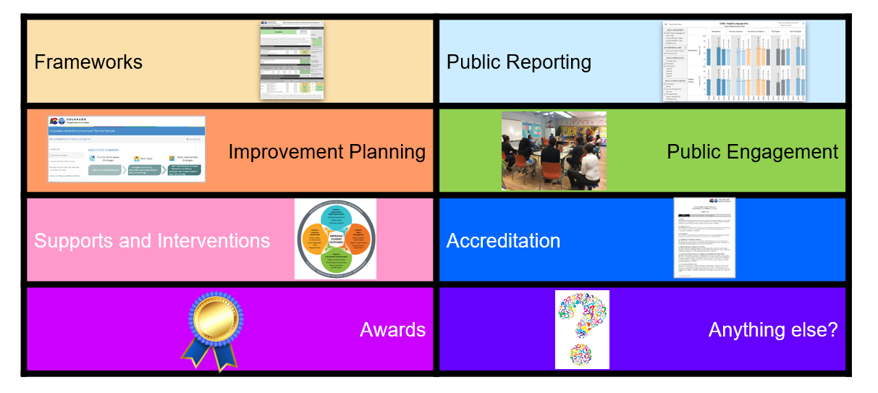
Elements of the Current State Accountability System

Slide 20
Reminders on Changes for 2024 Accountability
Accountability Elements
Performance Frameworks
Public Reporting
Improvement Planning
Stakeholder Engagement
Supports & Interventions
Accreditation
Awards
Performance Frameworks
CMAS Science Achievement for all schools, including disaggregated groups
Attendance and Truancy rates for Alternative Education Campuses (AECs)
Informational Frameworks with these measures included for points were released to district accountability contacts on January 31 via Syncplicity.
Plan is to officially include these measures for points for fall 2024.
Recent clarifications on newcomers and implications for accountability
State Board of Education voted to delay inclusion of On Track Growth indicator and higher bar sub-indicators for Postsecondary and Workforce Readiness.
CDE will release On Track Growth data for elementary and middle school levels for informational purposes to support school improvement efforts.
Improvement Planning
Option to use new streamlined UIP template. Rollover scheduled for April 15 for the 2024-25 plans.
More details are available in 2024 Accountability Changes Summary
Notes:
Marie

Slide 21
Newcomer Multilingual Learners (MLs)
Newly Arrived Multilingual Learners for Accountability Purposes: Students with a language proficiency designation of Non-English Proficient (NEP) or Limited English Proficient (LEP) who are recently or newly arrived to U.S. schools within the last 12 months. A subset of Newly Arrived MLs of interest this year includes students with limited or interrupted formal education (SLIFE) who first enrolled in a U.S. school after October 1 of the current school year.
New Resource:
Newly Arrived Multilingual Learners - Performance Framework Implications fact sheet

Slide 22
Matriculation Concordance Study Update
We currently have partnerships with three districts and are working on preliminary analyses.
Data collection has been extremely challenging, and we are still in the process of obtaining records for the most recent year from our largest collaborating district.
We will provide results of analyses once we have a more comprehensive data set.
We are seeking at least one additional collaborating district, preferably medium-large enrollment.
Beginning with 2024 frameworks, we are planning to include ASCENT, PTECH, and TREP as a new “Postsecondary Program” pathway for matriculation.

Slide 23
Taskforce Updates and Stakeholder Discussion Feedback Item Lisa Medler & Ryan Marks

Slide 24
H.B. 23-1241: Accountability, Accreditation, Student Performance, and Resource Inequity Task Force
Link to Bill: https://leg.colorado.gov/bills/hb23-1241
Purpose: Creates a representative task force of 26-members that studies academic opportunities, inequities, promising practices in schools, and improvements to the accountability and accreditation system.
Website: https://www.cde.state.co.us/accountability/accountability-task-force
Builds upon: Accountability Audit and the Local Accountability System Grant
Task Force members are working in study groups now focused on frameworks and then will focus on the other accountability elements later this spring.
Gathering stakeholder input now through stakeholder panels and a survey. Go to website for links to access the survey.
Timeline:
July 1, 2023: Task force members appointed
August 15, 2023: Department contracts with a facilitator
No later than September 1, 2023: Convene first meeting
March 1, 2024: Interim report
November 15, 2024: Final report reflecting findings and recommendations to the education committees of the house of representatives and senate, the governor, the state board, the commissioner of education and the department.
Upcoming Meetings:
May 7
June 4
Fall meetings have not yet been set

Slide 25
Draft TAP Principles
Growth data is a highly valued part of the accountability system.
Data included in the accountability system should be verifiable and valid, accessible and transparent.
There should be consistency across grade bands, schools, and districts.
Recommendations should be grounded in empirical analysis when possible.
Recommendations should consider the need for flexibility to adapt to changing contexts across schools.
TAP Feedback-
Link to Google Document

Slide 26
Break (10 minutes)

Slide 27
On Track Growth Reporting Feedback Item Aislinn Wales & Lisa Steffen

Slide 28
On Track Growth in Colorado
Transition to CMAS
Adequate growth measure is retired. CDE is charged with exploring other methodologies in partnership with the TAP.
Pandemic Interrupts HS and District Methodology Conversations
Discussions on how to approach this measure for high schools and districts were paused.
2019
2023
2015
2020
On Track Growth Calculation Methodology Adopted for Elementary and Middle Schools
For grades 3-8: students that are not at grade level and need to Catch Up should be supported to move to the next performance level within two years. Students who are currently meeting expectations and need to Keep Up should be supported to maintain grade level proficiency for the next three years.
State Board votes to Delay Implementation
The State Board of Education voted to delay implementation of the On Track Growth indicator in the performance frameworks until all school levels are available for inclusion. Public reporting of the measure is required in the meantime.

Slide 29
Why We Are Here
CDE is re-introducing On Track Growth into public reports and performance frameworks.
To do this, CDE is creating new reports, resources, and a training and technical assistance plan and we want to make sure the resources are useful, meet the district’s needs, and are timely and relevant.
Today’s conversation will focus on public reporting and technical assistance for On Track Growth next Fall/Winter.

Slide 30
What Are Our Goals
Stakeholders understand the basics of what On Track Growth means, how CDE uses it, and what data it uses.
Stakeholders have a more detailed grasp of how On Track growth is calculated.
District staff can use the data to identify areas of need or understand patterns in their own data to share with their school staff, board, and parent community.

Slide 31
Plans for Reporting
CDE produces student-level growth data files for districts.
CDE will include On Track Growth for elementary and middle school students in student-level reports in the Fall.
CDE has existing public reports that include additional detail on performance framework measures.
CDE will create a public On Track Growth report containing elementary and middle school data in the Fall.

Slide 32
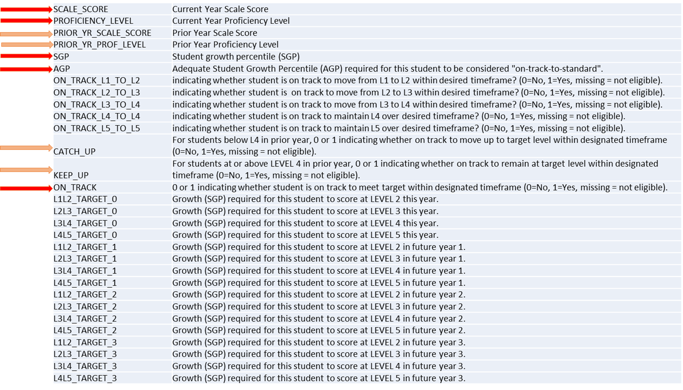
Sample Content of Student Level Data Files - Available to Districts

Slide 33
TAP Recommendation
Using student-level data files, districts would have access to individual student scale scores, growth percentiles, which students are considered “Catch Up”, “Keep Up”, and “On Track”.
TAP Feedback-
Does the student level data file meet your needs? Why or why not?

Slide 34
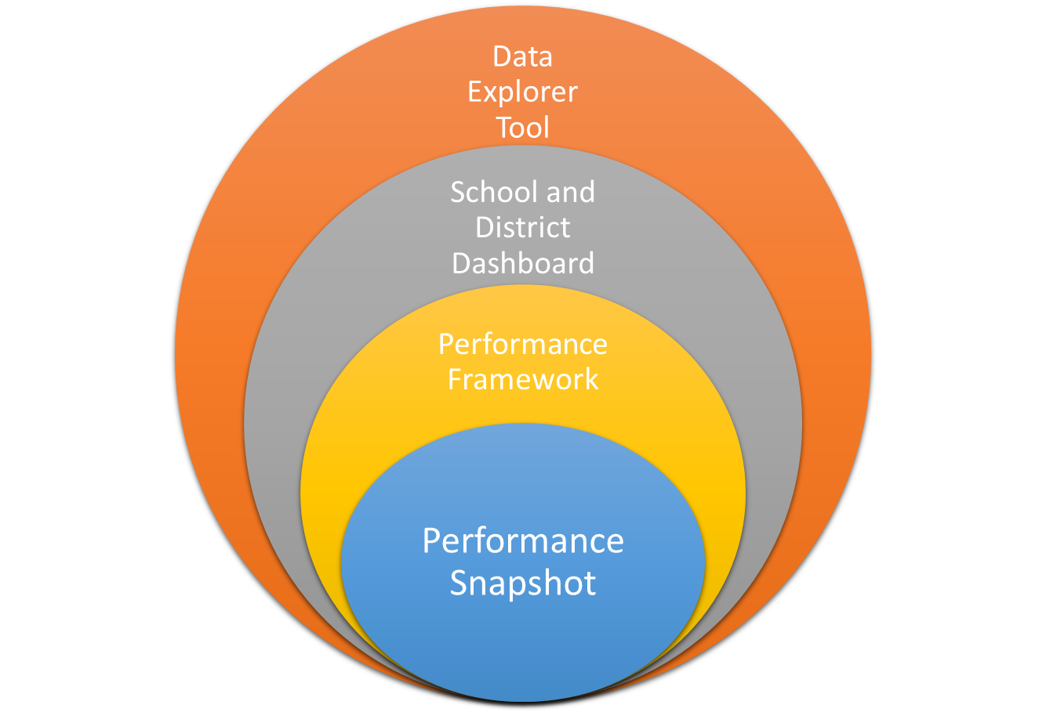
More data
Ability to make comparisons across schools and districts
Ability to look at school/district data trends across years
Ability to understand Identification
Ability to understand Accountability and Continuous Improvement
Less data

Slide 35
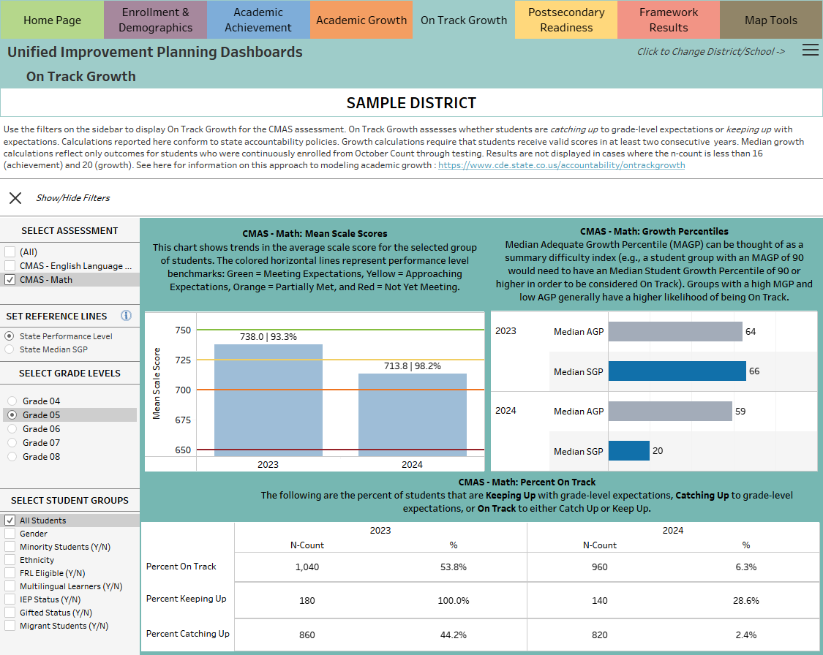
Public Report Sample
Considerations:
Informational
E/M only
Must be public
Will be asking other stakeholder groups for feedback (AWG, SACPIE)

Slide 36
TAP Recommendation
TAP Feedback-
Should the report be embedded in existing tools or used as a standalone dashboard?
Is the visual functional to interpret results? Why or why not?
Does the mock report align with the intended goals?

Slide 37
Technical Assistance Plan for Schools and Districts
CDE will be coordinating the release of the On Track Growth reports and resources with a training and professional development series this summer.
Once On Track Growth is Released in August | Event | Audience
 | Resource Availability Webinar | District staff
 | Growth Modules - virtual | School and District Staff
 | Growth In Person Meetings ? | School and District Staff
 | SAC/DAC Training on Frameworks and Growth Model ? | Members of Accountability Committees

Slide 38
TAP Recommendation
TAP Feedback-
Which training option would you prefer - webinar modules or an in-person option?
What kind of supports would be helpful?

Slide 39
Public Comments and Meeting Close

Slide 40
Technical Advisory Panel
Meeting Summary
Suggested future analysis
TAP recommendations from this meeting
Public Comment
Close Meeting
Next Scheduled Meeting: May 16th, 1-4pm

