Slide 1
2023 Accreditation & Request to Reconsider Webinar
August 17, 2023 - 1:00-2:00pm

Slide 2
Agenda
Brief overview of 2023 state accountability
District and school accreditation process
Accreditation Form Walkthrough
District accreditation contracts
Request to reconsider (R2R)
R2R Submission Walkthrough
Reviewing Requests
Next steps and support
Meeting Norms
This webinar is being recorded. Slides and the recording will be posted to the CDE website. Q&A at the end of this session won’t be recorded.
Please mute your sound if you are not speaking.
Use the chat feature to ask questions throughout the presentation. I will take pause breaks to answer chat questions.

Slide 3
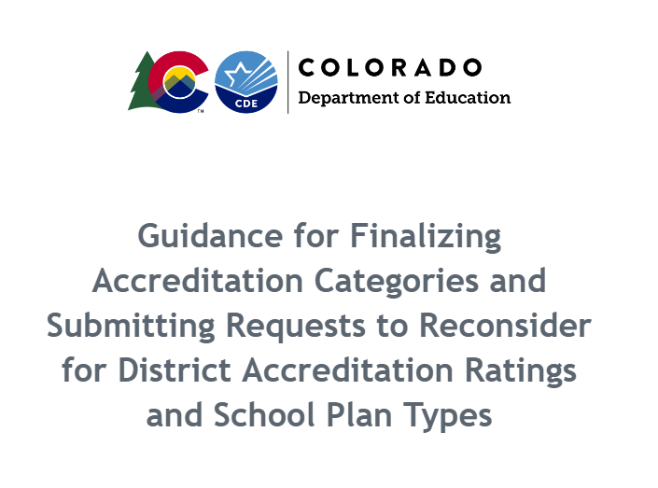
Guidance is Now Available
To access guidance on the accreditation and request to reconsider process, go to https://www.cde.state.co.us/accountability/requesttoreconsider

Slide 4
2023 Accountability Overview

Slide 5
2023 High Level Accountability Changes
Clock progress resumes. Performance frameworks are no longer considered “transitional”.
“Decreased Due to Participation” requirement will be applied in 2023.
Total participation descriptor is moved from the overall rating in the frameworks but still on cover page for reference.
No longer calculating growth participation.
CDE will calculate single-year and multi-year frameworks (multi-year frameworks will represent two years of data) in 2023.
“English Learner” is now “Multilingual Learner” in the performance frameworks.
Captures students that are Non-English Proficient (NEP), Limited English Proficient (LEP), and Fluent English Proficient (FEP) - Monitor Year 1, Monitor Year 2, Exited Year 1, & Exited Year 2.
For additional information, see the Summary Accountability and Improvement Planning Changes for 2023 fact sheet.

Slide 6
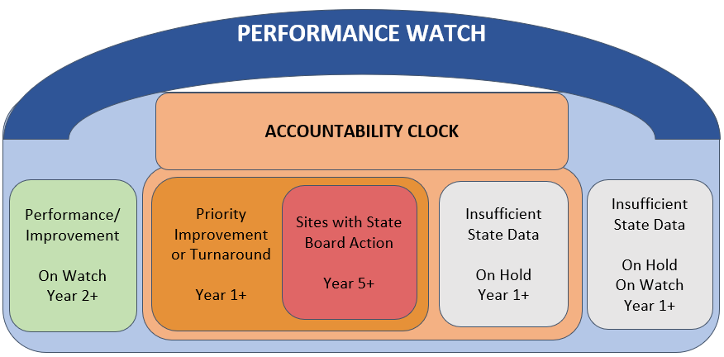
Clock Progress Resumes
In 2023, performance watch identifications (i.e., On Clock, On Watch, On Hold) will be applied once again -- meaning that sites may advance on the clock or begin the exiting process without using request to reconsider.

Slide 7
Current 2023 State Accountability Timeline
Anticipated Timeframe | Activities/Actions
June 29 | Districts Receive ACCESS Growth Data
August 14 | Districts Receive CMAS and P/SAT Achievement, Growth, Participation Data; UIP Data Dashboards available
August 17 (SBE Meeting) | Public Release of Colorado Growth Data Results; Alternative Education Campus (AEC) Designations Finalized
August 15 - August 23 | Districts Receive Matriculation Data
Later in the week of August 21 | Preliminary Performance Frameworks Released to Districts. Public release 3 days later.
Early September | ESSA Identifications (i.e., CS, TS, A-TS) Released to Districts and districts will need to notify schools
Mid-September | AEC Performance Frameworks Released
September 22 | Accreditation Form Submissions Due for ALL Districts
October 16 | Unified Improvement Plan (UIP) Submissions Due Final Request to Reconsider Materials Due (for participating districts)
November 8-9 (SBE Meeting) | District Accreditation Ratings & School Plan Types Finalized for Districts/Schools not participating in request to reconsider
December 13-14 (SBE Meeting) | District Accreditation Ratings & School Plan Types Finalized for Districts/Schools participating in request to reconsider
By December 31 | District Accreditation Contracts Due
January 17, 2024 | Schools and districts participating in request to reconsider eligible to submit UIP for CDE review and posting.

Slide 8
District and School Accreditation

Slide 9
School & District Accreditation Process
State Accredits Districts
August/September
CDE annually reviews performance through school and district performance frameworks
Districts Sign Accreditation Contracts
Districts Accredit their Schools
Districts officially sign off on final district accreditation ratings
Districts can submit a request to reconsider school plan types and district ratings
By December 31st
September/October

Slide 10
District and School Accreditation General Process
August
September
October
November/December
December
CDE reviews performance
Districts review and verify ratings
Districts can request reconsideration
Ratings are finalized by the state board
Districts sign accreditation contracts
The Education Accountability Act of 2009 (S.B. 09-163) and H.B. 18-1355 authorize the Colorado Department of Education to conduct an annual review of the performance of public schools and districts in the state.
Each year, districts have the opportunity to review and verify the state identified district accreditation rating or school plan types.
If the district disagrees with the initial rating/plan type, then additional performance data may be submitted to the department through the request to reconsider process.
Preliminary ratings/plan types and requests to reconsider are approved and finalized by the State Board of Education.
Once the district’s rating and all school plan types are finalized, districts that are rated Improvement or below must sign the district’s accreditation contract. Contracts for districts rated Accredited or above will be automatically renewed unless a new contract is requested.

Slide 11
2023 Accreditation and Request to Reconsider Timeline
The accreditation form opens when preliminary frameworks are released.
See below for details on important dates for this year.
Preliminary Frameworks Released
School and district ratings are released to districts.
Final Request Materials Due
Final request materials (e.g., district narrative, local data) are due.
September 22
November 8-9 & December 13-14
Late August
October 16
Accreditation Form Submissions Due
To initiate the request to reconsider process, the accountability contact will “Request Changed Rating” using the Accreditation form.
District and School Plan Types Finalized during the State Board Meeting
For districts and schools, ratings will be considered final after the state board meeting.

Slide 12
Pathways for State Accountability Rating Adjustments
1
2
3
District Update
Request to Reconsider
CDE Administrative Change
District Action
For schools where the district selects a plan type based on the district’s evaluation of the school’s performance. These include:
New schools with no state data who received a preliminary plan type of “New School”,
Schools with no state data who received a preliminary plan type of “Insufficient State Data: No Students at Grade Levels Tested for State Assessments”, or
Small schools that do not meet the required number of reportable students who received a preliminary plan type of “Insufficient State Data: Small Tested Population”.
Districts that use a District-Created School Performance Framework (prior approval required).
If the district disagrees with a preliminary rating, then additional performance data may be submitted to CDE through the request to reconsider process. The Department will consider the request and review it based on criteria outlined in policy. Request conditions include:
Body of Evidence of Student Performance
Accountability Participation Impact
Calculation Error
Impact of Alternative Education Campuses on the District Performance Framework
Districts with a Single School
Districts with a Closed School
Change to Insufficient State Data
Grade Reconfiguration
The Department can make changes through an administrative change if a school or district meets a rare special circumstance. Special circumstances include issues with school codes, issues with test boxes that impacted participation, and other areas that can not be addressed by other data collections or the request to reconsider process. These changes are considered on a case-by-case basis and must be done in consultation with CDE and the district. These actions may require additional data or information in order to be considered and may not result in changes.

Slide 13
District Updates
District with New Schools
Districts with Insufficient State Data (ISD) Ratings
District-Created Frameworks
Districts must select a plan type using the dropdown for new schools. The plan type should be based on the district’s own evaluation of performance.
For districts and schools labeled “ISD”: The district is not eligible to assign a rating and the site will maintain the ISD rating and any associated clock status.
For districts and schools labeled “ISD: Small Tested Population” or “ISD: No Students at Grade Levels Tested for State Assessments”:
If the site is on Performance Watch, it will maintain the ISD rating and any associated clock status.
If the site is Improvement or higher, districts can select a plan type, based on the district’s evaluation of performance, using the dropdown.
Districts that received past approval to submit a District-Created Framework must provide information about their framework and attach it to the Accreditation form. CDE will defer to the district rating only if (1) the framework is more rigorous than the state framework and (2) the rating shows a lower rating.

Slide 14
Accreditation Form Walkthrough

Slide 15
Accreditation Form| Purpose and Submission
The form’s purpose is to:
Begin the process of finalizing school plan types and district accreditation ratings;
Provide district updates for unique circumstances (e.g., new schools); &
Indicate intent to pursue a request to reconsider.
Accreditation forms are required for all districts and are due September 22 in the Accreditation Portal in the ACI/UIP online system.

Slide 16
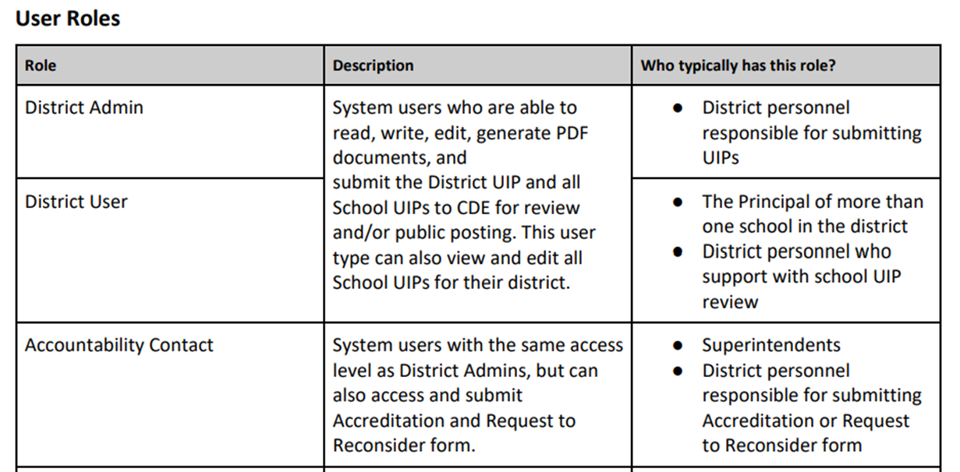
Accessing the Form
Does your district have updated accountability contacts?
Current List of Accountability Contacts
Did your district’s Local Access Manager (LAM) designate your system login role to “Accountability Contact”?
UIP/ACI Online System User Setup Management
Still don’t have access to the form? Contact your district’s LAM to request they change your system login role using this form.

Slide 17
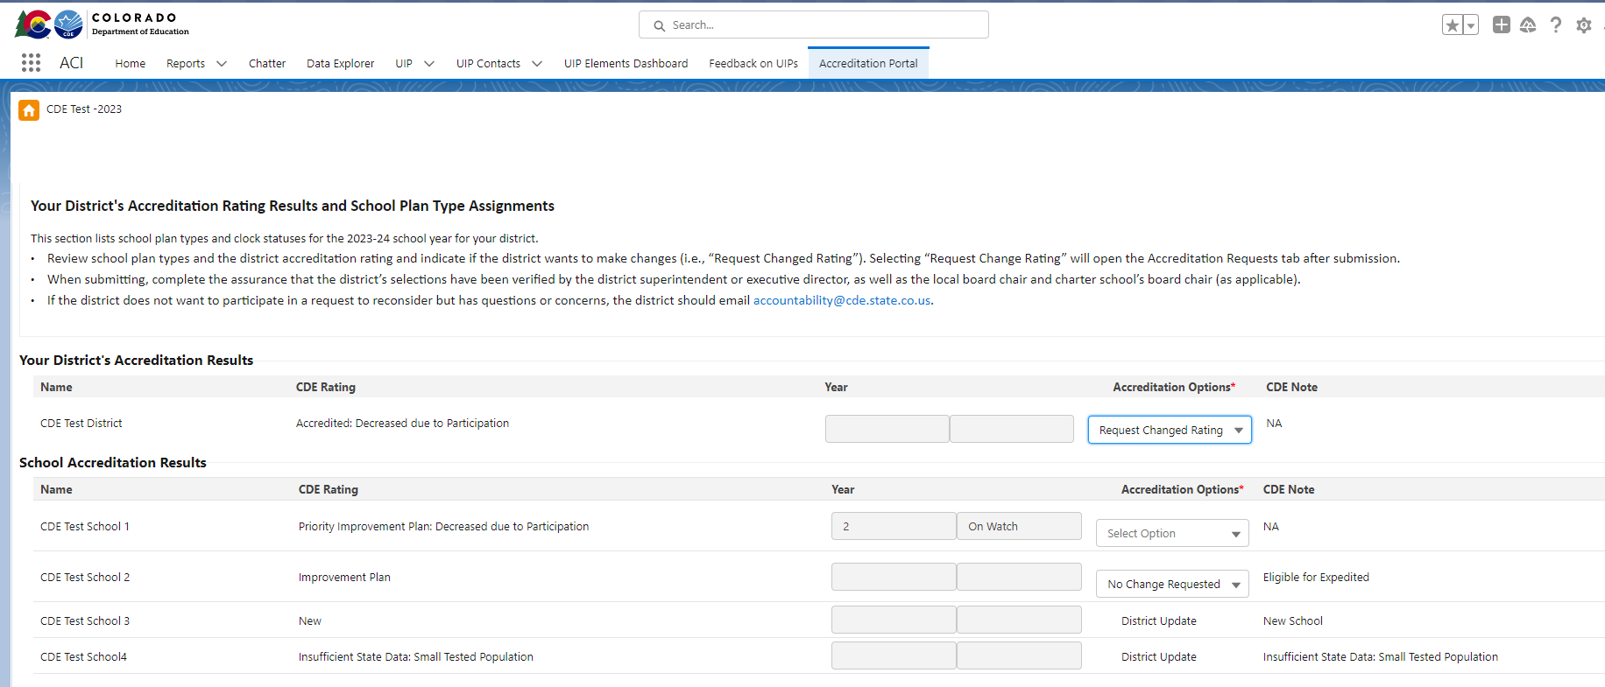
Accreditation Form Walkthrough
Once you have access, this is what you should see when you log-in and click “Accreditation Portal” at the top of the homepage.

Slide 18
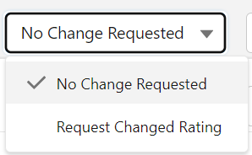
Selecting Accreditation Options for Your District
The form is pre-populated with the preliminary ratings/plan types/clock years for your district.
The form guides users to select the accreditation options available (either selecting a rating from the dropdown or selecting no change requested/request changed rating).

Slide 19
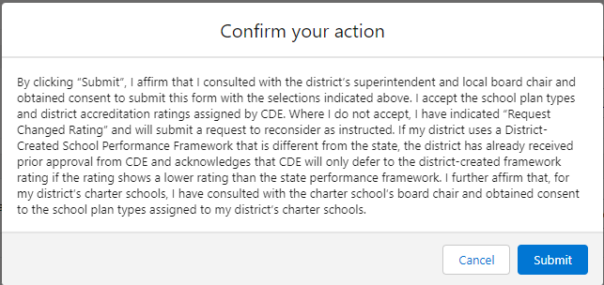
Submitting the Form and Assurance
To submit the form, district accountability contacts need to complete an assurance. The completed form is due September 22.

Slide 20
Checking Form Submission
testemail@email.com
09-22-2023 11:53:55 AM
At the top of the form, your Full Name, Email Address, and the Date of Submission will automatically populate once you successfully submit to CDE. You don’t need to sign the form or email the form to CDE. You can save the form for your records by clicking “Print” at the bottom of the form.

Slide 21
Summary
The completed form is due September 22.
If the district does not submit the form by the deadline, the department will consider the preliminary district accreditation rating and school plan types final and will submit them to the state board for approval.
If no sites in the district are engaging in R2R, no additional materials are needed until ratings/plan types are finalized by the state board in November. Once ratings are finalized, districts that are rated Improvement or lower will need to sign the district’s accreditation contract.

Slide 22
District Accreditation Contracts

Slide 23
District Accreditation Process
District accreditation contracts will be available to superintendents via Docusign once plan types are finalized by the state board in November and December. The contract must be signed by the superintendent and the local board president by the end of December.
Districts Accredited with Improvement, Turnaround, or Insufficient State Data: Contracts must be annually completed.
Districts Accredited or Accredited with Distinction: The existing contract will be automatically renewed unless the district requests an updated contract. CDE recommends that a new contract be signed when there is a new superintendent and/or board president. Otherwise, contracts must be signed at least every five years.

Slide 24
District Accreditation Sample
A sample template of the accreditation contract is available in the District Accountability Handbook (Appendix B), available here: https://www.cde.state.co.us/accountability/accountability-resources.
To find your district’s most recent signed accreditation contract, go to: https://www.cde.state.co.us/accountability/performanceframeworkresults/.

Slide 25
Request to Reconsider

Slide 26
Request to Reconsider | Purpose and Process
Request to reconsider is the district’s opportunity to request reconsideration of a school or district’s preliminary rating based on additional evidence.
The state board adopted rules in 2022 that added an eligibility requirement of 90% total participation on state assessments. This requirement expires in 2023.
Request to reconsider is due October 16.
CDE staff review requests based on criteria outlined in policy.
The state board reviews and finalizes CDE recommendations and approves school plan types.
All formally reviewed requests are public documents.
Approved 2022 Request Example
Preliminary Plan Type:
Body of Evidence request (using K-2 local data), approved by State Board of Education in December
Final Plan Type:

Slide 27
Example Request to Reconsider Results Over Time
Request to reconsider can only result in a rating change by one level (e.g., a change from Turnaround to Improvement is not possible). See below for more examples:
2022 Final Plan Type | 2023 Preliminary Plan Type | 2023 Request to Reconsider Approved? | 2023 Final Plan Type | 2024 Final Plan Type
Priority Improvement - Y3 | Priority Improvement - Y4 | Yes | Improvement - Y3 On Watch | Improvement
Priority Improvement - Y1 | Priority Improvement - Y2 | Yes | Improvement | Performance
Improvement | Improvement | No | Improvement | Priority Improvement - Y1

Slide 28
Decision Tree for Making a Request
Does the school/district meet a condition for a request?
Body of Evidence
Does data meet expectations outlined by CDE (e.g., in the Local Assessment Tool)?
Accountability Participation Impact
Was their rating decreased due to a test misadministr-ation or small n counts?
Calculation
Error
Was a mathematical calculation error presented in their framework?
Impact of AECs on the DPF
Has CDE notified the district of their eligibility for this request?
Districts with a Single School
Has CDE notified the district of their eligibility for this request?
Districts with a Closed School
Does the district have a closed school impacting their rating?
Insufficient State Data (ISD)
Is their total participation below 85% and is an ISD rating a better representatio-n of the site?
Grade Reconfiguration
Has a school reconfigured and the new configuration would result in an improved plan type?
If yes to any box,
If no to any box,
School/district may participate in a request to reconsider in 2023
School/district cannot participate in a request to reconsider in 2023

Slide 29
*CDE will inform districts on their eligibility for this condition.
R2R Condition | Description
Body of Evidence | School/district may provide supplemental evidence (e.g., nationally normed local data, matriculation data, extenuating circumstances) that demonstrates different performance than the preliminary state assignment. To submit additional data, 95% total participation is needed.
Accountability Participation Impact | Districts and schools that had their rating “decreased due to participation” by not meeting the 95% accountability participation rate in English language arts and math may make a request if the requirement was not met due to reasons other than parent refusals (e.g., test misadministration) or due to issues with N counts.
Calculation Error | Districts and schools may submit a request to reconsider based on a mathematical calculation error in the data presented in the performance frameworks. This generally excludes data issues that should have been addressed through the Student Biographical Data (SBD) collection.
Impact of AECs on the District Performance Framework (DPF)* | Districts may request the removal of Alternative Education Campus (AEC) results from overall DPF rating calculation, as long as all AECs have earned Performance ratings in the current year. Districts with only AECs may elect to use the AEC framework rating as the district rating.
Districts with a Single School* | Districts with a single school may elect to use the calculated SPF rating as the district accreditation rating.
Districts with a Closed School | Districts with Priority Improvement or Turnaround accreditation ratings that have closed a school due to low performance may request a recalculated DPF with the results of the closed school removed.
Change to Insufficient State Data | For districts and schools with less than or equal to 85% total participation, a change in plan type to “Insufficient State Data” may be requested if the district can establish that the tested population is not representative of the overall student population.
Grade Reconfiguration | Schools that have changed the grade levels they serve for the 2023-24 school year (e.g., K-8 school that now serve only grades K-5) can request a changed rating based on their new grade configuration.

Slide 30
Submitting a Request
Steps to successfully submit a request:
To initiate, the accountability contact should indicate “Request Changed Rating” for each eligible site and submit the accreditation form by the September 22nd due date.
By submitting the form, “Accreditation Changes” tabs will be triggered. Click on the tabs for each site and begin to compile evidence according to the applicable request condition.
Complete the criteria for each request and click submit or rescind on each tab. All evidence must be submitted by October 16th.

Slide 31
Successful Request Components
In order for a request to be considered, the following must be submitted by the due date:
Accreditation Form and Accreditation Changes Tabs
District Narrative: presents the district rationale for participating in the request process
District narratives are not required for Impact of AECs on the DPF or Districts with a Single School request.
Supplemental Data: data used to verify the district rationale for a change in plan type
Supplemental data templates are required only for Body of Evidence requests.

Slide 32
Request to Reconsider Submission Walkthrough

Slide 33
Accreditation Changes Tab
An “Accreditation Changes” tab will appear for any site where a change was requested or where the district selected a rating from the dropdown.
Verify New School and ISD rating submissions - No additional data needed
Submit request to reconsider materials (e.g., district narrative, data templates)

Slide 34
Completing Request Tabs
Click on the “Accreditation Changes” tab to access the submission portal.
The submission portal includes a dropdown for the type of request being submitted, a request status indicator, a district narrative text box, and an area to upload attachments for each site.

Slide 35
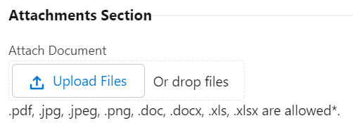
Completing Request Tabs
For any applicable requests, complete the dropdown for the request type, type the district narrative, and upload any attachments (e.g., the Local Assessment Tool template, matriculation documentation and template) before submitting the request for that site.

Slide 36
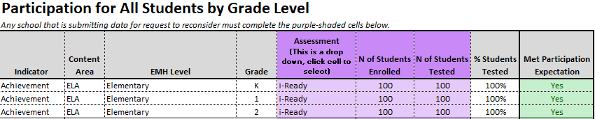
2023 Local Assessment Tool (available on the website with the public release of SPF/DPFs)
1
Enter district and school code.
2
Enter participation and local assessment data.
3
Use the ratings and points tab to see if participation and local assessment data indicates that the site meets the threshold for a request (e.g., local K-2 must be of sufficient quality to increase overall plan type).

Slide 37
2023 Matriculation Template (available on the website with the public release of SPF/DPFs)
1
Enter district and school code.
2
Enter student information for students that were miscoded in the student level data file. Be sure to include how you know they matriculated (documentation source) and include as an attachment in the portal.
3
Use the ratings and points tab to see if additional students in the numerator meets the threshold for a request (i.e., changes to matriculation numerator must lead to an increase in overall plan type).

Slide 38
Submission Considerations | FAQ
Should the district wait to submit the accreditation form until request to reconsider analysis is complete?
When submitting the Accreditation form, select “Request Changed Rating” for any site you’re considering for a request. Once you conduct any necessary data analysis (e.g., Local Assessment Tool) and verify a school doesn’t meet the threshold for a request, you can always rescind the request in the Accreditation Changes tab. If you rescind, the school would keep their preliminary rating and the request wouldn’t be included as a part of the public record.
What should a district narrative include?
District narratives should include the condition of the request and a description of any relevant data analysis or rationale associated with the request. Sample templates are available at the request to reconsider website. District narratives average around 2-5 pages.
What happens if a request is approved?
If a request is approved, the approved plan type is included in the final version of the performance frameworks and any associated reports (e.g., data dashboards). None of the data in the performance framework itself will change. The final rating may impact clock expectations (e.g., planning requirements) and supports (e.g., EASI grant eligibility), depending on the type of change.

Slide 39
Submission Considerations | Districts with AECs
AEC ratings will be released in September prior to September 22 (when the Accreditation Form is due)
Beginning in 2022, AECs are eligible for some request types (i.e., Calculation Error or Change to Insufficient State Data Rating)
Districts that are considering an Impact of AECs on the DPF request or individual AEC requests should wait until AEC ratings are released to submit the Accreditation Form
If your district submits the Accreditation Form prior to the release of AEC ratings, this indicates to CDE that no additional requests to reconsider will be pursued

Slide 40
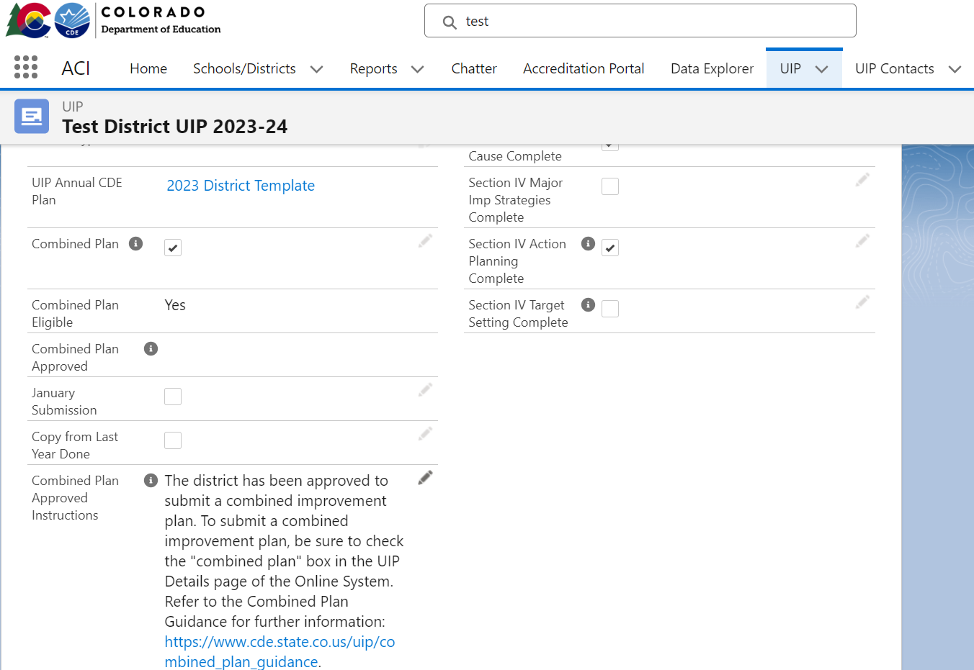
Submission Considerations | Unified Improvement Plan Flexibility
Optional: Districts can submit UIPs in January for any site participating in request to reconsider.
These selections are on the landing page of the school’s UIP. (New!)
See January Submission guidance for details.
Note: January eligibility won’t appear until after performance framework ratings are released.

Slide 41
Reviewing Requests

Slide 42
Reviewing a Request
Cross-unit CDE team reviews requests
The review will be conducted by a cross-unit CDE team. CDE staff will evaluate the extent to which the request meets the conditions and criteria and whether the additional evidence supports a different rating.
CDE staff makes recommendations to the Commissioner
The staff will then make a recommendation to the Commissioner as to the district’s final accreditation rating and/or school plan type.
The Commissioner requests approval from the board
The Commissioner will request the state board to approve the department’s recommendations on ratings, plan types, and/or clock status at the State Board of Education meeting in December.

Slide 43
Guiding Principles for the Request to Reconsider Process
CDE will ensure the request to reconsider process is…
Principle 1: Clear, transparent and accessible
Principle 2: Rigorous and upholds state accountability expectations
Principle 3: Logical and provides feasible pathways for districts to submit their request
Principle 4: Evaluated often to ensure the least amount of burden for districts
Principle 5: Timely (CDE will provide recommendations to the SBE by the December board meeting so ratings can be considered final)

Slide 44
Summary – R2R
The department will only consider requests that meet one or more of the conditions for a request to reconsider as outlined in the policy guidance document.
Requests will not be considered if the request is to change individual performance indicator ratings or data points within the frameworks.
All requests received by October 16 are public documents and part of public record.
If a district does not wish for a request to be a part of public record, it may rescind the request prior to October 16.
Approved requests are reflected in final performance frameworks and reports.

Slide 45
Opportunities for Support

Slide 46
R2R Support and Technical Assistance
Office Hours
Website
General Contact
Begins today (August 17) and will be held from 3-4pm every Tuesday and Thursday until the process concludes, click here to register.
To access accreditation and R2R guidance and tools, go to: https://www.cde.state.co.us/accountability/requesttoreconsider
Aislinn Wales, wales_a@cde.state.co.us or (720) 614-2151

Slide 47
Other Resources
District Accountability Handbook - This handbook provides an outline of the requirements and responsibilities for the state, district, and school stakeholders in the state’s accountability process.
Performance Watch Labels and Progression - This resource describes the performance watch process for the 2023-24 school year and the associated requirements for each plan type, clock year, and performance watch status.
Participation and Accountability Guide - This resource describes assessment participation requirements and the role of participation in both state and federal accountability.

Slide 48
Q & A
(recording will stop here)

Slide 49
Thank you!
Complete our feedback survey:
https://tinyurl.com/ACIWebinarSurvey

