Slide 1
Insufficient State Data Ratings
Rating Definition, Description, and Considerations
for Improvement Planning
August 29, 2024 – 10:00-11:00 am
Notes:
Before we get started, We’d like to know who’s joining us.
In the chat, please introduce yourself providing…
Your name
Your District and School, if relevant, and
The mascot of the high school that you graduated from.
START recording, introduce self and support / back channel

Slide 2
Agenda
Meeting Practices
Background on Insufficient State Data Ratings
Overview of plan types and descriptors
Reasons for Insufficient State Data Ratings
Considerations for Alternative Ed Campuses
Implications for Improvement Planning
Protecting Student PII
Conducting Small N Analysis
Accessing state data analysis resources
Student level files
Dashboards
N of 1 report
Q&A
This meeting is being recorded.
Use the Chat feature in Zoom to ask questions throughout the presentation.
Please mute your sound if you are not speaking.
All participants are encouraged to be on camera if tech allows.
Slides and the recording will be posted to the CDE website.
Notes:
We’ll first review background on the ISD ratings including reasons why sites receive an ISD rating, then we’ll consider implications for improvement planning and wrap up with state data analysis resources followed by a Q&A session when I’ll stop the recording. Please take a moment to jot down questions you’ve brought with you today. We'll then return to these questions at the end of the webinar, to ensure we’ve answered them. (pause)
We encourage use of the chat feature in Zoom to ask questions along the way. We’ve got _____ who will monitor the chat. We also love to see faces, so please consider being on camera if possible. After this webinar, we’ll post the slides and recording at our Accountability Resources webpage.

Slide 3
Background on Insufficient State Data (ISD) Ratings

Slide 4
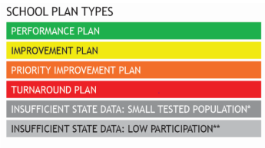
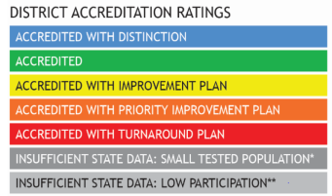
Performance Frameworks | Ratings and Explanatory Notes
Ratings
Descriptors
Meets Participation
Above 95% total participation rate in ELA and Math in 2024⁺
Low Participation
Below 95% total participation rate in ELA and Math in 2024⁺
Decreased Due to Participation
Below 95% accountability participation, once parent excuses are removed, in ELA and Math in 2024⁺
+
⁺ 2024 Science participation results are not included or factored into participation calculations for accountability purposes.
Note that Science achievement results are included for points in 2024 frameworks, the first time since the revised 2020 Colorado Science Academic Standards.
Notes:
Each school receives Plan Types with the highest noted in green, a Performance Plan type. Districts receive an Accreditation rating – the highest noted in blue, Accredited with distinction.
Throughout this session, note that I’ll refer to a rating or plan type interchangeably.
[CLICK] Frameworks also identify if schools and districts meet the total participation rate of 95% to provide context for interpreting how representative results are likely to be of the entire population.
This is noted as either “meets participation” or with a “low participation,” which is included on page 1 of the performance framework under “Test Participation Rates.”
The footnote explains that Science participation results are NOT factored into participation rates this year.
[CLICK] Only the “decreased due to participation” is included with the plan type at the top of page 1.
This flags that the framework rating was“decreased due to participation” — meaning that the school or district’s accountability participation rate, rather than the total participation rate was below 95%
This participation rate does NOT include parental excusals.

Slide 5
Reasons for Insufficient State Data Ratings
Insufficient State Data (ISD) Ratings are assigned when the state does not have enough data to assign a rating or plan type. There are multiple reasons.
Insufficient State Data: Small Tested Population
Insufficient State Data:
Low Participation
ISD: No data for one of the three indicators in the framework
Achievement N < 16
Growth N < 20
Less than 25% total participation in English Language Arts & Math⁺
Must have all 3 indicators – Achievement, Growth & PSWR
Example. ISD rating is assigned if there is no CMAS or P/SAT growth.
Other ISD rating: No Students at Grade Levels Tested for State Assessments (e.g., PK-2 school)
Note: The same ISD criteria applies to Alternative Education Campuses or AECs
⁺ 2024 Science participation results are not included or factored into participation calculations for accountability purposes.
Notes:
There are multiple reasons an ISD rating can be assigned, including:
The historical reason for insufficient state data is due to Small Tested Population, where the total count is less than 16 for Achievement and 20 for Growth. More recently,
[CLICK] an ISD rating is assigned due to Low Participation – meaning that the Total Participation in English Language Arts and Math was less than 25%. This includes parental excusals.
[CLICK] It’s also possible to receive an ISD because the site has no data in one of the three indicators – Achievement, Growth, or Postsecondary Workforce Readiness
In other words, the site must have data for all indicators.
Note that this does not apply by content. So, if you have growth in reading, but not math, you’ll still have enough reporting data and will receive a rating.
This rule also applies for multilevel schools. At a PK-8th grade school, if either level – elementary or middle, does not have reportable data for achievement or growth, the site receives an ISD
[CLICK] The final reason for an ISD rating is if the school has No Students at Grade Levels Tested, such as a PK-2 school.
[CLICK] The criteria for ISD ratings also applies to Alternative Education Campuses or AECs

Slide 6
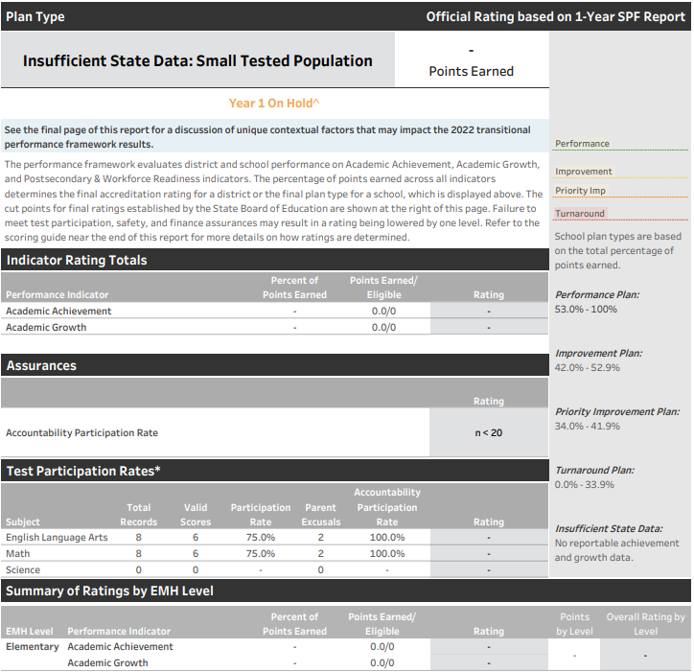
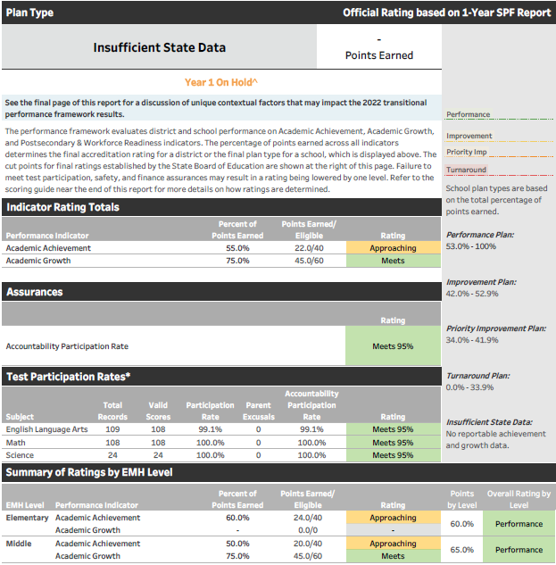
Examples of ISD Frameworks
No reported state data
No growth data at the Elementary level
Notes:
In this ISD framework example there is no reported state data in both academic achievement and growth. This ISD rating is due to a small tested population. These are tiny systems that have no reportable state data.
[CLICK] The second example for a PK-8 school on the right shows that there was no elementary growth rating due to low N count. Since a multi-level school needs all indicators at each level, the school receives an ISD rating.

Slide 7
Number of ISD Plan Type Assignments over time
2024 prelim counts embargoed until 9/5/2024
 | 2019 - Final ISD | 2020 and 2021 | 2022 - Final ISD | 2023 - Final ISD | 2024 - Prelim ISD
Districts | 0 | Frameworks Paused | 72 39% of districts | 30 17% of districts | ## ##% of districts
Schools | 25 1% of schools |  | 274 17% of schools | 146 8% of schools | ## ##% of schools (AEC frameworks not available yet)
3-year multi- frameworks
No multi-year frameworks available
2-year multi- frameworks
3-year multi- frameworks
Notes:
Based on trends of ISD ratings since 2019, the department observed a jump in ISD assignments when the frameworks restarted in 2022. Then last year, in 2023, we still saw more ISD rating since 2019, but less than 2022 since there were 2-year frameworks. Now this year, with 3-year frameworks available, the total ISD count is expected to drop, albeit still above pre- Pandemic levels. 2024 preliminary counts will be publicly released on Sept. 5 when the embargo lifts, while district accountability contacts should receive their preliminary frameworks today, Aug. 29.

Slide 8
Considerations for Alternative Education Campuses (AECs)
AECs did not receive an ISD rating prior to 2022.
3-year multi-year frameworks are back in 2024.
AECs may still receive an ISD due to lack of state data and/or optional local data.
Any AEC that participated in the selection of measures process and submitted optional measures in both achievement and growth will receive a rating.
Notes:
With regards to AECs, they did not receive an ISD rating prior to 2022. From the pause in state testing in spring 2020 and limited testing in spring 2021, spring 2022 produced frameworks with even less data, resulting in some AECs with ISD ratings due to this lack of state data, multi-year frameworks, or optional local data. While this year we are back to 3-year multi-year frameworks, it’s still possible that AECs may still receive an ISD rating. With that said, any AEC that participated in the Selection of Measures process, and submitted optional measures in both achievement and growth will receive a rating in the AEC preliminary framework.

Slide 9
Key Ideas |Communicating an ISD Rating to Your Community
Insufficient State Data does not imply a value judgment, other than there is not enough data for the state to have confidence in the rating.
While some information may be available for particular indicators (e.g. achievement), it is important not to characterize the performance for the whole school based on representation of limited performance indicators.
It may be helpful to look at available data over time compared to historical performance to gain context.
Identify areas where performance framework ratings/data has been used and use local assessment and non-assessment data for other indicators.
Notes:
When communicating with stakeholders about the accountability rating of Insufficient State Data there are key ideas to consider:
[CLICK]
Insufficient State Data does not imply a value judgment, other than there is not enough data for the state to have confidence in the rating.
While some information may be available for particular indicators, it’s important not to characterize the performance for the whole school based on representation of limited performance indicators.
It may be helpful to look at available data over time compared to historical performance to gain context. And,
Identify areas where performance framework ratings/data has been used and use local assessment and non-assessment data for other indicators
In the next section, I’ll go more into data analysis for smaller populations.

Slide 10
My Site has an ISD rating – Other Considerations
Not eligible for biennial flexibility for Unified Improvement Plan (UIP) submission
Even if your site received a performance rating the last time your site had a rating
May be eligible for Empowering Action for School Improvement (EASI) grants.
If your plan type includes a clock year, with either ‘on hold’ or ‘on hold on watch’
Example - ISD Year 1 On Hold
→ Last assigned a plan type – it was Priority Improvement, Year 1
Notes:
With an ISD rating, your site would NOT be eligible for biennial flexibility regarding UIP submission, even if you received a performance rating in the most recent year that your site had a rating.
Your site may still be eligible for EASI grants, if your site’s plan type includes a clock year with either on hold or on hold on watch.
In this example, the ISD plan type has a performance watch status of Year 1 On Hold meaning that the last time the site was assigned a plan type, it was Priority Improvement, Year 1.
You now “HOLD” that plan type and year until there is enough data to determine otherwise.

Slide 11
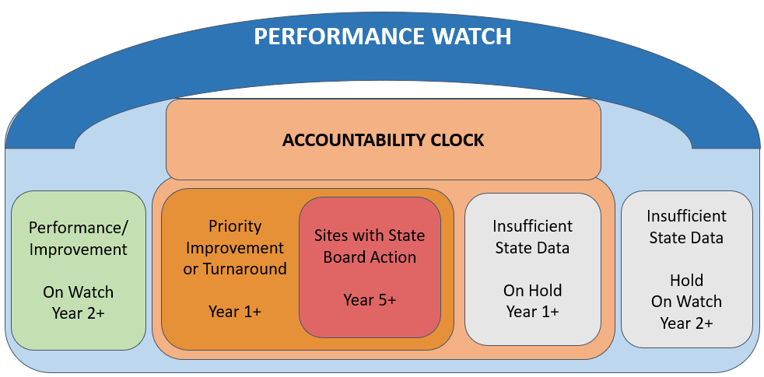
Performance Watch
Performance Watch Expectations, webpage
Notes:
In this illustration of Performance Watch, [CLICK] a site with an Insufficient State Data rating this year that had their last Plan Type – Priority Improvement or Turnaround are On Hold, within the clock
In other words, they remain on the Accountability Clock, while their Year label will not advance.
Now, if the site with Insufficient State Data was previously On Watch, not on clock, but still in Performance Watch
[CLICK] or in the blue box in this illustration, then they are On Hold On Watch with the same Year label they previously had
Any questions?

Slide 12
Implications for Improvement Planning

Slide 13
Improvement Planning as an ISD School/District
Respond to UIP requirements based on your previous plan type
On Clock (previous plan type: priority improvement/turnaround)
Use the previous plan type when responding to planning requirements
If On Clock / On Watch, respond to those planning expectations
Stakeholder involvement includes parent notification as well as a board hearing and adoption of the UIP
On Watch (previous plan type: performance/improvement)
Act as if your site is on Improvement; biennial flex is not available
Adoption of UIP by principal for schools and superintendent or designee for districts. Local policy determines whether the local board reviews or adopts the plan.
Notes:
When completing your UIP, respond to UIP requirements based on your previous plan type or rating.
If your site was On Clock, where the previous plan type was priority improvement/turnaround → then, follow your site's previous Year-specific On Clock requirements. For example, on clock sites must notify parents and hold a public hearing before adoption of the UIP by the local board. Other examples include family engagement strategies; and if your site had a turnaround rating, then you’ll need to continue including a turnaround strategy.
If your site was On Watch, [CLICK] where the previous plan type was performance/improvement → then act as if your site has an Improvement plan type,since biennial flexibility is not available with an ISD rating, even if your site’s previous plan type was Performance. In the case of an Improvement plan type, local policy determines whether the local board reviews or adopts the plan. This is different to sites on the clock. Sites with an Improvement plan type also have requirements associated with the Math Acceleration efforts associated with HB 23-1231. You can find all specific plan type requirements in the UIP Quality Criteria that I’ll go over in a few slides.

Slide 14
Data Analysis to Guide Planning as an ISD School/District
Resource
Data Analysis for Small Student Populations (PDF) This guidance focuses on how to include analysis of data with small populations of students in the UIP. This resource is appropriate for all users that need to report on small student groups, either due to size of the school/district or disaggregated data analysis.
Analyze Aggregate State & Local Assessment & Non-Assessment data
Use department’s District & School Dashboard for state data
Combine results of smaller groups (e.g., minority vs. white instead of by race/ethnicity)
Collapse data across grades (e.g., grades 4-8 CMAS growth)
Analysis of individual student performance may be conducted internally to inform a plan
Public report should describe patterns observed in the data generally without including specific numbers
Notes:
As you grapple with data for analysis, use available state and local data as well as non-assessment data to enhance data analysis and identify areas of strength and areas for improvement.
Consider ways your site can describe its performance and growth by analyzing available state aggregate data in the department’s District & School Dashboard that we’ll dig into later in this webinar.
Combine results of smaller groups or across grades to increase the reporting group size.
It’s also appropriate to conduct an analysis of individual student performance internally to inform a plan. Then the public report would be limited to describing patterns observed in the data generally without including specific numbers in order to protect personally identifiable information or PII. In general, any reported data should not be too small that the public can determine information about individual students.
The Data Analysis for Small Student Populations resource is linked in the blue box.

Slide 15
Protecting Student Personally Identifiable Information (PII)
Local districts may have different policies or approaches to reporting small Ns. When reporting data in a public document, like the UIP consider:
Including achievement data with student counts of 16 or more records
Including growth data with student counts of 20 or more records
The Family Educational Rights and Privacy Act (FERPA) prohibits any disclosure of PII derived from education records.
Notes:
When you do report data in a public document consider setting local reporting rules to protect PII. For example, the state uses
A student count of 16 or more to report achievement results
and 20 or more for growth results
This also connects to FERPA that prohibits any disclosure of PII that comes from education records.

Slide 16
Data Statements | Low N
Scenario 1:
State assessment data is not available
Proposed Solution:
Scenario 2:
State or local assessment data doesn’t yield clear trends for analysis.
Proposed Solution:
Focus the collection and analysis of local data. Use framework indicators (e.g., achievement, growth, and postsecondary workforce readiness) to guide your analysis and acknowledge areas where N-counts are too low to be reported. For example: “Local data indicates achievement results for multilingual learners increased over the past three years. Due to low student counts, data cannot be reported publicly.”
Use non-assessment data to supplement assessment data. Attendance, successful course completion, and other measures may be leading indicators of overall performance and offer additional evidence to the needs of students. For example: “Suspension and expulsion rates increased over the past three years, from 2% to 5% of students. 70% of behavior incidents involve male students, indicating disproportionate impacts for this population of students.”
Notes:
In this slide and the next one, I’ll walk through different scenarios that provide sample statements the would support evidence or rationale for your identified priority within the UIP.
[CLICK] (read straight from the slide)

Slide 17
Improvement Planning as an ISD School/District
Scenario 3:
Performance among groups or across time is similar when combining grades.
Proposed Solution:
Scenario 4:
Aggregation does not provide numbers that are large enough to yield representative or meaningful results.
Proposed Solution:
Aggregate the data to identify data trends or patterns. Consider aggregating across grade levels or across multiple years. Example: “In Math overall and over the past three years, students with disabilities had an MGP of or below 35, which is not meeting state expectations.”
Schools may use student-level metrics (like student growth percentiles or student scale scores) internally to provide more accurate and actionable data about performance. Describe the analysis and findings without sharing specific data. Example: “We analyzed student scale scores from 2022 to 2024 and found high school scores increased over that time.”
Notes:
(read straight from the slide, then…)
Essentially, you’re providing an indication of performance without identifying any students.

Slide 18
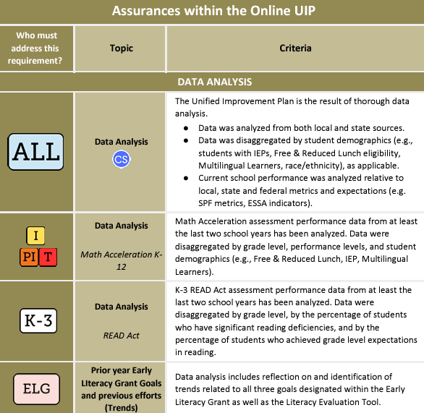
Assurances in the UIP Template
Assurances to meet process requirements
Data Analysis
Stakeholder Involvement
Refer to the UIP Quality Criteria & Requirements for more information
Notes:
Of particular value for small sites to protect student information, you don’t need to include much data analysis in the UIP template anymore because, there are additional data analysis assurances this year.
This snapshot is taken from the UIP quality criteria that illustrates assurances that will be included in each site’s UIP, either all sites or sites targeted to address specific requirements.
[CLICK] And this example flags a Math Acceleration data analysis requirement that applies to site on Improvement as well as Priority Improvement & Turnaround.
Now, let’s take a moment to look the the UIP Quality Criteria. Consider your site or one of your site’s that has to respond to an Improvement, Priority Improvement or Turnaround plan type; or maybe a school ESSA identified with Comprehensive Support or CS. Look through the QC picking the UIP template you use, either streamlined or traditional; and identify a requirement in a section of the UIP. Then add to the CHAT something you identified.

Slide 19
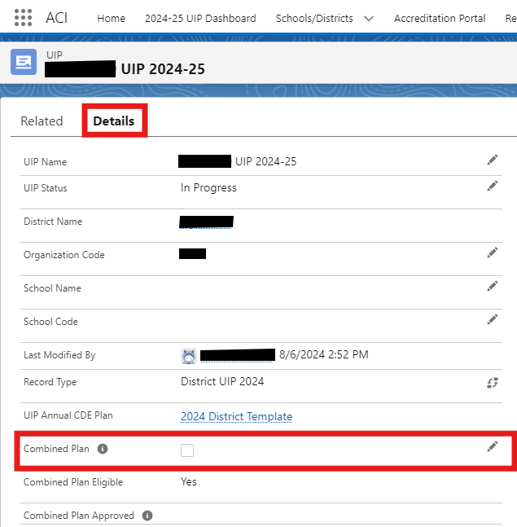
UIP Considerations | Combined Plan Submission
Districts with less than 1,000 students:
Automatically eligible for combined plan submission
Can have their District Accountability Committee (DAC) serve as their School Accountability Committee (SAC)
Districts with between 1,000 to 1,200 students:
Can request to create a combined plan for the district
For any district submitting a combined plan:
Combined plan must reflect all the indicators where any of its schools are ESSA identified
Combined plan also still needs to address the magnitude of issues and supports for schools on the accountability clock
Notes:
This slide clarifies the criteria for small districts to be eligible in submitting one combined UIP for the district and it’s schools.
Districts with less than 1,000 students are automatically eligible for a combined plan submission, whereas districts with 1000 to 1200 students must request to create a combined plan.
Districts that fit into this student count range, can check off the ‘Combined Plan’ in the DETAILS tab of the online UIP system, before entering into the UIP template. [CLICK] The screen shot shows this.
[CLICK] It’s also important to note what’s described in the third box – that any district submitting a combined plan, must consider their schools if they are federal identified by ESSA or are on the state accountability clock.
In the case of ESSA identification, the district’s combined plan must reflect all the indicators where its schools are identified – such as Comprehensive Support at a title 1 school in the lowest 5% of achievement or a high school identified CS because of low graduation rates. In the case of the state accountability clock, for a school with a priority improvement or turnaround plan type, the district must notify the families of that school and hold a public hearing about improvement planning efforts specifically for that school.

Slide 20
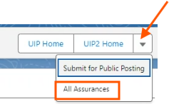
New Assurances Dashboard for District Users
Ensure the combined UIP plan covers district & school requirements based on identification
Login to online UIP system, open the district’s current UIP ‘Details’ tab
Two ways to view school assurances (the 1st way for all districts, 2nd way, for combined plans)
From the ‘Details’ tab, select the dropdown menu right of the ‘UIP2 home’ button | Combined Plans only. Go to the district’s streamlined UIP Template → Select the UIP2 Home button. Then navigate to a tab (coming soon) ‘All School Assurances’ tab across the top of the Streamlined template.
‘All Schools Assurance’ tab will only be viewable for combined plans
Available to all districts – list of all schools and plan type requirements
Notes:
To help districts writing combined plans, the online UIP system has a new dashboard where you can view “All Assurances” for all schools in the District UIP. There are two ways to do that with directions explained here.
The first way is available to all districts, from the UIP “Details” tab. The second way will only be available to districts with a combined plan.
I’ll login to the online UIP system and demo it quickly. While I’m in the system, I’ll also show you where you select a ‘combined plan’.

Slide 21
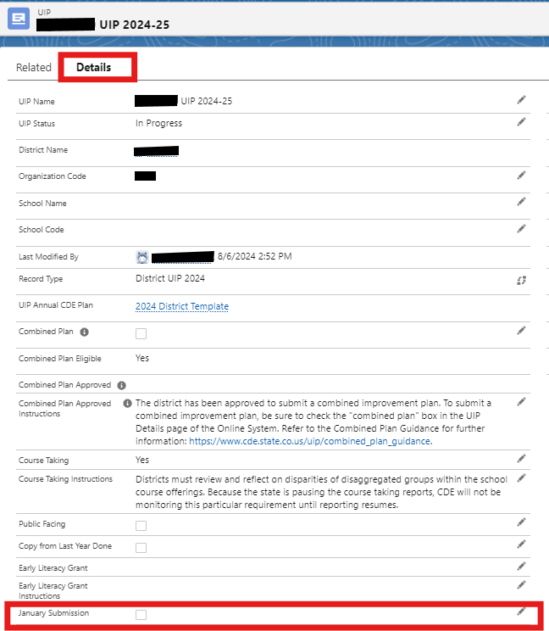
UIP Timeline Considerations
Unified Improvement Plan (UIP) Submission Deadline
October 15
Flexibility is at the the district’s discretion
January 15
Newly identified (Year 1) as Priority Improvement or Turnaround based on the School/District Frameworks
Newly identified as Comprehensive Support based on federal ESSA identifications
Participating in the Request to Reconsider process
Eligible schools must seek approval from their district to submit in January.
Resource: January Submission Guidance for district UIP users, not school level users
Notes:
While UIPs are due October 15, there are exceptions.
Sites newly identified under the state or federal system, may submit their UIP no later than January 15 ONLY IF the district allows this. Similarly, if districts are requesting changed ratings through the Request to Reconsider process, the later submission date is available too – again, at the district’s discretion. Some districts may prefer that all schools submit their plans by October 15. The snapshot on the right shows where on the UIP details tab a district UIP user can select the “January Submission” option.
Before moving to the next section, does anyone have any questions?

Slide 22
Accessing State Data & Resources

Slide 23
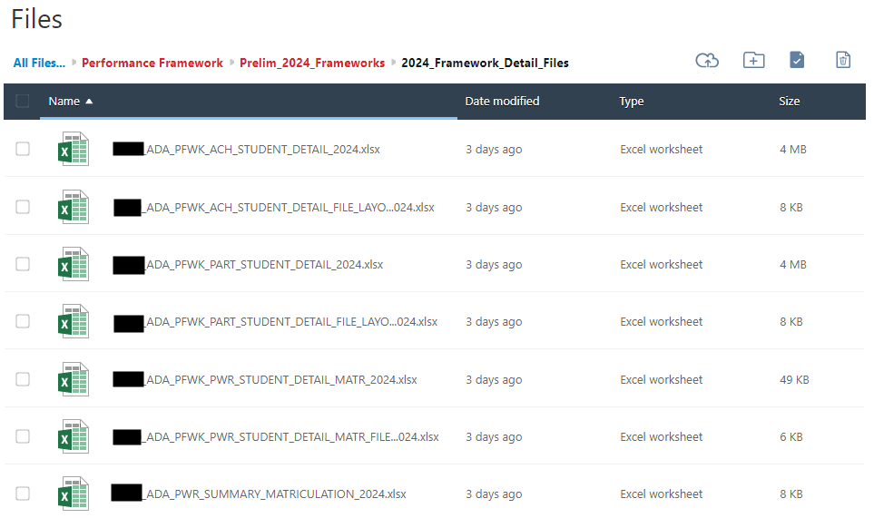
Accessing State Data
Syncplicity
Includes student-level detail files with all data that populates your performance framework
Use these files to conduct district or school-level analysis to identify patterns.
Available to District Accountability Contacts through their Syncplicity login.
If you don’t know your LAM - ask here!
Notes:
Syncplicity is our secure file sharing platform at CDE. How many folks on this webinar access your district’s Accountability Contact folder in Syncplicity?
This is where your district’s accountability contact pulls student level detail files with all the data that populates your performance framework for this year and prior years, as well as growth files and the Individual Student Achievement & Growth Reports. You may use these files to conduct district, school, or student-level analysis to identify patterns, being more caution when looking at student level data to make any generalizations. It’s also through Syncplicity where the accountability contact accesses preliminary frameworks later today and the final frameworks in December.
And, if you’re not sure who your accountability contact is, refer to the District Accountability Contacts link to look up your district’s contact. Note that this spreadsheet is updated daily.

Slide 24
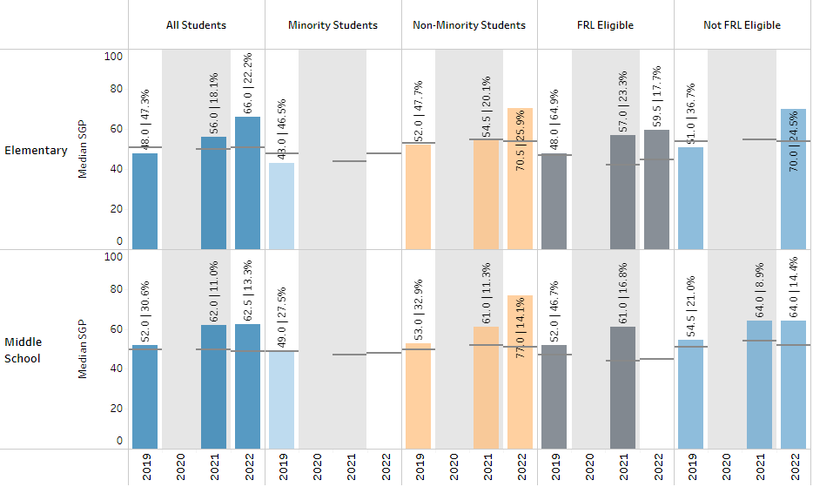
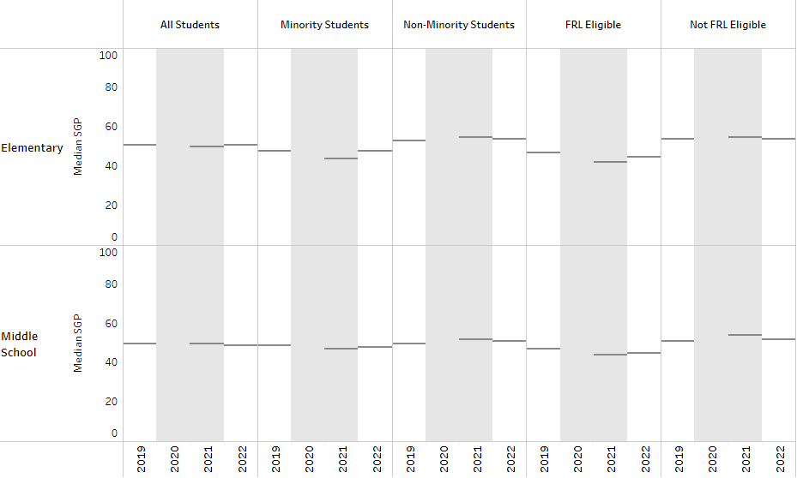
District and School Dashboard
Includes enrollment, achievement, growth, on track growth, postsecondary workforce readiness, performance framework results, and demographic comparisons
Available publicly (http://www.cde.state.co.us/district-school-dashboard) or in the UIP online system under “Current Performance” when you’re filling out your UIP.
New resource: 2024 Annotated District & School Dashboard that also includes annotations for the new OTG tab (OTG factsheet)
Some data may be populated, some may not.
Notes:
Even with an ISD rating, you may have some data to analyze in the public District and School Dashboard or DISH.
This dashboard includes enrollment, as well as achievement, growth, a new on track growth tab that will be released Sept. 5 when the embargo lifts, postsecondary workforce readiness and performance framework results, all with demographic comparisons if the count is large enough for public reporting. Depending on the dashboard, you can combine smaller groups. For example, a small district might not be able to see grade specific results, but they could compare elementary to middle level results to analyze a grade level difference or just look across all grades to receive an aggregate result.
I also want to point out this new resource as a guide when you navigate the different tabs of the DISH. (walk through and point out new OTG tab)
I’d now like to ask for a volunteer to demo with in the DISH. (or use Prairie as an example)

Slide 25
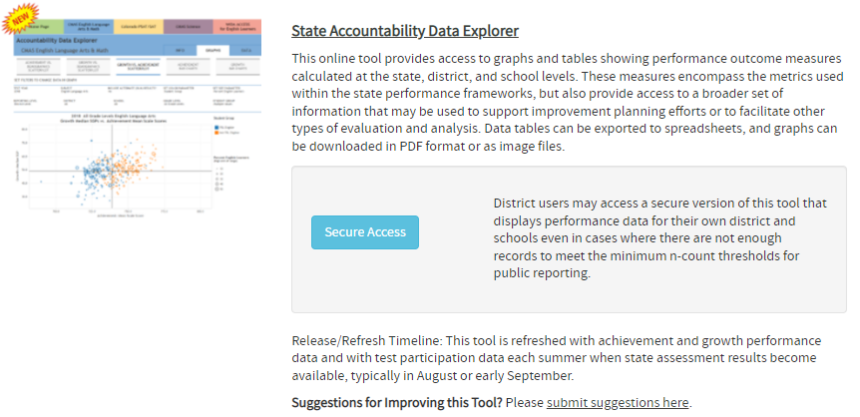
N of 1 Report
Displays performance data for your district and schools even in cases where there are not enough records to meet the minimum n-count thresholds for public reporting.
Available to district admin with appropriate PII access
contact your district’s Local Access Manager to assign this role
Directions to assign the role: TABLEAU~Acct_Contact
Notes:
In addition to analyzing student level data files from Syncplicity, there is also a Secure Access button in the State Accountability Data Explorer dashboard.
To have ‘Secure Access’, you must have the “N of 1 access”. If you don’t have access, please contact your district’s Local Access Manager or LAM using the ‘Local Access Manager link if you don’t know your LAM, and ask for the Tableau~Acct_Contact role.
This slide includes directions for the LAM to assign the role.
Given the secure access, I can’t demo this dashboard, while I encourage you to play with this dashboard or reach out to accountability@cde.state.co.us for assistance in using this dashboard.

Slide 26
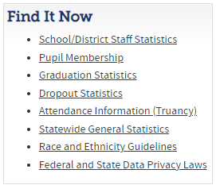
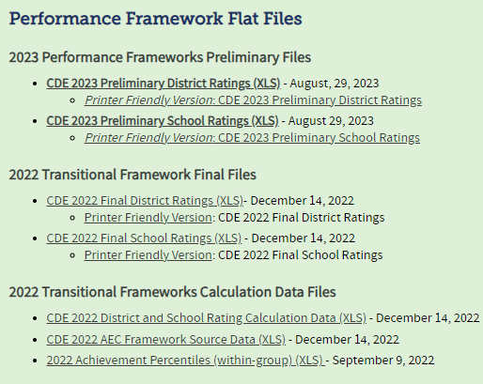
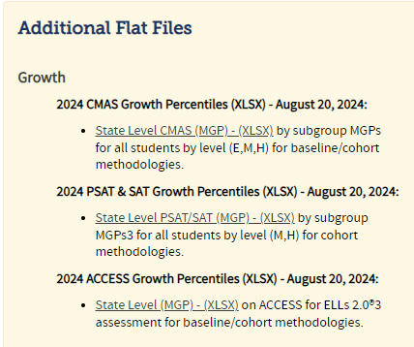
Other Data Tools and Reports
Performance Framework & Growth Flat Files
Available here:
http://www.cde.state.co.us/accountability/performanceframeworkresults
Education Statistics
Other education data is available in Excel files on the state website here: https://www.cde.state.co.us/cdereval
2024 prelim frameworks embargoed until 9/5/2024
Notes:
There are also other Excel data files available from other CDE units. You’ll find data on staff statistics, pupil membership, grad rates, dropout rates, attendance and more.
And the Accountability and Continuous Improvement Unit posts both framework and growth flat files too. Do note, that while 2024 growth files are posted, the preliminary framework flat files will only be made available after the embargo lifts on Sept. 5th.
With exception to staff statistics and public memberships, many of these files with have an N or count suppression rule applied.

Slide 27
Resources
KEY RESOURCE: Insufficient State Data Fact Sheet – coming soon
UIP Homepage - This webpage provides access to all Unified Improvement Plan (UIP) training and resources.
State Accountability Homepage – This page contains updated resources about 2024 state accountability.
A newer resource, the 2024 Accountability Use of Data Guide is intended to help district administrators and technical data staff members understand how the state accountability system uses various data sources (e.g., Data Pipeline, State Assessment System), where data comes from with accountability implications.
Notes:
And if this webinar left you short of information, there are many useful resources available with some key resources provided on this slide.
(walk through briefly)

Slide 28
Contact Us
General accountability support:
accountability@cde.state.co.us
General UIP support:
uiphelp@cde.state.co.us
1-on-1 Office Hours Sign-Up link
Mondays, Wednesdays, Fridays
9-11 am & 1-3 pm

Slide 29
Q & A Please complete our feedback survey: https://tinyurl.com/ACIWebinarSurvey Thank you!!
Notes:
STOP RECORDING
https://tinyurl.com/ACIWebinarSurvey

